Slide 1
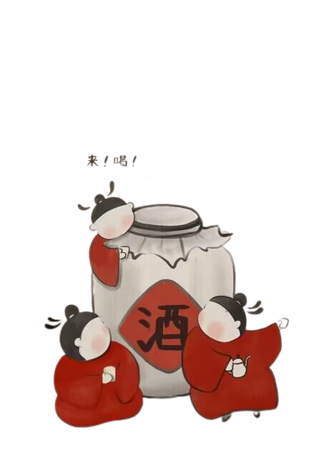

品味
中国酒文化
醉
The liquor Culture of Ancient China

Slide 2
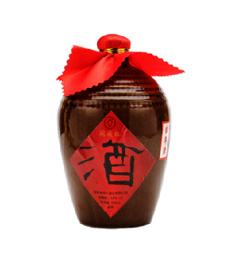

Contents
1
The Origins of Liquor
2
The Types of Liquor
3
Drinking Vessels
4
Drinking Games

Slide 3
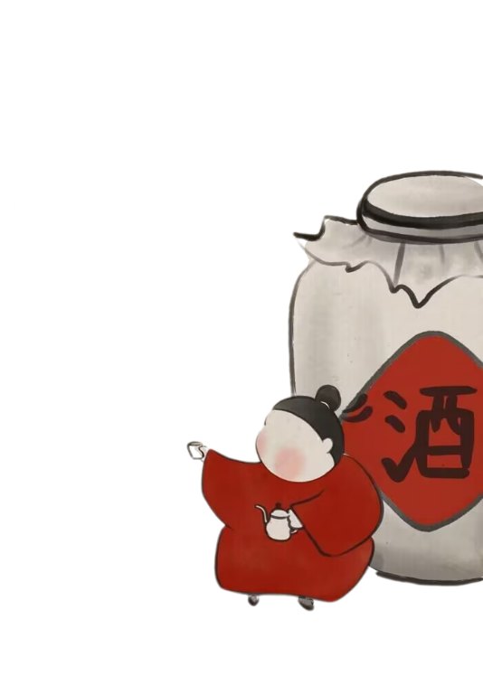


壹
·The First Part·
The Origins of Liquor

Slide 4
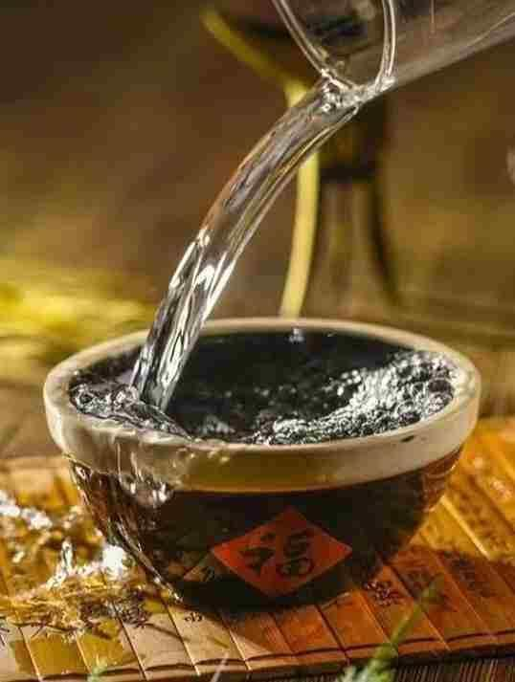
The Origins of Liquor
Who is generally believed to invent liquor in China?
何以解忧，唯有杜康

Slide 5
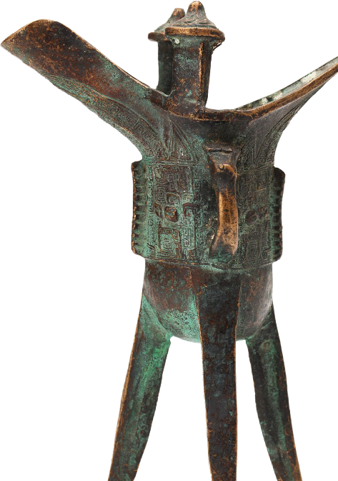
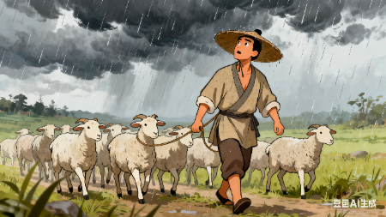
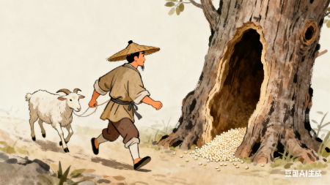
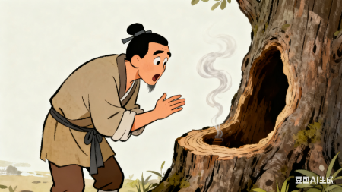
The Origins of liquor
One day it rained heavily while Du Kang was herding the sheep.
Hastily driving the sheep back to the sheepfold, he forgot some husked sorghum rice in a hollowed trunk by accident.
When he came back after a few days,
the rice he left there became so fragrant.

Slide 6
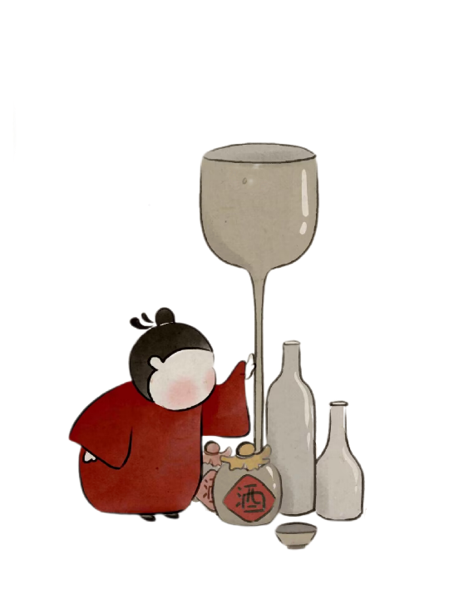
贰
·The Second Part·
The Types of Liquor

Slide 7
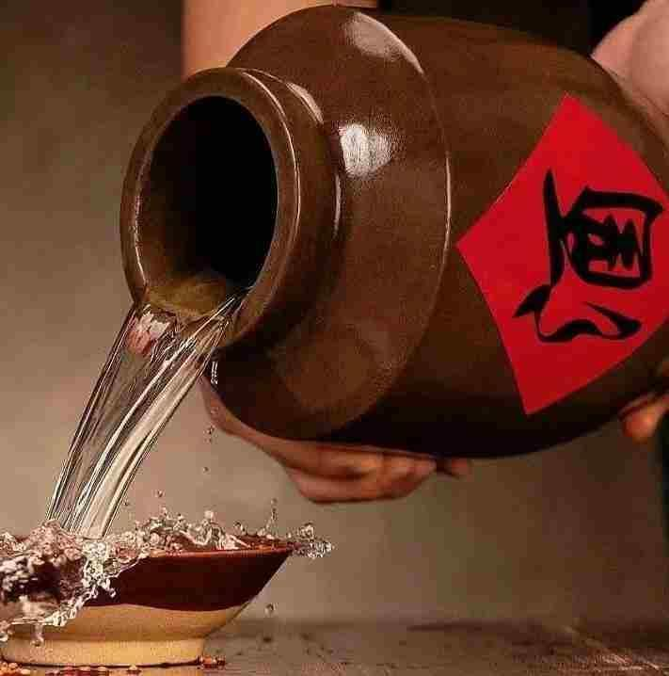
fermented wine(发酵酒）
Shaoxing Wine
distilled liquor(蒸馏酒)
Kweichow Moutai

Slide 8
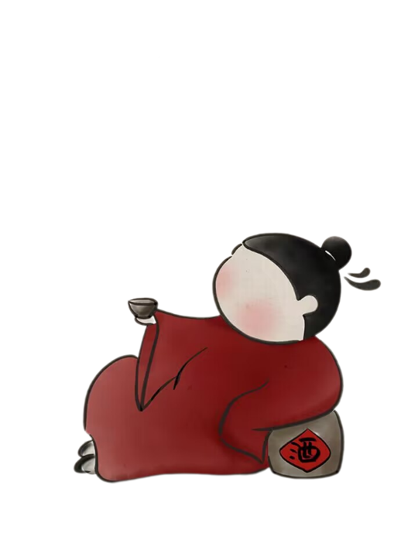
叁
·The Third Part·
Drinking Vessels

Slide 9
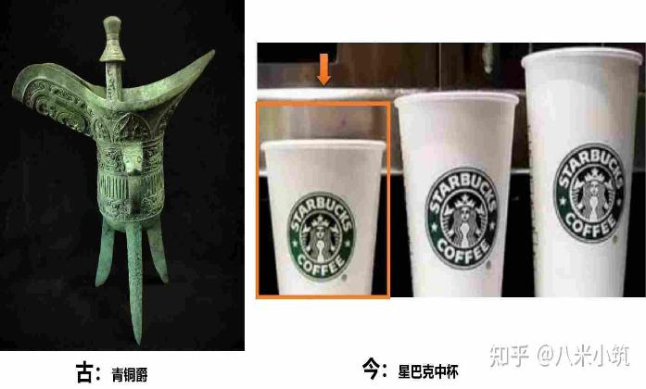
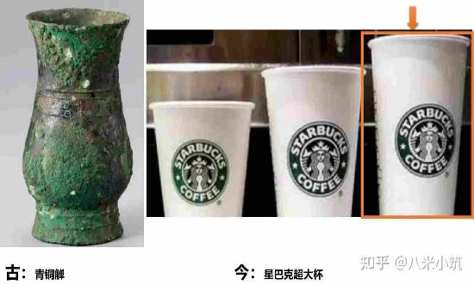
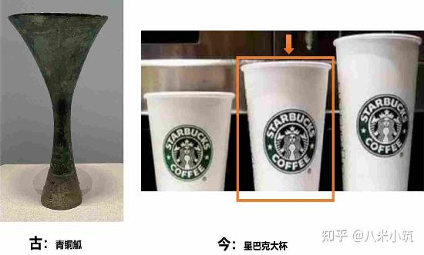
Drinking Vessels
一升曰爵，二升曰觚，三升曰觯

Slide 10


Drinking Vessels
一升曰爵，二升曰觚，三升曰觯

Slide 11


Drinking Vessels
一升曰爵，二升曰觚，三升曰觯

Slide 12
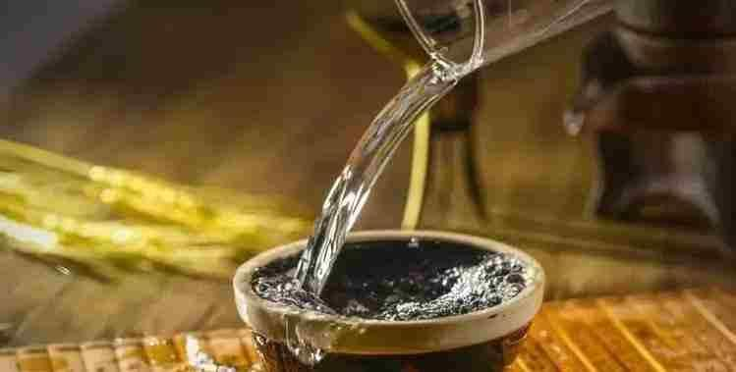
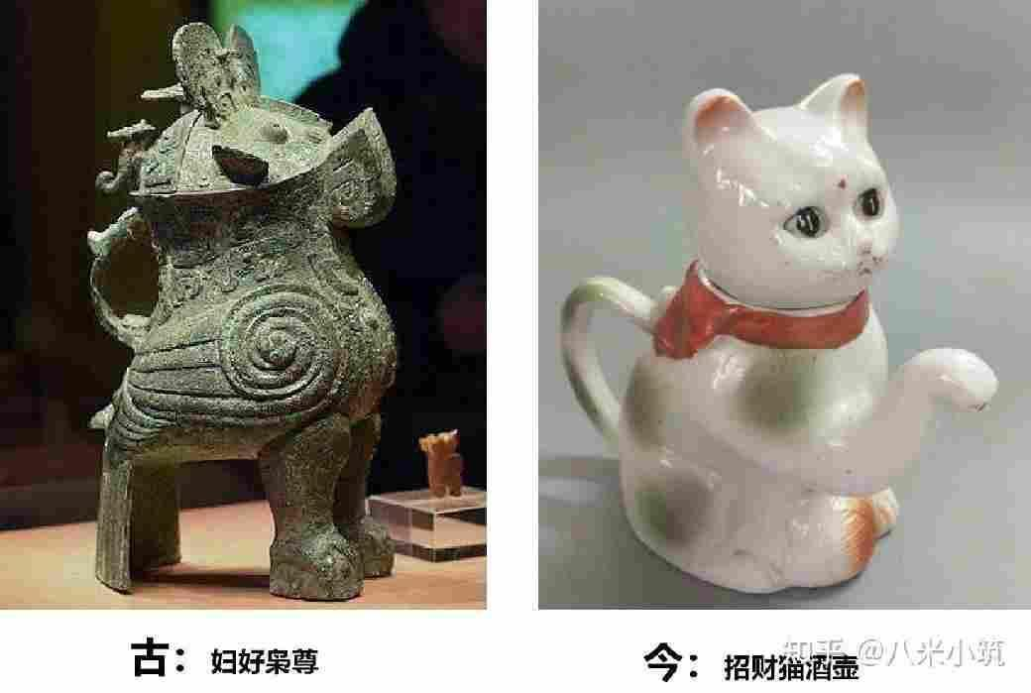
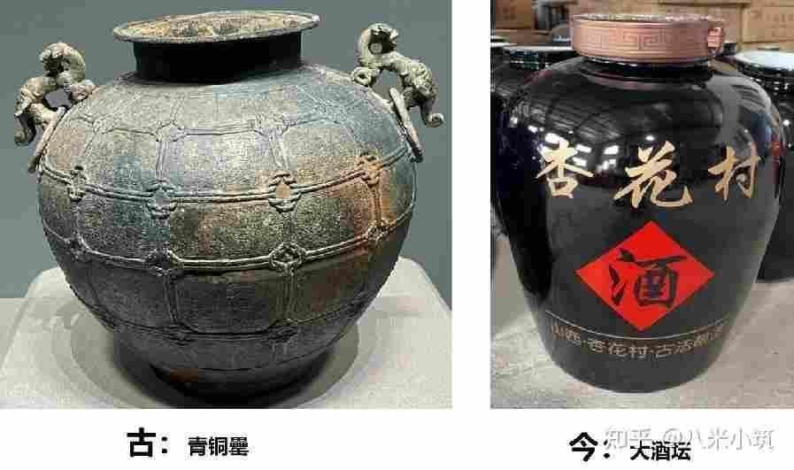
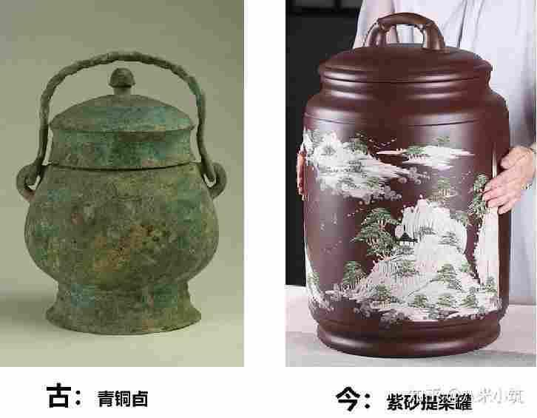
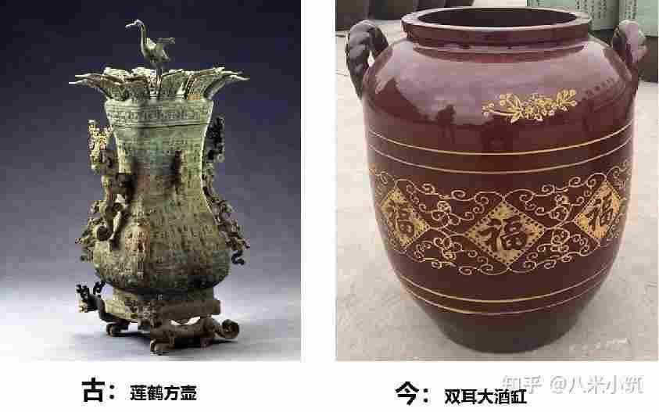
Liquor Storaging Vessels

Slide 13
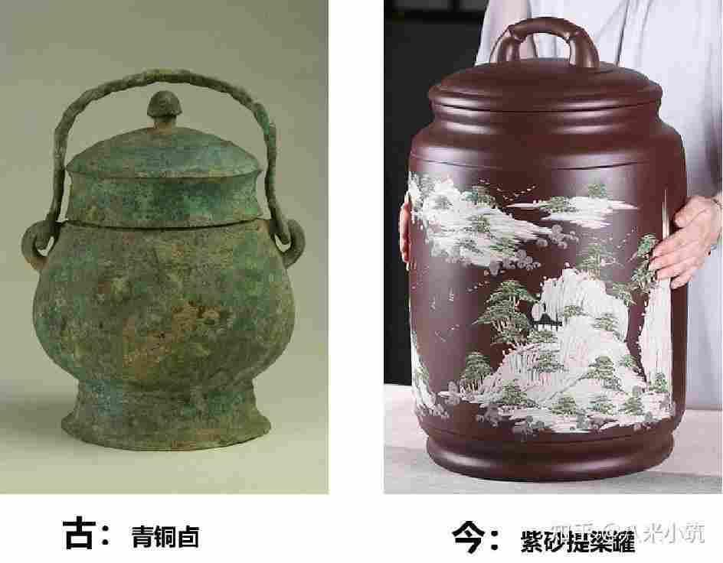
Liquor Storaging Vessels

Slide 14

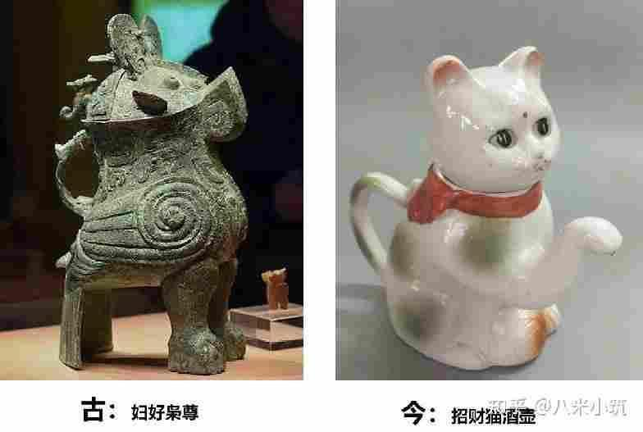
Liquor Storaging Vessels

Slide 15

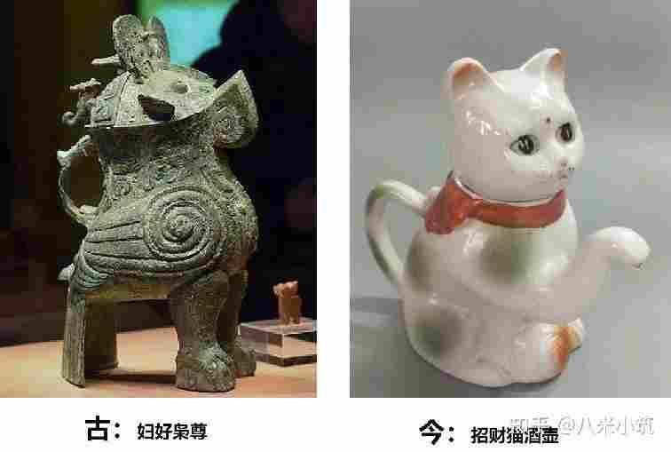
Liquor Storaging Vessels

Slide 16
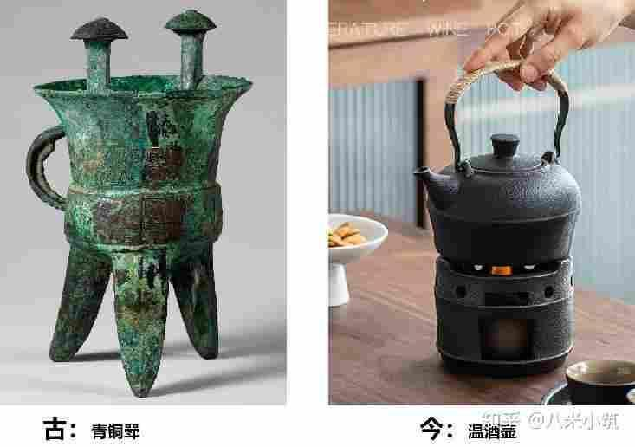
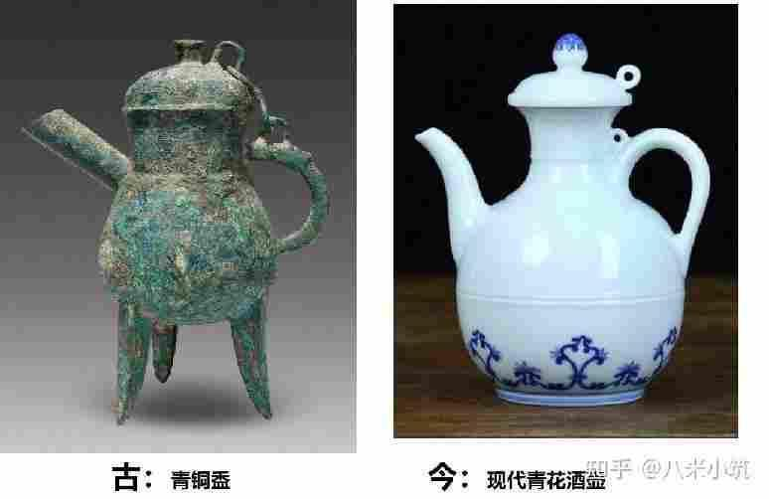
Liquor Boiling Vessels

Slide 17
肆
·The Fourth Part·
Drinking Games

Slide 18
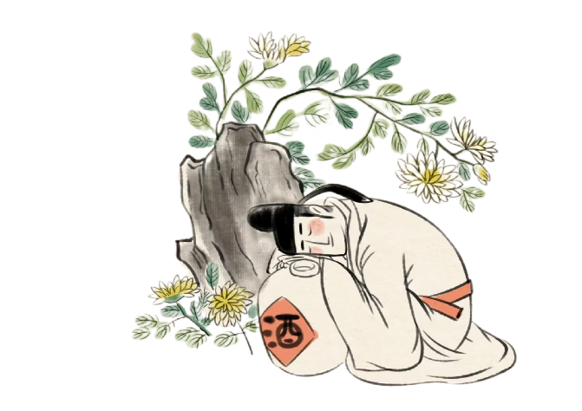
Drinking Games
1.飞花令
花径不曾缘客扫
落花时节又逢君
春江花朝秋月夜
2.曲水流觞
3.投壶
4.筹令
5.大型歌舞
单击输入标题
添加您的副标题文字说明以及简要性描述
请替换文字内容，点击相关标题文字请替请替换文字内容，点击相关标题文字请替换文字请替换文字内请替换文字内容

Slide 19
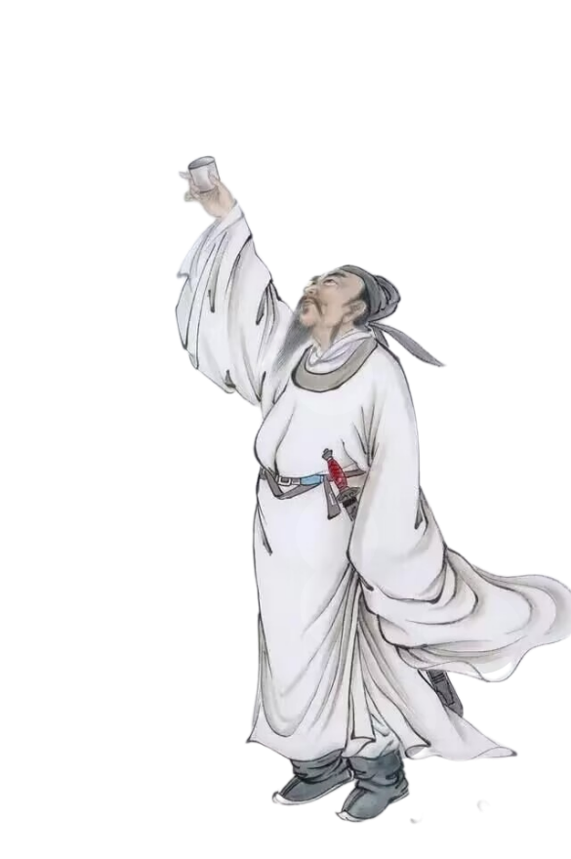
Class Drinking Game
“简易版”现代飞花令

Slide 20
再
品味
中国酒文化
The liquor Culture of Ancient China
见

