Slide 1
The Five Canonized Classics
By Arnold Qin
Notes:
-These five books, or parts of them, were either commented, compiled, or edited by Confucius himself.

Slide 2
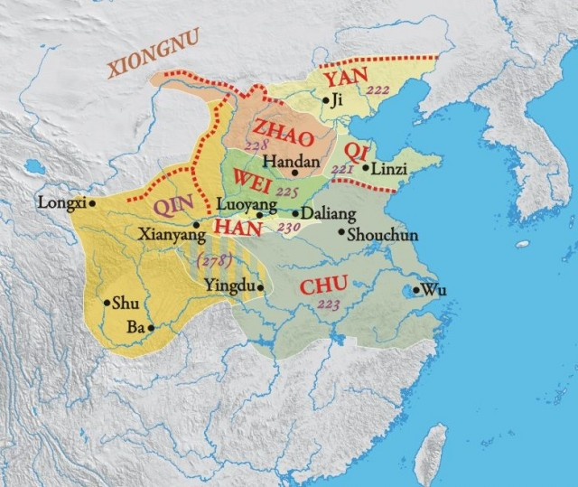
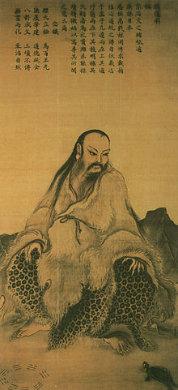
I Ching ("Yì Jīng“)
One of the oldest Chinese Classics
Believed to be written by Fu Xi
Geomancy
Yin/Yang
Notes:
-The oldest manuscript that has been found, albeit incomplete, dates back to the Warring States Period.
-Traditionally, the I Ching and its hexagrams were thought to be before recorded history,
- Based on traditional Chinese accounts, its origins trace back to the 3rd to the 2nd millennium BC.
-Nowadays, it is suggested that the earliest layer of the text may date from the end of the 2nd millennium BC, but place doubts on the mythological aspects in the traditional accounts.
Not the work of one or several legendary or historical figures
Is an accretion of Western Zhou divinatory concepts.
- During the Warring States Period, the text was re-interpreted as a system of cosmology and philosophy
- It centred on the ideas of the dynamic balance of opposites, the evolution of events as a process, and acceptance of the inevitability of change.

Slide 3
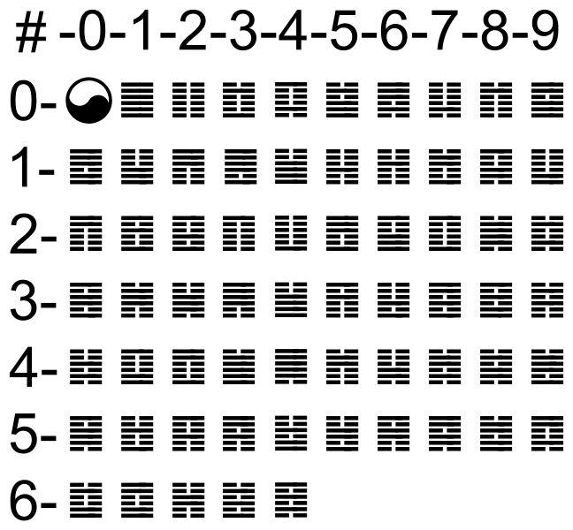
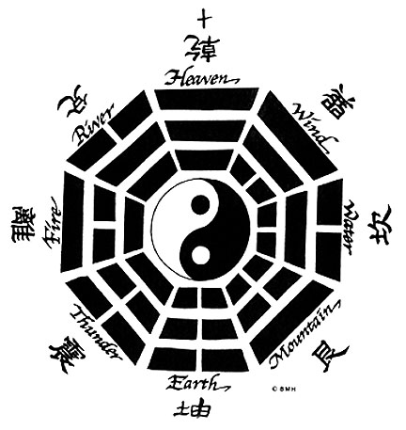
Hexagrams
Notes:
64 sets of the grid – many types
-. Each hexagram is accompanied with a description, often cryptic, akin to parables. Each line in every hexagram is also given a similar description.
Pic is of the famous King Wen sequence
Last pic is of the 8 trigrams
Yin and yang, whilst common expressions associated with many schools of classical Chinese culture, are especially associated with the Taoists.
Another view: I Ching is primarily a Confucianist ethical or philosophical document.
- The heart of early Chinese philosophical thought, serving as a common ground for the Confucian and Taoist schools.
Article Explication de l'Arithmétique Binaire (1703) Gottfried Leibniz : he found in the hexagrams a base for claiming the universality of the binary numeral system
hexagrams to represent binary sequences, so that ¦¦¦¦¦¦ would correspond to the binary sequence 000000 and ¦¦¦¦¦| would be 000001, and so forth.
I Ching had two distinct functions. The first was as a compendium and classic of ancient cosmic principles.
The second function was that of divination text. As a divination text the world of the I Ching was that of the marketplace fortune teller and roadside oracle. These individuals served the illiterate peasantry.

Slide 4
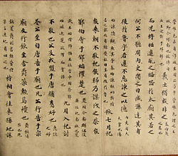
Spring and Autumn Annals
Official chronicle of the State of Lu covering the period from 722 BCE to 481 BCE.
Very Concise
The Commentary of Zou (鄒氏傳)
The Commentary of Jia (夾氏傳)
The Commentary of Gongyang (公羊傳)
The Commentary of Guliang (榖梁傳)
The Commentary of Zuo (左氏傳)
Notes:
Pic: Manuscript handscroll of Du Yu’s Critical study of Spring and Autumn Annals
Because it was traditionally regarded as having been compiled by Confucius (after a claim to this effect by Mencius), it was included as one of the Five Classics of Chinese literature.
-Formed by various chroniclers from the State of Lu.
-The scope of events recorded in the book is quite limited.
-The focus is on various feudal states' diplomatic relations, alliances and military actions, as well as births and deaths among the ruling families.
- The chronicle also takes note of natural disasters such as floods, earthquakes, locusts and solar eclipses, since these were seen as reflecting the influence of heaven on the world.
-Events are narrated in chronological order, dated by the reign-year of the Duke of Lu, the season, the month and the day
-The annalist structure is followed strictly, to the extent of listing the four seasons of each year even when no events are recorded.
-The style is terse and impersonal, and gives no clue as to the actual authorship.

Slide 5
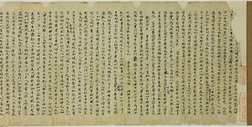
Classic of Rites
It described the social forms, governmental system, and ancient/ceremonial rites of the Zhou Dynasty (c. 1050–256 BCE).
"good form" or "decorum“
Traditional conduct would help during time period
Notes:
"The Burning of the Books." This occurred in 213 BCE when most traditional books were burned with the exception of books on war, medicine, astrology, agriculture, and divination.
Some Confucian scholars had memorized the Classics and transmitted the Classics to their disciples who in turn recorded them in manuscripts.
These disciples recorded each of the Classics from memory but the Classic of Music (Yuejing) could not be recompiled. However, a chapter in the Classic of Rites is the Record of Music (Yueji), which was derived from the lost Classic.
The Classic of Rites was rewritten and edited by Confucius' disciples after the "Burning of the Books."
Other scholars have attempted to shorten these scripts, including Dai De who reworked the text in the 1st Century BCE, reducing the original 214 books to 85, which was further reduced by his younger brother Dai Sheng to 46 books, to which three were added towards the end of the Han Dynasty, bringing the total to 49.

Slide 6
6th Classic?
Classic of Music
Absorbed into Rites
Notes:
During the life of Confucius, not only did Five Classics exist, there were actually Six Classics. The sixth classic was known as the Classic of Music, Book of Music, or Yuejing, and as was previously mentioned has been completely lost and destroyed. The focus of the book was believed to be the selected 305 songs personally chosen and performed by Confucius himself to ensure that they all properly fit together.

Slide 7
Classic of History
Contains some of the earliest examples of Chinese prose.
58 chapters + short introduction.
“Old Text” discovered in 186 BC.
Another version discovered in 4th century AD. Forged.
Since the Han Dynasty, The Classic of History has been regarded as a classic on feudal Chinese politics and philosophy.
Notes:
-The Classic of History was compiled between the 6th and 4th centuries BC, traditionally by Confucius, and reportedly included over 100 chapters.
-Many citations of its content can be found in the bamboo slips texts from the tombs of Guodian, in Hubei, dated to around 300 BC.
- It is also referenced in several classic texts, such as the Mencius.
-Many copies of the work were destroyed in the Burning of Books during the Qin dynasty.
Fú Shēng (伏生) reconstructed part of the work from hidden copies in the late 3rd to early 2nd century BC, at the start of the succeeding Han dynasty.
His version was known as the "New Text" (今文 jīn wén lit. "modern script") because it was written in the clerical script.
It originally consisted of 28 chapters, later expanded to 33 when Du Lin divided some chapters during the 1st century.
The book is in four writing forms:
"codes" - the documentation of law codes and statutes;
2) "written admonitions" - the conversations between emperors and ministers and those between ministers, as well as prayers at sacrificial rituals;
3) "pledges" - the pledges made by emperors and vassals;
4) "mandates" - the imperial mandates emperors made when appointing officials or rewarding vassals.
-The language of these documents is archaic, closely resembling inscriptions found on Western Zhou bronzes, and differs in grammar and vocabulary from that typical of prose from the classical age of Chinese literature

Slide 8
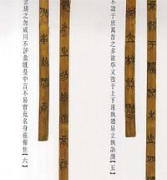
Classic of Poetry
The earliest existing collection of Chinese poems and songs.
A majority of the Odes date to the Western Zhou period (1046–771 BC),
4 character lines
Canonization recognized during
Han Dynasty
Notes:
Pic: discussion
The Odes provided founding principles in composition and rhyme that were patterned by Chinese writers for well over two thousand years, and are thus a seminal influence on Chinese Classical poetry.
Additionally, the Odes preserve the descriptions of daily life among the ancient Chinese culture of the Yellow River watershed.
Over half of the poems are said to have originally been popular songs. They concern basic human problems such as love, marriage, work, and war.
Although the Shijing does not specify the names of authors in association with the contained works we have hints
The Odes became an important and controversial force, influencing political, social and educational phenomena

Slide 9
Cheng, Anne (1993). "Ch'un ch'iu 春秋, Kung yang 公羊, Ku liang 榖梁 and Tso chuan 左傳", pp. 67–76 in Loewe, Michael (ed.) "Early Chinese Texts: A Bibliographical Guide", (Early China Special Monograph Series No. 2), Society for the Study of Early China, and the Institute of East Asian Studies, University of California, Berkeley, ISBN 1-55729-043-1
Shaughnessy, Edward L. (1999). "Western Zhou history". In Loewe, Michael; Shaughnessy, Edward L.. The Cambridge History of Ancient China. Cambridge: Cambridge University Press. pp. 292–351. ISBN 0-521-47030-7.
http://history.cultural-china.com/en/37History596.html
Dobson, W. A. C. H. (1964). "Linguistic Evidence and the Dating of the Book of Songs". T'oung Pao 51 (4–5): 322–334. JSTOR 4527607.
http://www.chinapage.com/poem105.html

