Slide 1
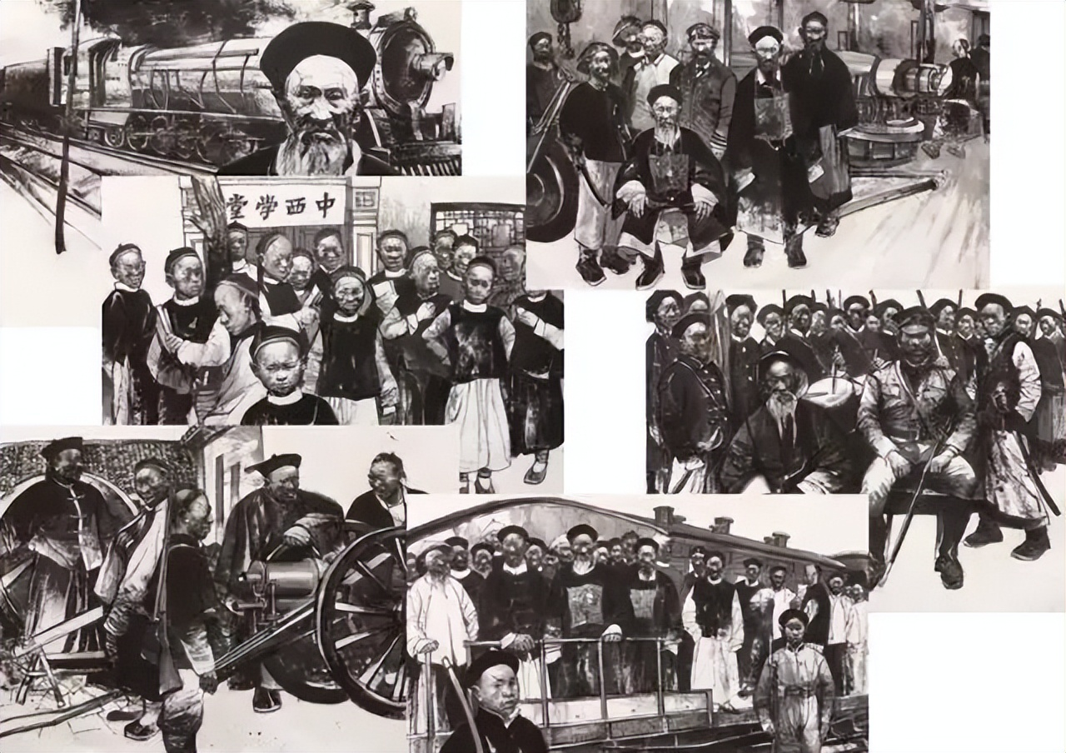
Westernization Movement
By Huang Tianqi

Slide 2
01.
Introduction
02.
Process
CONTENTS
03.
Conclusion

Slide 3
01
Introduction

Slide 4
Military equipment
Machine manufacturing
Science and technology
01
03
“self-improvement and seeking wealth”

Slide 5
02
Process

Slide 6
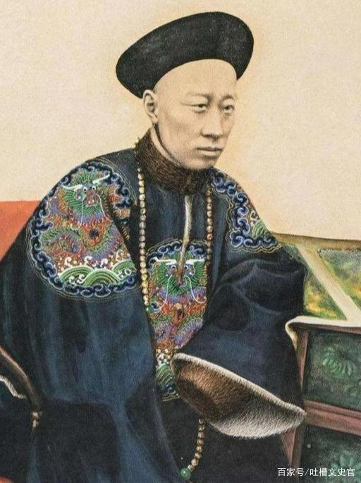
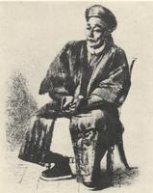
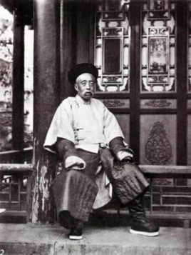
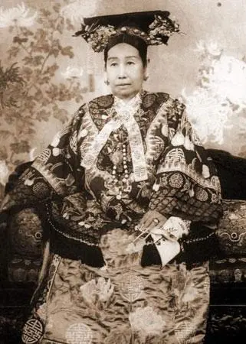
输入您的标题
Prince Gong
Guiliang
Wenxiang
Cixi

Slide 7
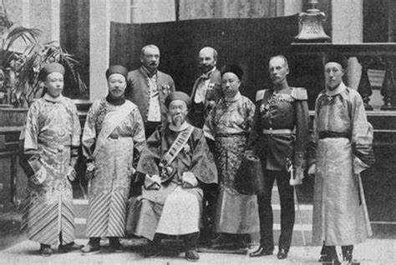
Westernization Movement advocators

Slide 8
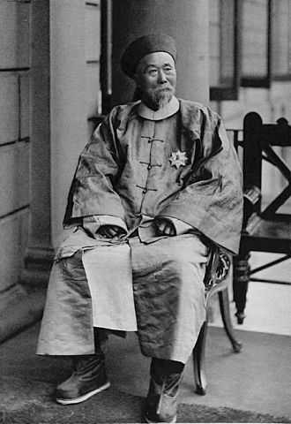
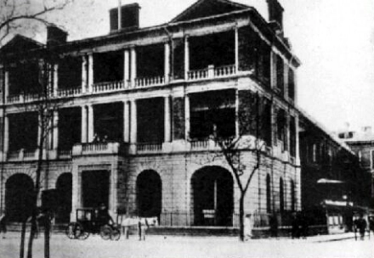
China Merchants Steam Navigation Company
Li Hongzhang

Slide 9
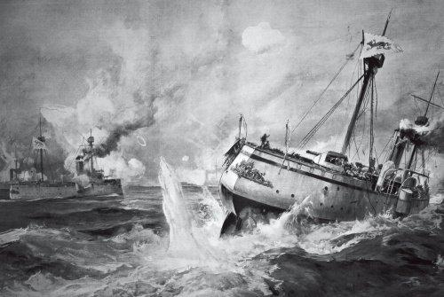
PPT模板 http://www.1ppt.com/moban/
Sino-Japanese War

Slide 10
03
Conclusion

Slide 11
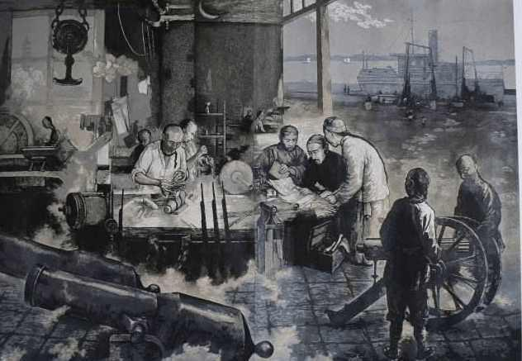

Slide 12
Thank you

