Slide 1
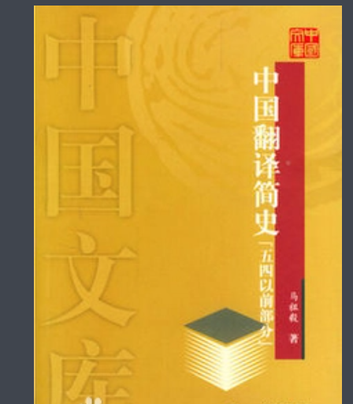
A Brief History of Chinese Translation Before the May Fourth Movement
Four climaxes of translation in Chinese history
By
Deng Yanglin

Slide 2
Ⅰ. From the Eastern Han Dynasty to the Tang and Song Dynasties
Ⅱ. From the late Ming Dynasty to the early Qing Dynasty
Ⅲ. From the Opium War to the May Fourth Movement
Ⅳ. From the May Fourth Movement to the contemporary era
Content

Slide 3
From the Eastern Han Dynasty to the Tang and Song Dynasties
Major Subject: Buddhist scriptures
Progress : Three periods
Representative Figures: An Qing , Shi Dao ’an and Xuan Zang
Purpose: Importing the knowledge of the Buddhism
Significance : Etching the Buddhism into the Chinese culture

Slide 4
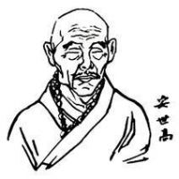
The First Period
The Translation of Buddhist scriptures in China began at the end of the Eastern Han Dynasty by An Qing.
Pioneer: An Qing (also An Shigao)
Introduction: An Qing is a Buddhist scholar and the first foreign monk who came to China to spread the teachings of Dhyana. His real name was Qing, and he was the prince of the Kingdom of Benin.

Slide 5
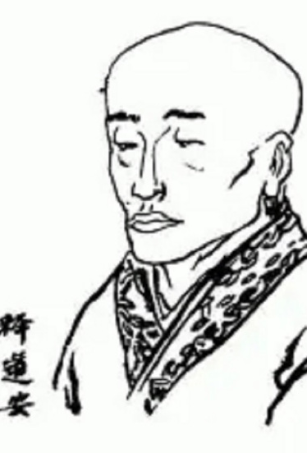
The Second Period
The second translation of Buddhist scriptures was initiated by Shi Dao ‘a.
Pioneer: Shi Dao’an
Introduction : Shi Dao’an (312 ~ 385), born in Fu liu, Changshan County [3-4] (now Ji Zhou, Hebei Province), was an outstanding writer, Buddhist scholar and translator in the pre-Qin period. He was of the Han nationality.

Slide 6
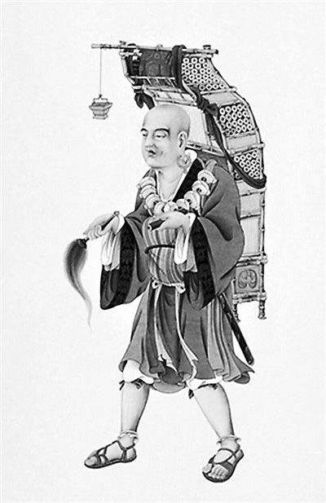
The third Period
The third translation , also the most prosperous period, of Buddhist scriptures was initiated by Xuan Zang.
Pioneer: Xuan Zang
Introduction : Xuan Zang (602-664), a prominent monk of the Tang Dynasty, was one of the four major translators of Buddhist sutras of Chinese Buddhism.

Slide 7
From the late Ming Dynasty to the early Qing Dynasty
Major Subject: science and technology
Representative Figures: Xu Guangqi ,Matteo Ricci
Purpose: Importing advanced technologies
Significance : Promoting the development of modern technologies in China

Slide 8
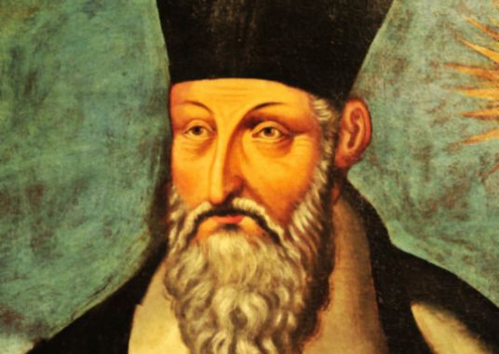
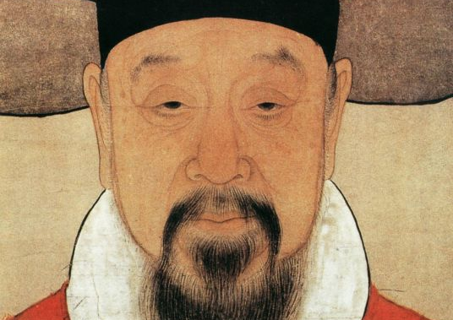
Translating activities focused mainly on Western books in terms of science and technologies from the late Ming Dynasty to the early Qing Dynasty, including astronomy, mathematics, physics and mechanical engineering.
Pioneer: Xu Guangqi and Matte Ricci
Introductions : Xu Guangqi (1562-1633), styled Zi Xian, styled Xuan Hu, posthumous wending, a native of Shanghai, wanli Jinshi, official to the Chongzhen Court of Rites, grand bachelor of Wenyuan Pavilion, deputy assistant to the Cabinet.
MatteoRicci (1552-1610) was an Italian Catholic Jesuit missionary and scholar. In 1582 (the 10th year of Wanli Ming Dynasty), he was sent to China to preach. He died in Beijing in 1610. He had preached in China for 28 years and was one of the earliest Missionaries of the Catholic Church in China.

Slide 9
From the Opium War to the May Fourth Movement
Major Subject: Political thinking and literature
Representative Figures: Lin Zexu , Yan Fu
Purpose: Importing Western culture and classic literatures
Significance :Bringing a great convergence of Western culture and Chinese culture

Slide 10
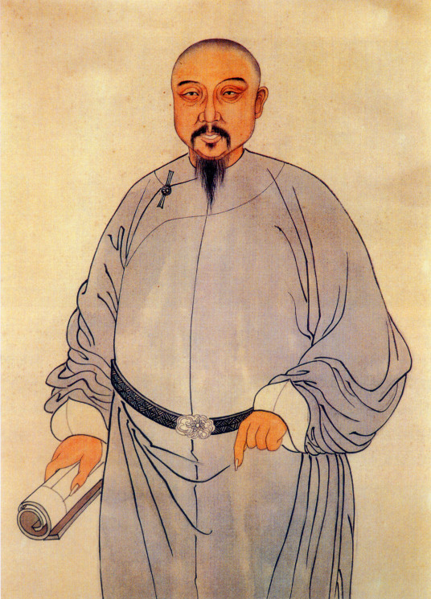
Lin Zexu (August 30, 1785 [53] -- November 22, 1850), styled Yuan Fu, also styled Shaomu and Shi Lin, was born in Houguan, Fujian province. He was also a statesman, writer, thinker and national hero in the late Qing Dynasty.

Slide 11
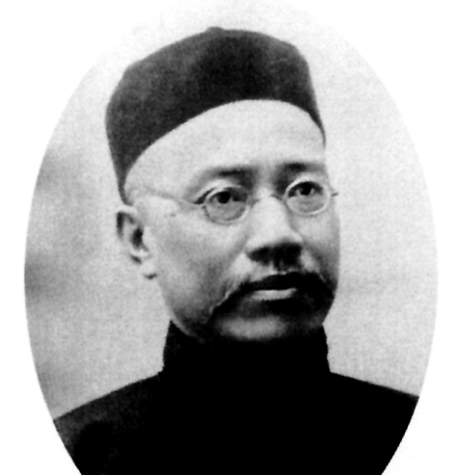
Yan Fu (January 8, 1854 -- October 27, 1921), male, original name Zongguang, courtesy name Youling, later changed his name to Fu, courtesy name Jidao, han nationality, was born in Houguan County, Fujian Province. He was an extremely influential bourgeois enlightenment thinker in modern times, a famous translator and educator [1], and a representative of the New Legalism.

Slide 12
From the May Fourth Movement to the contemporary era
The fourth translation climax took place from the May 4th Movement to the contemporary era. During this period, translation activities covered a wide range, including literature, science, medicine, agriculture and others. Many famous translators also appeared during this period, and translation reached an unprecedented height.

Slide 13
Conclusion
Generally speaking, there are four major upsurge in the history of Chinese translation, each of which has played a great role in promoting the development of translation.

Slide 14
Thanks

