Slide 1

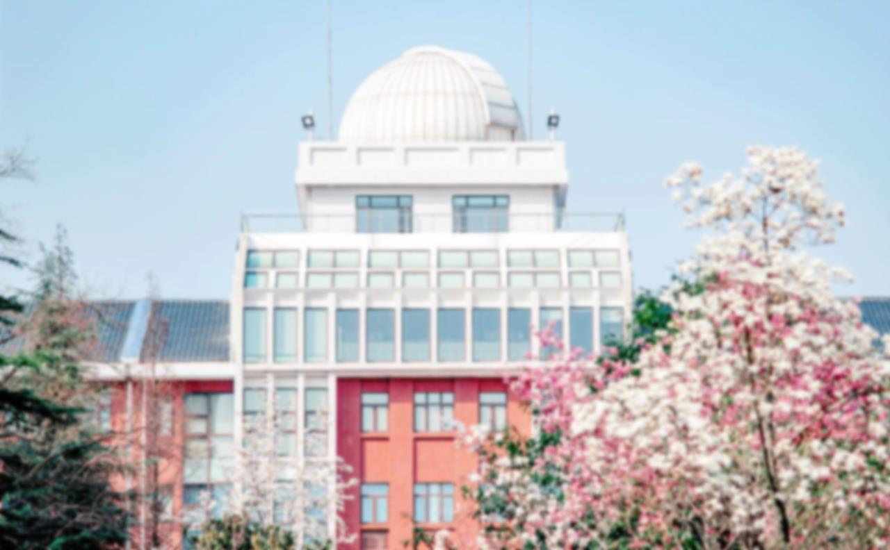
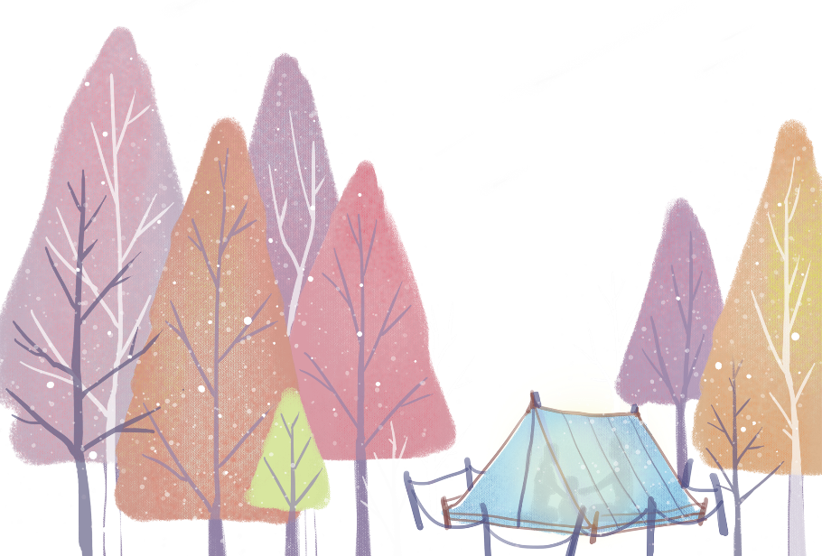

Gender Discrimination in Chinese
熊丹Xiong Dan 李鸿Li Hong

Slide 2

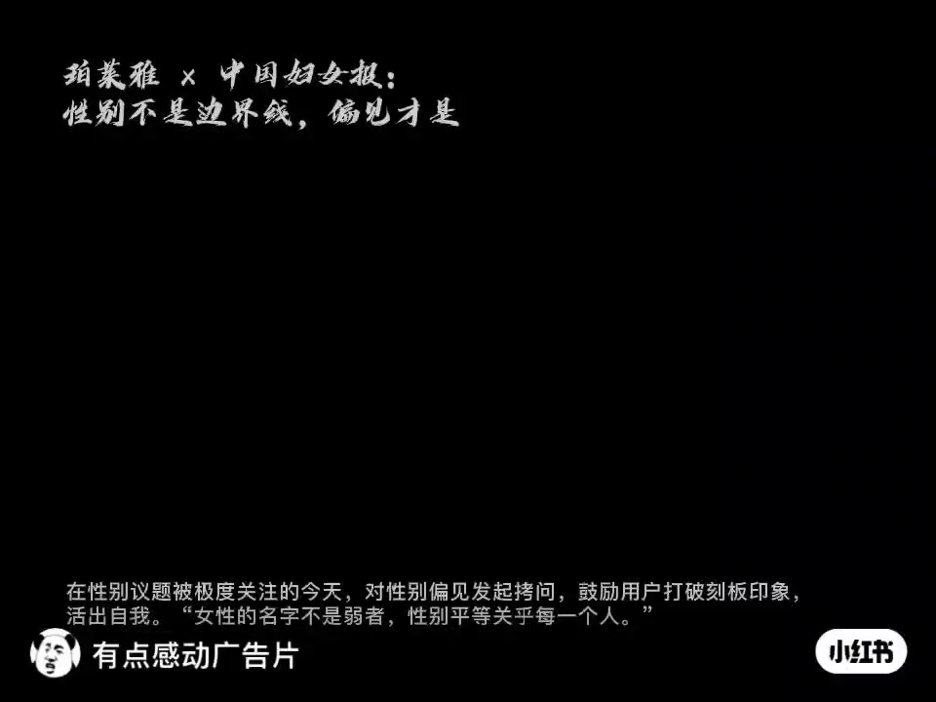

Slide 3
gender
women men
gentle considerate clean
independent brave strong striving for a career
balance family and career
men can’t cry?
let us can be gentle , can be brave, can be romantic ,can be clam, can be strong ,and can be cry!

Slide 4
Q1:Have you experience the descrination?Can you share it with us?

Slide 5
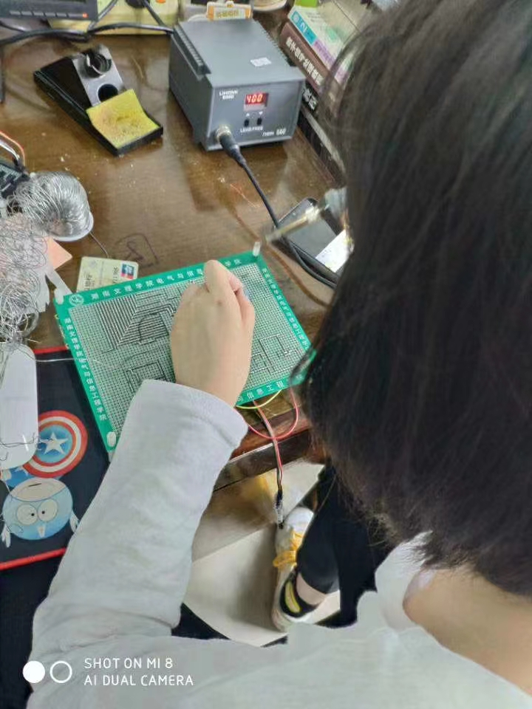
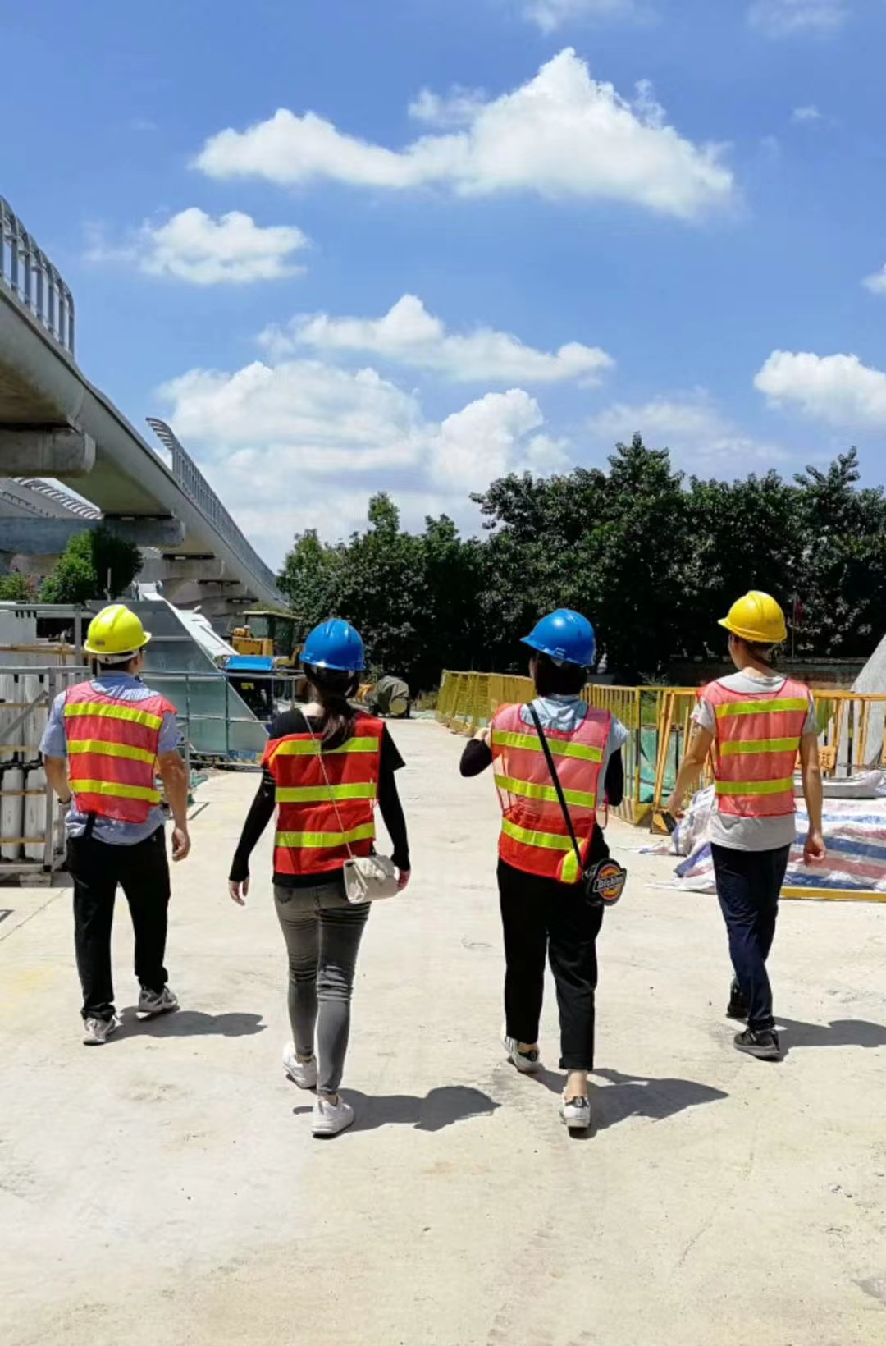
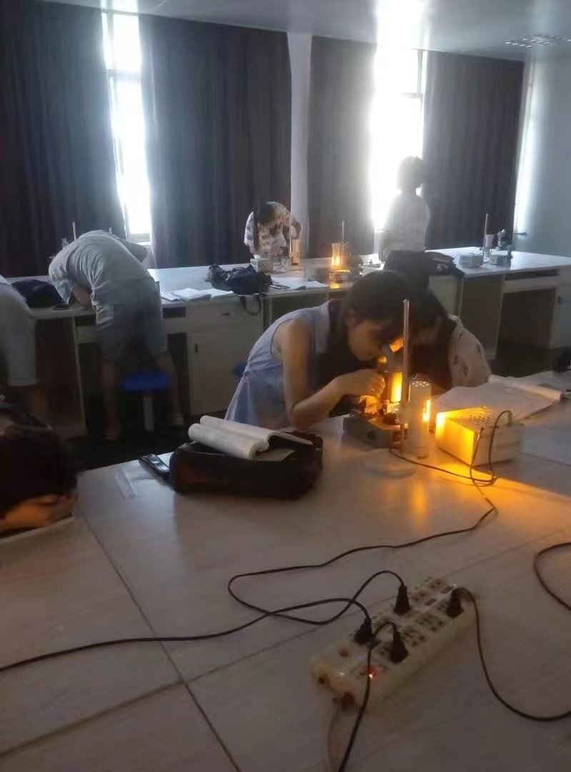
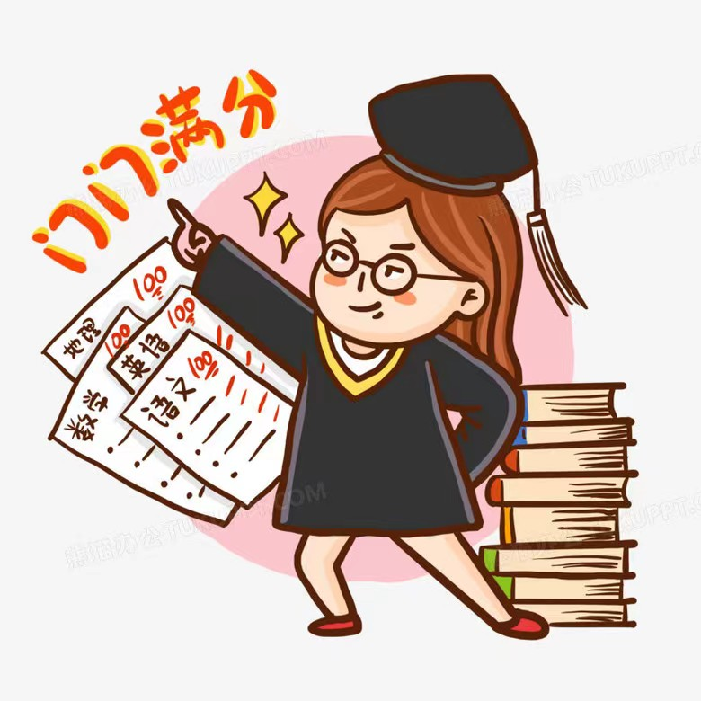
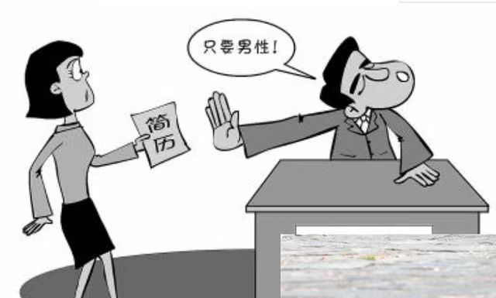

Slide 6
Q1:Have you experience the descrination?Can you share it with us?
Q2:How we fix it?

Slide 7
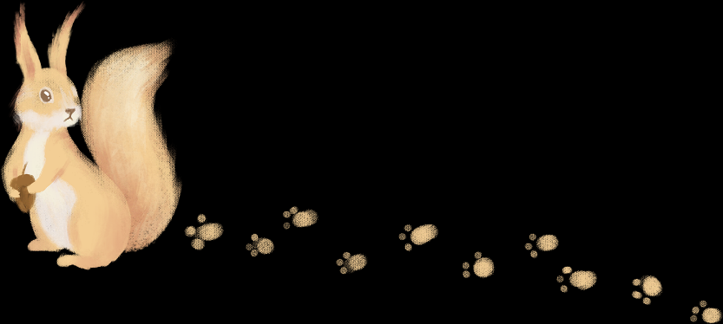

CONTENT
Gender Discrimination in word formation
Gender Discrimination in proverbs
01
03
02
Gender Discrimination
in metaphors
04
Ways to fix it

Slide 8

The definition of gender discrimination
The Cambridge Dictionary defines “gender discrimination” as “a situation in which someone is treated less well because of their sex, usually when a woman is treated less well than a man.”

Slide 9

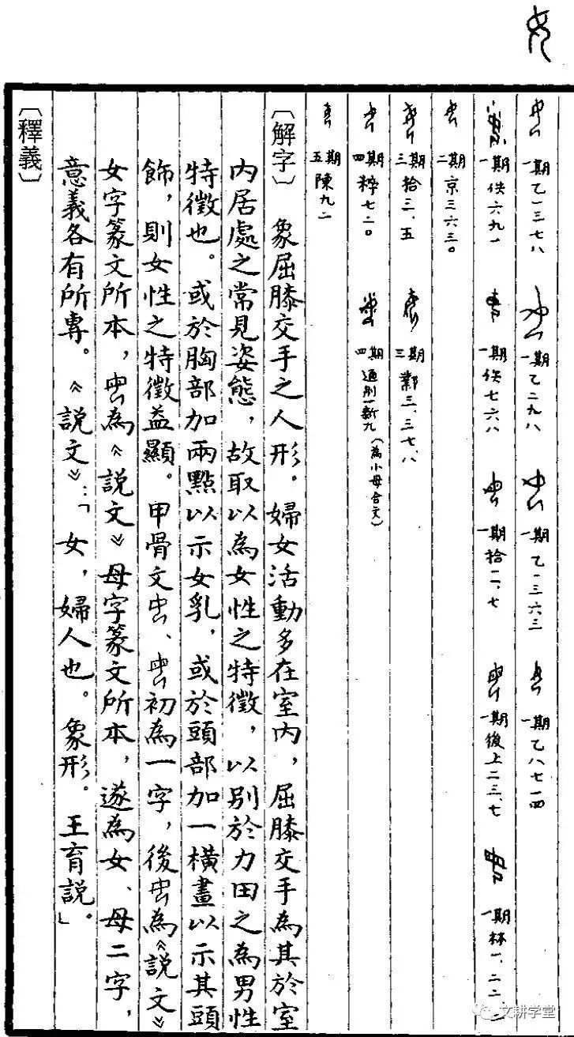
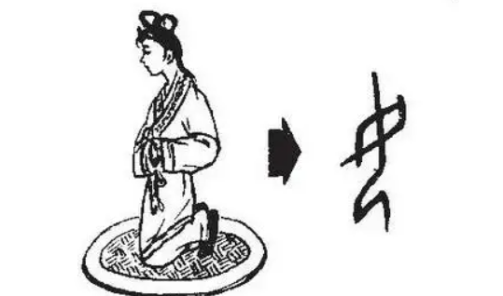
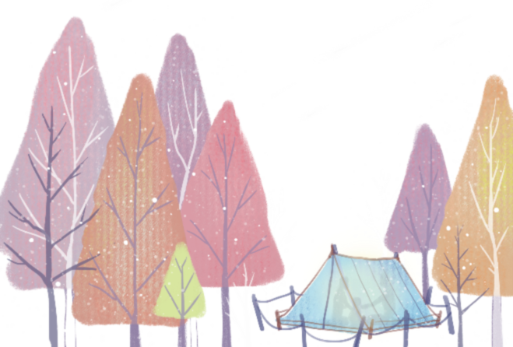
Word Formation
The original meaning of the word "女(female)" is a woman with low status who focuses on domestic trifles. In addition, the ancient pronunciation of the word "女(female)" is "奴(slave)."
Thus, both the word formation and pronunciation of “女(female)” reflect the ancient people's contempt for women.

Slide 10
There are five types of Chinese characters with a “女”
Viewing women as instruments for reproduction or toys for men
“姓” “妊” “娠” “妃” 嫖” “妾”
Reflecting the status of married women as occupants and slaves
“娶” “嫁” “婚”
Indicating female sexuality as evil, greedy and immoral
“嫌” “妖” “妒” “耍” “妨” “奸” “婊” “妄”
Meaning obedience, ignorance and lowliness
“妇” “奴” “如” “安” “娓” “姻”
In a society dominated by men, the value of women appears to be determined solely by their: “好” “姝” “妙” “娜” “妍” “娟” “婧” “娴”.

Slide 11
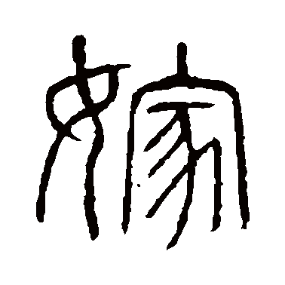
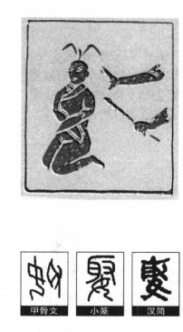
“嫁”and “娶”
《白虎通·婚娶》
“嫁者，家也。妇人外成以出适人为家。”
This sentence means that once a woman married, her husband’s home is her home while her parents’ house is no longer her home. Generally, married women wish to leave their hometown and join her husband's family, thereby becoming a member of her husband's family.
《韩非子》
“天饥岁寒，嫁妻卖子者，必是家也。”
When the weather is cold and suffering hunger, marry your wife to another and sell your children can earn you a house.
"嫁" was pronounced with the sound of “卖”, which means "sell.”
“娶”： “取” means "take and capture prisoners.”
"娶" can also mean "rob wife."

Slide 12


proverbs
1.reflecting the defects of the female sex： 三个女人一台戏。 (Three women can constitute a play.) 红颜女子多是非。 (Beautiful women can attract troubles.)
2. reflecting the low status of women： 母以子为贵。(Mothers’ honor is their sons. ) 兄弟如手足，妻子如衣 服。(Treat brothers as hands and feet while wives as wear.) 养儿防老， 养女赔钱。(Bring up sons to support parents in their old age while bringing up daughters to waste money.)
3. reflecting the ignorance of women： 头发长见识短。 (Long hair, short sight.) 女子无才便是德。 (No knowledge is the value of a woman.)
4. reflecting the existence of sexism in marriage：嫁出去的女儿，泼出去的水。(Married daughters, spilled water.) 嫁鸡随鸡， 嫁狗随狗。(Accept anything in a marriage.)
5. reflecting that women are evil and curse: 女人上屋屋要塌，女人上船船要翻。 (Women on the roof, houses will collapse.) 最毒妇人心。 (There is no devil so bad as a woman’s heart.)

Slide 13
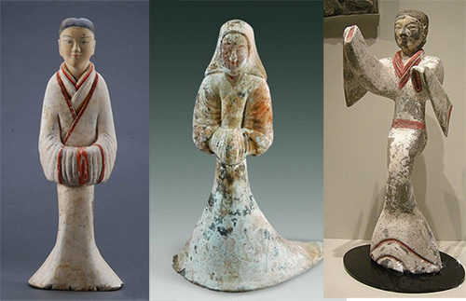
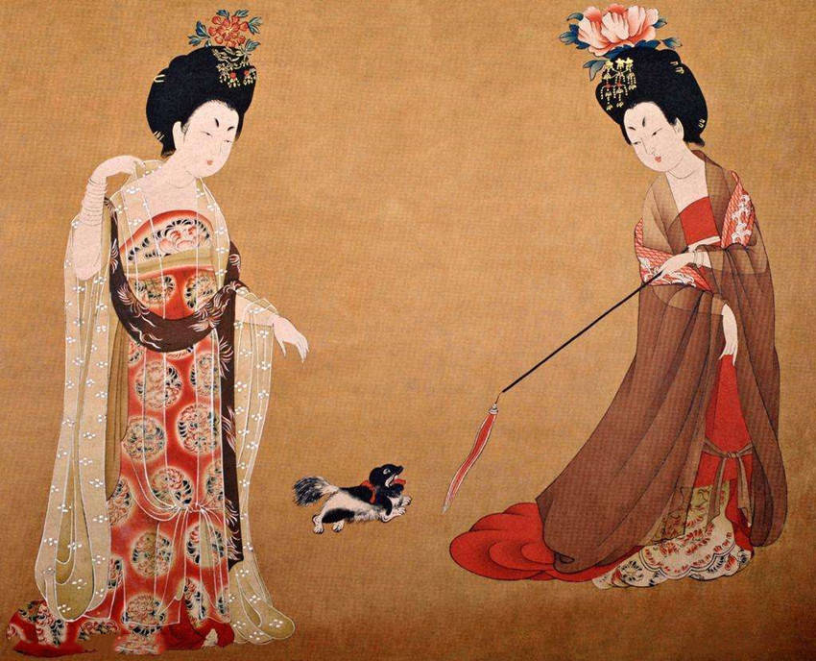
metaphors
the standard of beauty
The Han Dynasty considered slim women as beautiful.
柳腰 (A waist as thin as wicker): a. describes the soft strips of willow; b. refers to a woman's thin, soft waist.
亭亭玉立(as straight as an ancient Chinese pavilion): describe beautiful women with slender figures or straight shapes such as flowers and trees.
The Tang Dynasty considered chubby women as beautiful. movements.
“丰润, 丰满, 丰盈, 丰腴”
in Chinese are adjectives describing chubby women.

Slide 14
metaphors
Metaphors in animals
Tiger
“The tiger descends the mountain" describes the ferocity and speed, and when used in the male, it refers to its sweeping and unstoppable momentum.
When the tiger metaphor is applied to women, it typically refers to outrageous, provocative, unreasonable women.
Chick
“鸡婆(a woman who ran a brothel）” who are noisy and haggle over every ounce of woman trouble;
“母鸡(the hen)” is used continuously to gossip disgusting woman.

Slide 15

It is only under the presumption of societal reform and linguistic equality that we will be able to completely eradicate social discrimination, eradicate language discrimination, and realize true equality between men and women.

Slide 16
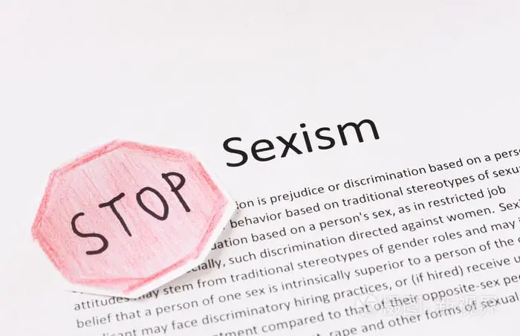
Ways to fix it
never use male terminology or complex words when talking about women.
avoid using phrases that are derogatory to women, and steer clear of including old stereotypes in what you say.
Expressions of women that are negative or sarcastic should be avoided

Slide 17
References
Bai Jiehong 白解红(2000). 性别语言文化与语用研究[Male/Female Language, Culture and Pragmatics].湖南教育出版社 Hunan Education Publishing House, 20.
Wang Xiuying 王秀英(2016).浅谈英汉语言中的性别歧视现象及其 产生的根源[On sexism in English and Chinese and its causes].甘肃高 师学报 GANSU GAOSHI XUEBAO, 34-35.
Zhou Huanmei 周欢梅(2011).隐喻视角下的英汉语言性别歧视研究 [A study of gender
discrimination in English and Chinese languages from the perspective of metaphor].西北大学 Northwest University, 14- 15.
Yin Xue 尹雪(2012)汉语词汇中的性别歧视研究[A study of sexism in Chinese vocabulary].黑龙江大学 Heilongjiang University, 26-27. Zhao Yiran 赵羿然(2020).
英汉语言中性别歧视的成因分析[An analysis of the causes of sexism in English and Chinese].现代交际 Modern Communication, 62-63.

Slide 18
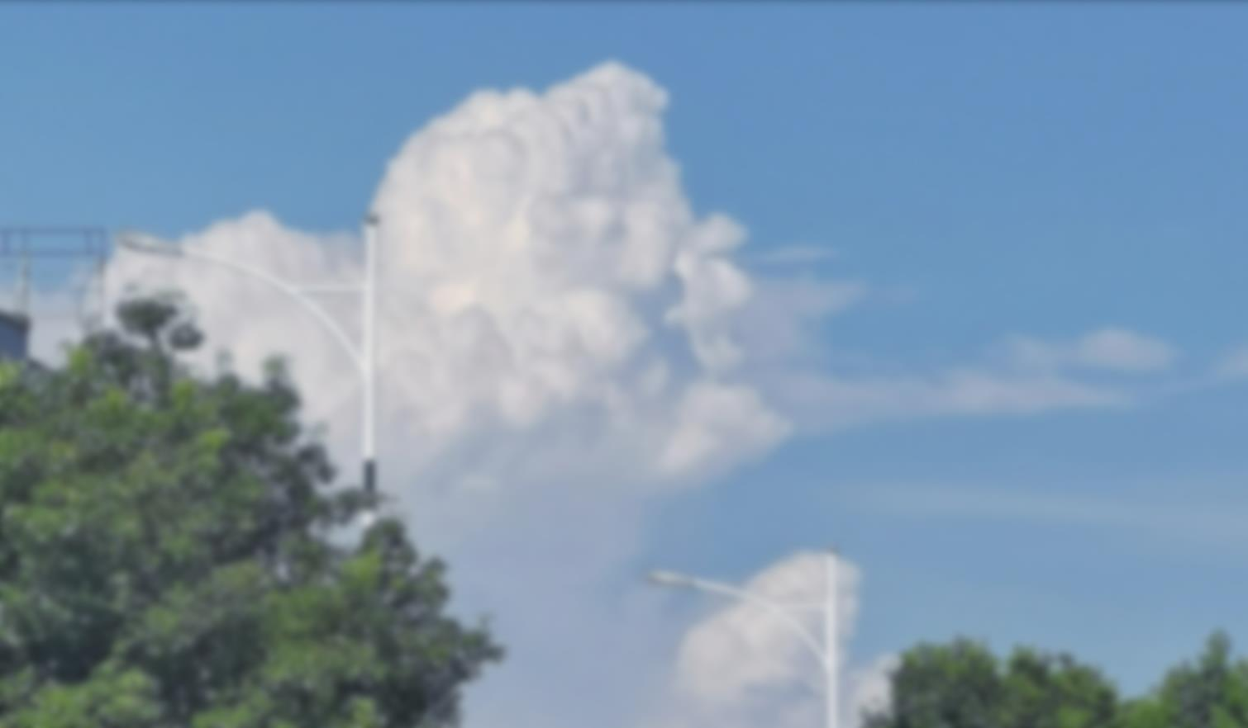
Thank you!

