Slide 1
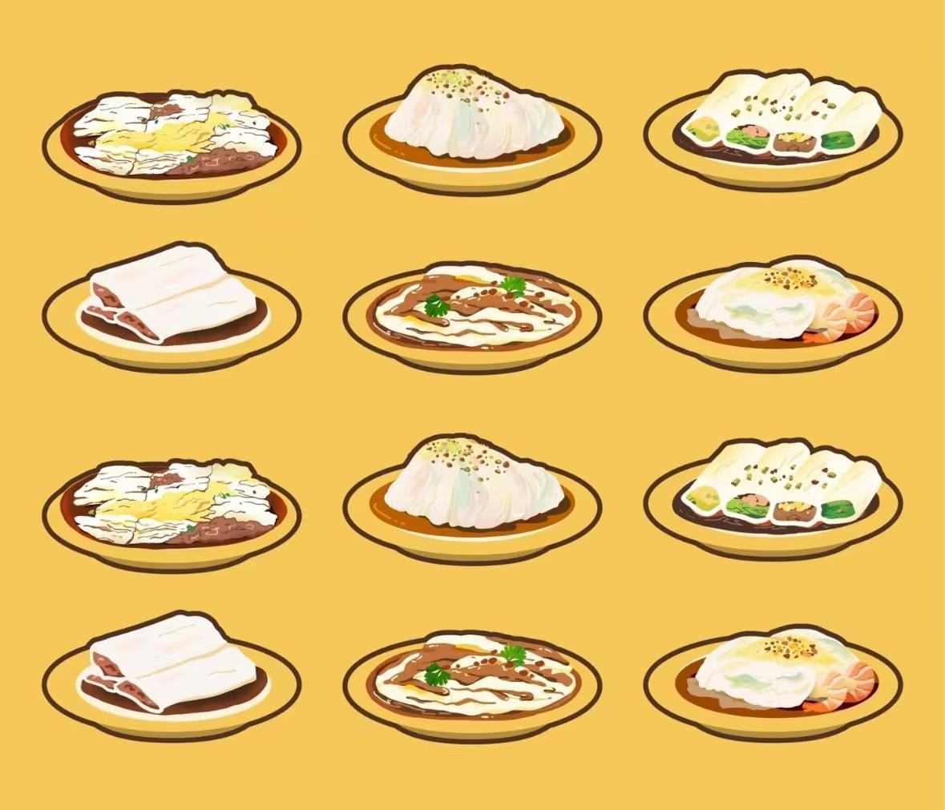
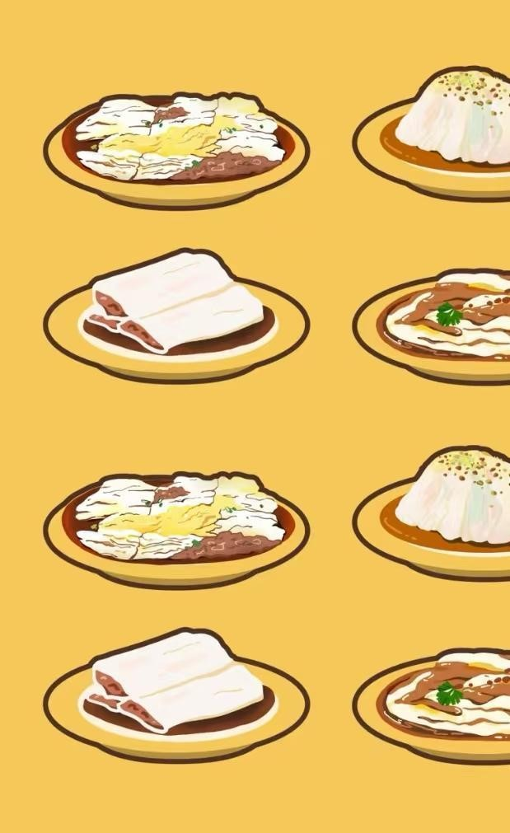
Rice Noodle Roll
A Culinary Delight of Cantonese Cuisine
Li Mingfeng

Slide 2
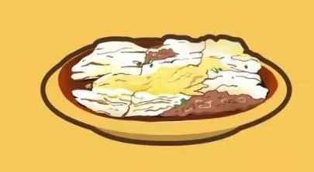
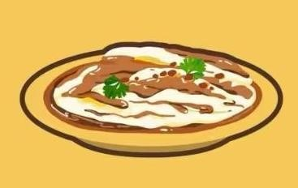
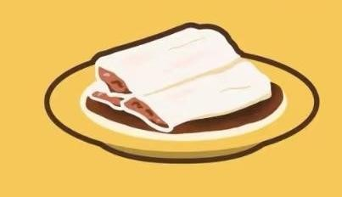
肠粉
Cheung Fun
Steamed Vermicelli Roll
Notes:
Besides Rice Noodle Rolls commonly used name

Slide 3
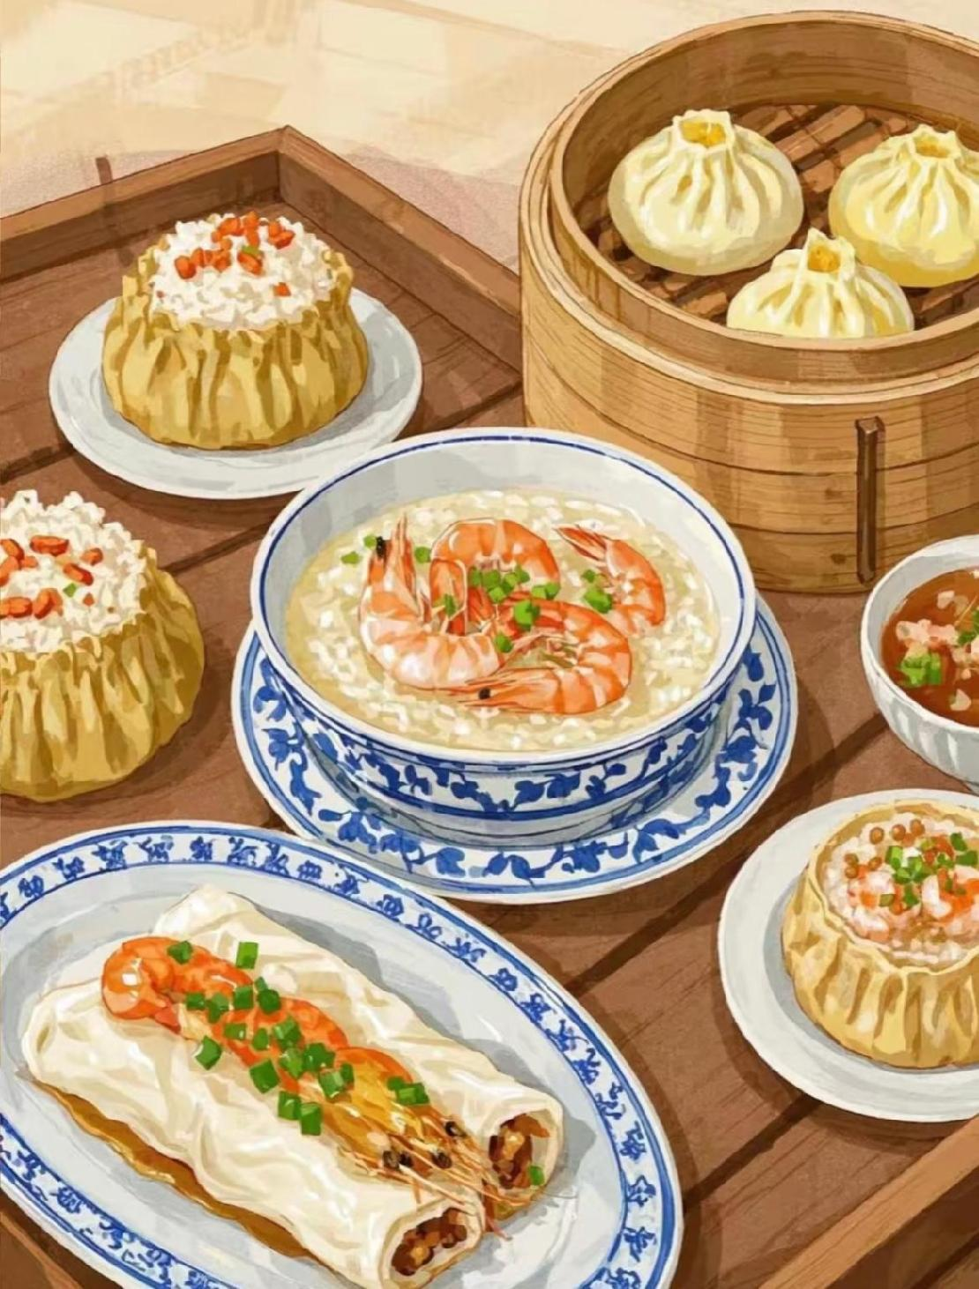

Origin & Culture
Categories
Recommendation

Slide 4
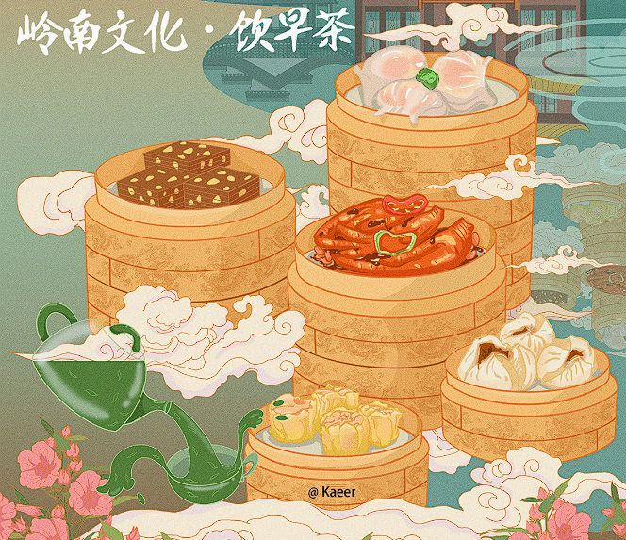
Origins & Culture

Slide 5
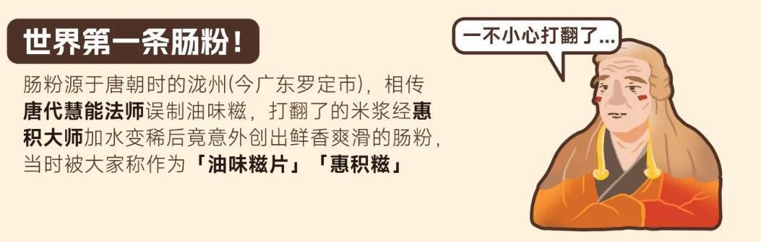
Notes:
Rice noodle rolls (Changfen) originated from Long County (today’s Luoding City, Guangdong Province) in the Tang Dynasty. It is said that during the Tang Dynasty, Master Huineng accidentally created "youwei ci" (a type of rice cake). When the spilled rice batter was thinned by Master Huiji by adding water, it unexpectedly resulted in the creation rice noodle rolls. At that time, rice noodle rolls were called "Youwei Cipian" or "Huiji Ci."

Slide 6
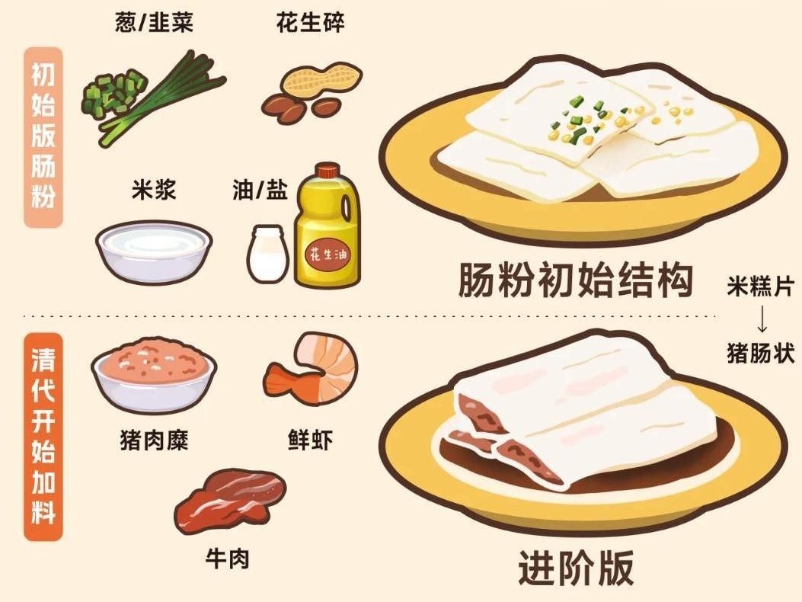
Notes:
The original version of rice noodle rolls, known as "Youwei Ci," usually had salt and peanut oil added to the rice batter. After steaming, crushed peanuts were added on top, and finally, scallions or chives were sprinkled over it.
Okay, so when we get to the Qing Dynasty, people started adding toppings like minced pork, shrimp, or beef to the cheong fun. This version was already looking increasingly similar to the cheong fun we have today. And here’s a cool detail: the shape of cheong fun. It used to be like these flat rice cake slices, but it changed to look more like a pig’s intestine. I guess that’s where the “cháng” (肠) in “cheong fun” (肠粉) comes from.

Slide 7
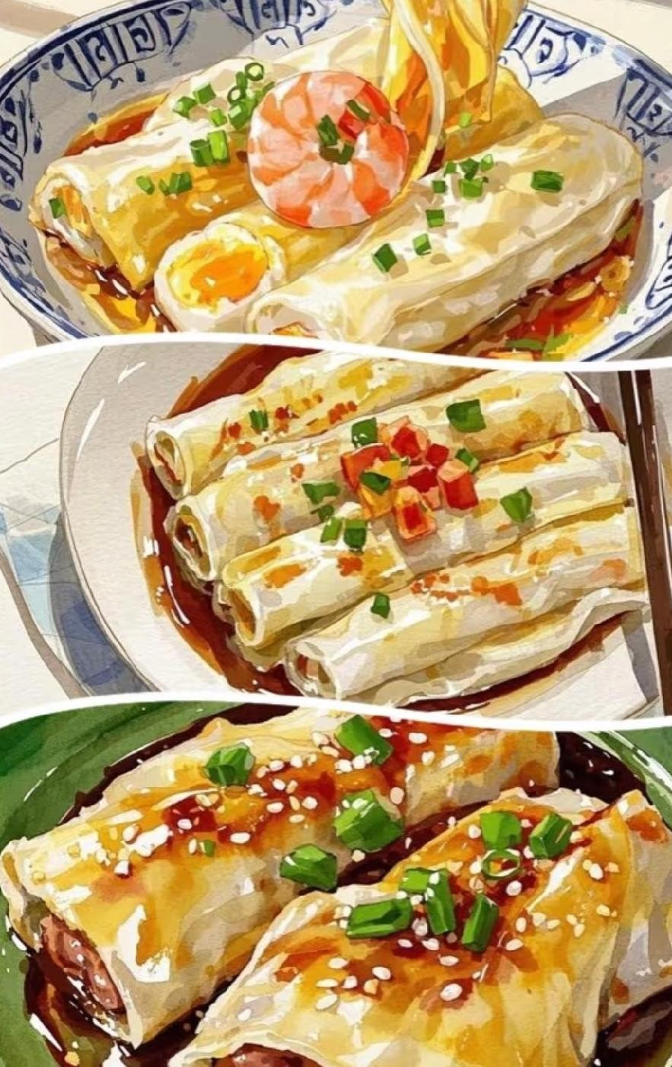
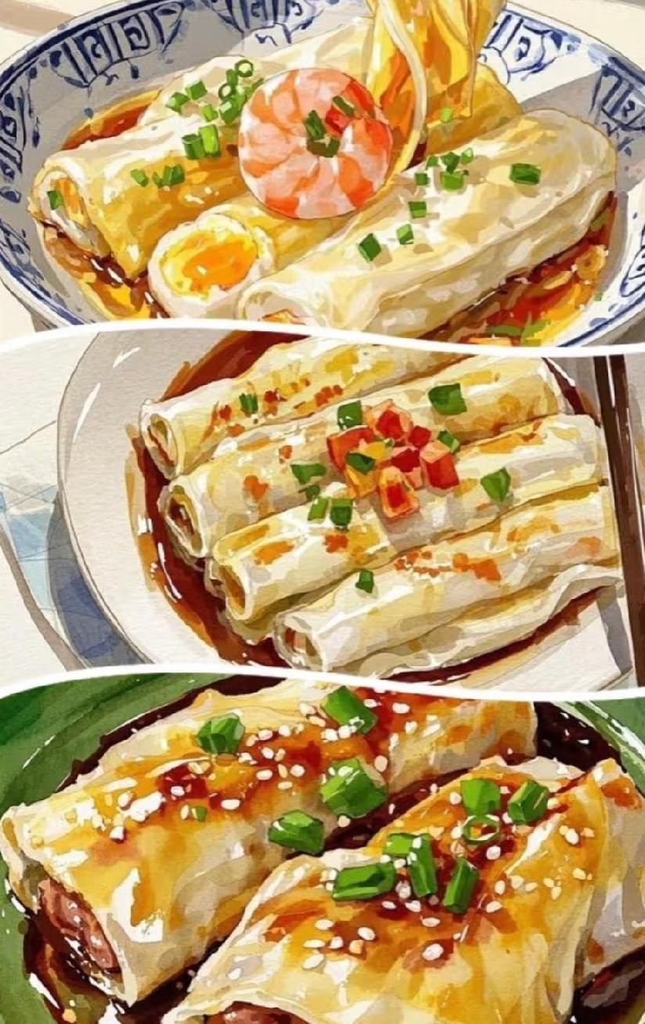
Categories
Notes:
Here comes the “categories.” And this is the second part of my presentation. There are two ways to classify them. The first is based on the “method of preparation,” and the second is the “place of origin.”

Slide 8
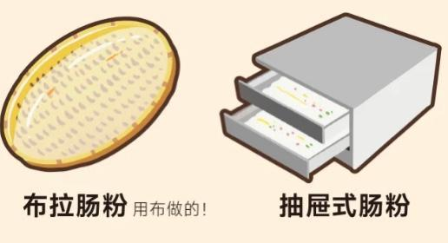

Slide 9
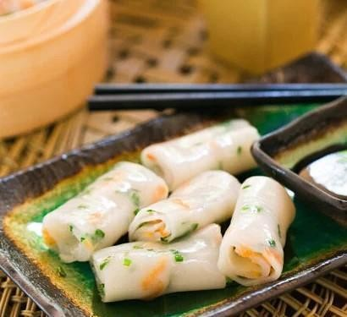
Cloth-Pulled
Rice Noodle Roll
Notes:
For “布拉肠粉” (Cloth-Pulled Rice Noodle Roll), it usually needs to place a cloth on the steaming tray and then pour the rice batter onto it. The final product typically comes out in this cylindrical shape.

Slide 10
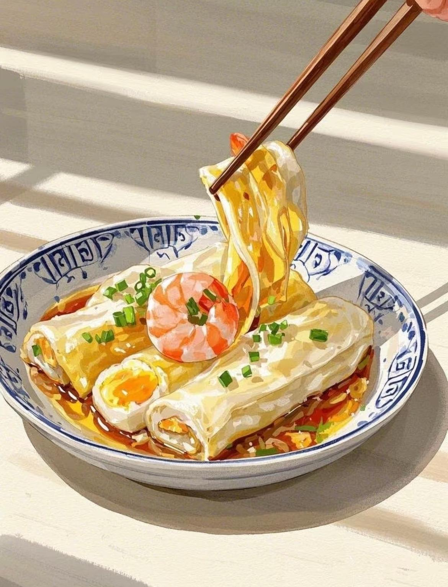
Drawer-Style
Rice Noodle Roll
Notes:
The 抽屉式肠粉（Drawer-Style Rice Noodle Roll） is just like its name suggests: the rice batter is poured directly into drawers for steaming. But before it, a bit of peanut oil is usually added first, and toppings like meat and eggs are mixed into the batter.

Slide 11
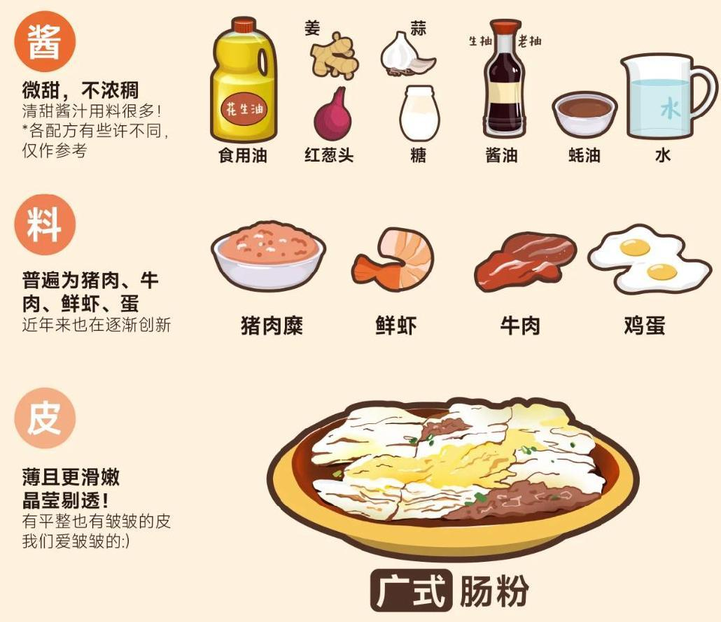
Notes:
As mentioned earlier, the second way of categorizing is based on the place of origin. Here, I've divided them into three main regions: the Guangzhou area, the Chaoshan area, and the Hakka area.
Their main differences lie in three aspects: the sauce, the toppings, and the wrapper, as shown in the picture.
The cheong fun from the Guangzhou area usually has a sweeter sauce, and the toppings are typically minced pork and eggs, with a thinner wrapper.

Slide 12
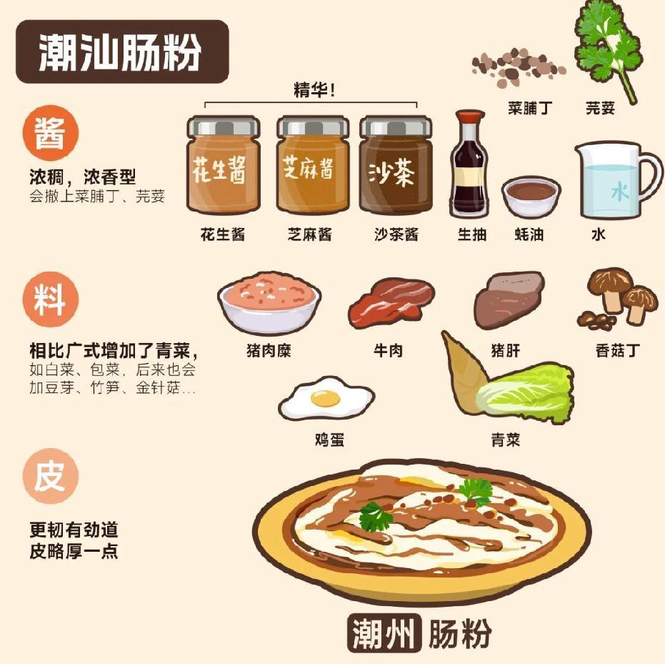
Notes:
In the Chaoshan area, the sauce is usually richer and thicker, and the toppings often include bean sprouts, green vegetables, and even oysters, in addition to the ones mentioned earlier, with a more chewy wrapper.

Slide 13
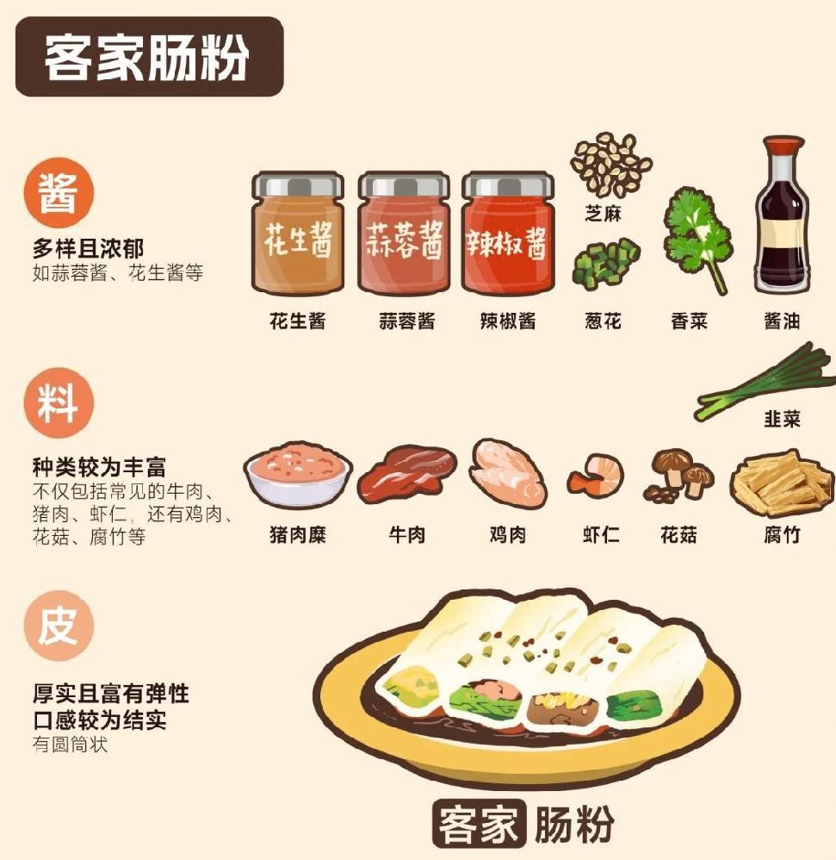
Notes:
As for the Hakka-style cheong fun, the toppings are more diverse. Just take a look at the picture for a quick idea.

Slide 14
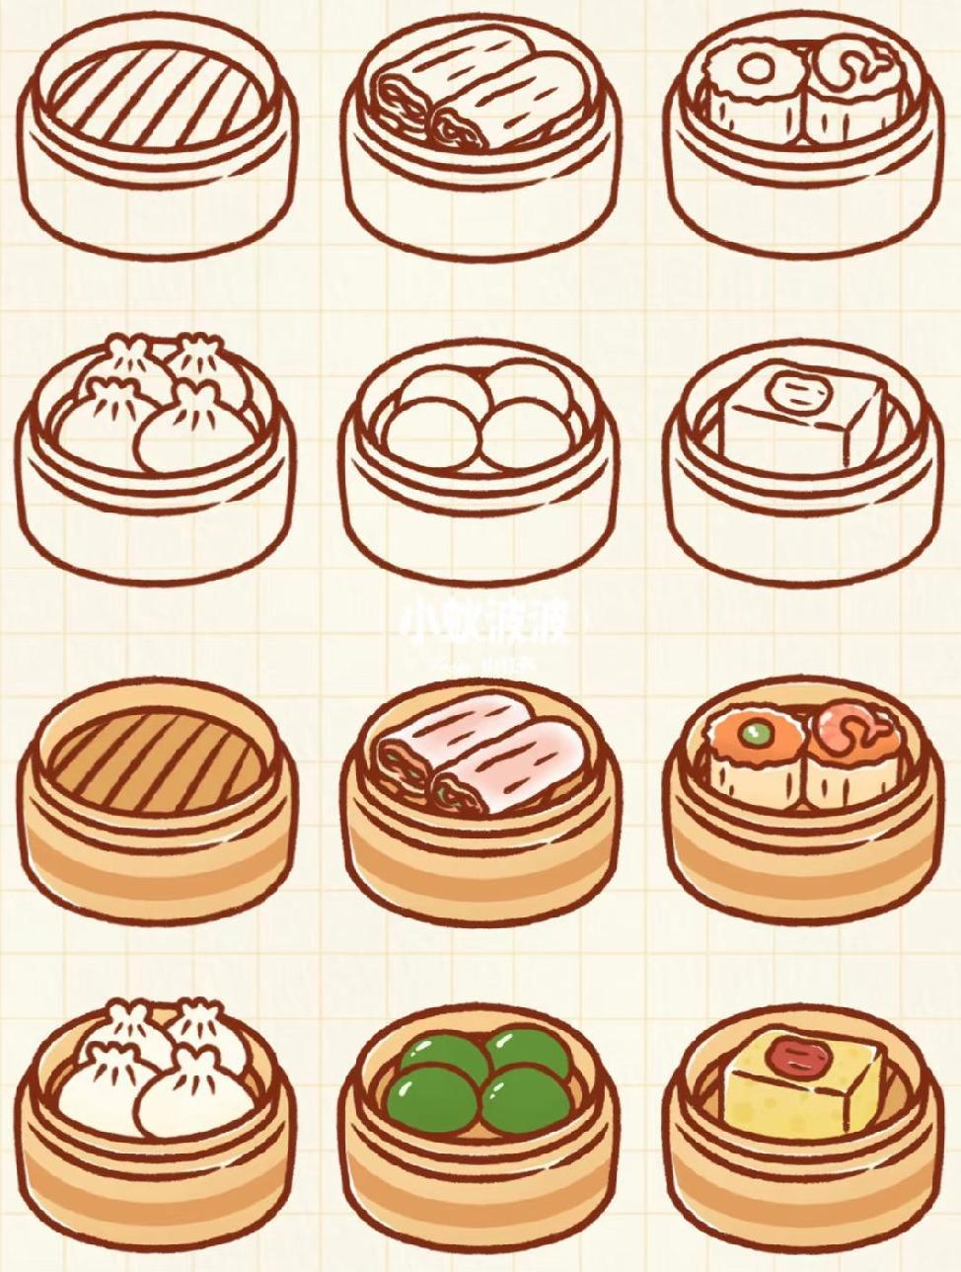
Recommendation
Notes:
Alright here comes the 3rd part, recommendations. These are some yummy Rice Noodle Rolls I’ve tried in Changsha, and they are super close to our school, so if you’re interested, just go and try.

Slide 15
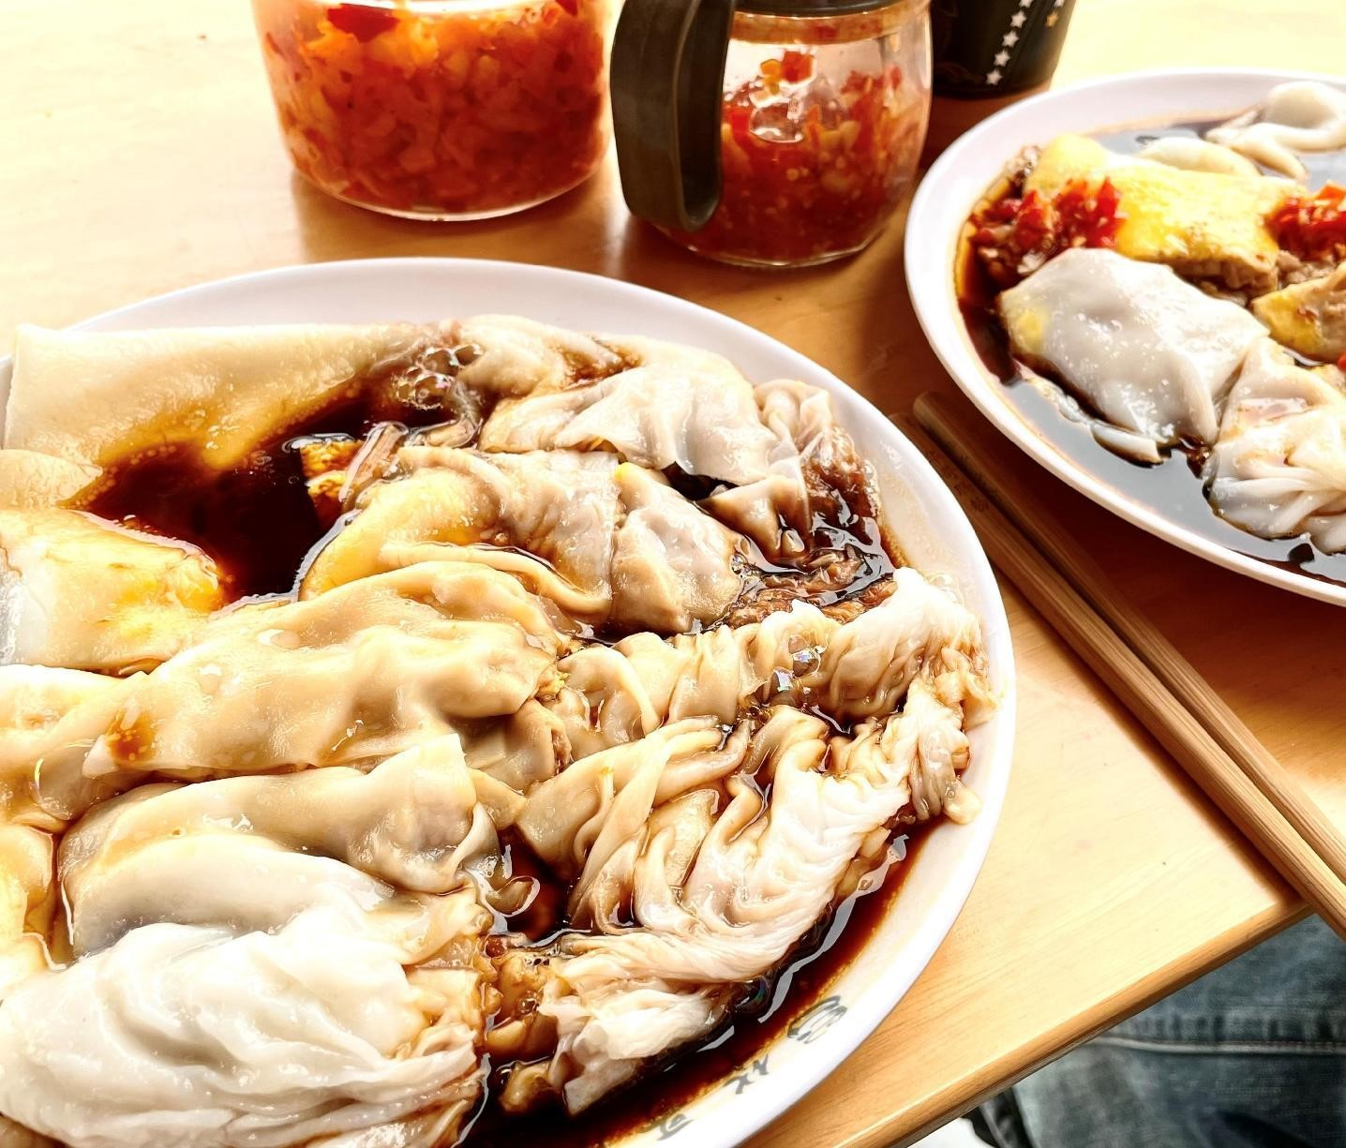
华哥石磨肠粉

Slide 16
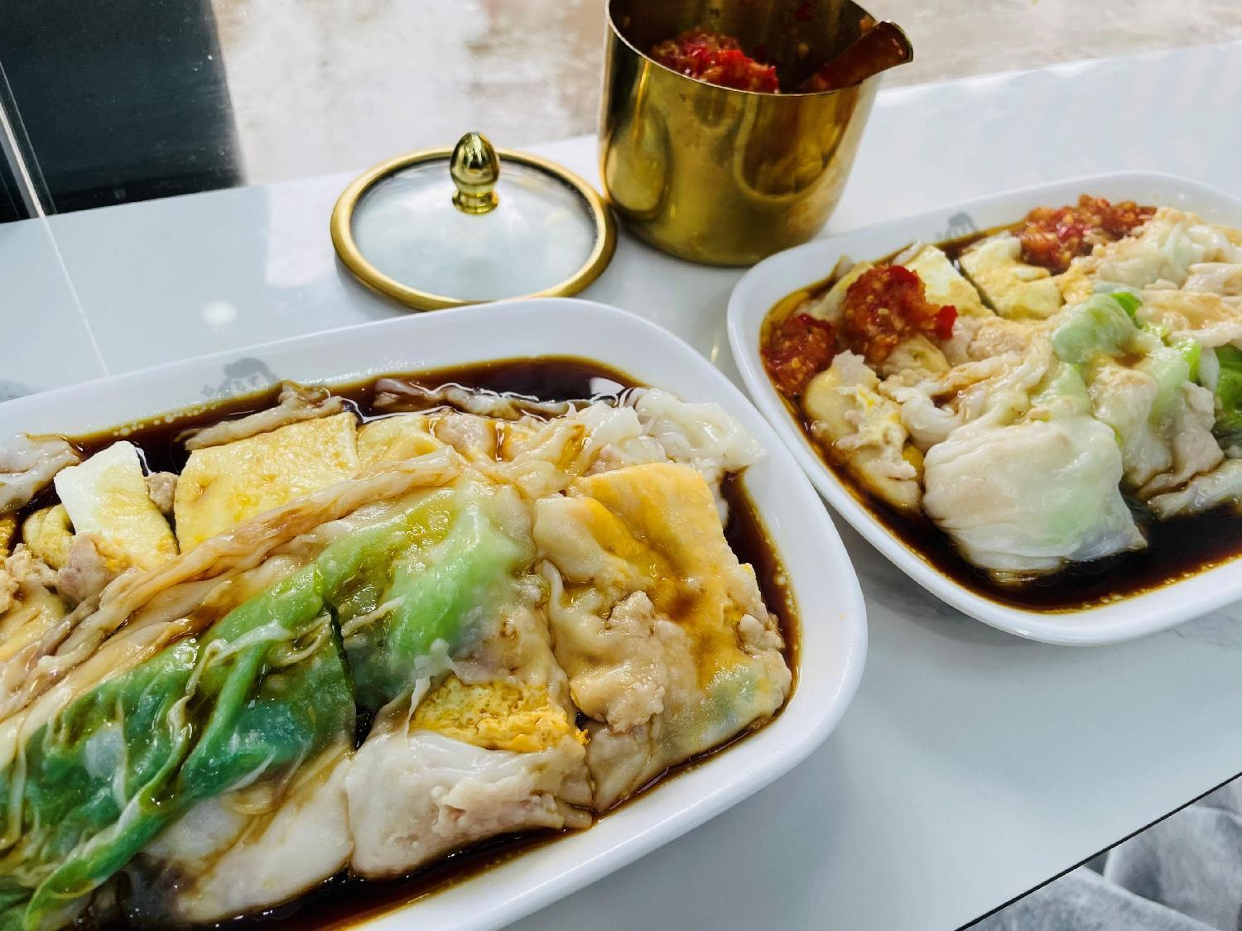
东记肠粉王

Slide 17
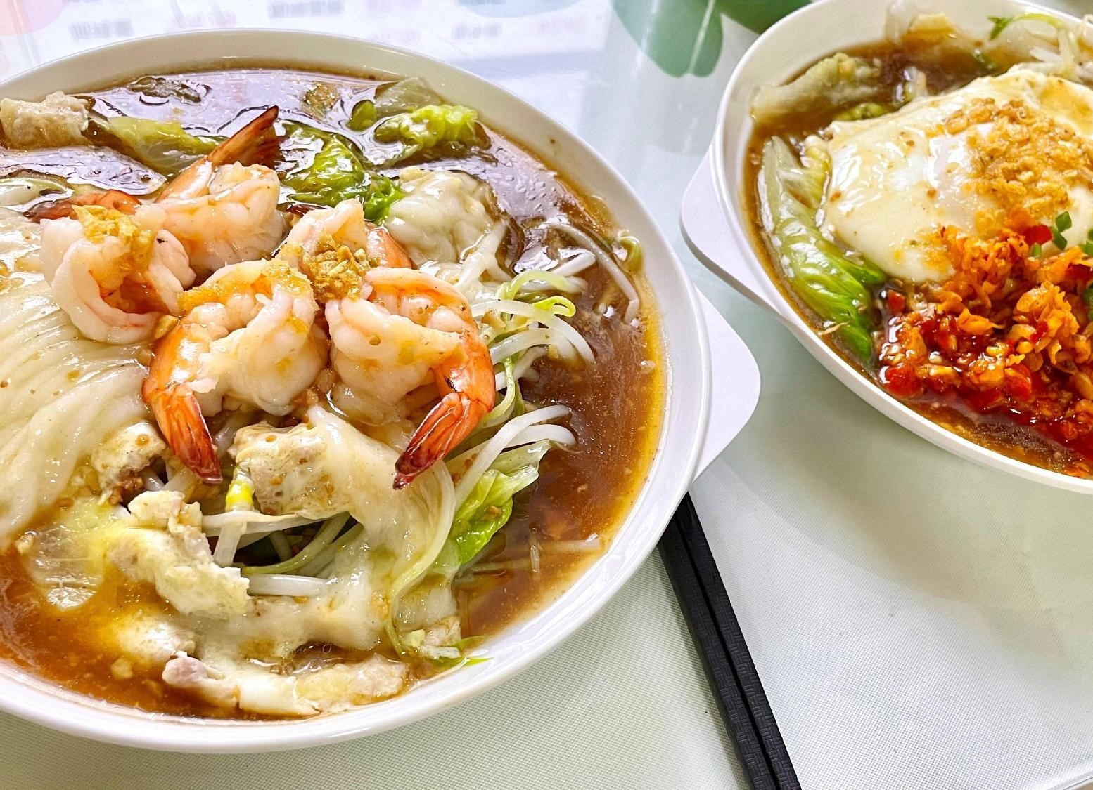

潮头家

Slide 18
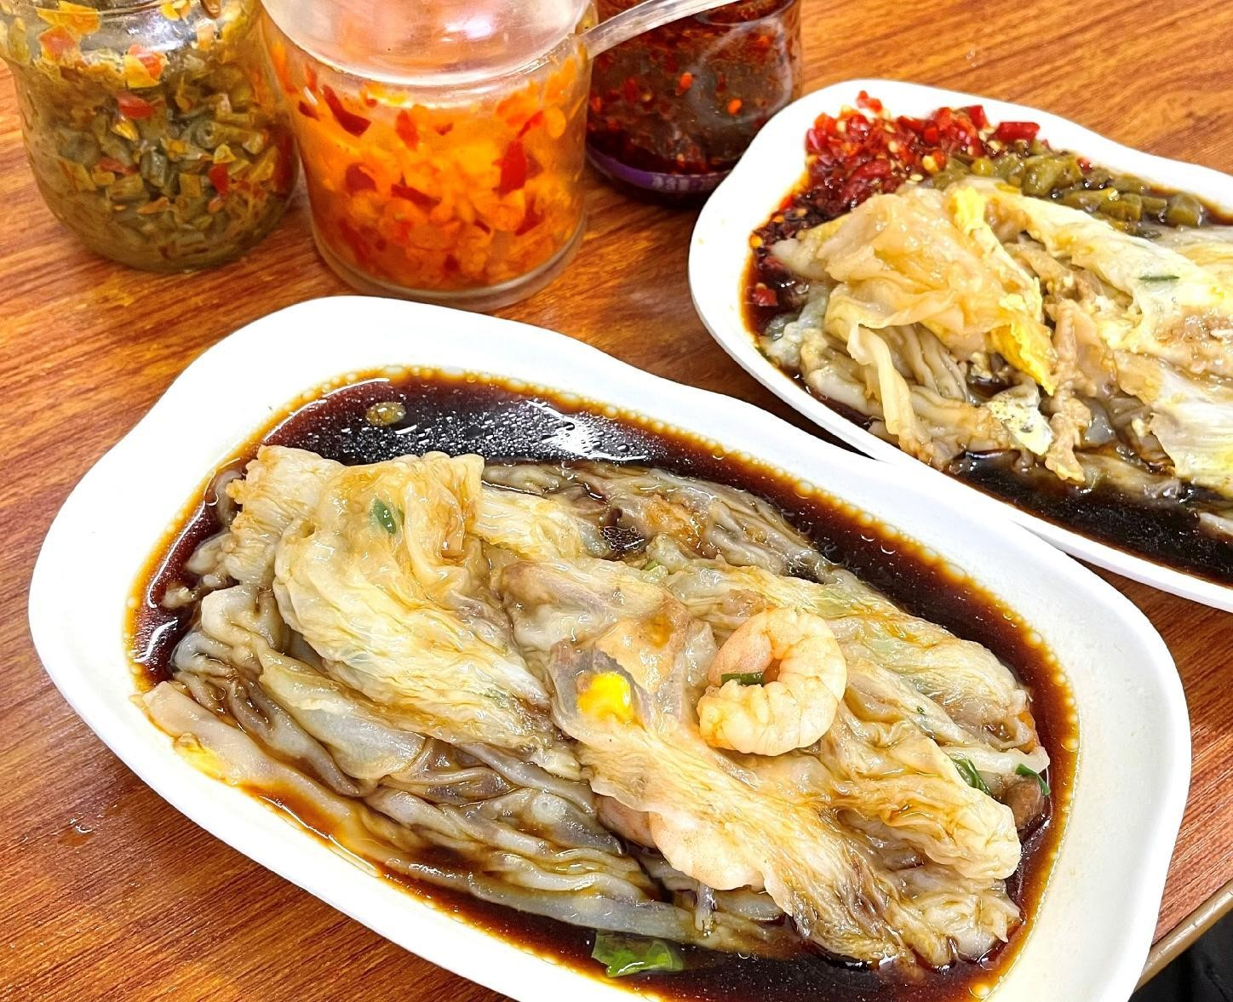
广州肠粉

Slide 19
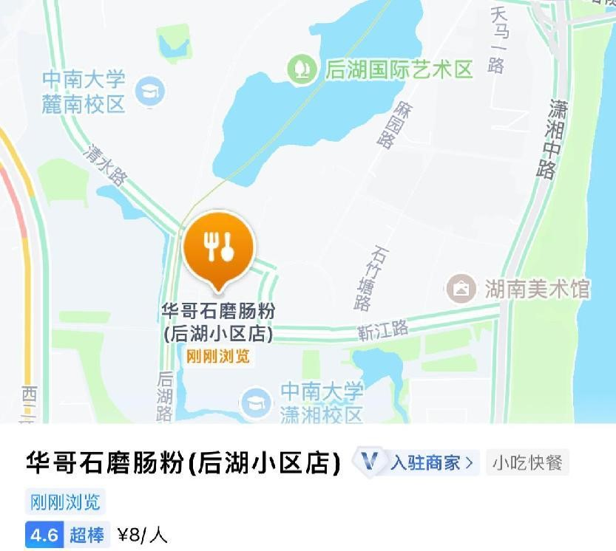
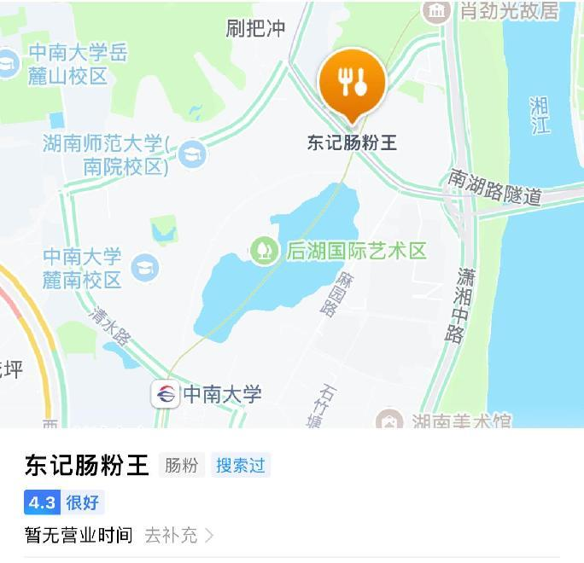
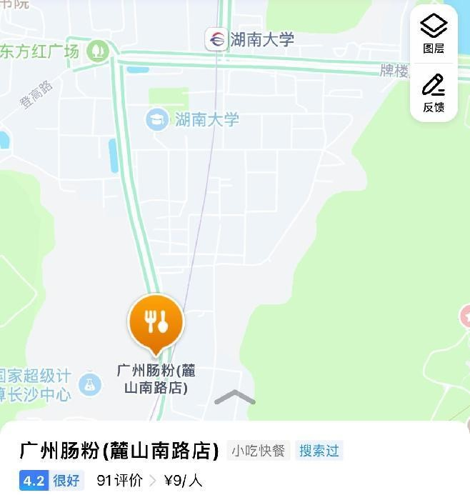
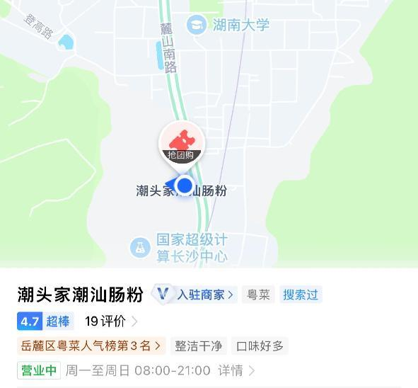
ADDRESS

Slide 20
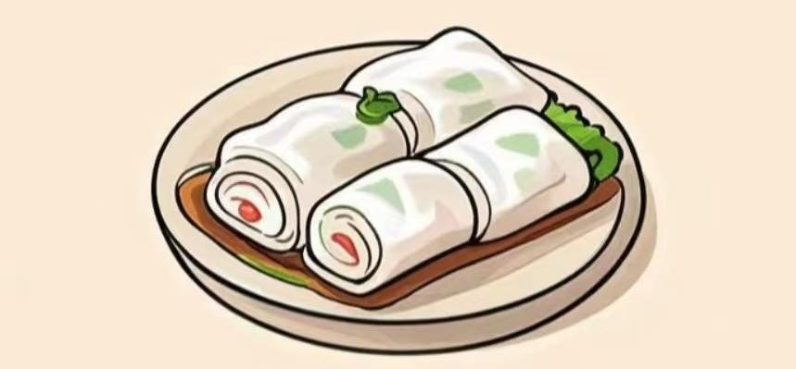
Thanks

