Slide 1
Western Translation History
——周思庆 张琪
By Zhou Siqing, Zhang Qi

Slide 2
The beginning of western translation history
The history of Western translation opened its first page in the third century B.C.
Broadly speaking, the earliest translation in the West was the Old Testament
of the Bible translated by 72 Jewish scholars in Alexandria, Egypt between
third and second century B.C.
Strictly speaking, the first translation in the West was the Greek Homeric epic Odysseus, translated in Latin by Andronico in Rome around the middle of the third century B.C.
Both the former and the latter appeared in the third century BC, so it can be
said that western translation has a history of more than two thousand years
since ancient times.

Slide 3
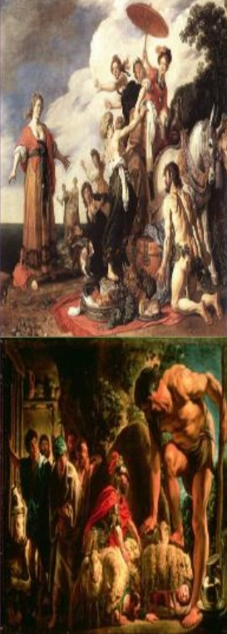
About Odysseus
It is one of the two most important epics of
ancient Greece (the other is "Iliad", collectively called "Homeric Epic")
This is a long narrative epic of ancient Greece
that describes the Trojan War between the 12th
and 11th century BC and relates maritime
adventure stories.
The content is mainly about the adventure story of the Greek hero Odysseus winning the Trojan War and returning to the voyage.

Slide 4
Six climaxes in western translation history
The first translation period: 300B.C.-500A.D.
The second translation period: 5 -11th century
The third translation period: 11th-12th century
The fourth translation period:14th-16th century
The fifth translation period: the second half of the 17th
century-the first half of the 20th centry.
The six translation period: since the end of the Second World War

Slide 5
The first climax
300 B.C.-500 A.D.
Translation objects:
Homer epic and other Greek dramas.
Representatives:
Andronico(安德罗尼柯): The first one to introduce ancient Greek epics and dramas into Rome; Odysseus
Naevius(涅维乌斯): The first one to create "tragic comedy";
Ennius(恩尼乌斯): The father of Rome literature.
Cicero(西塞罗): The first translation theorist in western translation history

Slide 6
Influence
It’s the first translation activity on a large scale in western history.
Introduce Greek culture especially Greek drama to Rome.
Promote the birth and development of Rome literature.
Make the western world inherit the great ancient Greek culture.

Slide 7
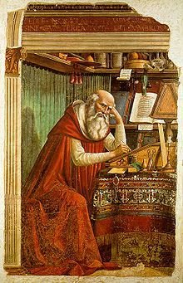
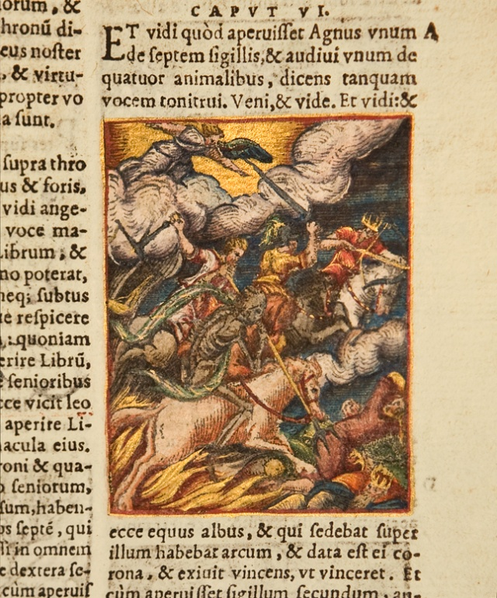
The second climax from late period of the Roman Empire to the early period of the Middle Age.
Translation object: the Bible（Religious）
Representative:
Jerome: translated the Bible into Latin;taking his "Edito
Vulgata" as the final version, marked that the translation of the "Bible" has achieved an important position to compete with the Secular Literature Translation.

Slide 8

Influence:
The Bible was translated into many languages.
The versions of Bible promoted the study of different nation's languages.

Slide 9
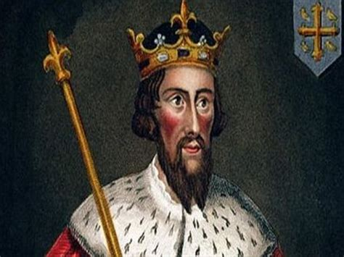
The third climax
11-12 century A.D. (the Middle Age)
Translation object: Arabic works
Representatives:
King Alfred: organized and participated in translating Latin works;

Slide 10

Toledo Translation Institute
Gathering in Toledo, a city of Spain, the western translators translated a great number of works from Arabic into Latin,which introduced the Arabic culture to other nations.

Slide 11

Influence
Toledo became the center of European academic researches.
The European languages had closer connections with each other.

Slide 12
The fourth climax translation in the Renaissance(14th-16th)
Brief introduction:
renaissance is a major development in the history of western
translation,especially in the sixteenth century and later period,the
translation activity reached an unprecedented height. Translation
deep into all areas of ideology,politics,philosophy,literature,religion,involving large major works of ancient and contemporary,resulting
in a large number of distingguished translators and a series of
excellent translations.

Slide 13
famous translators and their works
In France
In Germany
the writer Amyot(阿米欧)had
spent seventeen years to translate the Plutarch's Celebrity Compare
Greek and Roman Biography(简称《名人传》).
Chapman(查普曼) from 1598
to 1616 translated The Iliad《伊利亚特》and Odyssey.《奥德赛》
religious reformer Luther
obeyed the will of the people
using the language of the people,
in 1522-1534,the first printed and
published translation,“the people of the Bible”,creating a new era of modern German development.

Slide 14
In Britain:
Florio in 1603 the translation of Montaigne “Essays”(蒙田《散文集》), was the brilliant literary star in the English translation.And
in 1611,the print of “the King James translation of the Bible ”(《钦定圣经译本》)marks another major development in the British
translation history. With English-style authourity, population and
beauty, it won the reputation of “the greatest English translation”,widely known in Britain and had a profound effect on the
development of modern English.

Slide 15
Influence:
The renaissance played a very important role in the western
history of the development of translation,it marked the national
language status in the field of literature and translation having
finally been consolidated,simultaneously it showed the translation playing a huge role in the formation and development of the
national language,literature and thought.

Slide 16
The fifth climax from the second half of the 17th to century-the first half of the 20th centry.
Feature: After the Renaissance, a large number of translations
still appeared in the first half of 17C to 20C. The biggest feature
was that translators not only continued to translate classical
works, but also became interested in modern and contemporary
works.
The works of Cervantes, Shakespeare, Balzac, Goethe and other
great writers had been repeatedly translated into various
languages, and translations of Eastern literature have also been
published.

Slide 17
The sixth climax
Translation after the second world war
Distinctive Features in this time,from the scope to the scale,effect,and to the forms,are all different from any time in the past,having made tremendous progress:
  (1) the expansion of the scope of the translation,especially in technology and business area.
  (2)the scale has exceed the past.
  (3)it plays a more and more important role in the world communication of literature,art ,science,technology,politics and economy.

Slide 18
Besides,the form of translation has also been greatly changed and improved in three aspects:
(1)Establish higher translation education;
(2)set up translation organizations,like International Federation of Translations, Association of Interpreters and so on;
(3)break traditional translation methods, and develop machine
translation.

Slide 19
Thanks!

