Slide 1

别犯困！还剩最后一趴

Slide 2


PART 03
公主王子们
这是第三部分
Part3 Money-saving Tips

Slide 3

这个可厉害了，仔细听！

Slide 4

How do people save money in other countries?
UK
Due to soaring energy prices, many UK households are facing enormous bills, with some electricity, heating, and gas suppliers' costs increasing by more than three times. As a result, to reduce expenses, some Britons choose not to turn on their heating.

Slide 5

How do people save money in other countries?
Japan
Tokyo, Japan, is one of the cities with the highest housing prices in the world. Even tourists, when their wallets are not well-funded, have to spend some money to stay in a small room. For young people living in Japan, a lack of money forces them to rent cheaper houses that are considered to be haunted.

Slide 6
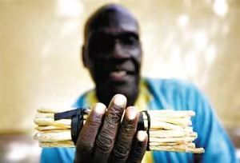
How do people save money in other countries?
Africa
In Africa, many people's day begins with a small stick or twig. They hold these slender branches in their mouths and chew on them continuously to clean their teeth. These branches, chopped from trees, serve as the locals' toothbrushes. Many locals claim that these "twig toothbrushes" are better than the expensive, beautifully packaged dental care products because they are natural, effective in protecting teeth, and affordable.

Slide 7
How do people save money in other countries?
Q1:What are the money-saving tips of Africans?
They use branches to brush their teeth instead of toothbrushes.
Q2:Which country's people choose to live in haunted houses to save money?
Japan

Slide 8

能认真听到这
你真是太棒了！
666
666
666

