Slide 1
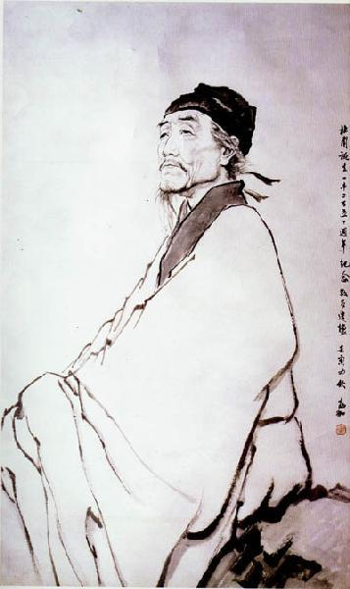
Du Fu
Poet Historian
By Brandon Heil

Slide 2
Biography
I lived from 712 to 770.
I have approximately 1,400 poems still in existence.
My courtesy name was "Zimei." A courtesy name is a name traditionally given by parents to twenty year old sons, to mark a coming of age. These names were sometimes given to women upon marriage.
I came from a family of successful writers; my grandfather, Du Shenyan was a noted poet. My ancestor Du Yu (222-284) was a Confucian scholar who compiled an authoritative commentary on the Zuozhuan.
I spent a large part of my youth traveling. From about 731 to 735 I wandered the area of Jiangsu and Zhejijang, near the coast, East of Chang'an. I traveled after I failed to pass the civil service exam in 735, and in 741, I returned to my home in Luoyang.
In Luoyang my friendship with Li Bai began.
In 740, my father died; I had the opportunity to take his position in the government, but instead allowed my half brother to have the position.

Slide 3
Biography
I traveled to Chang'an in 746 and in 747, I took a special exam given by Emperor Xuanzong, but I failed along with every other candidate. Some suspected chief minister Li Linfu of tampering with the results.
In 750, my son Zongwen was born. In 753, my second son, Zongwu, was born.
In 755, the An Lushan Rebellion began. My old home of Luoyang fell to the rebels. My family and I fled the capital, northward. The Emperor fled Chang'an and abdicated. As I tried to reach the court of the new Emperor, Suzong, in Fengxiang, I was captured and held captive in Chang'an in 756.
After four months, I escaped. I managed to reach the new court and was appointed "Reminder" to the Emperor. In autumn of 757, I had angered the Emperor and was ordered to return to Qiang, the village my family was staying at.
From about 760 to 770, the year of my death, I traveled constantly, often returning to a home in Chengdu.

Slide 4
Poems of my captivity
Moonlight Night
From her room in Fuzhou tonight,
all alone she watches the moon.
Far away, I grieve that her children
can't understand why she thinks of Chang'an.
Fragrant mist in her cloud hair damp,
clear lucence on her jade arms cold--
when will we lean by chamber curtains and let it light the two of us, our tear stains dried?

Slide 5
Poem of Qiang Village
I wrote many poems about my return home after my captivity in Chang'an.
This poem was written about being reunited with my family after several months.
Qiang Village
Red clouds, their towering shapes move westward;
sun's rays streak down to the level plain.
Bramble gate, sparrows and little birds chattering--
the traveler home from his thousand-mile trek.
My wife, amazed to see me alive,
recovers from her astonishment, wipes away tears.
A world in chaos, buffeted, tumbled,
by sheerest chance I've managed to make it back.
Faces of my neighbors crowd the wall;
pitying, they add their sighs and exclamations.
As night deepens, we bring out candles,
face one another as though in a dream.

Slide 6
Style
After my life, others considered my strength in my understanding forms and my ability to work in all types of poetry. Much of this is lost in translation, unfortunately.
What can be seen in translation is my focus on different subjects. I've written poems from the tragedy of the rebellion, to the company of good friends.
My title, given after I died, was "the poet historian" because my poems revealed so much about the world I lived in, my own life and others.
While others wrote about their personal feelings, I'm often remembered because of the extent to which I revealed the details of my life.

Slide 7
Historical poems
On the Border (Poem two of nine)
With heavy hearts we leave the old village,
set out on the long, long road to Jiaohe.
Officials have fixed the date for our arrival--
run away and you're snared in the net of the law!
Ruler, already with such abundance of territory,
why all this opening up of borders?
We turn our backs on love of father and mother,
swallow our sobs, shoulder halberds, and move on.
I've written many poems through a persona. My more famous ones are of peasants conscripted to the war efforts.

Slide 8
Poems of friendship
Accompanying Mr. Zheng of the Broad Learning Academy on an Outing to General He's Mountain Villa
Beside the bed, books piled to the ceiling;
in front of the steps, trees that brush the clouds:
the General has no taste for military matters;
his young sons are all skilled in literature.
Sobering up from wine, we let in the gentle breeze,
listen to poems, pass the quiet night.
Thin summer cloaks are draped on the vines
where cool moonlight, white, shimmers over them.

Slide 9
A personal favorite
New Moon
Frail rays of the crescent newly risen,
slanting beams only a fraction of the full circle,
barely lifted above the old fort,
already hidden in slivers of evening cloud.
Stars of the River of Heaven keep their hue unchanged,
barrier mountains, untouched, cold as before.
In the courtyard white dew forms,
moisture imperceptibly drenching the
chrysanthemums.

Slide 10
Sources
The Selected Poems of Du Fu. Trans. Burton Watson. New York: Columbia University Press, 2002. Print.
The Cambridge History of Chinese Literature. Ed. Chang, Kang-I Sun and Owen, Stephen. Cambridge: Cambridge University Press, 2010. Print.

