Slide 1
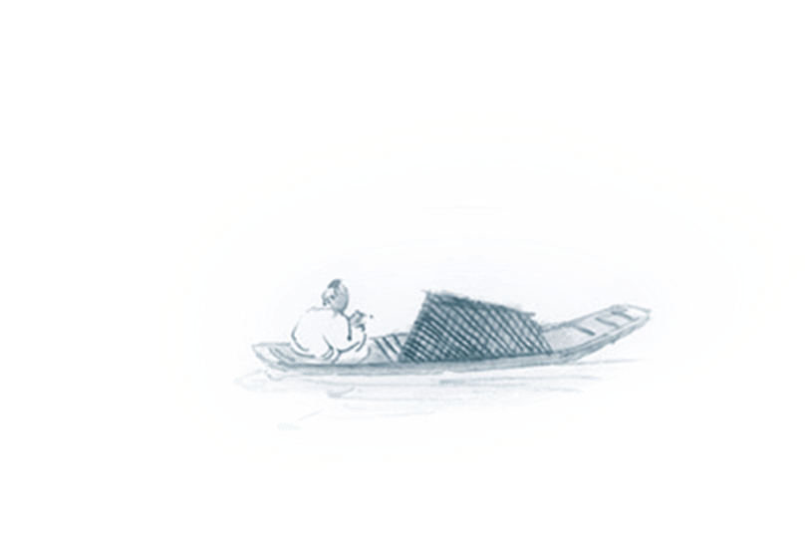

Chinese Modern Literature
Presenter: Lan Qi

Slide 2
人人皆笑我 人人皆为我
Every fool makes fool of himself
Video link:
https://www.bilibili.com/video/BV1y64y1D7uA?spm_id_from=333.337.search-card.all.click

Slide 3
Reasons for the emergence of the Chinese modern literature era
2. The natural result of the evolution of Chinese literature
1. To save the country and the people

Slide 4
New Culture Movement（新文化运动）: 1915
The movement promoted:
Vernacular literature
An end to the patriarchal family in favor of individual freedom and women's liberation
The view that China is a nation among nations, not a uniquely Confucian culture
The re-examination of Confucian texts and ancient classics using modern textual and critical methods, known as the Doubting Antiquity School
Democratic and egalitarian values
An orientation to the future rather than the past

Slide 5

壹
1917-1927
印

Slide 6
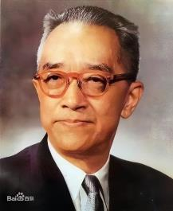

Beginning Sign :
the publishment of A Preliminary Discussion of Literature Reform
《文学改良刍议》
Eight guidelines (八不主义) :
Hu Shi
胡适
Write with substance.
Do not imitate the ancients.
Respect grammar.
Reject melancholy.
Eliminate old clichés.
Do not use allusions.
Do not use couplets or parallelism.
Do not avoid popular expressions or popular forms of characters.
一曰：须言之有物；
二曰：不摹仿古人；
三曰：须讲求文法；
四曰：不做无病之呻吟；
五曰：务去烂调套语；
六曰：不用典；
七曰：不讲对仗；
八曰：不避俗字俗语。

Slide 7

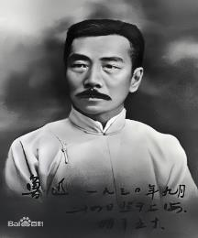
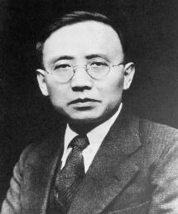
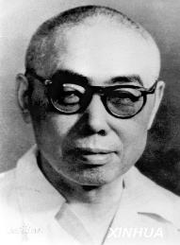

Representatives & Their Works
Lu Xun 鲁迅
Guo Moruo 郭沫若
Tian Han 田汉
Short Stories：
Outcry 《呐喊》
Hesitation 《彷徨》
Anthology of poems:
The Goddesses 《女神》
Plays:
Plum Rains 《梅雨》
A Night in the Coffee Shop
《咖啡店之一夜》

Slide 8
贰
1927-1937
印

Slide 9

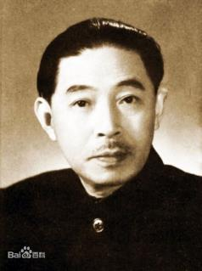
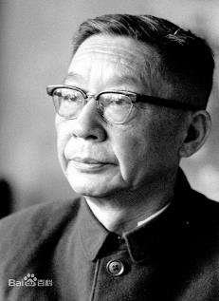
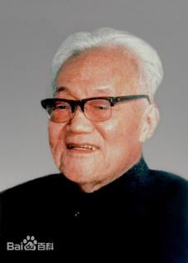
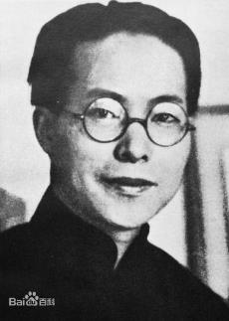
A new form of literature : literary criticism
Mao Dun 茅盾
Lao She 老舍
Ba Jin 巴金
Shen Congwen 沈从文
The "Love" Trilogy
《爱情的三部曲》
The "Torrents" Trilogy
《激流三部曲》
Border Town 《边城》
Rickshaw Boy 《骆驼祥子》
Midnight《子夜》

Slide 10

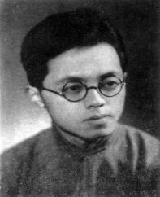
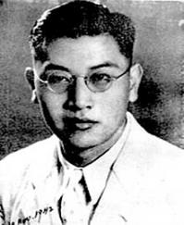
New Poem Schools:
Symbolist poetry
断章
Fragment
作者 卞之琳 ‖ 译者 杨宪益、戴乃迭
你站在桥上看风景，
When you watch the scenery from the bridge,
看风景人在楼上看你。
The sightseer watches you from the balcony.
明月装饰了你的窗子，
The bright moon adorns your window,
你装饰了别人的梦。
While you adorn another's dream.
Bian Zhilin
卞之琳
Dai Wangshu
戴望舒
The Rain Lane 《雨巷》

Slide 11
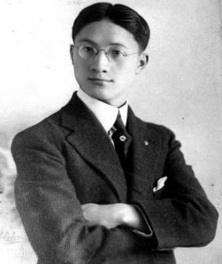
The Crescent School:
Taking Leave of Cambridge Again Softly I am leaving, Just as softly as I came; I softly wave goodbye To the clouds in the western sky. The golden willows by the riverside Are young brides in the setting sun; Their glittering reflections on the shimmering river Keep undulating in my heart. The green tape grass rooted in the soft mud Sways leisurely in the water; I am willing to be such a waterweed In the gentle flow of the River Cam. That pool in the shade of elm trees Holds not clear spring water, but a rainbow Crumpled in the midst of duckweeds, Where rainbow-like dreams settle.
再别康桥
轻轻的我走了， 正如我轻轻的来； 我轻轻的招手， 作别西天的云彩。 那河畔的金柳， 是夕阳中的新娘； 波光里的艳影， 在我的心头荡漾。 软泥上的青荇， 油油的在水底招摇； 在康河的柔波里， 我甘心做一条水草！ 那榆荫下的一潭， 不是清泉， 是天上虹； 揉碎在浮藻间， 沉淀着彩虹似的梦。
Xu Zhimo 徐志摩

Slide 12
寻梦？撑一支长篙， 向青草更青处漫溯； 满载一船星辉， 在星辉斑斓里放歌。 但我不能放歌， 悄悄是别离的笙箫； 夏虫也为我沉默， 沉默是今晚的康桥！ 悄悄的我走了， 正如我悄悄的来； 我挥一挥衣袖， 不带走一片云彩。
To seek a dream? Go punting with a long pole, Upstream to where green grass is greener, With the punt laden with starlight, And sing out loud in its radiance. Yet now I cannot sing out loud, Peace is my farewell music; Even crickets are now silent for me, For Cambridge this evening is silent. Quietly I am leaving, Just as quietly as I came; Gently waving my sleeve, I am not taking away a single cloud.

Slide 13
叁
1937-1949
印

Slide 14

In 1937: the Marco Polo Bridge Incident 七七事变/卢沟桥事变
Themes: heroism & patriotism
Reality-based
exposing and satirizing the dark forces of society
Ep. Qian Zhongshu: Fortress Besieged
Contents:
turning to history to learn from it
Ep. Guo Moruo: Qu Yuan
Lao She: The Yellow Storm
(Four Generations Under One Roof)
History-centered
Self-describing
describing the sufferings of patriotic intellectuals in the broad context of the war against Japan
Ep. Ai Qing: Torch

Slide 15

To remember history is not to remember hatred, but to remind us of our lessons

Slide 16
Thank you for watching!
Presenter: Lan Qi

