Slide 1
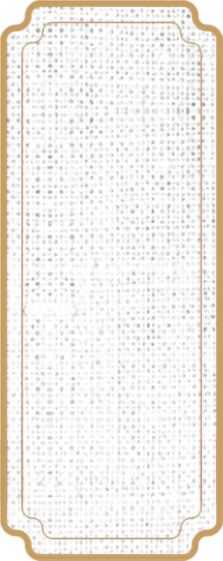

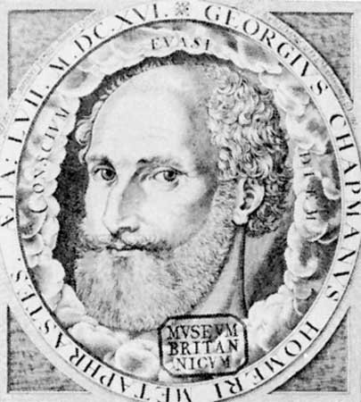
1
Various Translation Thoughts
Various Translation Thoughts
Georga Chapman, English poet and dramatist, whose translation of Homer long remained the standard English version, paid special attention to the stylistic and metrical unity of poetry in his translations of Homer's epics, he translated the Iliad with sonnets and the Odyssey in heroic couplets.
Chapman thought that the translation of any work, especially Homer's works, should make use of the most suitable lexicon, style and form to express and decorate the translation.

Slide 2
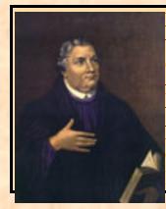
2
Various Translation Thoughts
Various Translation Thoughts
Martin Luther, a Christian theologian and Augustinian monk whose teachings inspired the Protestant Reformation and deeply influenced the doctrines of Protestant and other Christian traditions, believed that translation must focus on the connection between grammar and meaning. Luther believed that translators should not "go against grammar". He emphasized the reducibility of languages and the grammatical differences between different languages.

Slide 3


3
Modern Translation
This period of translation have made great progress from many aspects such as its scope, scale, influence and form.
Representative: Schleiermacher, John Dryden, Tytle etc.

Slide 4
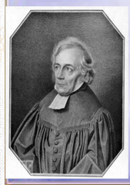
4
Friedrich Ernst Schleiermacher was himself a masterful translator, and his views on translation carry a certain authority. He explains his theory of translation mainly in the brilliant essay On the Different Methods of Translation (1813).

Slide 5
Schleiermacher's main points:
5
Translation typically faces the problem of a conceptual gulf between the language of the text to be translated and the translator's home lanuage.
Translation is justified.
“Either the translator leaves the author in peace, as much as possible, and moves the reader towards him; or he leaves the reader in peace, as much as possible, and moves the author towards him.”

Slide 6
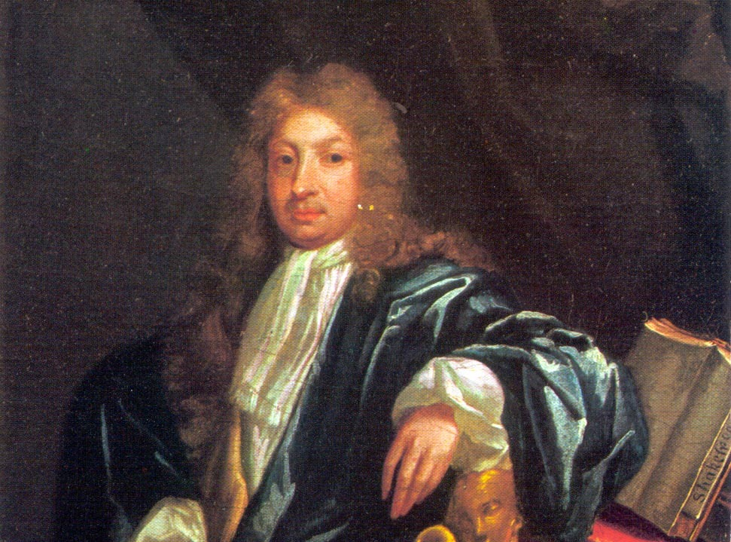
6
John Dryden, English poet, dramatist, and literary critic who so dominated the literary scene of his day that it came to be known as the Age of Dryden.
As a poet himself, he believed that to be a good translator, one must first be an excellent poet, especially in style, the translator and the original author must be similar.
John Dryden

Slide 7
7
Dryden divides poetry translation into three categories:
The so-called metaphrase is to translate word by word according to the corresponding relationship of words.He thought it was almost impossible to translate well in this way .Dryden believes that translators in imitation enjoy great freedom to choose words and sentences regardless of the language of the original text, or to modify the original text according to their own preferences.He disapproved of imitation, which, in his view, was a creation rather than a translation.Dryden thinks that metaphrase and imitation are two extremes of translation and should be avoided.
metaphrase
paraphrase
imitation
John Dryden

Slide 8
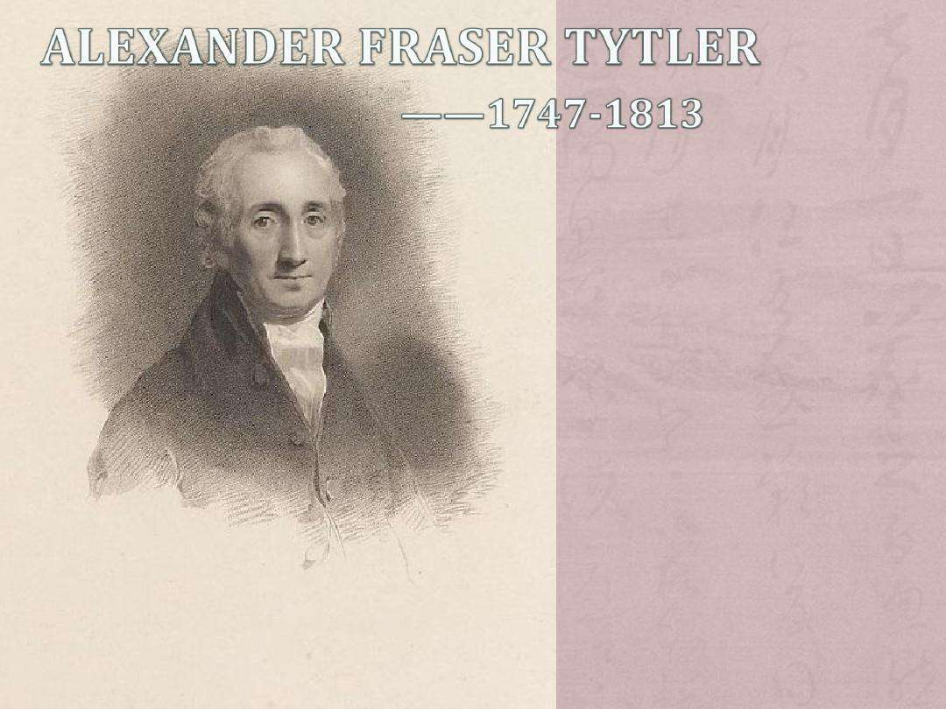
Alexander Fraser Tytler was a Scottish-born British lawyer and writer.
About translation, Tytler wrote a treatise that is important in the history of translation theory, the "Essay on the Principles of Translation".
8

Slide 9
Tytler’s principles on Translation
The translation should give a complete transcript of the ideas of the original work
The style and manner of writing should be of the same character with that of the original
The translation should have all the ease of the original composition
The importance of the three aspects is decreasing step by step
9

Slide 10
Thank you for listening~

