Slide 1
Ray Bradbury & Farenheit 451

Slide 2
Index
Ray Bradbury
Background
Legacy
Fahrenheit 451
Characters
Plot
Themes
Historical Background

Slide 3
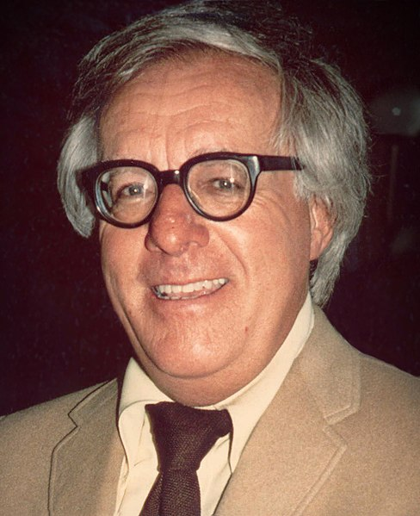
Ray Bradbury
8/22/1920 – 6/5/2012
Born: Illinois, U.S.
Writer,
Fantasy, Science Fiction, Horror, Mystery Fiction
Notable Works：Farenheit 451, The Martian Chronicles, The Illustrated Man

Slide 4

Farenheit 451

Slide 5
Characters
Guy Montag
Mildred Montag
Captain Beatty
Professor Faber

Slide 6
Plot
A Futuristic Dystopian American City where firemen start fires instead of stopping them
Guy Montag and his meeting with his neighbor Clarisse McClellan
Montag finds his wife overdosed
Montag’s change and reading
Discovery by Captain Beatty
Montag’s meeting with Faber and seeing the light
Montag killing Captain Beatty, fleeing the city and meeting other book readers

Slide 7
Theme
Censorship
Knowledge VS Ignorance
Technology
Dissatisfaction

Slide 8
Historical Background
The Pedestrian
Bright Pheonix
Censorship and banning
McCarthyism

Slide 9


Slide 10
“Radio has contributed to our ‘growing lack of attention.’ […] This sort of hopscotching existence makes it almost impossible for people, myself included, to sit down and get into a novel again. We have become a short story reading people, or, worse than that, a QUICK reading people.”
In writing the short novel Fahrenheit 451, I thought I was describing a world that might evolve in four or five decades. But only a few weeks ago, in Beverly Hills one night, a husband and wife passed me, walking their dog. I stood staring after them, absolutely stunned. The woman held in one hand a small cigarette-package-sized radio, its antenna quivering. From this sprang tiny copper wires which ended in a dainty cone plugged into her right ear. There she was, oblivious to man and dog, listening to far winds and whispers and soap-opera cries, sleep-walking, helped up and down curbs by a husband who might just as well not have been there. This was not fiction.

Slide 11


Slide 12
https://www.biography.com/people/ray-bradbury-9223240
https://en.wikipedia.org/wiki/Fahrenheit_451
https://www.shmoop.com/fahrenheit-451

Slide 13
Thank You!

