Slide 1
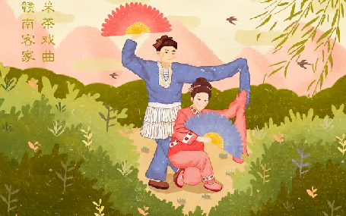
Tea-picking Opera
Empty Mountain Osmanthus Flower
空
山
桂
雨
Empty Mountain Osmanthus Flower
采茶戏

Slide 2
空
CONTENTS
山
桂
雨
Introduction to Tea-picking Opera
壹
The Origin of
Tea-picking Opera
贰
Empty Mountain Osmanthus Flower
The Development
of Tea-picking Opera
叁
Gannan
Tea-picking Opera
肆

Slide 3
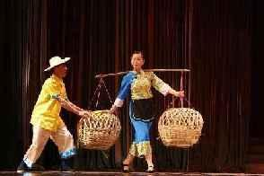
Introduction to Tea-picking Opera
It is produced in the Ming and Qing Dynasties, and has more than 400 years of history of a wide variety of distinctive features. On May 20, 2006, tea-picking opera was approved by the State Council and included in the first batch of the National Intangible Cultural Heritage Lists.
Tea-Picking Opera, is a traditional Chinese folk opera originating from southern China, particularly in Jiangxi, Hunan, and Fujian provinces. It developed in rural tea-picking regions, where the daily activities of tea farmers are a central theme. The performances often depict the lives, work, and emotions of tea pickers, blending humor and local customs.
空
山
桂
雨

Slide 4
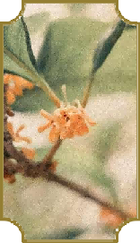
ACTIVITY BACKGROUND
Introduction
to
Tea-picking
Opera
空
山
桂
雨
Tea-picking opera in the provinces take local names to distinguish according to the regions, such as Guangdong's "Guangdong North Teapicking Drama", Hubei's "Yangxin Tea-picking Drama, " "Yellow Mei Tea Opera, " "YuChun Tea-picking Opera" and so on.

Slide 5
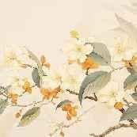
The production of tea-picking opera is related to the abundance of tea. According to historical records in the Ming Dynasty, in the tea area in the South of Fujian Province, east, south and north of Jiangxi Province, working women went up the mountain, picked tea while singing mountain songs to encourage labor enthusiasm.
The Origin of
Tea-picking Opera
ACTIVITY CONTENT
桂花留晚色 帘影淡秋光

Slide 6
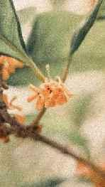
ACTIVITY CONTENT
The Origin of
Tea-picking Opera
In special festival or time in rural areas such as at the time of widespread tea tress in March and harvesting, people sing in the tea forest with the joy of harvesting. Mountain songs and ditties sang by them are in vivid form and rich contents expressing the joy of labor and love between men and women.

Slide 7
ACTIVITY CONTENT
The Origin of
Tea-picking Opera
This kind of mountain songs circulating in the tea area are
known as "tea-picking songs. " Tea-picking opera developed from the folk tea-picking songs and tea-picking lamp singing, and then become a kind of folk drama with characters and storyline. Because it is generally only two female roles and one clown, or a painted role, a female role, and a clown three persons’ performance, it is also known as “Three characters’ troupe. ”

Slide 8
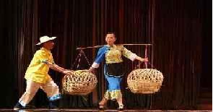

Tea-picking opera has experienced a tortuous process of development.
PROCESS DETAILS
In the Ming Dynasty
Before the founding of the People's Republic of China
Tea farmers in the Jiulong Mountain Tea District of Anyuan County, Jiangxi Province, which is rich in famous tea, often performed impromptu programs related to tea picking in the form of teapicking lantern opera in order to receive tea merchants from Guangdong. This kind of performance is already the prototype of tea-picking opera.
the performance of tea-picking opera was often interfered and banned by the rulers. The first reason was that there were few literati involved in tea picking, and the cultural level of the artists was not high, so the rulers thought these plays were very vulgar and difficult to be elegant. Secondly, in order to cater to the audience, the actors added some unhealthy contents during the performance. Some plays appear to be very vulgar and indecent, and
even disturb social order.

Slide 9
Tea-picking opera has experienced a tortuous process of development.
PROCESS DETAILS
In the middle Guangxu (光绪) period of the Qing Dynasty (about 1891)
After the foundation of the People's Republic of China
some Qi opera artists and half-troupe performers could independently perform high-tone and disordered-tone repertoire. The original plays of Qi opera and half-troupe repertoire coexisted on the half-troupe stage, so they were called Half Mix Opera. Around 10 years in the Republic of China, Half Mix Opera disintegrated, caused the reproduction of “seven tight eight loose nine free and unrestrained” half-troupe. They performed in the mountains until the eve of liberation.
professional opera troupes were established. They not only excavated, arranged and made excellent traditional repertoire, but also created a number of new repertoires, such as One Heart, Send Straw Shoes, New Neighbors and the adaptation of Legend of Luang Knife.

Slide 10
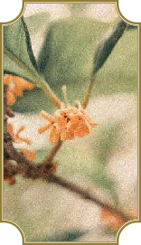
Gannan
Tea-picking Opera
ACTIVITY BUDGET
Gannan Tea- Picking Opera is an important school of Tea picking Opera, mainly popular in southern Jiangxi, that is,Ganzhou. In the tea-picking opera groups, the characteristics of tea picking in southern Jiangxi are reflected in the following aspects:
1.
空
山
桂
雨
First, it belongs to the Hakka ethnic group. The dialect of the South Jiangxi is Hakka, so the traditional repertoire of Gannan Tea-peaking Opera is basically performed in Hakka.

Slide 11
Gannan
Tea-picking Opera
ACTIVITY BUDGET
Second, tea picking in southern Jiangxi originated early and had an impact on the early development of various tea picking operas. Its origin can be traced back to the late Ming and early Qing dynasties. In the first year of Qianlong's reign, Yu Zhaoyue, governor of Jiangxi Province, mentioned in a note that “the custom of pretending to be a sex play is forbidden”. Drama experts believe that the “sex play” here is the tea-picking opera in southern Jiangxi Province, so it is speculated that its birth date should be earlier than this.
2
空
山
桂
雨
Thirdly, in terms of artistic form, the traditional repertory of tea-picking opera in southern Jiangxi still retains the form of “three small operas”. And many other types of tea-picking opera have a trend of development to the big drama.
3

Slide 12
Current Situation
Tea-Picking Opera, as a form of regional Chinese opera, has a rich cultural history, but it faces certain challenges and opportunities in contemporary society:
1. Decreasing Audience Base
2. Operational Difficulties for Performance Troupes
3. Challenges in Heritage Transmission
4. Government Support and Protection

Slide 13
Tea-picking Opera
Empty Mountain Osmanthus Flower
Thankyou
空
山
桂
雨
Empty Mountain Osmanthus Flower

