Slide 1
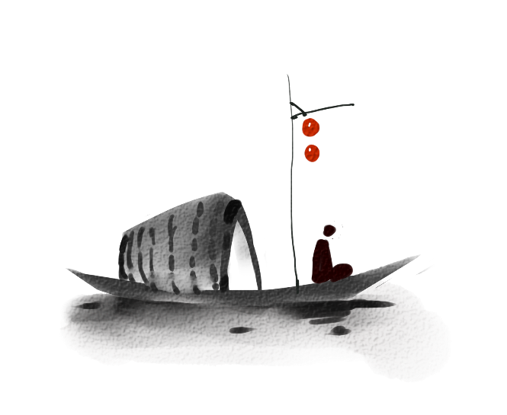
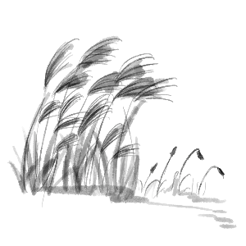
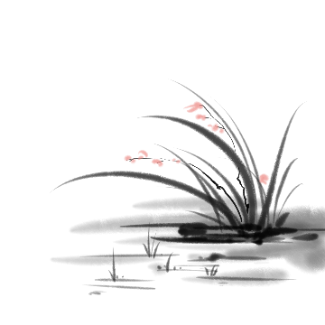
古人篆刻思离群
舒卷浑同岭上云
The craft of Seal-cutting
Presenter: Wang Zhiling

Slide 2

君看一叶舟
第一章
Introduction
出没风波里

Slide 3
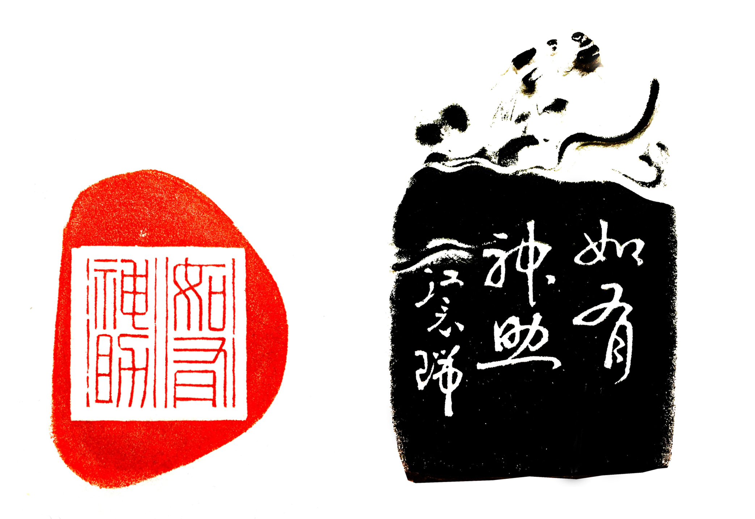

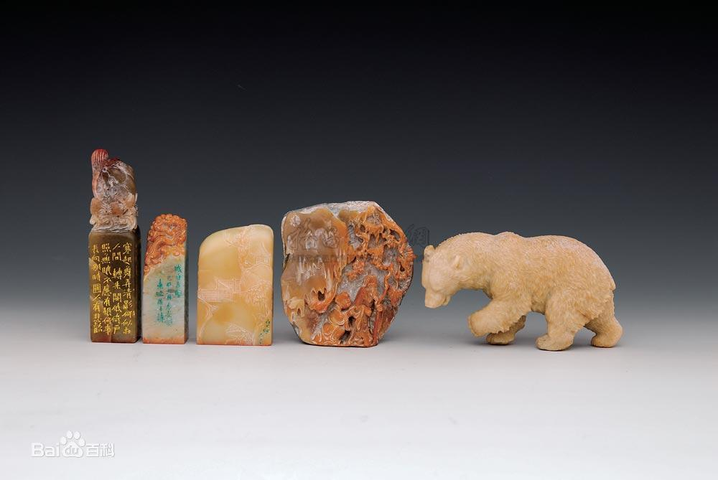
君看一叶舟
What is seal-cutting?
1.Seal-cutting is a unique art form in China that has a history of more than 3,700 years.
2.It tactfully combines calligraphy with engraving.
3.In 2009, it was listed in the "Representative List of Intangible Cultural Heritage" by UNESCO.
4.Seal-cutting（篆刻） VS Seal（印章）
出没风波里

Slide 4
君看一叶舟
Why is it called seal-cutting?（篆刻）
出没风波里
It is named seal-cutting because seal script（篆书）, a style of Chinese characters is mostly used in acient times to make seals.

Slide 5
君看一叶舟
第二章
History
出没风波里

Slide 6
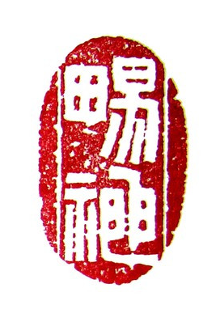
君看一叶舟
History
Origin:Shang Dynasty(1600BC-1100BC)
Period of Spring and Autumn and Warring States(770BC-221BC)
Flourishing Period:Qin and Han Dynasties(221BC-220CE)
Song and Yuan Dynasties(960-1368CE)
出没风波里

Slide 7
君看一叶舟
Origin:Shang Dynasty
Seal-cutting dates back about 3, 700 years to the Shang Dynasty and originated from the cutting of oracle inscriptions on tortoise shells.
At that time, commodity exchange was increasingly frequent, and a credit certificate was needed to ensure the safe transfer and storage of goods. Hence, seals emerged.
出没风波里

Slide 8
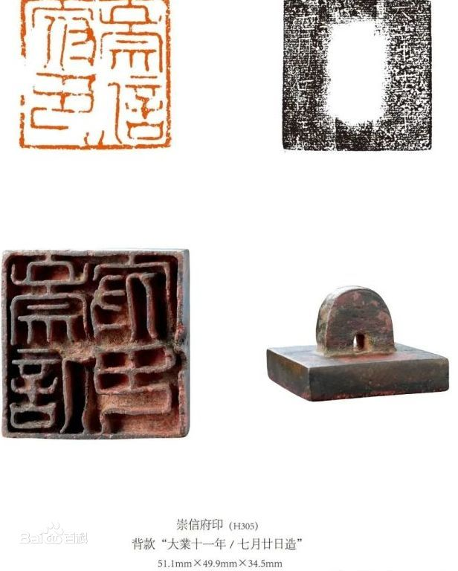
君看一叶舟
Period of Spring and Autumn and Warring States
During the period, seals were gradually used widely.
For example, seals were used to engrave the name of the handicraftsman on artifacts.
出没风波里

Slide 9
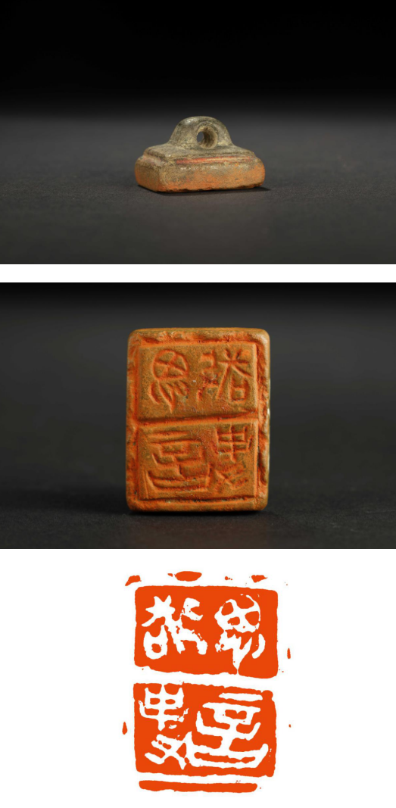
君看一叶舟
Interpretation: thinking, speaking and respecting things.（思言敬事）
Material: copper
Specification: 26 × twenty × 18（mm）
出没风波里

Slide 10
Flourishing Period: Qin and Han Dynasties
君看一叶舟
1.There is a great difference between “xi” and “yin”.
Seals in earlier dynasties were called “xi”（玺）.Since the First Emperor of Qin unified China, it has been stipulated that“xi”is only called by the emperor, and seals used by others can only be called yin(印).
2.People engraved their names on utensils and documents of bamboo and wood to show ownership or authorship.
出没风波里

Slide 11
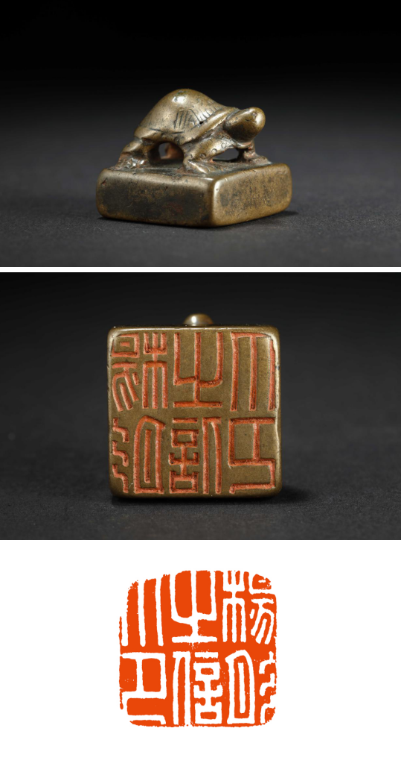
Interpretation: Seal of Yang Tongzhi(杨彤之信印)
Material: copper
Specification: 23 × 23（mm）
君看一叶舟
出没风波里

Slide 12
君看一叶舟
Song and Yuan Dynasties
The generation and use of seals have a long history, but the appreciation of seals as a kind of artwork began in the Song and Yuan Dynasties.
The seals before the Song and Yuan Dynasties are called the era of practical seals（实用印章时代）; Since the Ming and Qing Dynasties, seal art schools have multiplied, which is called the era of school seal cutting.（流派篆刻时代）
出没风波里

Slide 13
君看一叶舟
第三章
Three Techniques of seal-cutting
出没风波里

Slide 14
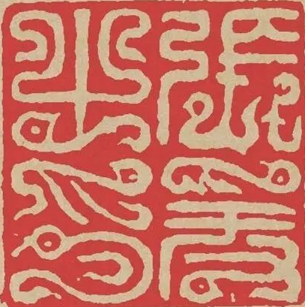

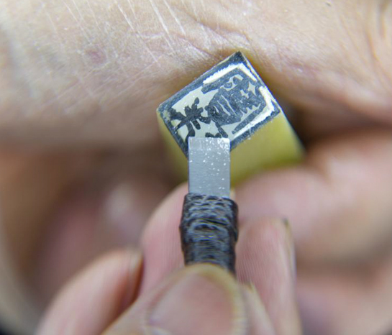
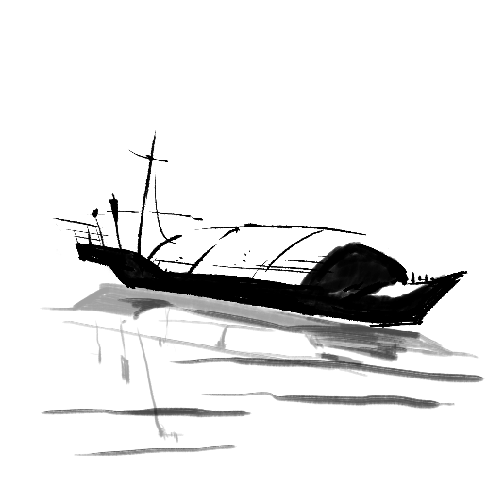
君看一叶舟
Three Techniques
出没风波里
calligraphy
composition
knife technique
（engraver’s handiwork）

Slide 15
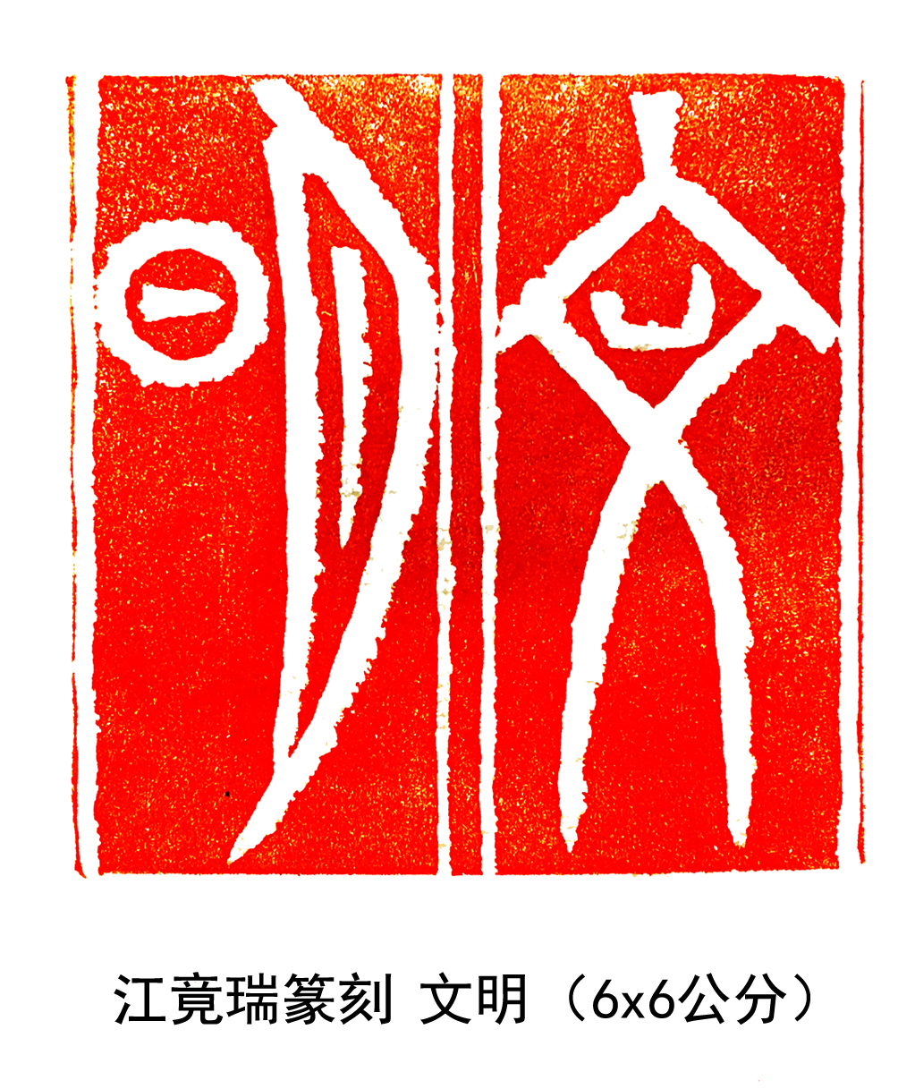
君看一叶舟
Calligraphy
Traditionally, seal script was mainly used for seal-cutting.
In modern times, official script, cursive script and regular script were also used for seal-cutting.
The artist should be good at writing various styles of the Chinese script, especially seal script.
出没风波里

Slide 16

Composition
君看一叶舟
Composition refers to the overall layout of different shapes and sizes of printed surfaces combined with different seals.
  Seals express their artistic charm with a few words in a very samll range. Therefore, the characters are required to be varied and their layout should be colorful and artistic.
出没风波里
The enngraver should know how to arrange within a small space a number of characters - some with many strokes and others with very few - to achieve a graceful effect.

Slide 17
君看一叶舟
Knife Technique
Seal-cutting must be completed with proper knife method.If the engraver is not familiar with using a knife, he or she can't carve a successful work.
The engraver should pays attention to the stability and the clarity of the knife. It not only requires the integration of seal cutting and composition, but also seeks subtle changes in the details.
出没风波里

Slide 18
Refeferences
江上渔者
【1】曹锦炎.古玺通论.杭州：浙江大学出版社，2017
【2】黄惇.中国古代印论史.上海：上海书画出版社，1994
【3】韩天衡.历代印学论文选.杭州：西冷印社出版社，1999
【4】沙孟海. 印学史. 杭州：西冷印社出版社，1999
【5】孙慰祖.中国玺印篆刻通史.上海：东方出版中心，2016
【6】吴颐人.篆刻五十讲.上海：上海书店出版社，2000
【7】The art of Seal cutting[EB/OL].https://en.gmw.cn/2022-04/26/content_35763947.htm,2022-04-26.

Slide 19
君看一叶舟
出没风波里
Thank You
Chinese style

