Slide 1
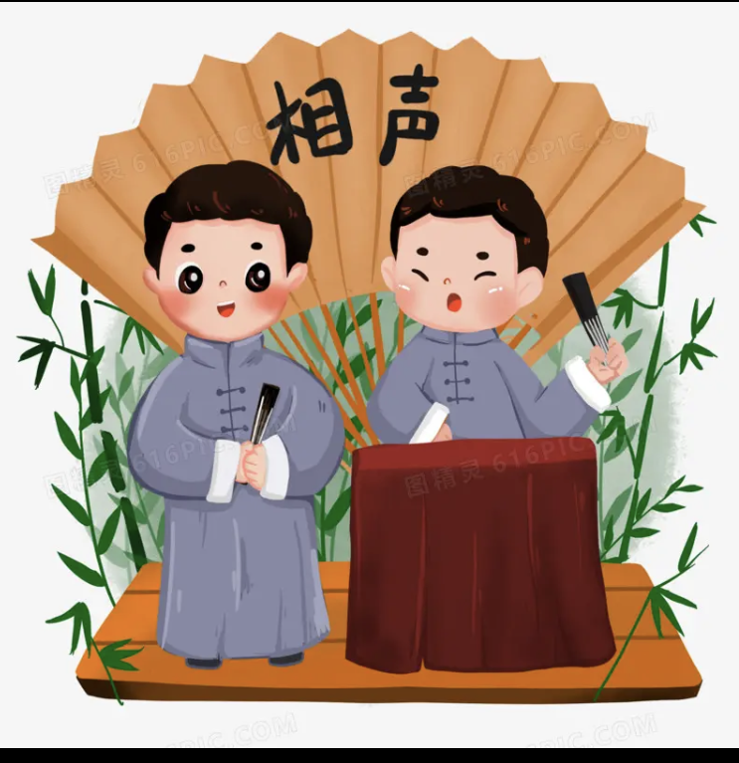
HNNU
Crosstalk(相声）
Wang Lu
from English Interpretation

Slide 2
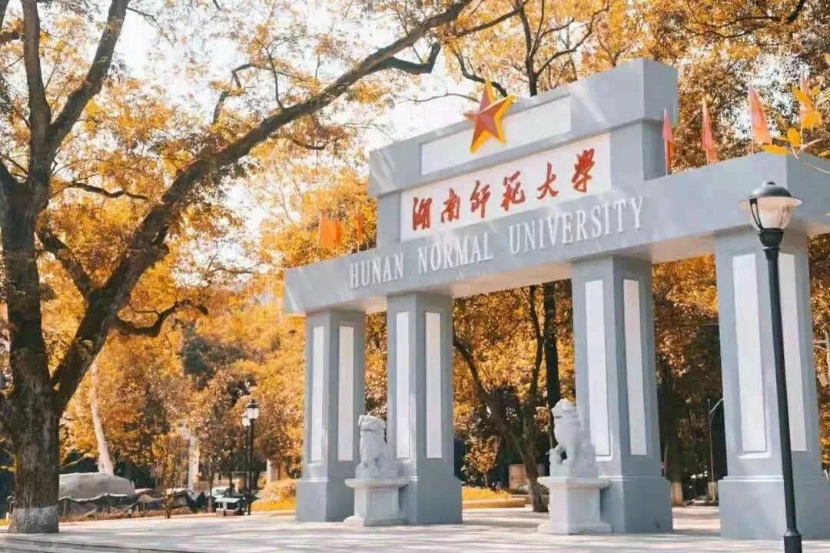
CONTENTS
Crosstalk
01.
The Development of Crosstalk
02.
Four Basic Skills in Crosstalk
03.
Characteristics of Crosstalk
04.
Famous Artists of Crosstalk

Slide 3
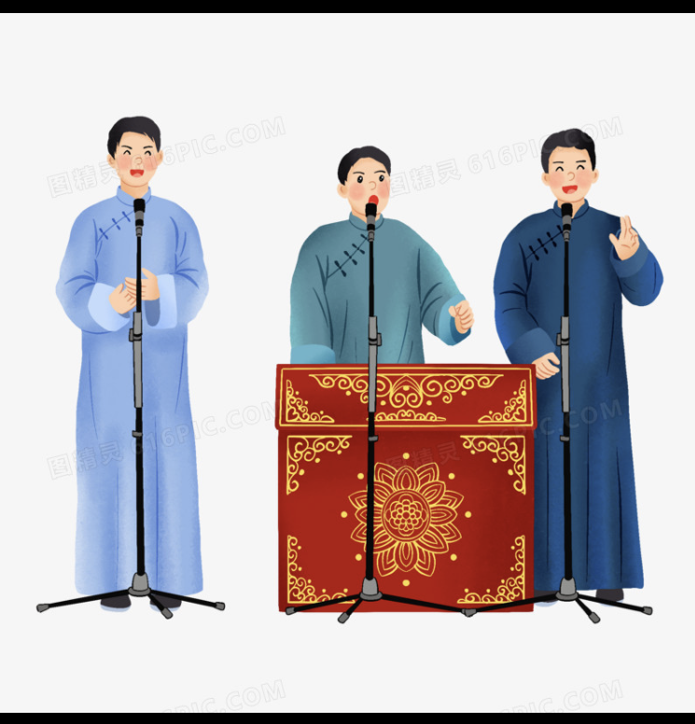
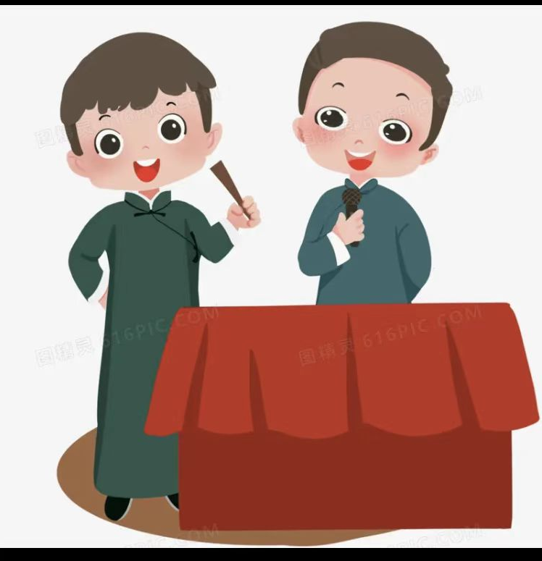
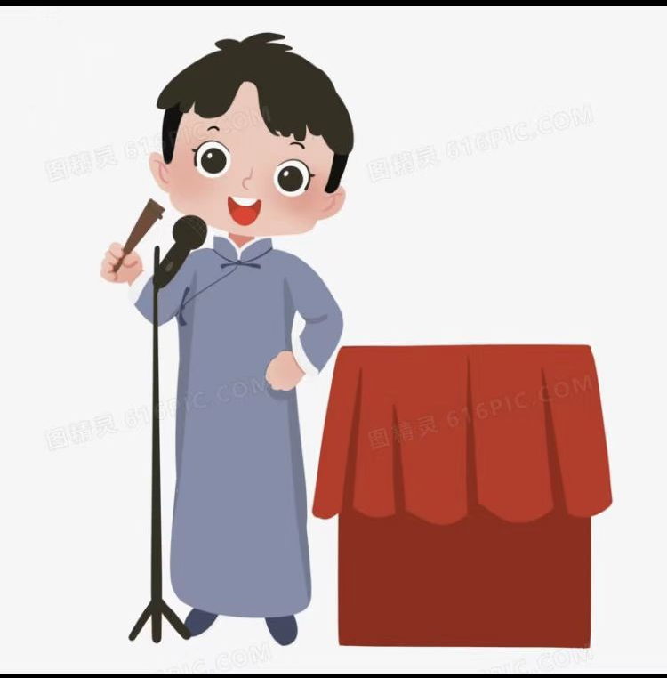
PART ONE
The Development
- Intgration of folk opera in North China, imitating oral skills and other folk art forms
- one-person ventriloquism(口技） to one person stand-up talk, and the name changed to crosstalk
- stand-up crosstalk, dual crosstalk, and group crosstalk.
- veritable form of art

Slide 4
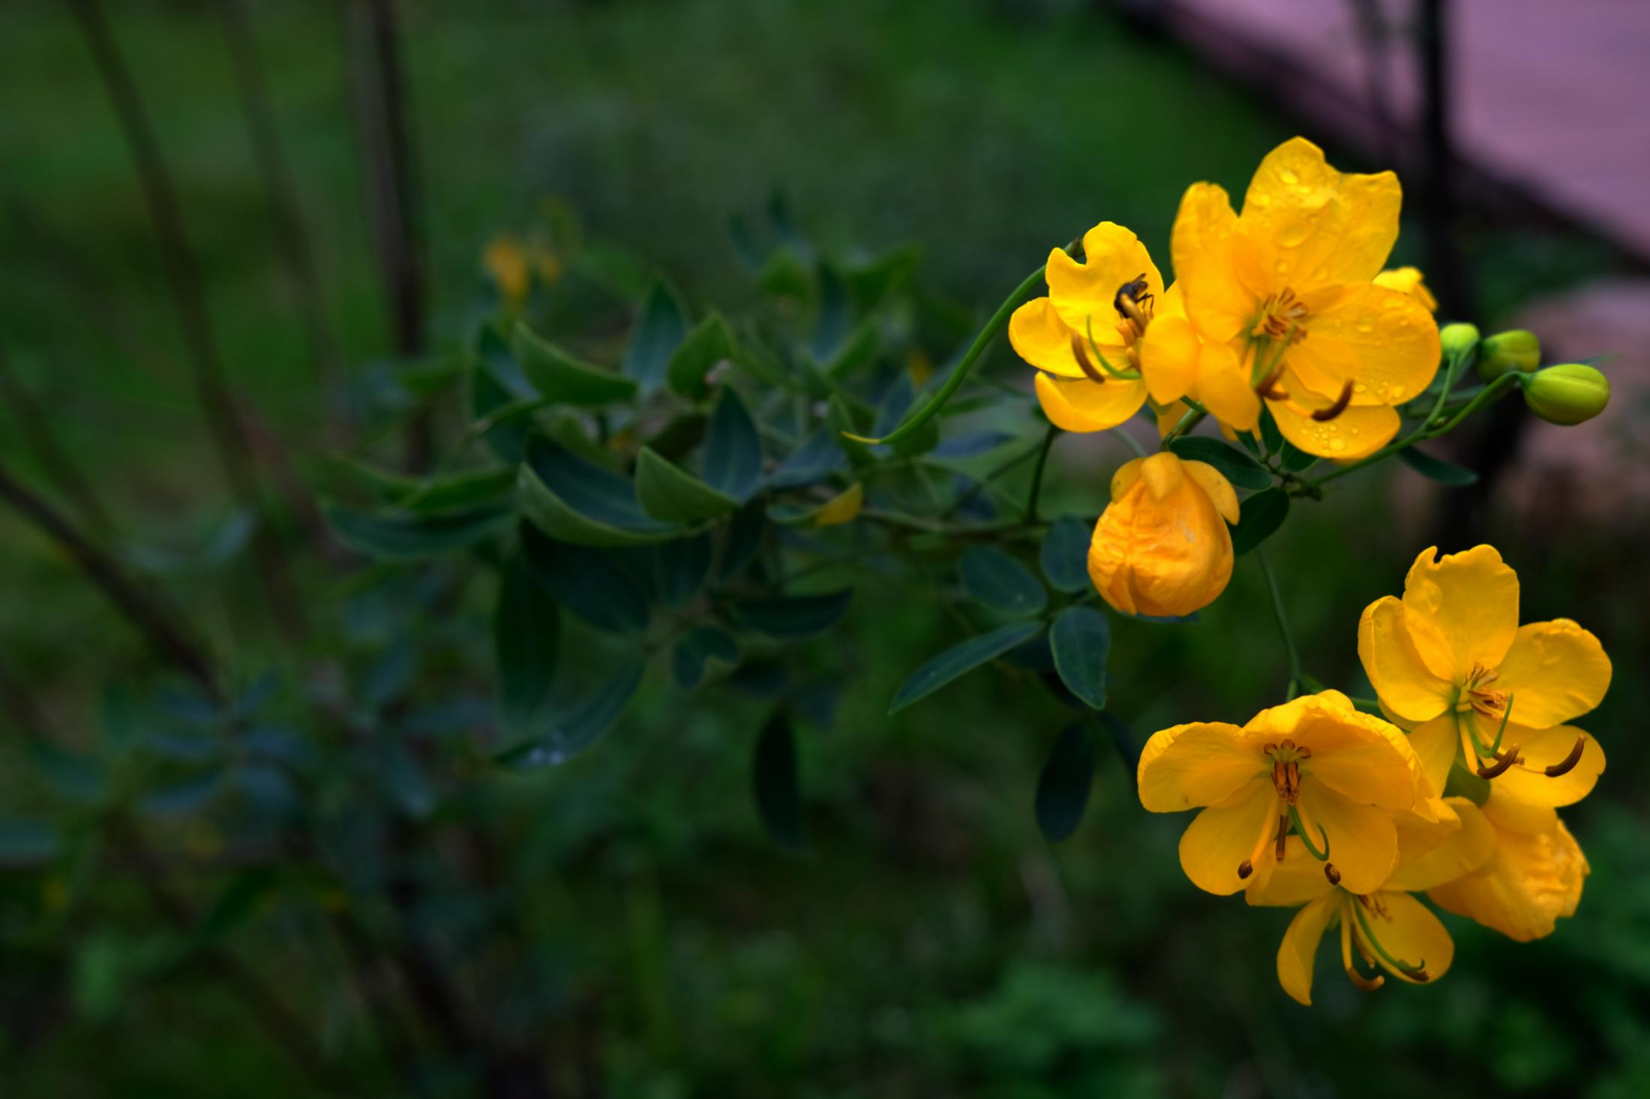
What are Four Basic Skills in Crosstalk?

Slide 5
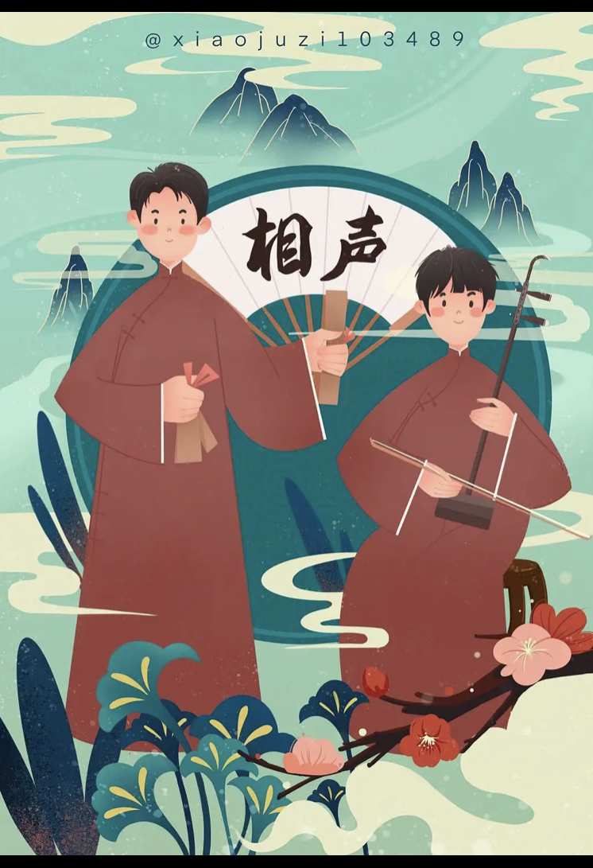
PART TWO
-“Speaking” means to tell jokes, stories, lantern riddles, drinking games, etc
-“Imitating” is to imitate all kinds of birds and animals, hawking, singing and the sound of different languages, etc
-“Teasing” is to gag and tease;
-“Singing” means to sing Taiping Lyrics, opera lyrics and songs.

Slide 6
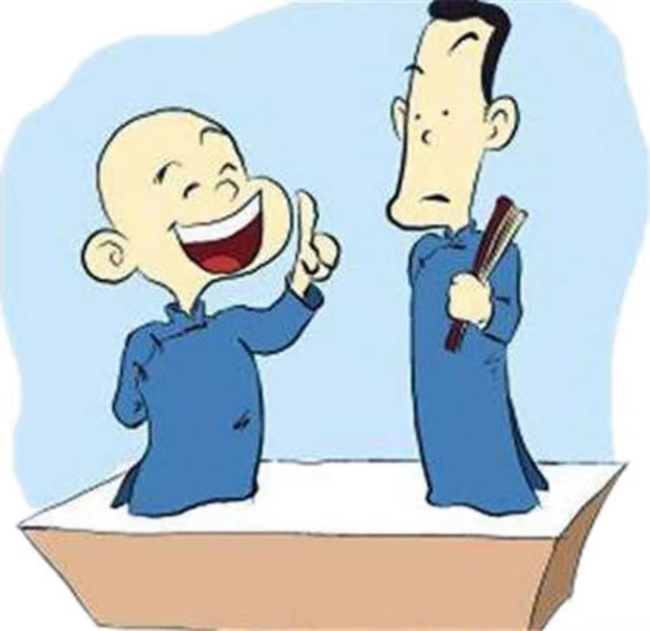
PART THREE
Characteristics of Crosstalk
the art of “speaking”
the art of "laughter"
a collective performance of actors and audiences
humour and satire
crosstalk is different from comedy

Slide 7
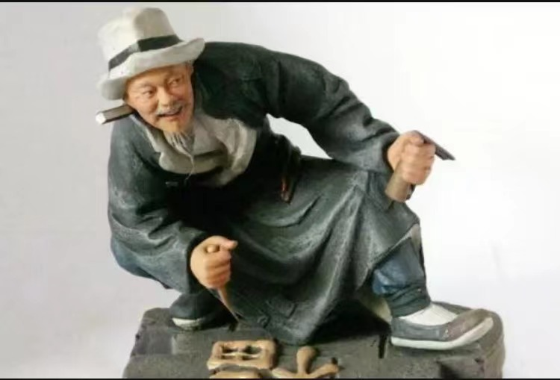
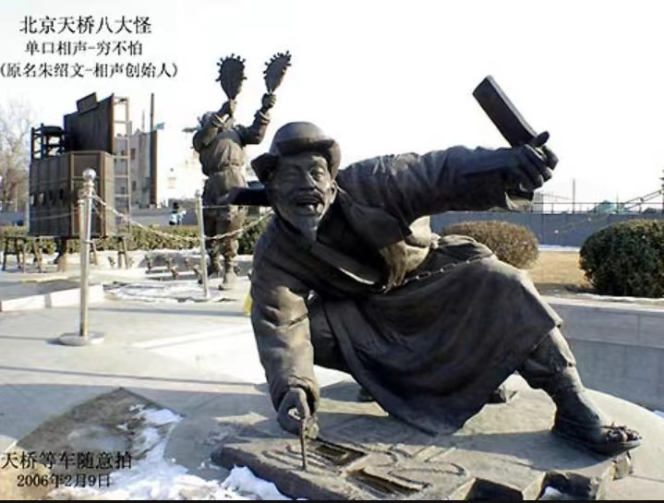
PART FOUR
Founder of Crosstalk
Zhu Shaowen（1829-1904)
stage name: “Qiong Bupa”
the “ancestor” of crosstalk

Slide 8
The Reference
1. Hou Baolin, Xue Baokun, 侯宝林, 薛宝坤. (1982). 《相声溯源》[The Origin of Crosstalk]1-13+194. 人 民 教 育 出 版 社People's Literature Publishing House.
2. Sohu 中 国 相 声 介绍 [The Introduction of China's Crosstalk] https://cul. sohu. com/20090619/n264630449. shtml
3. 360 Encyclopedia. 相 声 [Crosstalk] https://baike. so.com/doc/1925383-2037001. html
4. Baidu 最著名的十位相声名家排行[The Rank of Ten Famous Crosstalk Artists] https://baijiahao. baidu. com/s?id=1590742532351773378

Slide 9
Thanks for your patience!
Welcome Hao Tianyu from English Interpretation

