Slide 1
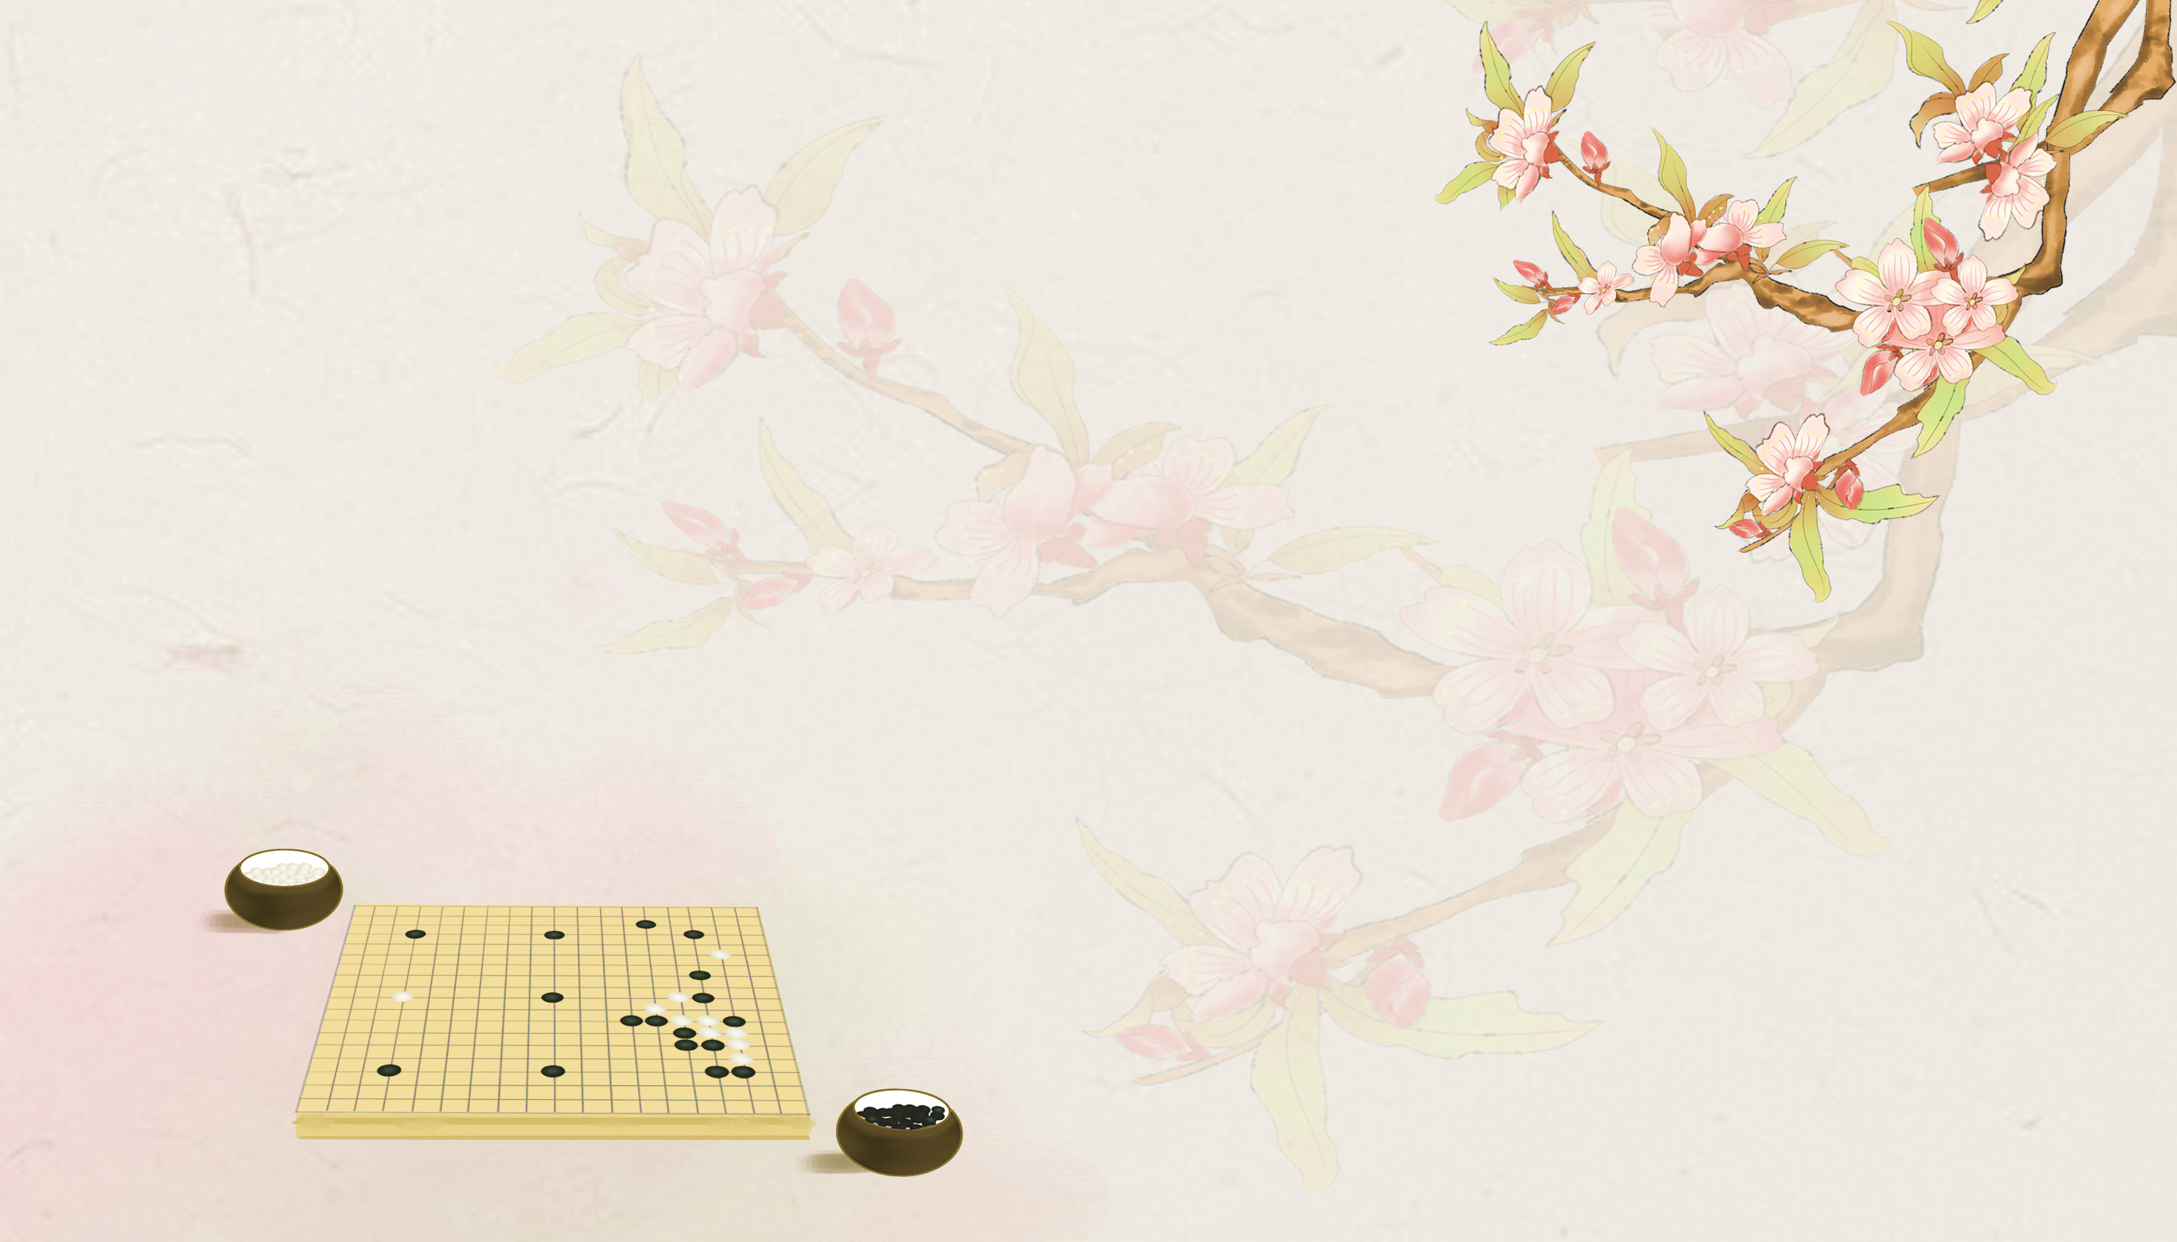
Games: Go
Speaker: Peng Yixin/Eason

Slide 2
Content
1. The Brief History of Go
2. Essential Rules of Go
3. Chinese Culture Reflected in Go
4. Human players V.S. AI

Slide 3
1.The Brief History of Go

Slide 4
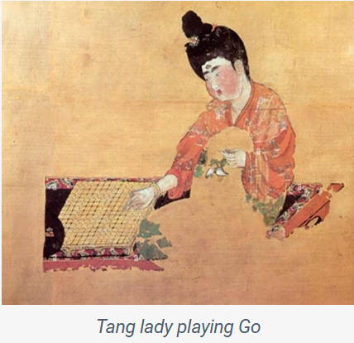
The Dawn of Go: A Chinese Invention Enhanced
With its origins tracing back from 4,000 to 5,000 years in ancient China, Go stands as one of the oldest and most intellectually challenging games in history.
Initially, it bore little resemblance to today’s game:
a 17×17 board
( 19×19 nowadays)
a square stone board
(wooden or plastic nowadays)

Slide 5
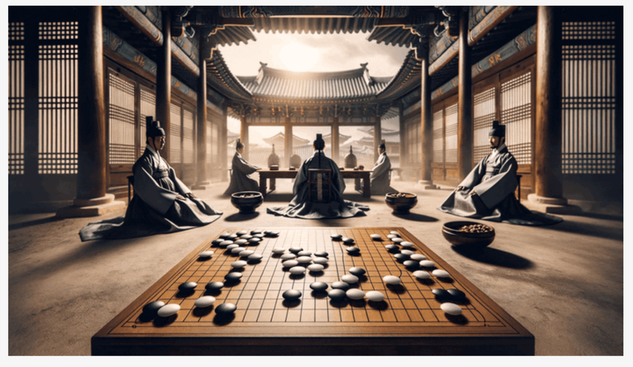
The Path of Go (Baduk) to Korea: The Introduction of Go From China
Two theories about the introduction of Go from China to Korea:
1.The migration of Qizi, a Chinese sage, who introduced various aspects of Chinese culture, including the game of Go
2. A Chinese occupation in 109 BCE
Traditional Go in Korea: SunChang Baduk
A 17x17 stone board
Different scoring rules

Slide 6
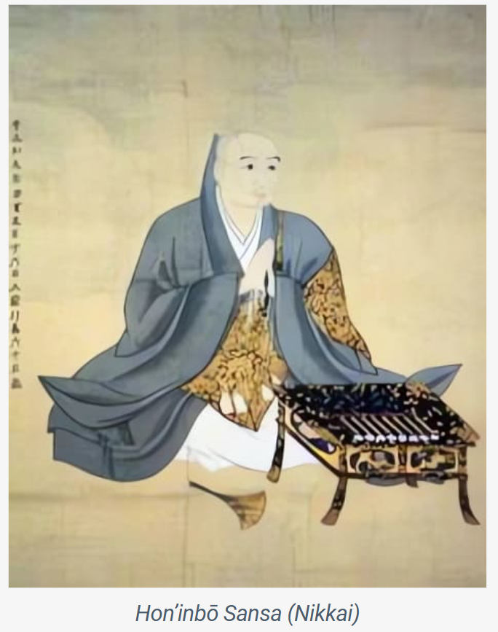
Go’s Journey in Japan: From Aristocratic Pastime to Shogunate Era
Evidence suggests Go was introduced to Japan from the Korean peninsula around the time of the Chinese occupation during the Han period.
Go in Japan:
Much government support
The ranking system, developed by Honinbo Sansa, categorized players from “Shodan” (first degree) to “Kudan” (ninth degree)

Slide 7
2.Essential Rules of Go

Slide 8

Traditionally, go is played with 181 black and 180 white stones (flat, round pieces called stones) on a square wooden board checkered by 19 vertical lines and 19 horizontal lines to form 361 intersections.
More recently, it has been played electronically on computers and on the Internet.
Basic rules:
Each player in turn (black moves first) places a stone on the point of intersection of any two lines, after which that stone cannot be moved.
Players try to conquer territory by completely enclosing vacant points with boundaries made of their own stones.

Slide 9
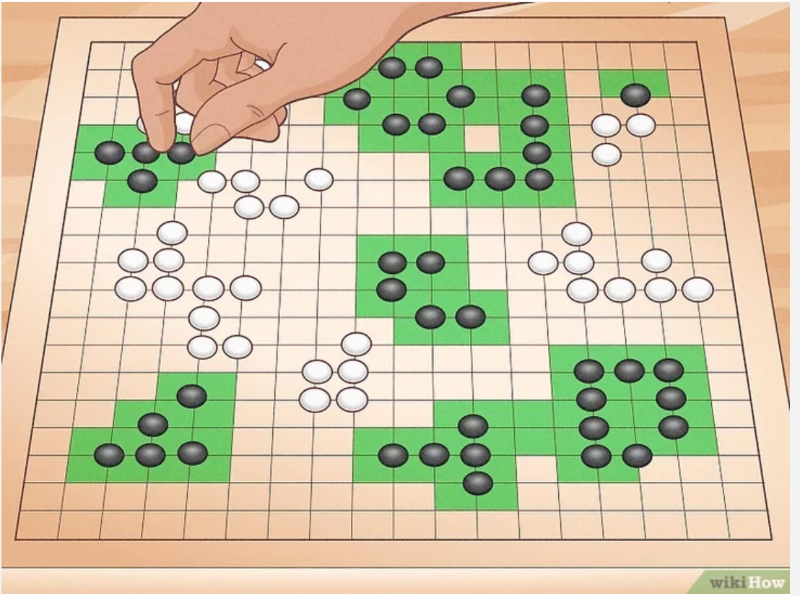
Strategy 1: Try to control more area on the board than your opponent.

Slide 10
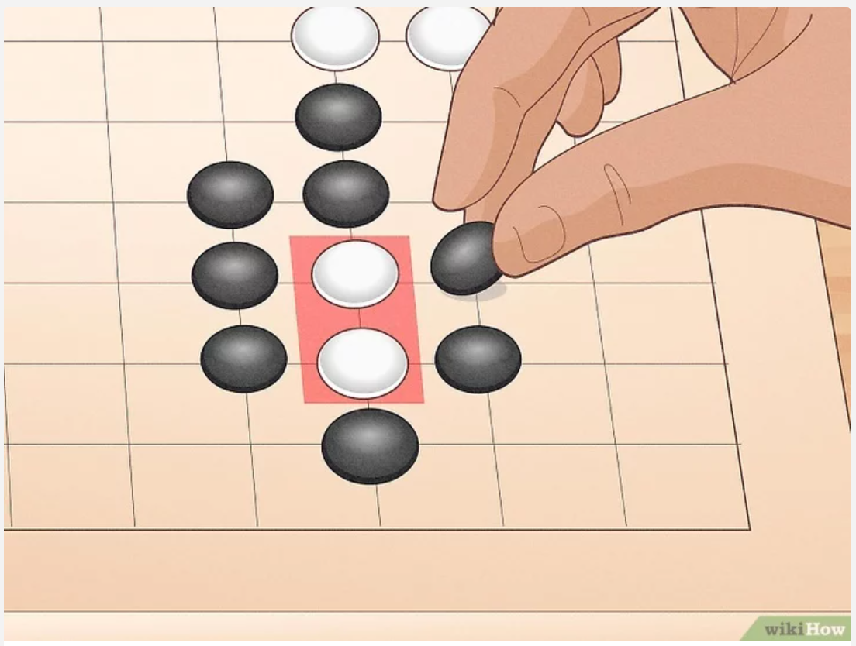
Strategy 2: Surround your opponent’s stones to capture them as “prisoners.”

Slide 11
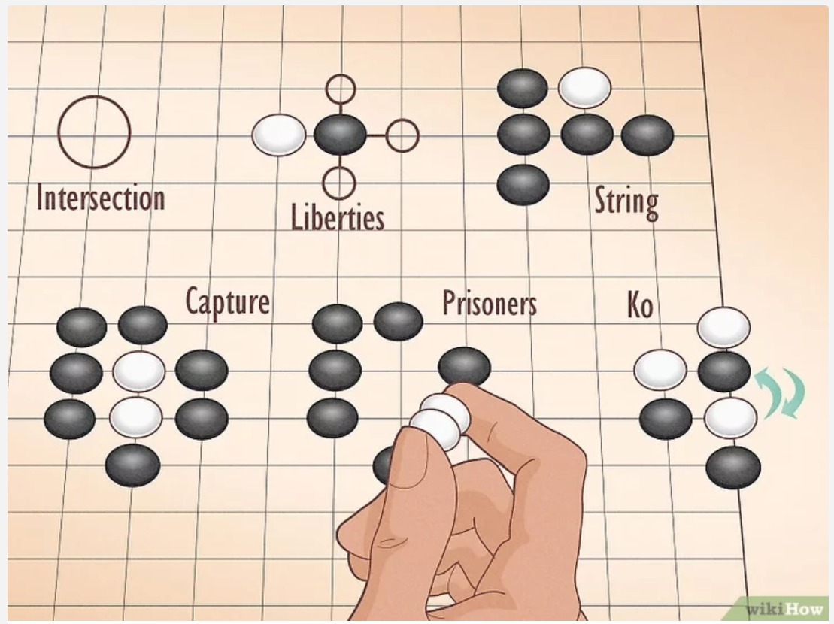
Strategy 3: Familiarize yourself with the terminology of the game.

Slide 12
Intersection: every crossing of lines on the board (including edges)
Liberties: empty intersections that are horizontally and vertically adjacent to a stone
String: a group of stones of the same color that are connected along board lines, forming a unit that cannot be divided

Slide 13
Capture: when a string’s liberties are occupied by opponent markers, they’re captured
Prisoners: the stones you capture from your opponent
Ko: a rule that removes the possibility of infinite recapture and capture

Slide 14
3.Chinese Culture Reflected in Go

Slide 15
(1)Daoism
The black and white pieces of Go symbolize the yin and yang of ancient Chinese philosophy.
(2)Chinese Military Philosophy
The importance of knowing both oneself and one's opponent ("The Art of War")

Slide 16
(3)The Doctrine of the Mean
It emphasizes balance and harmony.
(4) Personal Development
The game demands calmness and patience, which helps in nurturing one's temperament and self-cultivation.

Slide 17
4.Human Players V.S. AI

Slide 18
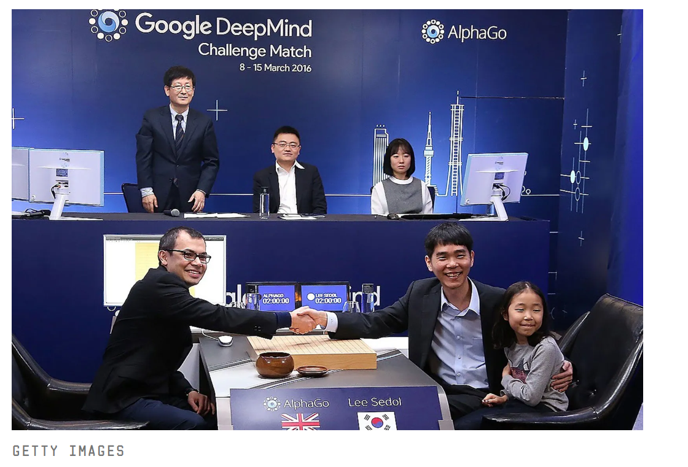
Google's DeepMind wins historic Go contest 4-1

Slide 19
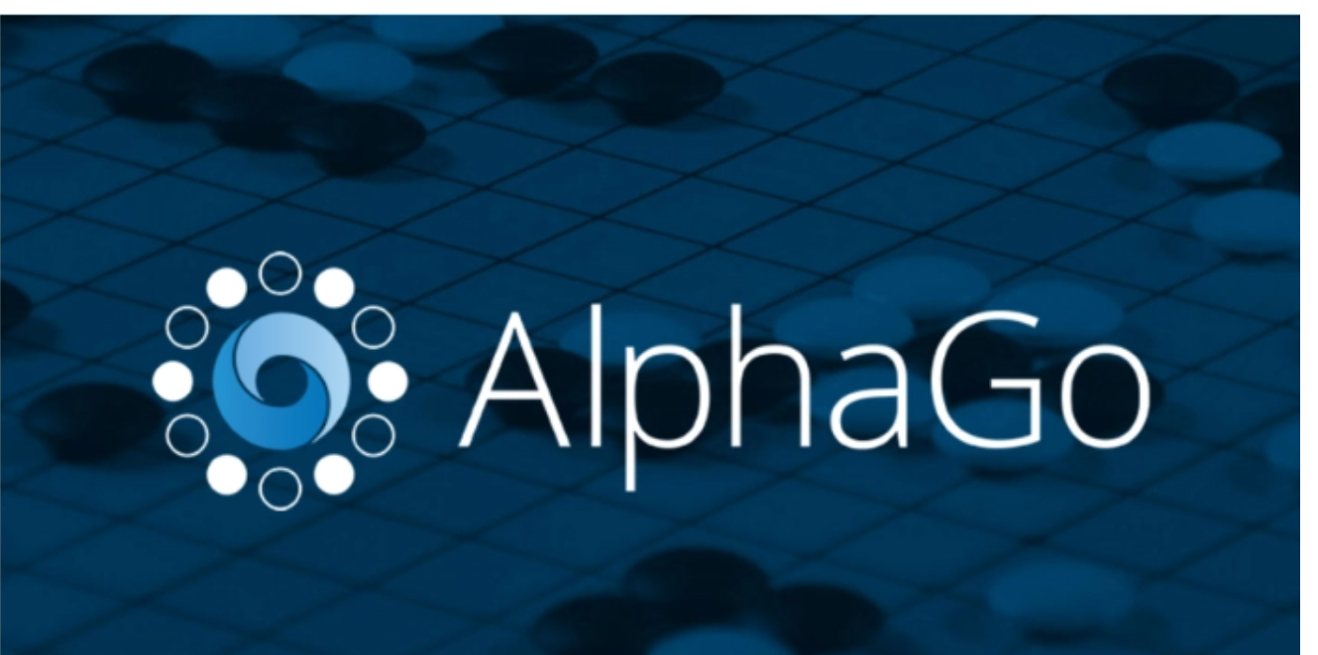
The Approach of AlphaGo
It is equipped with deep neural networks and improved after training.
Neural network:
One neural network — the “policy network” — selects the next move to play.
The other neural network — the “value network” — predicts the winner of the game.

Slide 20
The Approach of AlphaGo
It is equipped with deep neural networks and improved after training.
Training:
Play against numerous amateur games of Go
Play against different versions of itself thousands of times

Slide 21

Using AlphaGo
https://alphagoteach.deepmind.com/

Slide 22
Thank you!

