Slide 1

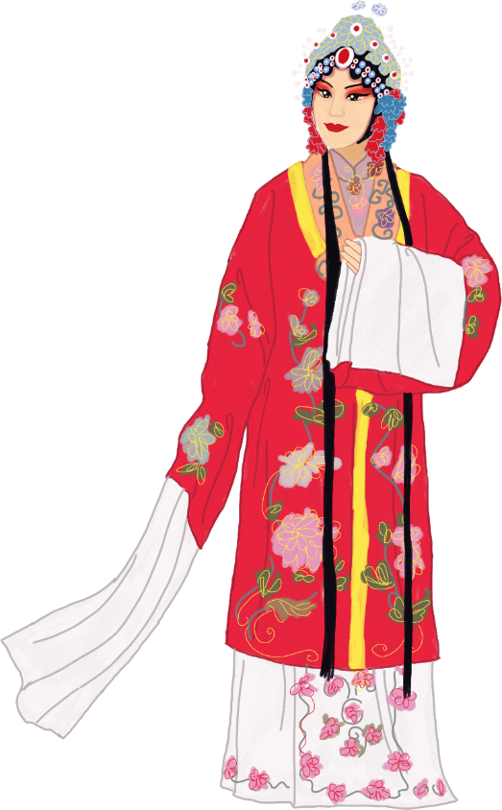


Peking Opera
By: Xie Xiaoying

Slide 2
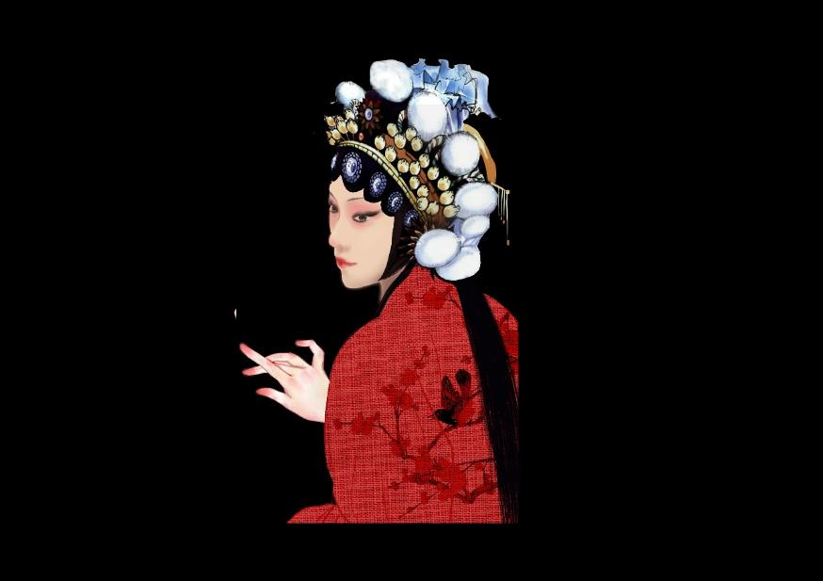
Contents
Brief Introduction
I.
II.
Artistic Forms of Expression
III.
Significance

Slide 3

I.Brief Introduction
Peking Opera, a major form of Chinese drama, enjoys great popularity both at home and abroad.
As the fusion of Anhui opera and Hubei opera in Peking at the end of the 18th century, Peking Opera is the most representative of all forms of traditional Chinese dramatic art.
It ingeniously combines elements from many sources: traditional Chinese music, poetry, singing, recitation, dancing, acrobatics and martial arts.

Slide 4
I.Brief Introduction
Theatrical art forms in many countries do not present singing, dancing and spoken parts in one single drama.
However, traditional Chinese drama, including Peking Opera, is a kind of entertainment which includes spoken parts, singing, dancing and acrobatics, thus demanding versatility on the part of the performers.
A top performer of Peking Opera, for instance, must be attractive enough when in costume and make-up, of pleasing body proportions, with bright eyes and rich facial expressions.

Slide 5
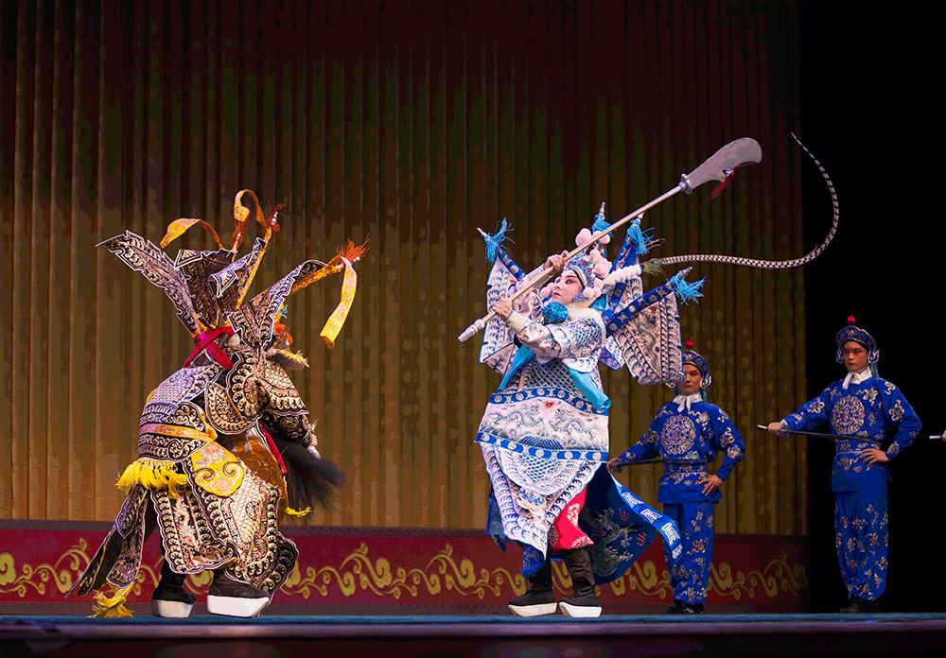
II.Artistic Forms of Expression
1.Symbolism
The performance of Peking Opera is not restricted by time and space: symbolism plays a role. Some activities in daily life cannot be performed perfectly on the stage, so performers of Peking Opera do it in a symbolic way, giving different meanings to particular body movements.
For example, running around the stage with a whip in hand means riding a horse; holding an oar with knees bent means taking a boat; somersaulting under the spotlight means fighting fiercely in the dark.

Slide 6
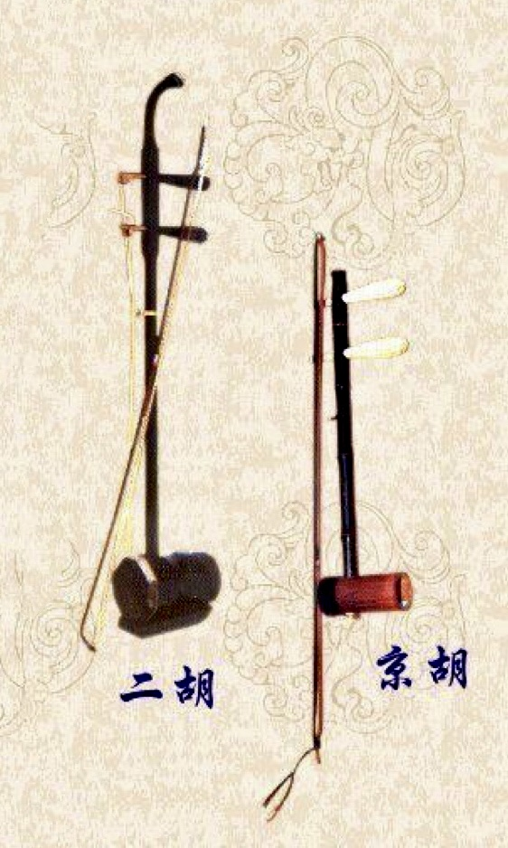
II.Artistic Forms of Expression
2.Music
Music is the most essential element in opera. And in China, it is said that one is not going to “watch” an opera, but to “listen to” it.
Both percussion instruments and orchestral instruments are used in Peking Opera. The former include the clapper, drum, gong, cymbal, etc. The latter include the jinghu (a two-stringed bowed instrument with a high register), the erhu (a two-stringed bowed instrument with a lower register than jinghu), etc. It is music that makes the performance of Peking Opera more rhythmic and artistic.
打击乐器
管弦乐器
板
鼓
锣
钹
京胡
二胡

Slide 7
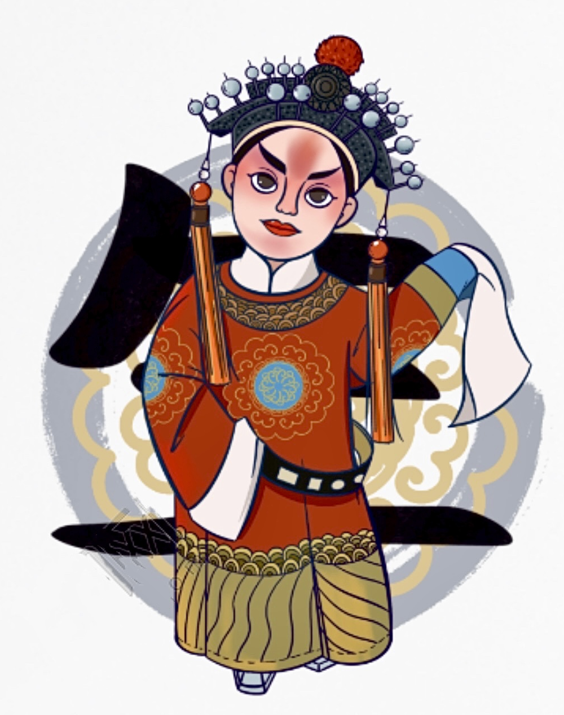
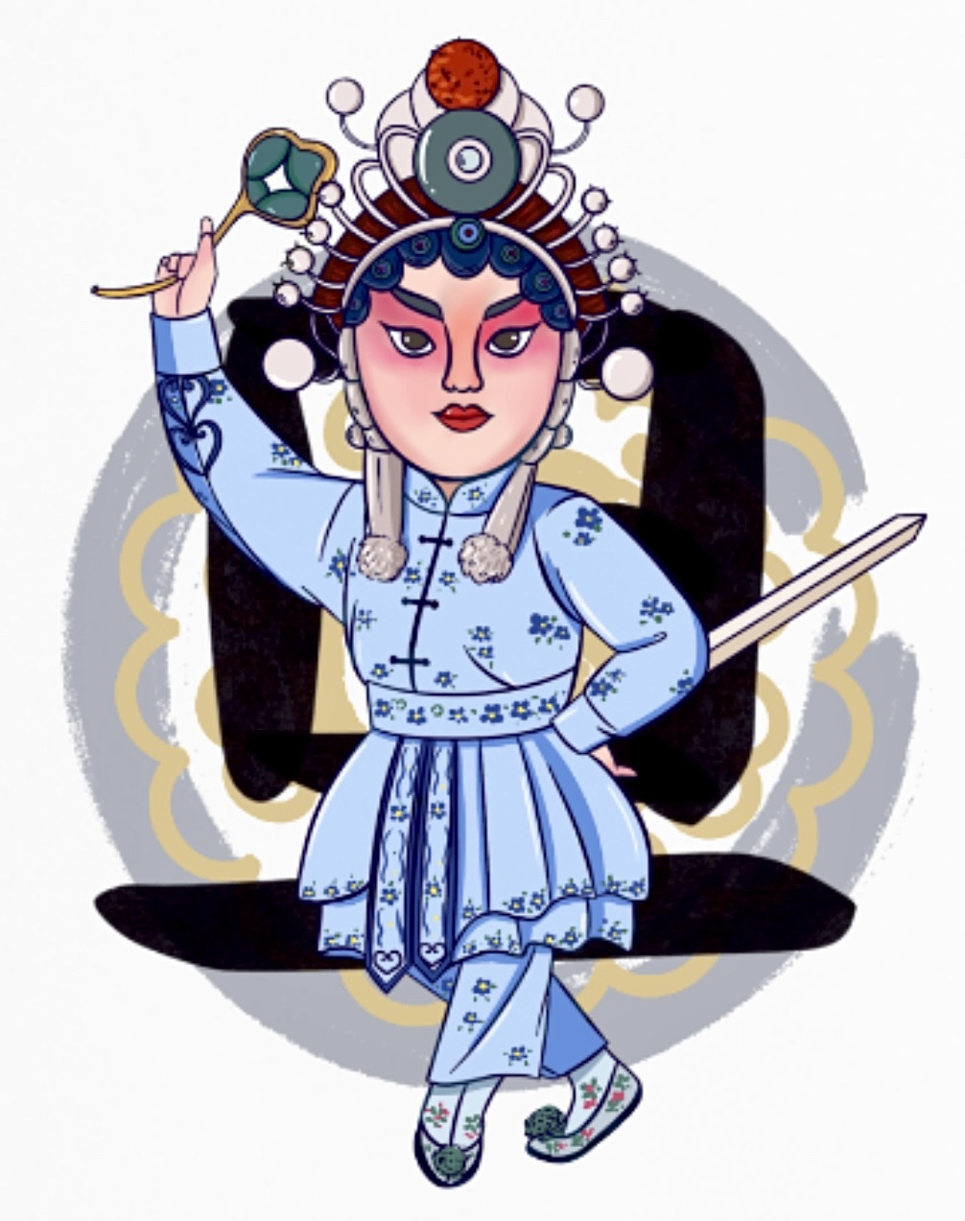
II.Artistic Forms of Expression
3.Character Role
According to the sex, age, profession and social status, the character roles in Peking Opera can be divided into 4 main types: Sheng, Dan, Jing and Chou.
Sheng refers to positive male role, which includes laosheng (middle-aged or old men), xiaosheng (young men), wusheng (men with martial skills), etc.
Dan refers to positive female role, which includes Qingyi (women with a strict moral code), huadan (young women), laodan (elderly women), etc.
“生”
老生
小生
武生
“旦”
青衣
花旦
老旦

Slide 8
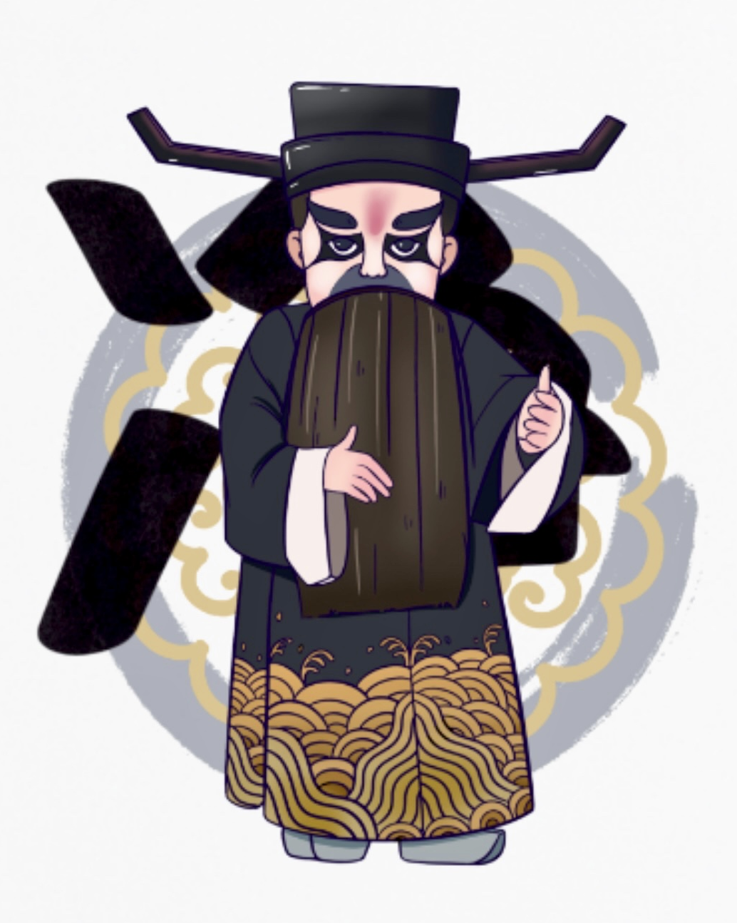
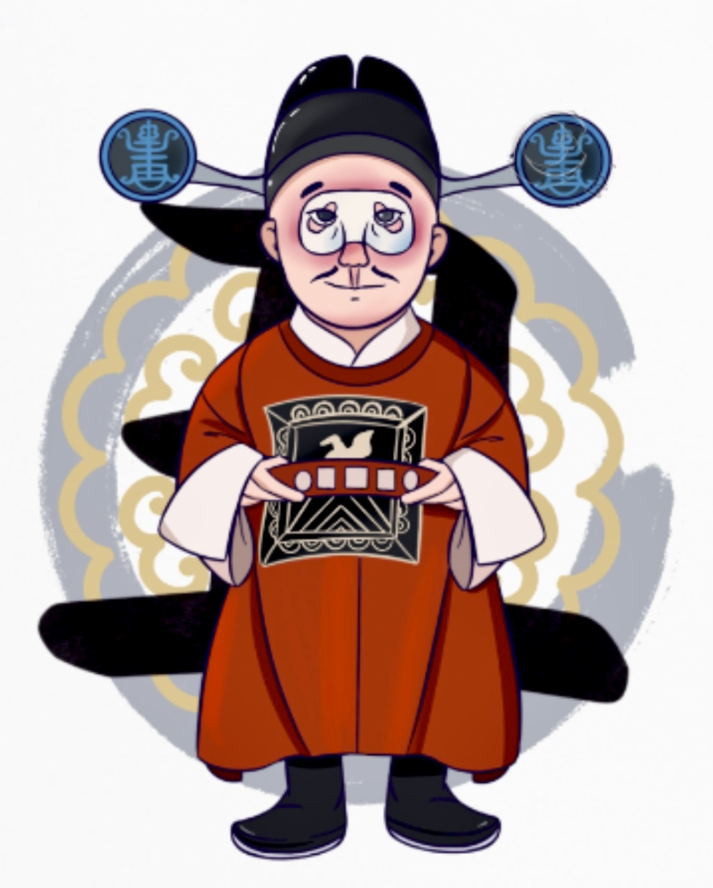
II.Artistic Forms of Expression
“净”
Jing refers to the supporting male role with painted face and striking character, which includes wenjing (civilian type) and wujing (warrior type). They usually represent warriors, heroes, statesmen or even demons.
Chou refers to the clown or negative character, which includes wenchou, wuchou, etc. They always can be easily recognized on the stage for their special make-up (a patch of white powder painted on his nose).
文净
武净
“丑”
文丑
武丑

Slide 9
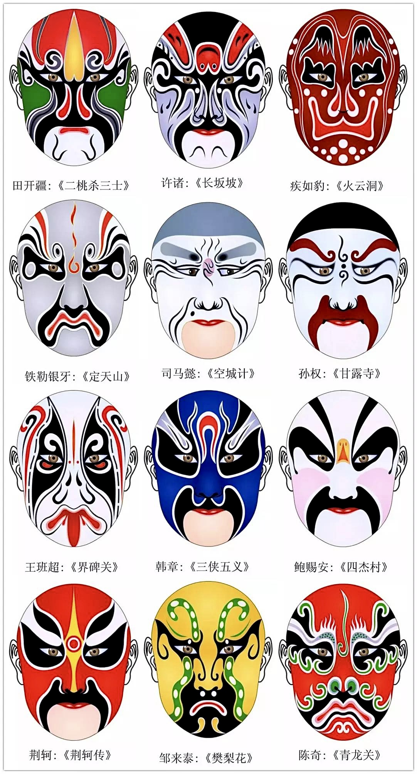
II.Artistic Forms of Expression
4.Facial Makeup
In Peking Opera, facial makeup, which is mainly applied to Jing and Chou roles, shows the character’s identity and personality by using different colors.
Each color reflects the character’s nature: red signifies loyalty and bravery; black signifies honesty and integrity; blue signifies frankness and rebellion; white signifies duplicity and suspiciousness, etc.
At first, facial makeup was to exaggerate the facial feature and show the personality of the characters, thus serving for the plot of the opera. However, it gradually became an art of pattern with national characteristics, recognized as one of the symbols of traditional Chinese culture.

Slide 10
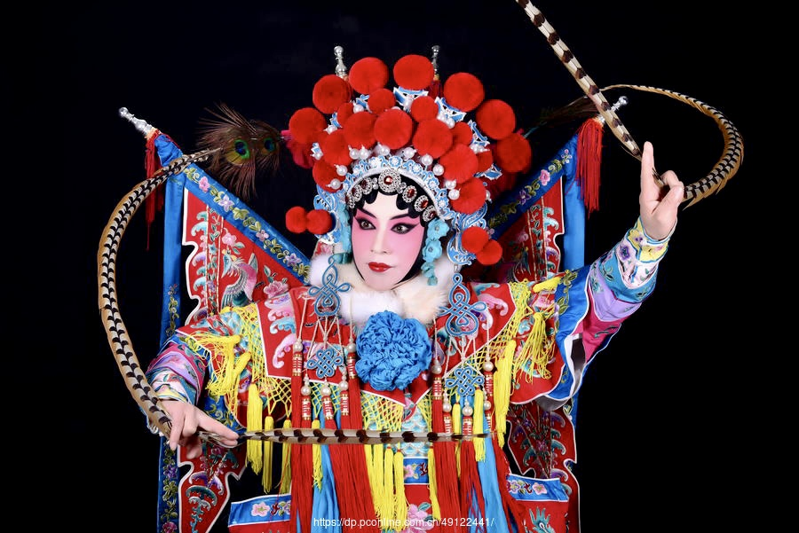
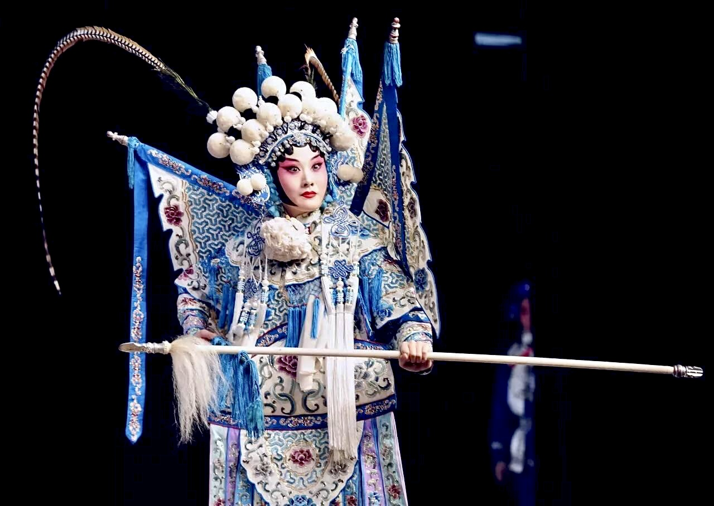
III.Significance
Known as the quintessence of Chinese culture, Peking Opera ranks the top of the Five Major Operas in China. It is an intangible cultural heritage of China and the world with profound cultural heritage.
(京剧、越剧、黄梅戏、评剧、豫剧)
Compared with Kun Opera which caters for the taste of literati and officials, Peking Opera, the product of specific regional culture, is closer to the taste of the lower class and the common people.
Having absorbed the strengths of other local operas through the reform and creation of numerous artists, Peking Opera now occupies an important position in the treasure house of world culture and art.
节日PPT模板 http://www.1ppt.com/jieri/

Slide 11
Thanks for Listening!

