Slide 1
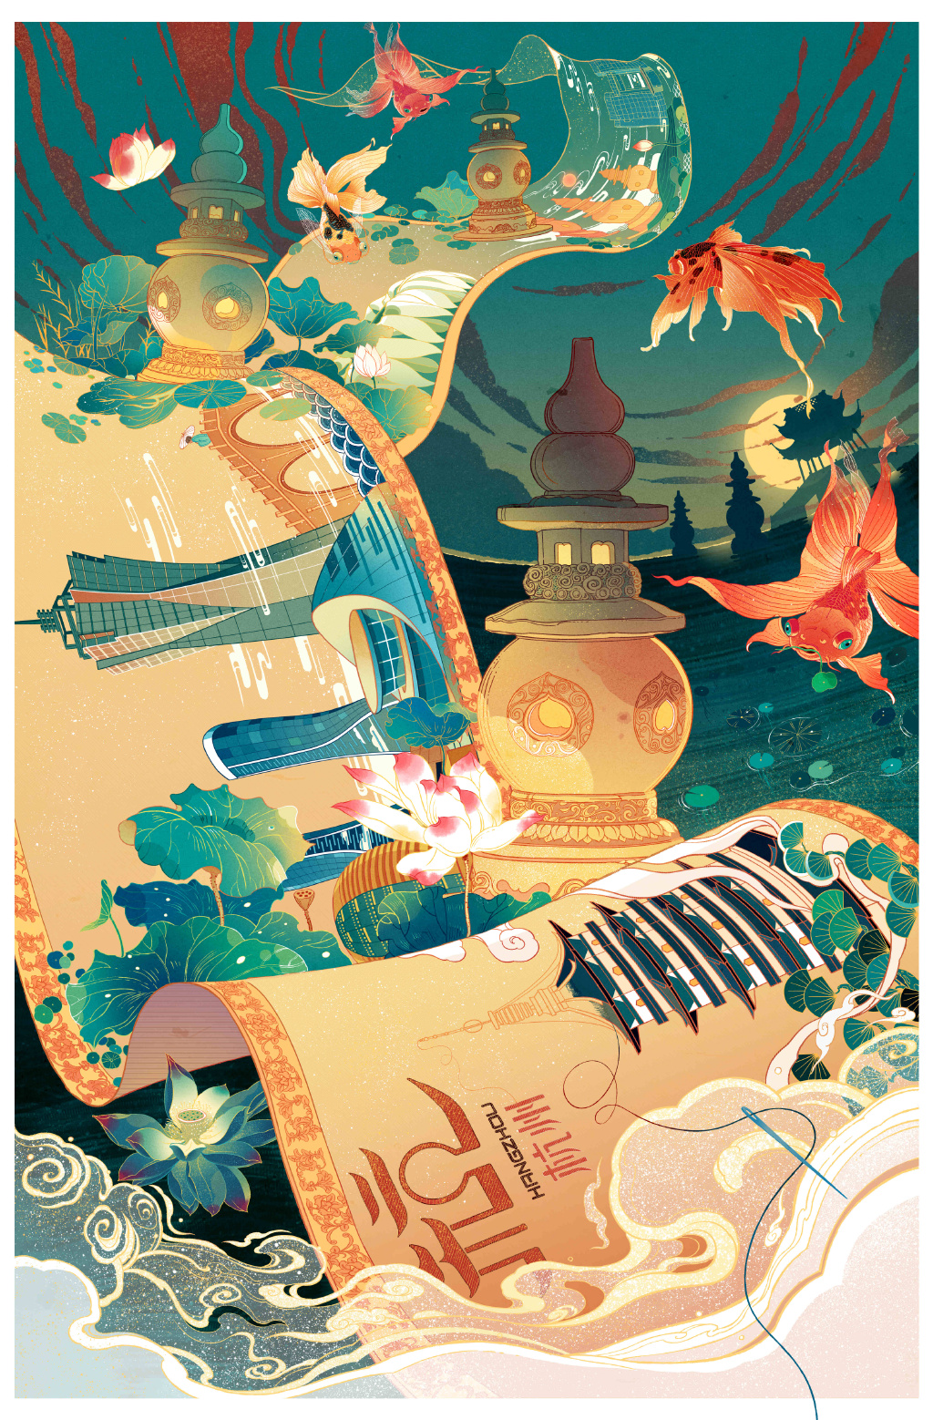
Lead-in
The topic of werewolves in the XXI century is perhaps one of the most discussed and studied. Along with vampires and zombies, the image of werewolves is firmly entrenched in world cinema and literature. However, as a rule,
speaking about the motives for the transformation of a person into an animal, most people have information mainly about lycanthropy(变狼妄想）, that is, about the specific transformation of a person into a wolf (werewolf). At the
same time, the theme of werewolves is represented by a fairly large number of transformations of a person not
only into a wolf but also into other animals. In Chinese mythology, one of the most popular werewolf myths is the myth of the Huli-Jing or werewolf foxes. In the Middle Ages, these myths were very popular and in-demand among writers. But what is the attitude of Huli-Jing in modern China? Are they given a place in modern
culture, or do werewolf foxes now sound more like a kind of atavism or a children’s fairy tale?

Slide 2
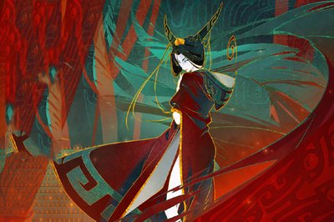
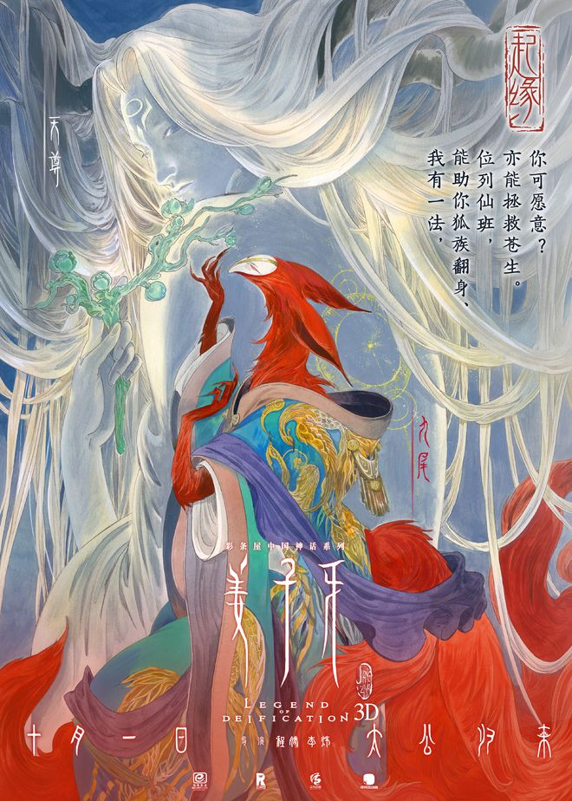
Mythology: Huli-jing
伍斯仪

Slide 3
Contents
Huli-jing in China
Kitsune (キツネ）in Japan
Kumiho (구 미 호) in Korea
Translations of Huli-jing

Slide 4
Huli-jing in China
Xia dynasty
01
02
Song dynasty
The stories of Pu Songling
03
04
21st century

Slide 5
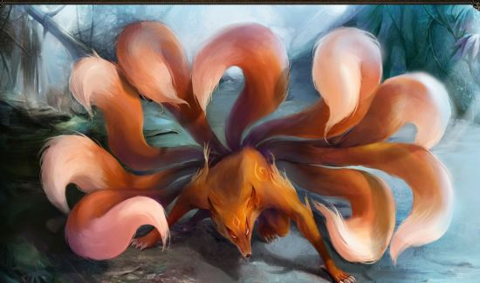
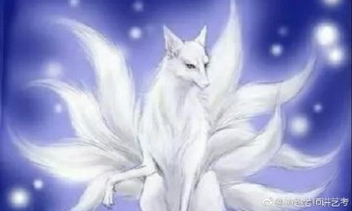
Huli-jing in China
Xia dynasty The image of werewolf foxes has been known in China
since the times of the Xia dynasty and its founder Yu,
who married a nine-tailed white fox who lived on Mount
Tu. People, especially women, believed that due to the
cult of the fox, they would be able to gain unearthly
beauty and immortality.
Song dynasty The official authorities of the ancient and medieval dynasties
tried to resist the representatives of the Huli-jing cult, but it was
only during the Song dynasty reign. At that time the cult of the
fox, including the cult of Da Ji, was almost completely destroyed.
However, the cult and image of Huli Jing were not fully eradicated in other parts of China.

Slide 6
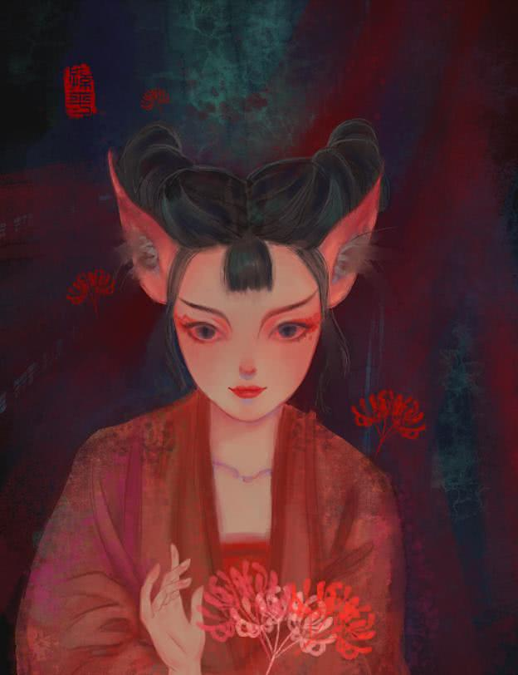
Huli-jing in China
The stories of Pu Songling Perhaps the most striking examples of where the changed image of
the Huli Jing is found can be called the stories of Pu Songling about
werewolf foxes. It is his stories, where girls are subject to the curse
of turning into foxes, that reflect their position as hostages of their
own life situations or even fears. The theme of fatal love in the
stories of werefoxes appears as a continuous line in Pu Songling
tales. This suggests that despite the fact that Huli-Jing strives for
happiness, she remains a spirit that is not a person. In addition,
despite the altered level of female foxes, they will still bear the curse of their savage ancestors, who personified evil in its purest form, andtherefore there can be no happy ending for those who bear such
heavy punishment.

Slide 7
21st century
Of course, the image of the Huli Jing as a mythological character by
the 21st century was constantly supplemented with small details. We can
say that most of the works of literature and cinema, in which the werewolf
fox was encountered, for the most part, were very strongly romanticized.
Remaining in its own way a relatively neutral character, Huli-Jing
nevertheless gradually becomes one of the most popular characters of
many writers and screenwriters, not only in China but also in many other
countries. A striking and original example of where the Huli Jing appears is
the work of the writer Ken Liu entitled "Good Hunt". The author presents
not only a very interesting view of the Huli Jing but also explains why the
legendary characters of Chinese mythology are gradually disappearing
from the memory of the Chinese people.

Slide 8
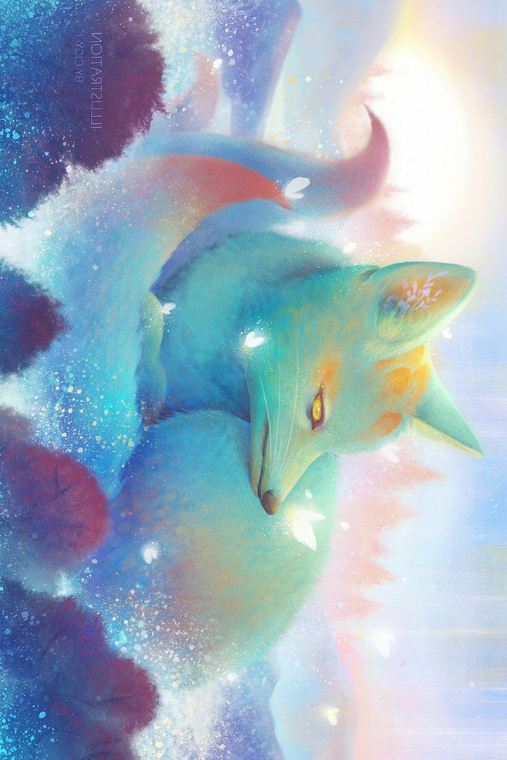
In addition to literary works, Huli Jing is quite often encountered
in Chinese cinema, as an episodic character or a protagonist.
One of the most striking images of a werewolf fox can be considered the film “Painted Skin", where the main character is Huli
Jing and must eat men’s hearts to maintain her youth and beauty. This film is based on the story of Pu Songling and is one of the
key works of cinema and modern Chinese culture, which fully
reveals the tragedy of the werewolf fox. Besides, Huli Jing is featured in a fairly large number of Chinese television series, each of which gives its own view of what character Huli Jing should be.

Slide 9

Quite a lot of information about werewolf foxes can be obtained from the TV series "The Legend of the Nine- Tailed Fox" released in 2016. The main interest here
is not only a rather vivid description of the Huli Jing,
which according to the plot are one family and are
forced to seek and return to their place the sacred fruit from the magic garden. This, perhaps, is an attempt
to provide an explanation of the true nature owerewolf foxes, who for a long time rushed from good to evil.

Slide 10
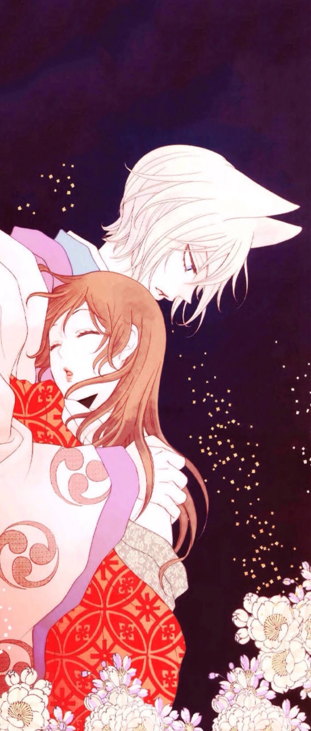
Kitsune (キツネ）in Japan
Initially, foxes were the messengers (tsukai) of this deity, but now the
difference between them has
become so blurred that Inari is sometimes depicted as a fox by himself.
In Buddhism, they gained fame thanks to the Shingon school of secret
Buddhism, popular in the 9th-10th centuries in Japan,one of the
Main deities of which, Dakini, was
depicted riding a fox across the sky. A kitsune can have up to nine tails.
In general, it is believed that the
older and stronger the foxes are, themore tails they have. Some sourceseven claim that a kitsune grows an extra tail every hundred or thousand years of its life. However, foxes
found in fairy tales almost always
have one, five, or nine tails. When
Kitsune are given nine tails, their fur
turns silvery, white, or gold.
In Japanese folklore, these animals have great
knowledge, long life, and magical abilities. Chief
among them is the ability to take shapeshift
themselves; the fox, according to legend, learns to
do this after reaching a certain age.
Kitsune usually take the form of seductive beauty, a pretty young girl, but sometimes they turn into
men. It should be noted that in Japanese mythology
there was a mixture of indigenous Japanese beliefs
that characterized the fox as an attribute of the god
Inari.

Slide 11
Kumiho (구 미 호) in Korea
Kumiho - (구 "ku" - nine, 미 "mi" - tail, 호 "ho" - fox - "fox with nine tails") is a folklore animal, the fox of which is first mentioned in the era of Gojoseon. According to legends, only a fox that lives for a thousand years can become 구미호. One of her superpowers is transforming into a beautiful girl. Although in myths there are also references to the becoming of a charming young man. In this form, the mythical animal fell in love with the opposite sex, and then ate their liver (according to some beliefs, and the heart). Why exactly the liver? We can say that the liver contains human energy, that is, we eat and receive the energy that our liver stores. In a later period, Kumiho, according to numerous legends, could get rid of the status of a monster and become a man forever. Kumiho can transform into a human if one of three conditions is met: she refrains from eating corpses and killing people for a thousand days; the person who recognized her as Kumiho when she is in human form will keep this secret for ten years; Kumiho will eat the liver of thousands of men over a thousand years (if this does not happen, it will disintegrate into many small bubbles); the first condition (then reduced to a hundred days) is sometimes added to the offer of help to any person who will need it

Slide 12
Huli-jing
Werewolf foxes
Coquette
Vixen
Fox spirit
Transliteration
Free translation
Derogatory
Neutral
√

Slide 13
Thanks for listening

