Slide 1
From the Han to the Ming
Or
Over 1800 years of history in under 20 minutes

Slide 2
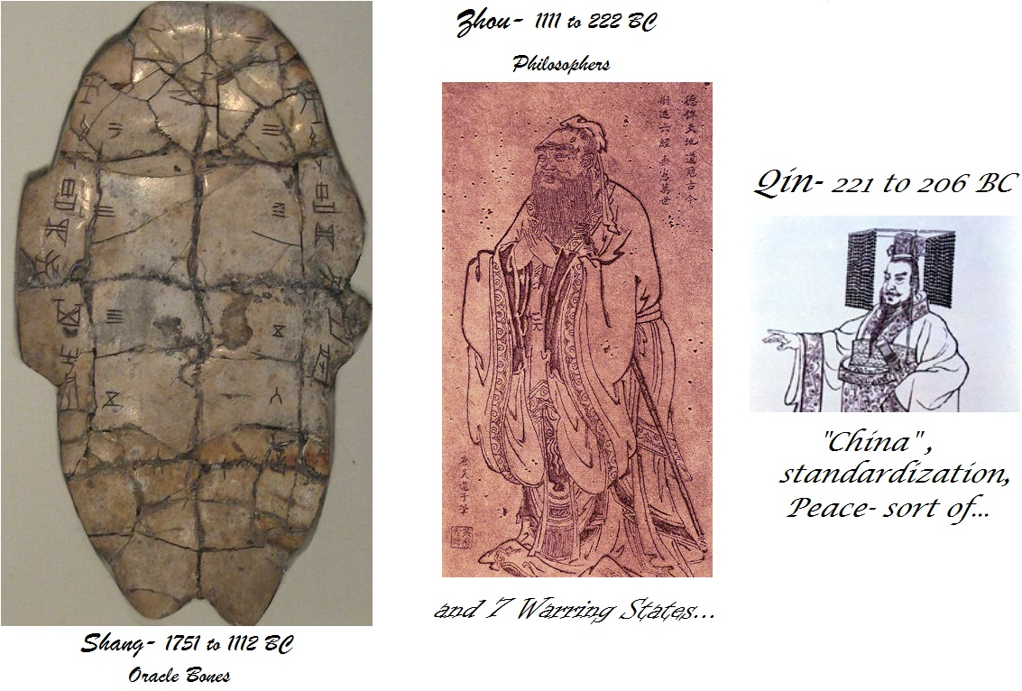
Just a quick little review…

Slide 3
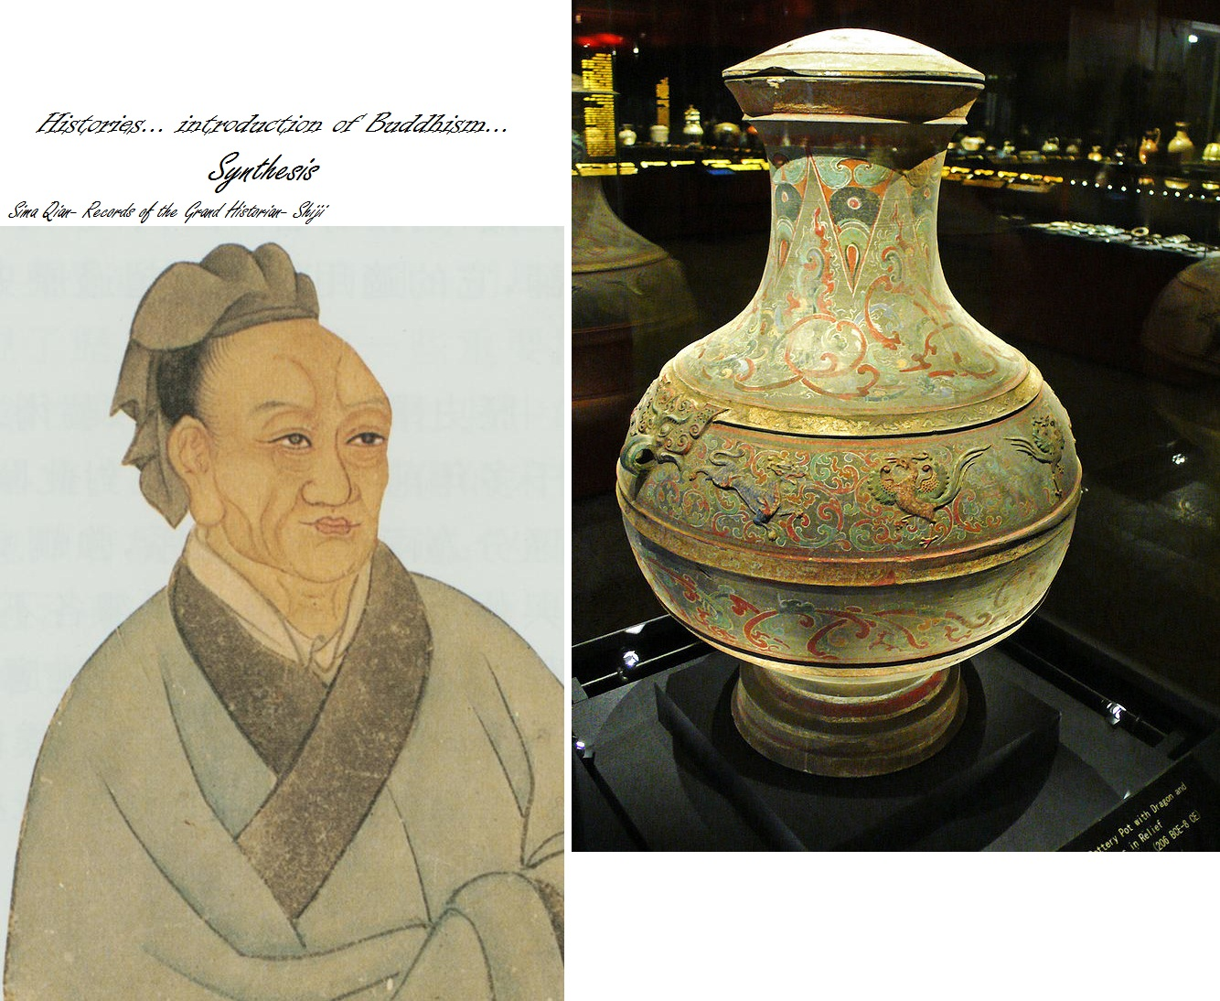
HAN- 206 BC to 220 AD

Slide 4
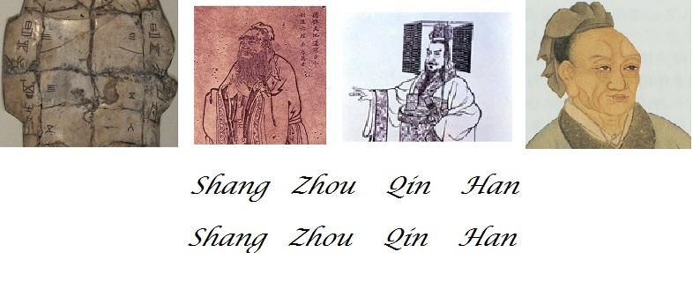
The first four…

Slide 5

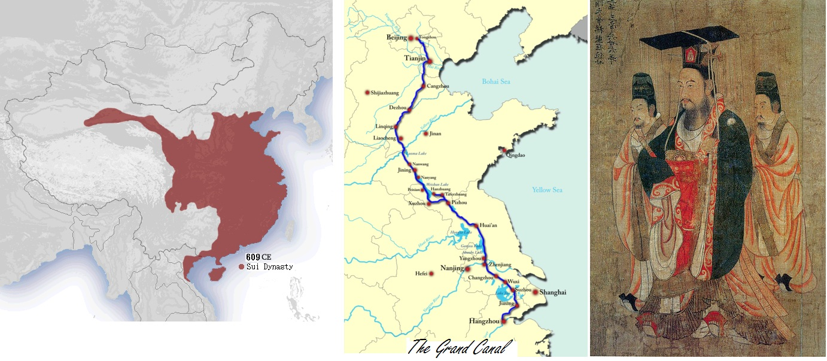
Sui- 581-618 AD

Slide 6

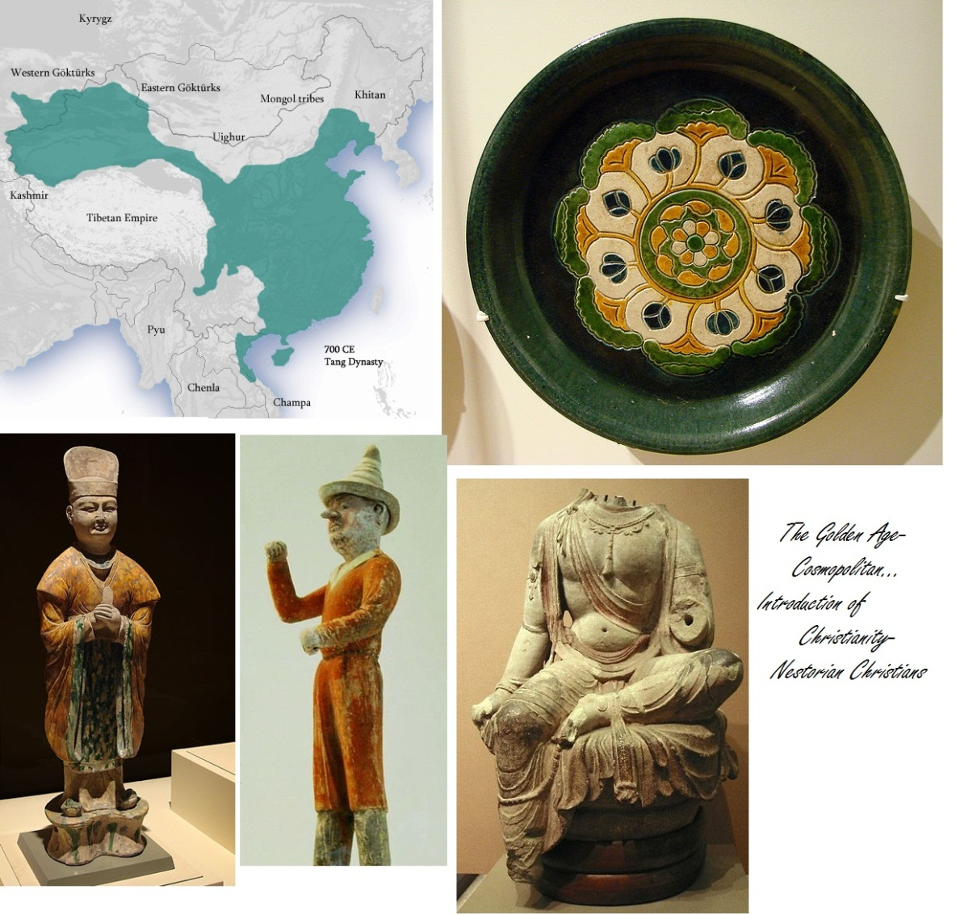
Tang- 618 to 906 AD

Slide 7

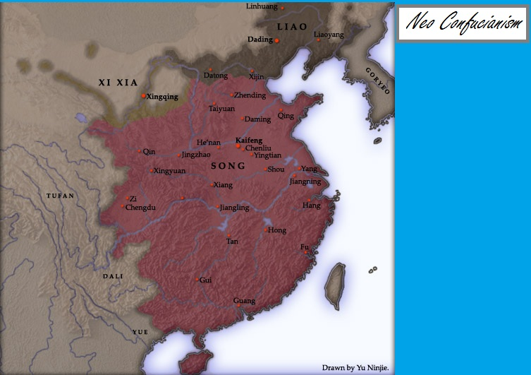
Song- 960 to 1279

Slide 8
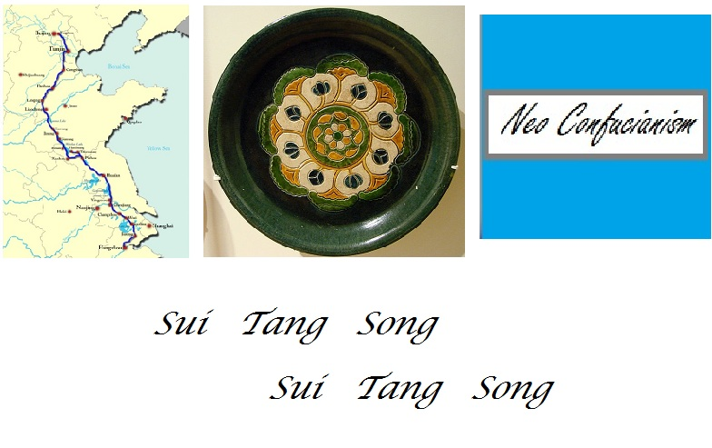
The next three…

Slide 9

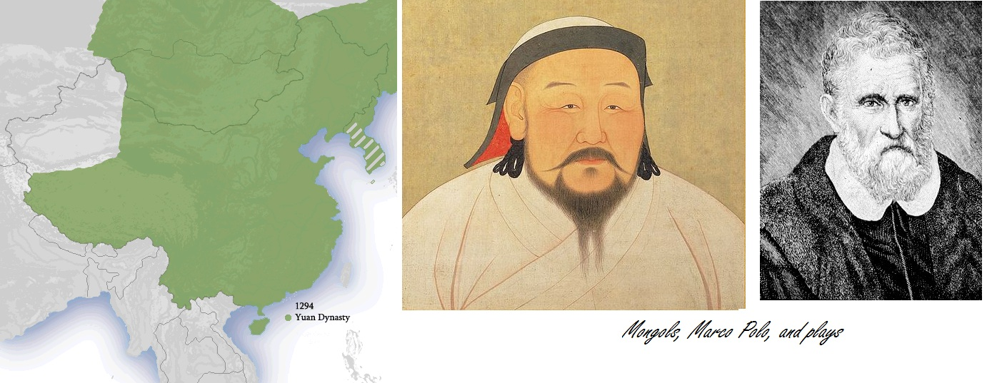
Yuan- 1280 to 1368 AD

Slide 10


Ming- 1368 to 1644

Slide 11
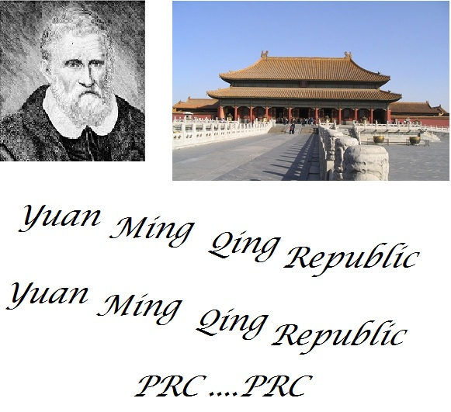
And to end the song…

Slide 12
