Slide 1
More Than a Game : Mahjong and Its Interactive Dynamics with Chinese Society
—— 汇报人：Hu Xinyin——
Created By AI

Slide 2
01.
Introduction

Slide 3
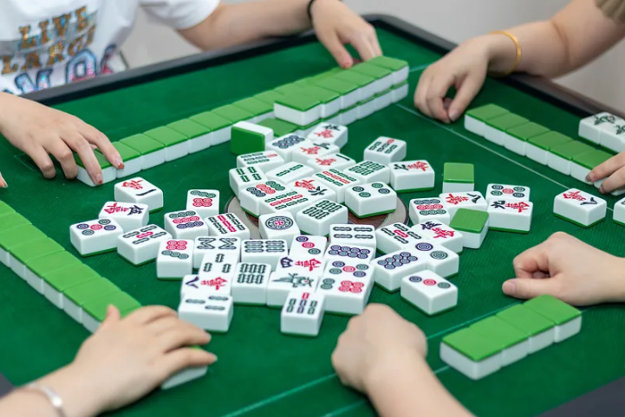
Fundamental Gameplay Structure
01
02
03
Four players
The East player as dealer
Drawing and discarding turns to form a winning hand
Peng：碰
Gang：杠
Chi：吃

Slide 4


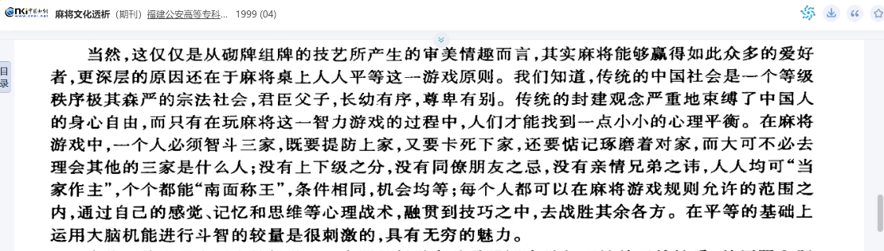
Interactive Social Structure
Mutual benefit from discards vs.
fear of "dealing in"
Aid and check behavior in
socio-psychological order
"Mutual restraint"
by Lin Guoqing

Slide 5
02.
Social Alignment

Slide 6
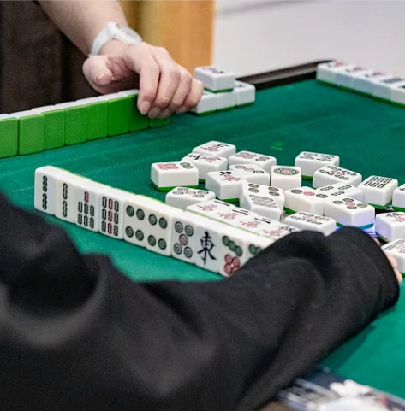
Focus on the left player
You must establish a kind of "interactive alignment" with the player to your left.
This lateral focus creates subtle cooperation and probing at the table.

Slide 7
Micro Public Spheres
Casual conversation
and
emotional maintenance
Social mechanisms weaving discourse and emotion
Breaks between games for information exchange

Slide 8
03.
Regional Variations and Social Encoding

Slide 9
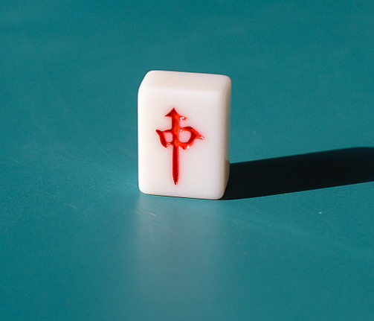
Changde vs. Changsha Styles
Changsha retains the "Chi" move
Changde abandons "Chi," uses Red Center as a wild card

Slide 10
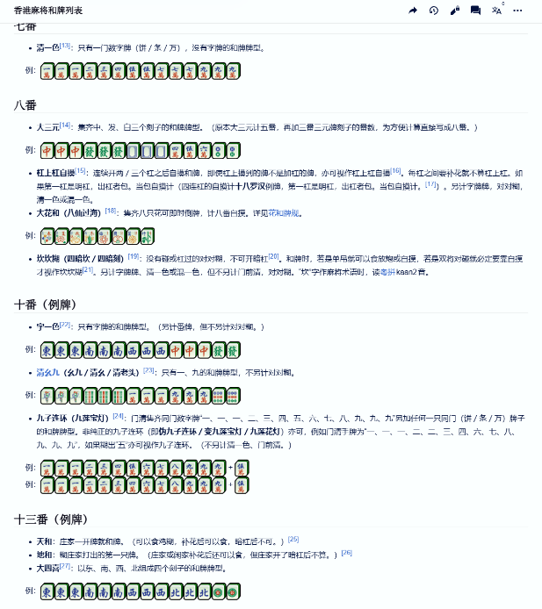
Sichuan Mahjong:
fast pace, offensive strategy
Hong Kong mahjong:
complex scoring, patience, and planning

Slide 11
04.
Social Significance

Slide 12
Movement into Domestic Sphere
01
Post-Republican era shift from teahouses to homes
02
Interviews in Shanghai and Hong Kong
Women organizing family games for kinship networks
03

Slide 13
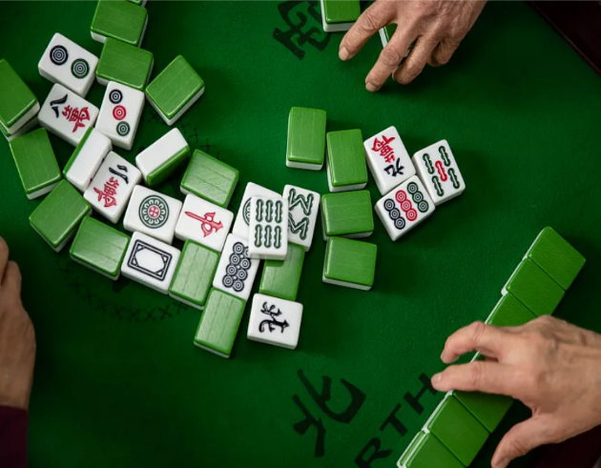
Competition and Balance
Mutual assistance vs. calculation
Incomplete information and risk management
“Reputation Effects”

Slide 14
Influence Rhythm of Interaction
Fast-paced: interruptions, jokes, quick restarts
Complex-scoring: silent calculation, debriefing discussions
Rules → Strategy → Interaction → Meaning

Slide 15
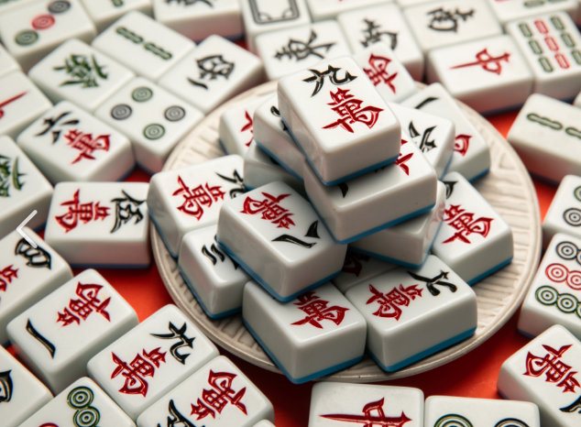
low stakes and strong social focus
“Mahjong is like society."

Slide 16
05.
Pleasures of Mahjong

Slide 17
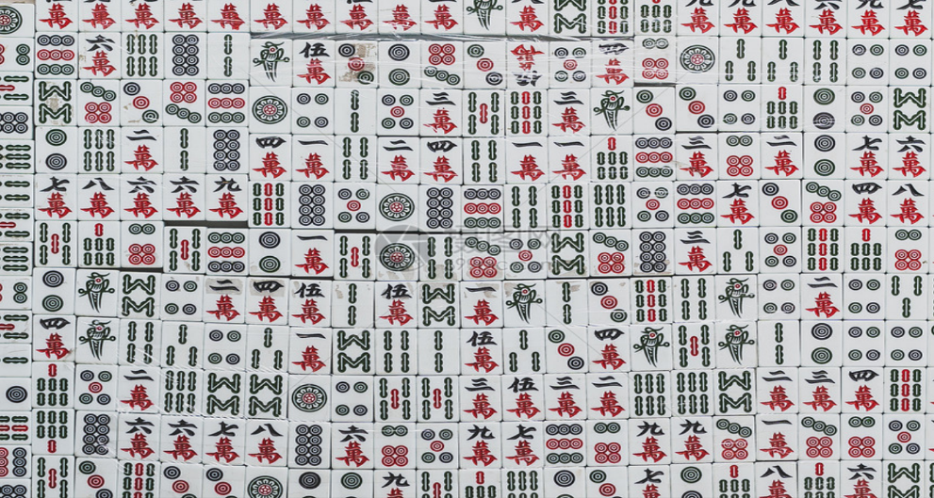
Threefold Pleasures
01
Safe interaction in cooperative-competitive boundaries
02
Soft connections via fragmented conversations
03
Shared imagination for "good luck is possible"

Slide 18
Thanks for Listening

