Slide 1
Catford’s Translation Equivalence Theory
黄逸妍 黄锦云

Slide 2
Catalogue
1
Definition of Translation
2
Textual Equivalence
3
Formal Correspondence
4
Conditions of Translation Equivalence

Slide 3
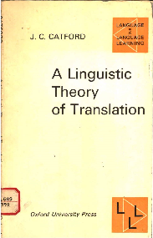
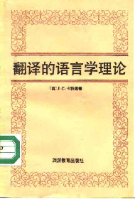
Definition of Translation
Translation：the replacement of textual material in one language (source language, SL) by equivalent textual material in another language(target language, TL). (Catford,1965:20)
Textual: it is not the entirety of an SL text that is replaced by TL equivalents.

Slide 4

text vs textual
English | What time is it?
French | Quelle heure est-it?

Slide 5
Textual Equivalent
A textual equivalent is any TL text or portion of text which is observed on a particular occasion, to be the equivalent of a given SL text or portion of text. (Catford,1965:27)
My son is six.
a translator
Mon fils a six ans.

Slide 6
Textual Equivalent
 | Version 1 | Version 2
SL | I bought this book yesterday. | I bought this paper yesterday.
TL | J’ai acheté ce livre hier. | J’ai acheté ce journal hier.
changed SL part
changed TL part
(textual equivalent)
paper = journal
book = livre
Textual equivalent: that portion of a TL text which is changed when and only when a given portion of the SL text is changed.

Slide 7
Formal Correspondent
English
Sentence
Clause
Group
Word
Morpheme
French
Sentence
Clause
Group
Word
Morpheme
A formal correspondent is any TL category(unit, class, structure, etc.) which can be said to occupy, as nearly as possible, the ‘same’ place in the ‘economy’(机体) of TL as the given SL category occupies in the SL. (Catford,1965:32)

Slide 8
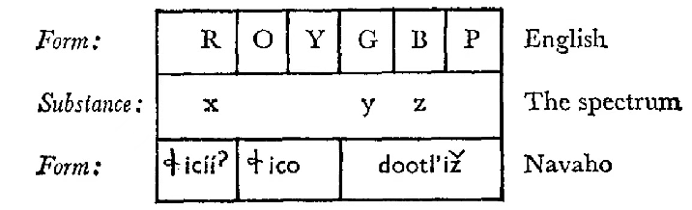
Conditions of Translation Equivalence
Translation equivalence occurs when an SL and a TL text or item are relatable to (at least some of ) the same features of substance. (Catford,1965:50)

Slide 9
Thanks
感谢大家的观看
Merci

