Slide 1
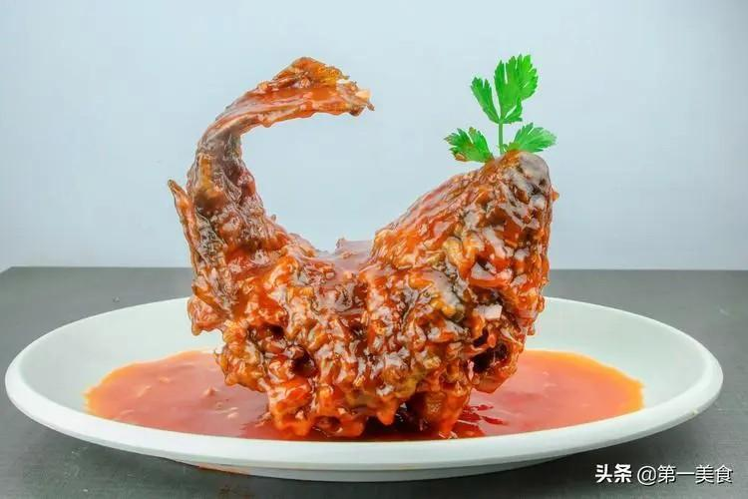
introduction to Shandong cuisine
Mellow and grand
The first among the eight major cuisines of China and the only northern cuisine.
It originates from the Qilu flavor in Shandong.
Taste characteristics: mainly salty and fresh.
Representative dishes: Sweet and Sour Carp, Nine-Twists Large Intestine, Braised Sea Cucumber with Scallions and so on.

Slide 2
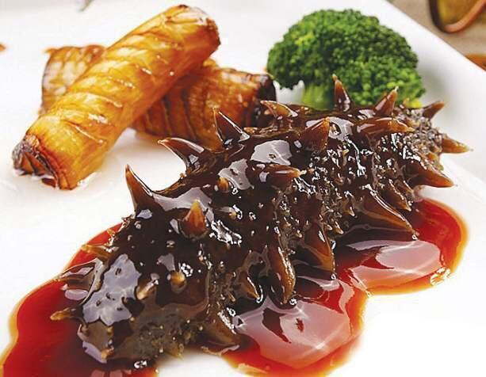
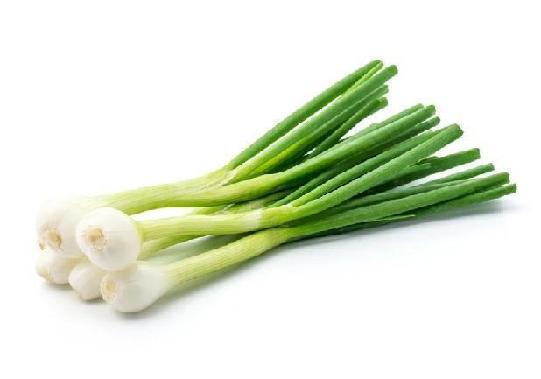

characteristics of Shangdong cuisine
It emphasizes excellent quality of raw materials and takes seafood, river delicacies, mountain delicacies and so on as the main ingredients.
Seasoning is particular. It is good at using seasonings such as scallions, ginger and garlic to highlight the salty and fresh taste.
There are rich cooking techniques. It pays attention to cooking duration and shaping.

Slide 3

a video of Shandong cuisine

Slide 4
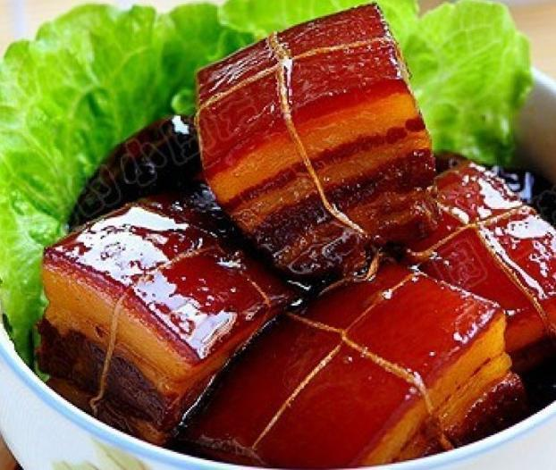
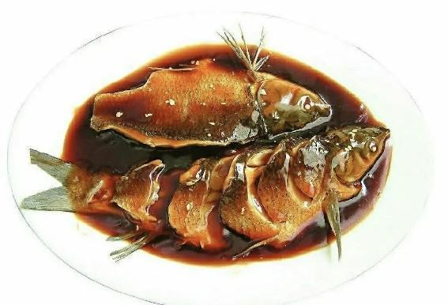
introduction to Jiangsu-Zhejiang cuisine
Jiangsu-Zhejiang cuisine includes Jiangsu cuisine and Zhejiang cuisine, and is mainly popular in Jiangsu and Zhejiang regions. It has a long history and profound cultural connotations.
Taste characteristics: fresh, delicate, exquisite, and elegant.
Representative dishes: West Lake vinegar fish, Dongpo Pork, beggar's chicken, Longjing shrimp

Slide 5
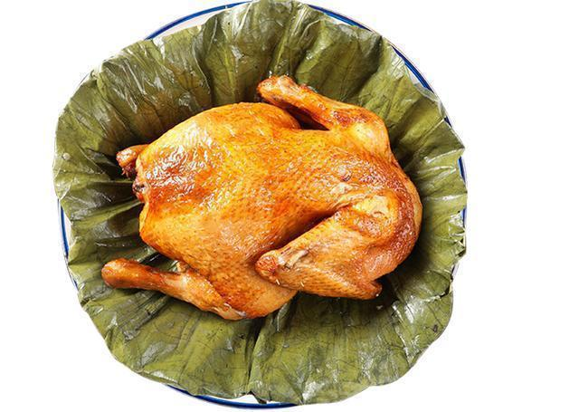
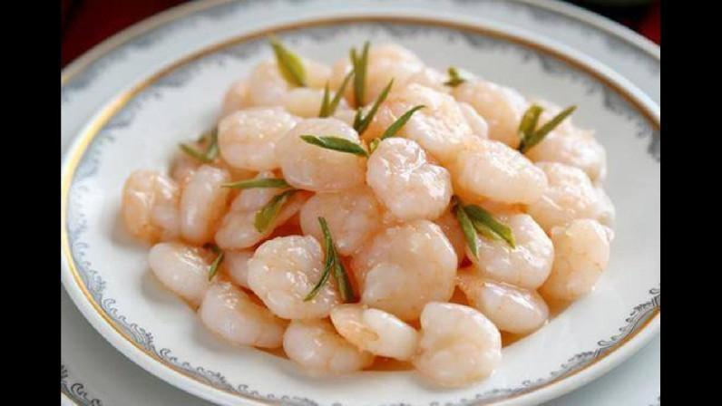
Characteristics of Jiangsu-Zhejiang cuisine
The selection of ingredients is strict, paying attention to the freshness and texture of raw materials.
The cooking methods are delicate, emphasizing knife skills and heat control.

Slide 6

a video of Jiangsu-Zhejiang cuisine

Slide 7
questions
1.Can you name a few representative dishes of Sichuan cuisine?
2.Which cuisine does Roast Suckling Pig belong to?
3.Which cuisine is the first among the eight major Chinese cuisine?
4.What are the characteristics of Jiangsu-Zhejiang cuisine?

Slide 8
summary
Sichuan cuisine, Cantonese cuisine, Shandong cuisine and Jiangsu-Zhejiang cuisine are the treasures of Chinese cuisine. Each has its own characteristics and represents the food culture and local customs of different regions. Whether it is the hot, spicy and fragrant Sichuan cuisine, the Cantonese cuisine with fresh and original flavor, the grand and mellow Shandong cuisine or the exquisite and elegant Jiangsu-Zhejiang cuisine, they are all worthy of our tasting and appreciation.

Slide 9
thanks for watching!

