Slide 1
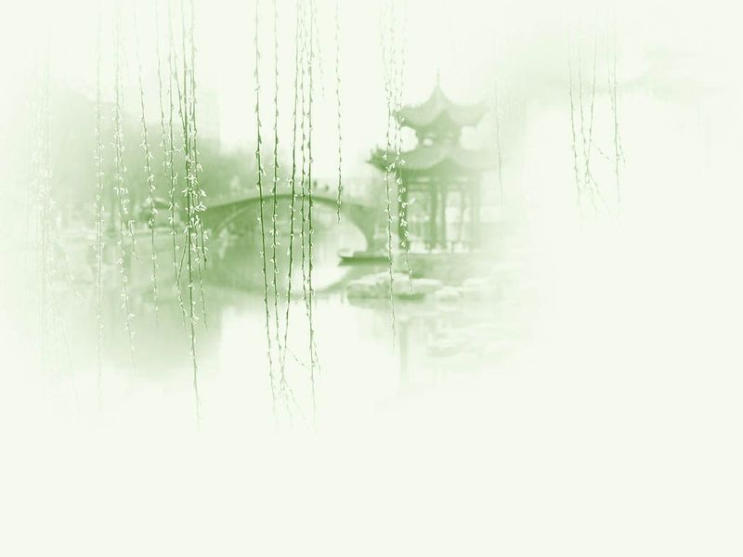
Unit 2 Traditional Festivals

Slide 2
Questions Concerning Section A
1. Why did ancient Chinese people start the year in late Jan. or early Feb.?
2. What is “年”? What does “过年” originally mean?
3. How do the Chinese celebrate the Lunar New Year?
4. What does “守岁” mean?
5. What is jiao zi? Why is it so popular with the Chinese?
6. What other customs of celebrating the New Year do you know?
7. How is the New Year celebrated abroad?

Slide 3
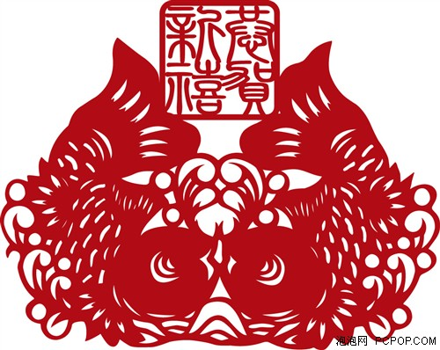
Why do we have fish during the Spring Festival?

Slide 4
Questions concerning Section B
1. Why is Jan. 15 of the lunar calendar called the Lantern Festival?
2. What do you know about the lantern exhibitions?
3. What is yuan xiao symbolic of?
4. How is the Lantern Festival celebrated in your hometown?

Slide 5
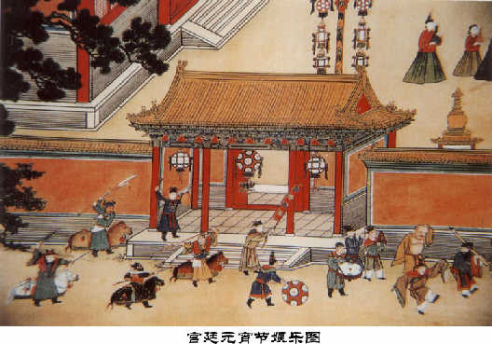
An imperial celebration

Slide 6
Questions Concerning Section C
1. What do you know about Qu Yuan?
2. How are Duanwu customs related to Qu Yuan?
3. What is zongzi?
4. Do you know any of Qu Yuan’s poems that are closely related to Hunan?

Slide 7
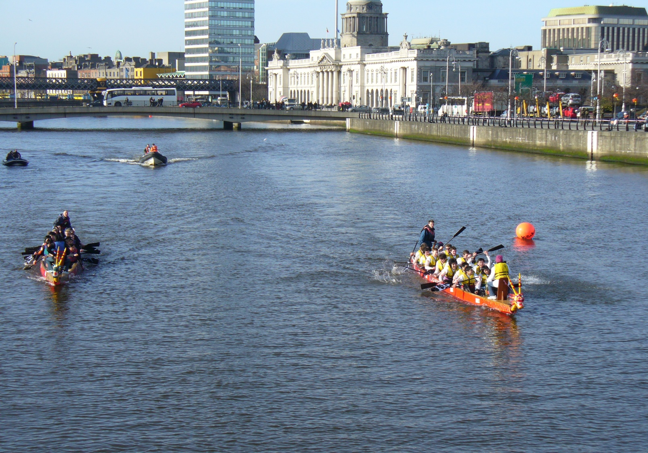
A dragon boat race in Dublin

Slide 8
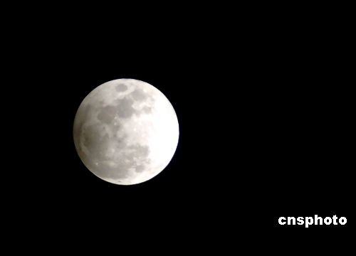
Questions Concerning Section D
1. Why is the Mid-Autumn Festival so-called?
2. Why is the Mid-Autumn Festival also known as “the day of reunion”?
3. What do you know about the legend of Chang E?
4. Is it romantic to share a moon cake with your family in the bright moonlight?

Slide 9
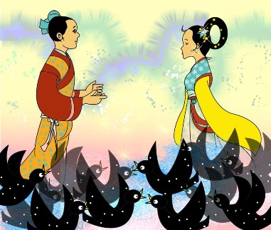
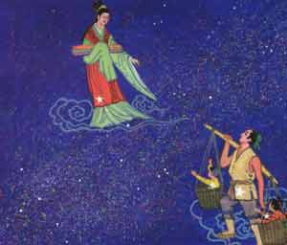
What do you know about the myth of Cowboy and Silas?

Slide 10
韩国江陵端午祭
江陵端午祭於2005年11月25日被聯合國教科文組織指定為世界文化遺產。江陵端午祭是以大關嶺城隍舉辦的祭祀為雛型，於端午節當天舉行的傳統慶典。端午祭自向神獻酒的農曆3月20日開始，一直到5月6日結束，端午祭於江陵南大川邊的端午場等地舉行。
端午祭上可以看到假面劇、端午巫術、盪鞦韆、尤茨遊戲等民俗遊戲及各種表演，還可以學唱歌或親手製作假面等。雖然端午節也是中國固有的民俗節慶，但韓國的端午節有不同的文化背景和傳統。
江陵端午祭是繼2001年的宗廟祭禮及2003年的板索裏(韓國清唱)後，又一個被指定為世界文化遺產的文化活動。

Slide 11
“祥和中国节”全球华人申遗活动
2010年 8月1日，由湖南广播电视台旗下七家广播媒体联合发起的“祥和中国节”全球华人申遗活动将在北京正式启动，一场遍及全年度的声势浩大的华人申遗倡议活动就此隆重拉开帷幕。
“全球华人申遗倡议”活动横跨七夕、中秋、重阳、春节、元宵五大中国传统节日，将汇聚已经申请成功的“中国物质文化遗产”项目，以各个节日为平台，使其能得以在世界面前进行魅力展示，进而推动人类对其的关注与保护。
本次“全球华人申遗倡议”活动是首次大规模联合中国大陆及港澳台、以及境外华人广播媒体的一次大联盟。旨在统一发声，为中国传统节日文化造势，激发数亿华人的爱国热情和民族情结。

Slide 12
Topics for discussion
1. The Dragon Boat Festival originated from China, but South Korea bid to UNESCO and had their celebrations of the festival (端午祭) inscribed in the List of World Cultural Heritage. What do you think of it?
2. Hunan Radio is cooperating with news agencies and government departments in preparing traditional festivals (祥和中国节) for the bidding to UNESCO. How urgent is it? Will these festivals be inscribed in the List of World Cultural Heritage?
3. Are traditional Chinese festivals losing their cultural value? Are they being increasingly commercialized?

Slide 13
See you next time!

Slide 14
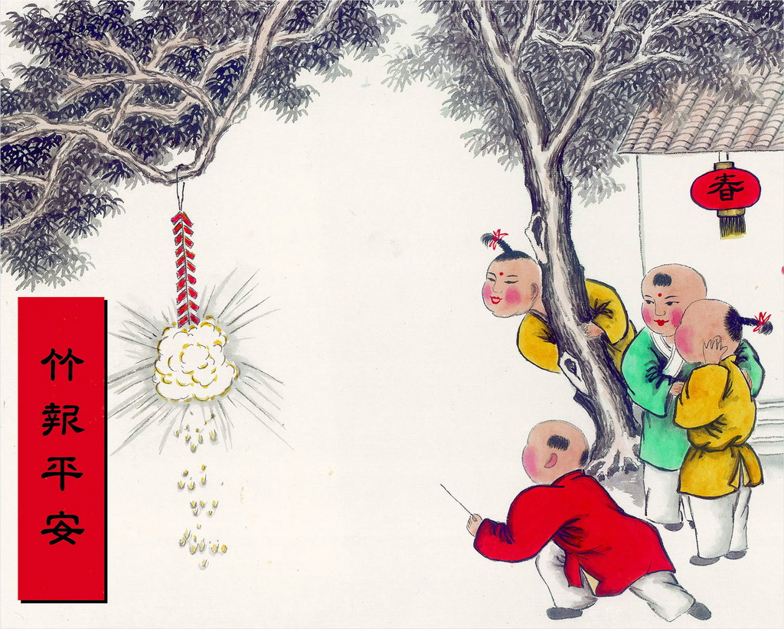
What is “年”? What does “过年” originally mean? ？
Firecrackers (爆竹)

Slide 15
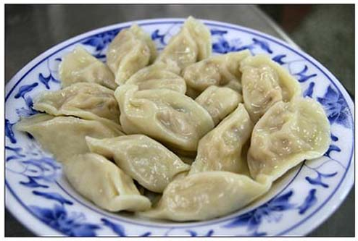
What is jiao zi? Why is it so popular with the Chinese?

Slide 16
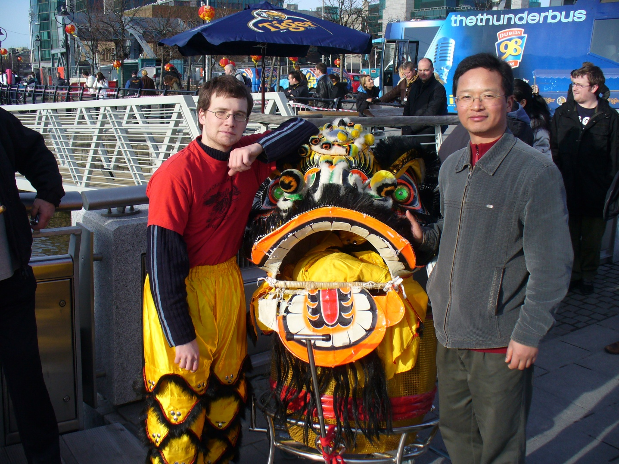
How is the New Year celebrated abroad?

Slide 17
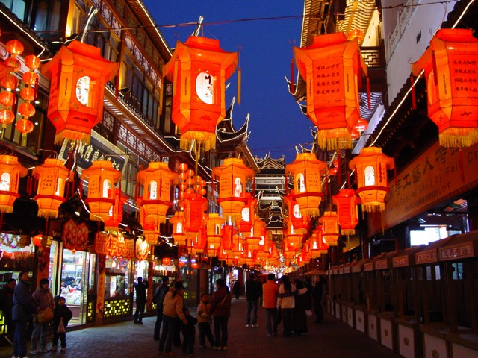
What do you know about the lantern exhibitions?

Slide 18
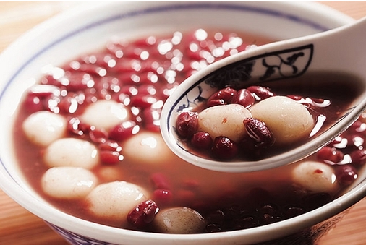
What is yuan xiao symbolic of?

Slide 19
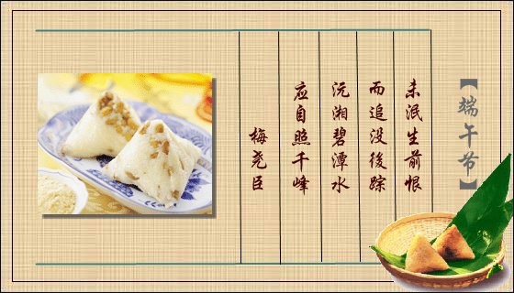
How are Duanwu customs related to Qu Yuan?

Slide 20
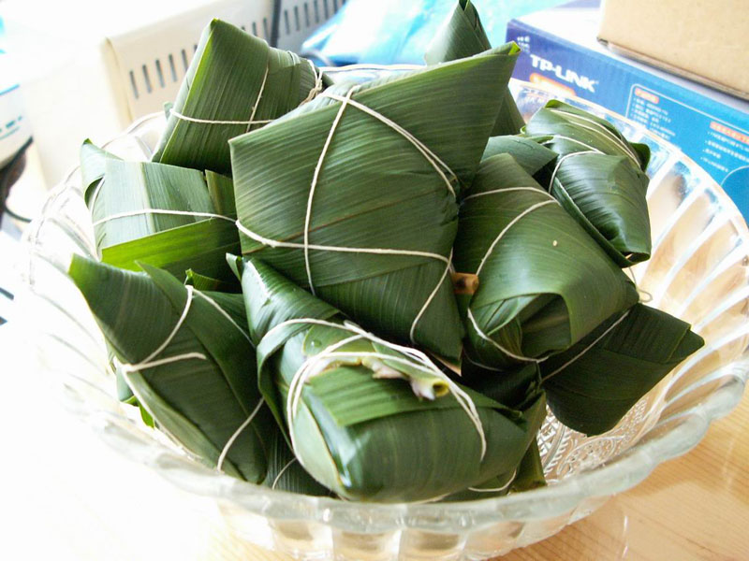
What is zongzi?

Slide 21
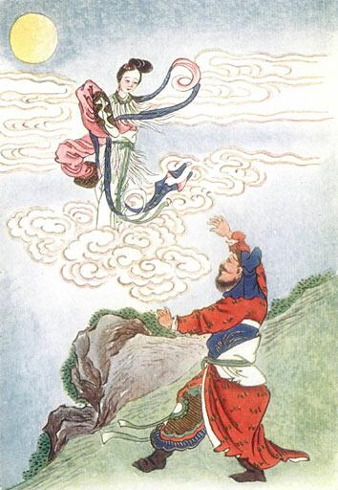
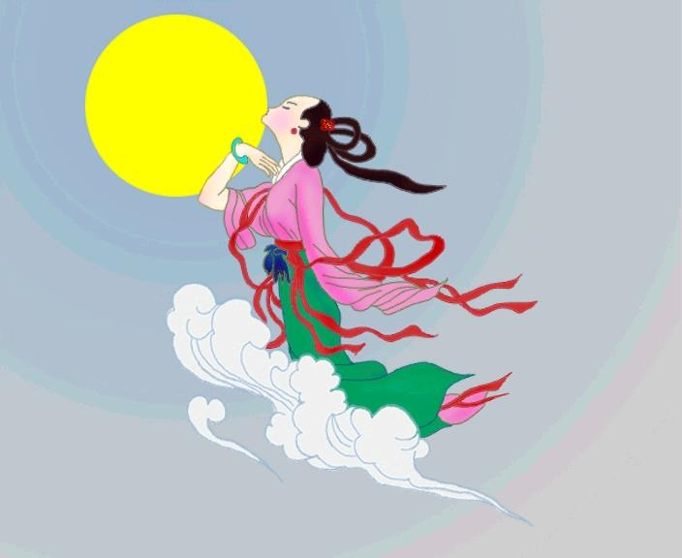
What do you know about the myth of Chang’e and Houyi?

