Slide 1


Post Tencent period
Mobile
Games
-Bloom of mobile games
FPS（First-person shooting game）
第一人称射击类游戏

Slide 2
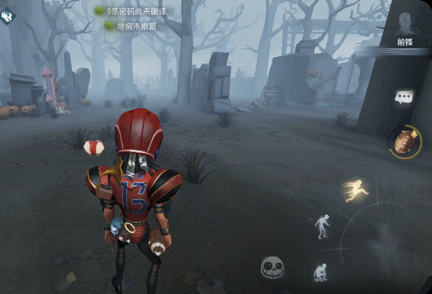

Post Tencent period
Mobile
Games
-Bloom of mobile games
Asymmetrical Battle Arena
非对称性对抗竞技类

Slide 3
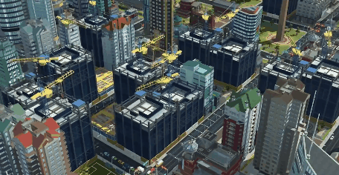

Post Tencent period
Mobile
Games
-Bloom of mobile games
SLG（Simulation Game）
模拟游戏

Slide 4
Post Tencent period
Mobile
Games
-Bloom of mobile games
RCG（Racing Game）竞速游戏
MSC（Music Game）音乐游戏
AVG/ADV恋爱养成游戏
SPG（Sport Game）体育运动类游戏
...

Slide 5

02
Current situation and trend

Slide 6

Mobile
Games
Current situation and trend
Expanding market scale
Expanding revenue scale
Promising prospect

Slide 7
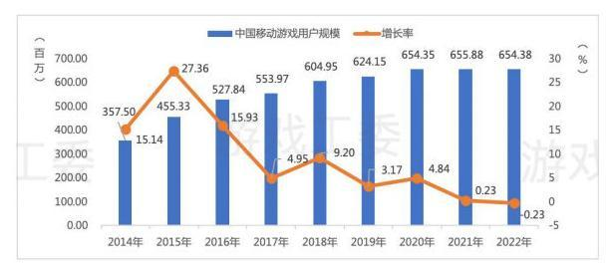
Expanding market scale
Mobile
Games
The scale of Chinese mobile games users

Slide 8
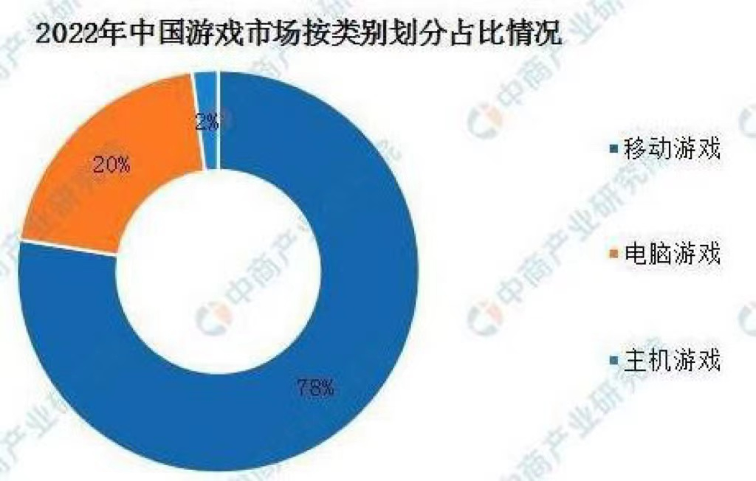
Expanding market scale
Mobile
Games
The scale share of Chinese game industry

Slide 9
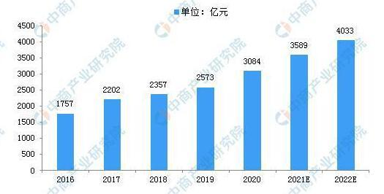
Expanding revenue scale
Mobile
Games
Chinese mobile games revenue

Slide 10
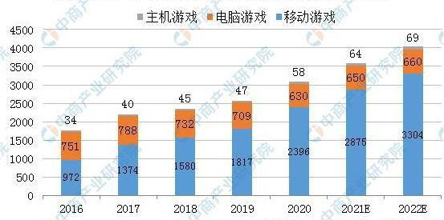
Expanding revenue scale
Mobile
Games
The revenue share of Chinese game industry

Slide 11

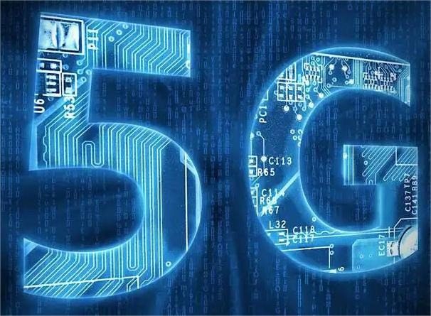
Promising prospect
Mobile
Games
Technology innovation promotes the development of mobile games
5G
Artificial Intelligence

Slide 12


Promising prospect
Mobile
Games
Technology innovation promotes the development of mobile games
Big Data(大数据)
Cloud Computing(云计算)

Slide 13
03
Social impact

Slide 14
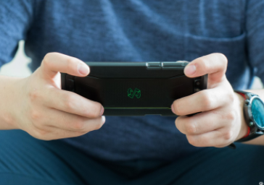
Social impact
Mobile
Games
Positive impact
Mobile games has created a large number of related industries and provided more employment opportunities for people.
Mobile games facilitate social communication and exercise intelligence
Mobile games is conducive to vigorously carrying forward Chinese culture and enhancing China's international influence.
Mobile games boost economic growth.

Slide 15
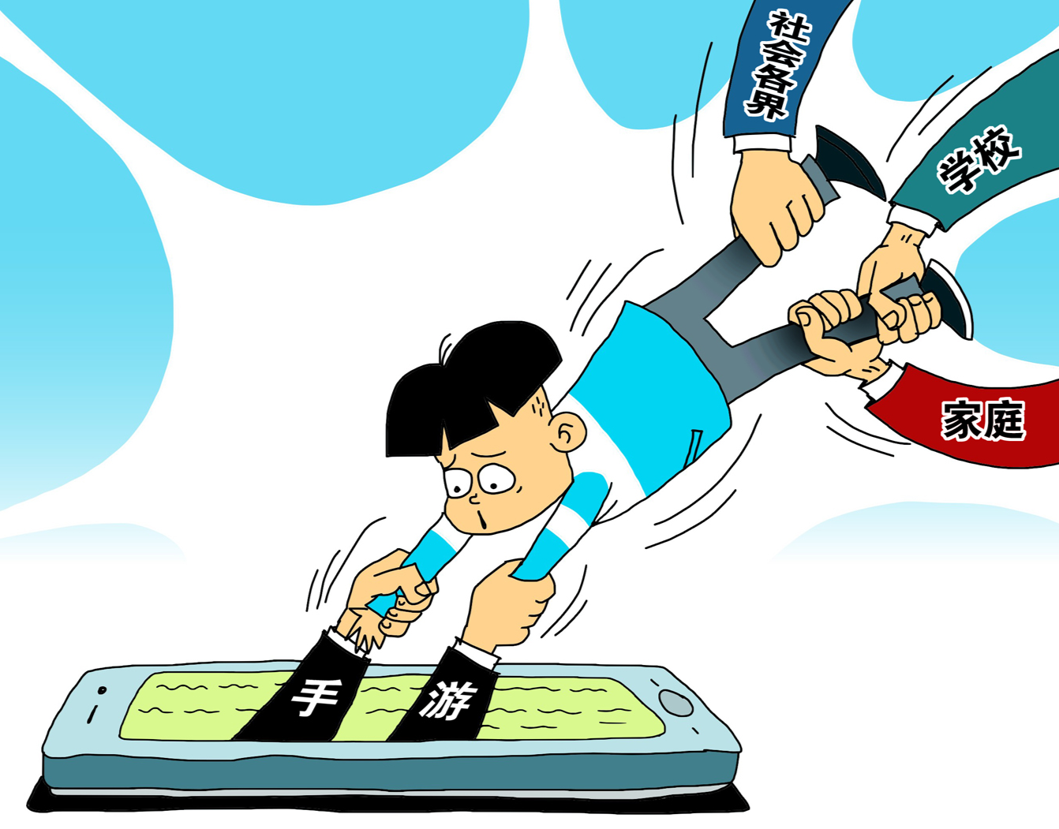
Social impact
Mobile
Games
Negative impact
Excessive immersion in mobile games may lead to wasted time, energy and money.
Mobile games affect people's mood, creating negative emotions.
Mobile games do harm to people’s health.

Slide 16
Thanks for watching!
谷钰婷

