Slide 1

中国语言文化
Chinese Language & Culture for Master Students of Translation Studies
湖南师范大学 2022年9月30日-2022年12月30日
中国文化基础 周五第十一和第十二节课19:00-20:40，
上课地点：外国语学院大楼_室, VooV: https://bit.ly/LangCult2022,
助教：Chen Ye
教授 Professor Dr. Ole Döring
培高德 教授 Professor Dr. Cord Eberspächer
吴漠汀特聘教授 Dist. Prof. Dr. Martin Woesler
湖南师范大学外国学院 Foreign Studies College, Hunan Normal University

Slide 2
Session 1 第一周
Session Overview 本节概览 (Organizational things)
Preparation:
1. WeChat group, rename yourself as
„Wang Jianguo王建国 21级笔译“
2. Register on course wiki https://bit.ly/WIKIREG (https://wiki.rub.de/uvu/index.php/Special:RequestAccount) input your username and real name (PINYIN!!!), first time password “wikicaptcha”更多资源：打开维基网站，请点击登录、申请，然后输入用户名字和真实姓名（以拼音的方式，第一次登录密码是“wikicaptcha”）
3. Start https://meeting.tencent.com/dm/G5AyUV10B0XA, #腾讯会议：531-816-070, VooV shortlink: https://bit.ly/LangCult2022. (All students need to turn on camera or will be blocked by student assistant. If Tencent does not work, here is an emergency Zoom session: https://bit.ly/ZOOMCOURSE.)
4. Access our course website http://bit.ly/LCFALL2022
5. Rate topics http://bit.ly/Topics2022, take part in EU survey http://bit.ly/EU-SURVEY, prepare texts/ppt

Slide 3
Session 1 第一周
Session Overview 本节概览 (Organizational things)
Self-introduction, student introductions (too many, so before presentation) 自我介绍，学生介绍 （学过口译麦恩慈大学、外交部、给总理、使馆、慕尼黑、翻译红楼梦、王蒙、韩寒等等。助教：Chen Ye）
Disclaimer: Course is recorded, all data and contributions incl. produced with students belong to teacher or (if indicated) to university, only published data will be stored longer than 10 years.
Contents, required textbooks, WeChat group 课程内容，课本，微信群
Review existing concepts (development from ethnocentrism to universalism), preview this semester‘s contents: 复习已有的概念，预习本学期的内容
What you will be able to do at the end of this semester 这学期结束时你能做到什么？
Jointly agree on commitment, use of classroom time, weight of grades 共同达成教室使用时间和成绩比重的协议

Slide 4
Self-Introduction 自我介绍
Ole Doering
Hunan Normal University, Full Professor 湖南師範大學，教授
Institute for Technology Futures at Karlsruhe Institute of Technology, Adjunct Professor 卡尔斯鲁厄理工学院，博士后（荣誉教授）
Peking University, School for Global Health, Adjunct Professor 北京大学全球健康学院兼职教授（荣誉）
Berlin Institute for Global Health, Co-Founder and Co-Chair 柏林全球卫生研究所，联合创始人兼联合主席
Tübingen, Göttingen, Hamburg, Bochum, Berlin, Shanghai,
Dunedin, Hongkong, 蒂宾根、哥廷根、汉堡、波鸿、柏林、上海、但尼丁、香港
Philosophy of Culture and Technology 文化科技哲学
Social, Life Science and Health Ethics 社会、生命和健康伦理学
Chinese Culture 中國文化

Slide 5
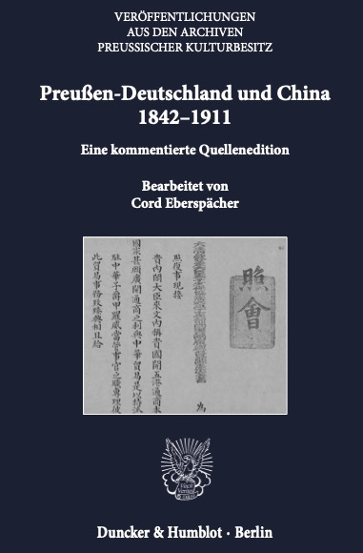
Self-Introduction 自我介绍
Cord Eberspächer 培高德
Hunan Normal University, Full Professor 湖南師範大學，教授
Friedrich-Wilhelms-University Bonn, Adjunct Professor 波恩大學兼职教授（荣誉）
World Conference of Sinology, Board Member 世界漢學大會理事會成员
German China Association, Board Member 德中協會理事會成员
Oldenburg, Hamburg, Leiden, Peking, Berlin, Bristol,
Düsseldorf, Peking, Bonn 奧爾登堡 漢堡 來頓 北京
柏林 布里斯托 杜塞爾多夫 北京 波恩
Modern Chinese History 中國近代歷史
History of Sino-German Relations 中德關係
Global History 全球歷史
Military/Naval History 軍史/海軍史
Historical Stereotypes 陈规定型在歷史
Chinese Culture 中國文化

Slide 6
Self-Introduction 自我介绍
Martin Woesler 吴漠汀
Xiaoxiang Scholar Dist. Prof., PhD supervisor 潇湘学者特聘教授、博士导师
Academian, Europ. Acad. of Sciences & Arts, Salzburg 欧洲科学院院士
Jean Monnet Chair Professor 让膜内主席教授
Int‘l Chinese Studies Centre, Director 外语学院国际汉学中心主任
Witten/Herdecke University, Researcher 德国维藤大学研究员
German China Association, President 德中協會主席
World Association of Chinese Studies, President 世界喊學研究會會長
Bochum, Peking, Harvard, Mainz/Germersheim, Witten, Harvard, Orem/USA, Rome, Peking Normal & Witten波鸿，北京，哈佛，美因茨/盖默斯海姆，威腾，哈佛，奥勒姆/美国，罗马，北师大&威腾
Essays (Western influence, social impact, cf.: blogs) 散文（西方的影响，社会影响）
Early literary translations 早期文学翻译
Literature Development (Canonization etc.) 文学的发展（经典，分类）
Early Western reception of Hongloumeng 《红楼梦》在西方的早期反响
Translation workshop (volunteers?) 翻译工作坊（有志愿者可以找我报名）

Slide 7
Your Introduction 学生介绍
Since we are too many students, please write your bio on your Wiki page:
https://wiki.rub.de/uvu/index.php/User:Lei_Feng

Slide 8
Schedule 学期题目
Organizational things, intro to intercultural communication
1 9.30
Your choice!
Old link will be updated: https://bit.ly/Topics2022
http://shijiehanxue.mikecrm.com/ac88d39

Slide 9
Ranking list of last term‘s votes
1 Movies: Chinese Movies 73%
2 Literature: Ancient literature: Chinese Classical Fairy Tales 71%
3 Global Impact of Chinese Culture 70%
4 Language: Chinese Dialects 70%
5 Literature: Ancient literature: Chinese Mythology 67%
6 Global Impact of Chinese Language 66%
7 Literature: Ancient literature: Four Folk Stories of Ancient China 65%
8 Song: Celadon and the Celadon Song 《青花瓷》歌词 64%
9 Literature: Premodern literature: Strange Stories from a Chinese Studio 64%
10 Stage entertainment: Crosstalk 相声 63%
11 Literature: Premodern literature - China's Four Great Classical Novels 63%
12 Social Media: Douyin (Tik Tok) 61%
13 Language: Chinese Folk Argot 61%
14 Literature: Ancient Literature - Four satirical novels in ancient China 60%
15 Literature: Ancient literature: Classical Literature 58%
16 Minority Languages in China 58%
17 Language: Chinese Language 57%
18 Song: Marriage Accompanying Songs in Hunan 57%
19 Language: How the language shapes the mind (comparison with other languages) 57%
20 Literature: Modern Literature: Qian Zhongshu (Ch'ien Chung-shu) 56%
21 Literature: Premodern literature: Tang-Song 56%
22 Literature: Ancient Literature - Take Su Shi as an example. Relegation Literature in Ancient China 55%
23 Literature: Modern Literature 55%
24 Language Styles (official, formal, written, colloquial, slang, sociolects, dialects, regionalects etc.) 55%
25 Translation: Oral Interpreting from and into Chinese 55%
26 Chinese Writing: Chinese Characters 54%
27 Globalization: The Westernization Movement 54%
28 Translation: Written Translation from and into Chinese 54%
29 Literature: Modern and Contemporary Literature: Literature, Science Fiction, and Fantasy 54%
30 Language: Ambiguity of Chinese Language (e.g. Tang poetry) 54%
31 Globalization: The Eastward Spread of Western Learning 53%
32 Literature: Premodern literature - Li Bai's “The River-Merchant's Wife: A Letter” and its translations 53%
33 Traditional Festivals: Spring Festival Couplets 53%
34 Literature: Ancient Literature: The Classic of Mountains and Seas 53%
35 Literature: Tang and Song - Classical Prose Movement of late Tang Dynasty and Song Dynasty 53%
36 Chinese Writing: Calligraphy 53%
37 Translation: Artificial Intelligence in Translation 52%
38 Opera: Peking Opera 52%
39 Language: Rhethorics and Propaganda in China 51%
40 Literature: Contemporary Literature 50%
41 Opera: Peking Opera Actor Mei Lanfang 50%
42 Opera: Hunan Flower-drum Opera (Huagu Opera) 50%

Slide 10
Use of time
Agreement on how to use time:
Homework before class
Reading before class
In Class: At least one oral contribution each session
Presentations once a semester

Slide 11
About grades 关于成绩
Expectation for grades 对成绩的期许
=
Requirements from the curriculum课程要求

Slide 12
About grades
学期论文（结合学期所学，撰写一篇
以上汉字或单词的论文）成绩占70%。

Slide 13
Unique Selling Points 独特的卖点
EU Expert Course – counts for Diploma Supplement
(EU multilingualism)
quality: based on experience in Germany (Bochum, Mainz/Germers-heim, UAL Munich, Witten), Italy (Rome III), the USA (Harvard, UVU) 质量：基于在德国、意大利、美国的经历
understand major literary trends with selection of extracts from main texts 理解重要课本中提取选择的主流文学趋向
jointly agree on: weight of grades 共同协议：成绩的比重
jointly agree on: your oral presentation will be documented in a wiki article and will be published 共同协议：你的口头展示会被收录到维基文章中并被公开
fellowship: get help of others and help others 同学/友谊：互帮互助
simple quizzes as reading response 对阅读反馈的简单测验

Slide 14
How to find resources
怎麽能找到參考資料
百科百度（起點，要看文章用的參考資料）
https://gg.xueshu5.com/ (MLA標準)
CNKI
圖書館
tupian.baidu.com、ppt on baidu
Ishare? Douban? books.google.de?

Slide 15
Session 1 第一次上课
1 Introduction: Organizational Things.
Prepare for next time: Choose your presentation topic (existing topic)
Unit 1, translate 1 sentence per text (ONLY FELLOW STUDENT CORRECTION)
2 Unit 1.
Homework: Reflect on last time: Write 1 tip for translation
Prepare for next time: Unit 2, translate 1 sentence/text
3 Unit 2.
Homework: Reflect on last time: Write 1 tip for translation
Prepare for next time: Unit 3, translate 1 sentence/text
…
16 Unit 15 – write new text book topic for final exam paper on wiki
(THE EARLIER, THE BETTER FELLOW STUDENT CORRECTION)

Slide 16
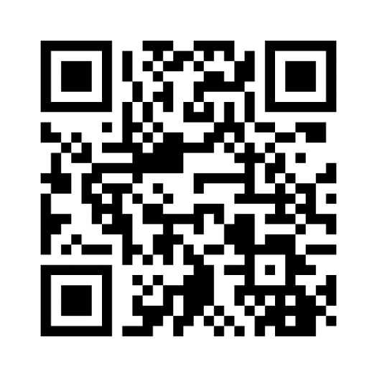
QUIZ
http://menti.com 2727 7506
https://www.menti.com/al9mzqvhgy4y

Slide 17
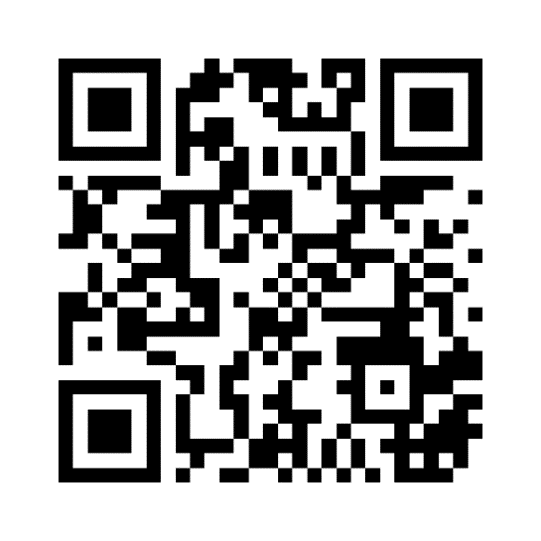
Expectations?
wordcloud
http://menti.com 4435 8061
https://www.menti.com/alu2eupgpyfx

Slide 18

Ask your teachers anything (anonymously)
http://menti.com 3656 1034
https://www.menti.com/alcnjfxn1dg3

Slide 19
纲 要
1, 传统的文化比较模块
2, 新的文化比较模块
3, 跨文化知识的例子
4, 构建全球化能力为国际性事业做准备
5, 讨论

Slide 20
纲 要
1, 传统的文化比较模块
2, 新的文化比较模块
3, 跨文化知识的例子
4, 构建全球化能力为国际性事业做准备
5, 讨论

Slide 21
传统的文化比较模块
例如：中国
被翻译为
“中心王国”，
罗马帝国，
拿破仑，
帝国主义，
殖民主义，
基督教化，
法西斯。
相近的：
伊斯兰教
文化 A
文化 B
1. 种族/民族中心主义的观点持续了上千年：自我文化主观定义外来文化。Perlmutter (1965)

Slide 22
传统的文化比较模块
文化 A
文化 B
2.通过文化A里的科学家的解释来了解文化B,但这些观点也只是片面，不完全的。Perlmutter (1965)

Slide 23
传统的文化比较模块
文化A
文化B
3.辩证的观点：意识到文化平等，同时意识到所有的文化是被其他文化定义的。Perlmutter (1965)

Slide 24
传统的文化比较模块
文化 A
文化B
4.对话的观点：通过持续的讨论以及参与者相互间平等的沟通达到自我及相互定义。 Yoshikawa (1982)

Slide 25
纲 要
1, 传统的文化比较模块
2, 新的文化比较模块
3, 跨文化知识的例子
4, 构建全球化能力为国际性事业做准备
5, 及讨论

Slide 26
新的文化比较模块
文化A
文化B
1.通过以下活动更新传统模块：1.交集：文化不是单独的圈。（例如：人类的共性，相似的发展）

Slide 27
新的文化比较模块
共性/相似的
显著特征
非显著特征
中心:
文化A
2.文化内部的复杂性

Slide 28
新的文化比较模块
文化A
背景文化要求较高
例如：中国
文化B
背景文化要求低
例如： 德国
3.文化的含量不会相同： Edward Hall将文化
分为背景文化要求较高和低的不同等级。

Slide 29

新的文化比较模块
人与人相互关系
时尚
正义感
宗教，信仰
烹饪
身体的理解
文化A
复杂化
音乐
神秘級別
语言
神话
交流

Slide 30
新的文化比较模块
全球化
文化B
英特网
旅游开放
文化A
文化碰撞

Slide 31
新的文化比较模块
文化B
文化A

Slide 32
新的文化比较模块
文化B
文化A

Slide 33

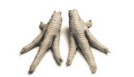
新的文化比较模块
文化B
文化A
文化比较

Slide 34


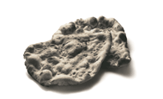
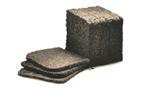





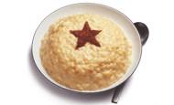
BEIJING: Speciality | AMSTERDAM: Speciality | PARIS: Speciality
ITALY: Bread | INDIA: Bread | GERMANY : Bread
SINGAPORE: Cutlery | UK : Cutlery | INDIA: Cutlery
BELGIUM: Festive treat | UK: Festive treat | SWEDEN: Festive treat

Slide 35
新的文化比较模块
文化B
文化A
建立新的文化岛屿

Slide 36
新的文化比较模块
文化B
文化B‘
文化A
建立另一个文化的地图

Slide 37
纲 要
1, 传统的文化比较模块
2, 新的文化比较模块
3, 跨文化知识的例子
4, 构建全球化能力为国际性事业做准备
5, 讨论

Slide 38
跨文化知识的例子:
常态分布
A
的
文
化
标
准
B
的
文
化
标
准
偶尔 频繁
弱 握手 强
Alexander Thomas 教授的常态分布

Slide 39
中德文化比较
Täglich drei Mahlzeiten. / 三餐
Die Künstlerin Liu Yang 刘扬, geboren 1976 in Peking, eröffnete 2004 nach Absolvieren der Berliner Kunsthochschule in Berlin ihr eigenes Atelier. Sie zeigt die Kulturunterschiede D-C in Symbolen.

Slide 40
Kontakte / 人际关系

Slide 41
Laune Wetter / 心情和天气

Slide 42
Lebensstil / 生活方式

Slide 43
1970
2006
Transport / 交通工具

Slide 44
Senioren im Alltag / 老人的生活方式

Slide 45
Ich / 自我

Slide 46
Sonntags auf der Straße / 周末街景

Slide 47
Das Kind / 孩子

Slide 48
Schönheitsideal / 美丽的标准

Slide 49
Bei Bauchschmer / 胃痛时的饮品

Slide 50
Pünktlichkeit / 准时

Slide 51
Reisen / 旅游

Slide 52
Warteschlange / 排队

Slide 53
Duschzeiten / 淋浴

Slide 54
Vorstellung vom Anderen / 理想中的对方

Slide 55
Meinung / 意见

Slide 56
Party / 聚会

Slide 57
Im Restaurant / 餐厅分贝

Slide 58
Umgang mit Problemen / 处理问题

Slide 59
Neuheiten / 对待新的事物

Slide 60
Ärger / 对待愤怒

Slide 61
Im Trend / 时尚

Slide 62
Chef / 领导

Slide 63

跨文化知识的例子： 观点的转换
0.8

Slide 64
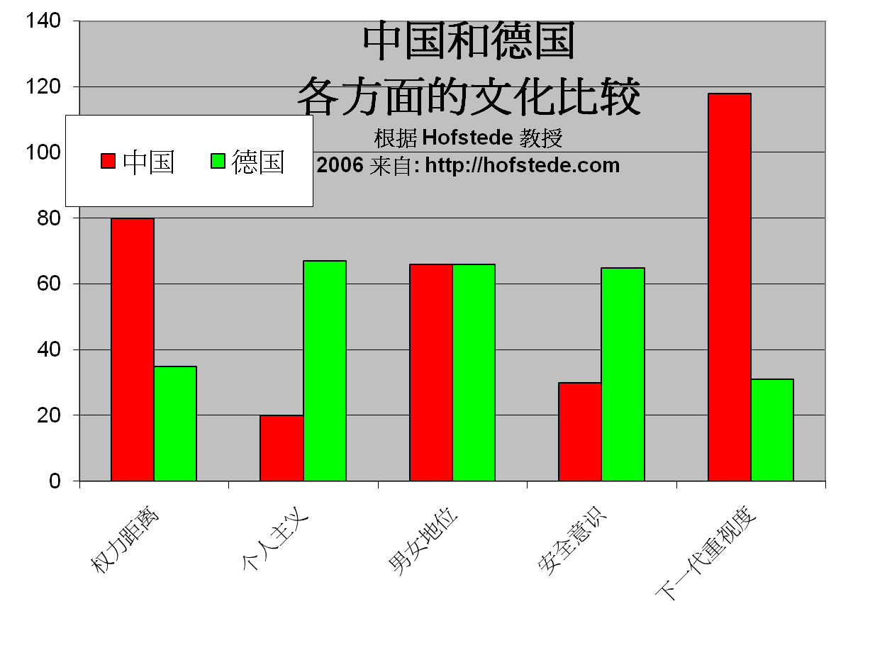
跨文化知识的例子:
类别比较

Slide 65
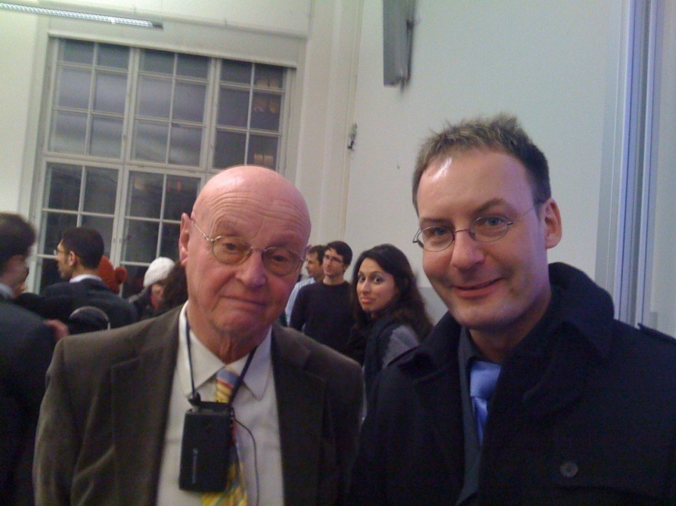

Slide 66
参考文摘
Hall, Edward T. (1977), Beyond Culture, New York: Anchor Book/Doubleday
Hofstede, G. (2006): Lokales Denken, globales Handeln. München:dtv
Oberg , K. (1960): Cultural shock : ajustment to new cultural environments , in Practical Anthropology , Bd . 7 , S . 177 – 182
Thomas, A. (2003): Handbuch interkulturelle Kommunikation und Kooperation, 2 Bde, 2. Aufl. Göttingen: Vandenhoeck & Ruprecht, ISBN 978-3-525-46186-0
Woesler, M. (2006): A new model of intercultural communication - critically reviewing, combining and further developing the basic models of Permutter, Yoshikawa, Hall, Hofstede, Thomas, Hallpike, and the social-constructivism, Europäischer Universitätsverlag, ISBN 978-3-89966-188-0, 52 S.

Slide 67
纲 要
1, 传统的文化比较模块
2, 新的文化比较模块
3, 跨文化知识的例子
4, 构建全球化能力为国际性事业做准备
5, 讨论

Slide 68
构建全球化能力为国际性事业做准备
中国劳工市场日益全球化（许多工作涉及海外，全球各大跨国企业已经进入中国， 海外工作机会，国际投资涌入中国）----跨文化能力不是选择性的，而是必须有的，因为世界已经进入中国。
中国本科生常无法找到让自己满意的工作，所以他们希望深造。
全球趋势：麦肯锡研究发现，生产工人数量在减少（15%），中间商（44%）及高级（41%）的中间商数量在增加
一种解决方法：出国深造（首选：美国；2 . 英国；3. 德国）
-------语言，跨文化经验，个人发展

Slide 69
新的“国际化人才”
麦肯锡的最新研究结果
  “生产人员”数量下降（生产线等）----在美国只有15%，很多工作被机器代替。Web2.0
  “对话互动人员”占统治地位（例如销售人员，中层管理人员）---在美国仍然还有44%
  在互动交流的工作中，需要较高技巧性的部分在增加 (复杂的判断和决定，例如像护士、财务总监、总经理）---今天在美国还占41%，他们在各自级别中获得最高的薪金

Slide 70
纲 要
1, 传统的文化比较模块
2, 新的文化比较模块
3, 跨文化知识的例子
4, 构建全球化能力为国际性事业做准备
5, 讨论

Slide 71
Foundations of Chinese Cultures
About Chinese culture around the world: the importance
About the course: the contents
About the studying: preview the unit; answer questions; interpret the text; discuss and translate.
About homework: translate 1 passage per unit
About grading: 20% from homework; 10% from classroom performance; 70% from the final test

Slide 72
About the teaching
1. Answer the questions after each section and see if the students have previewed the text and how well they’ve mastered it.
2. Interpret cultural phenomena and terms and expressions of high frequency in the text.
3. Introduce related topics and invite students to comment.
4. Grade students’ essays.

Slide 73
Questions concerning Introduction
1. How large is China?
2. What are the countries that China borders?
3. What do you know about China’s coastline?
4. What’s China’s climate like?
5. What’s China’s general land surface like?
6. What do you know about China’s vegetation and animal life?

Slide 74
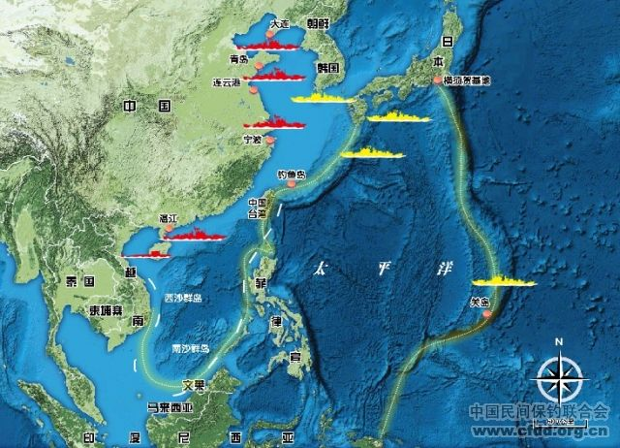
How large is China?

Slide 75
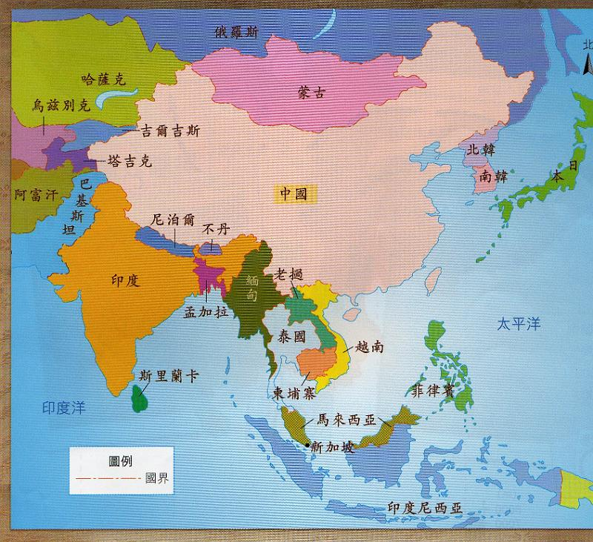
How many countries border China?

Slide 76
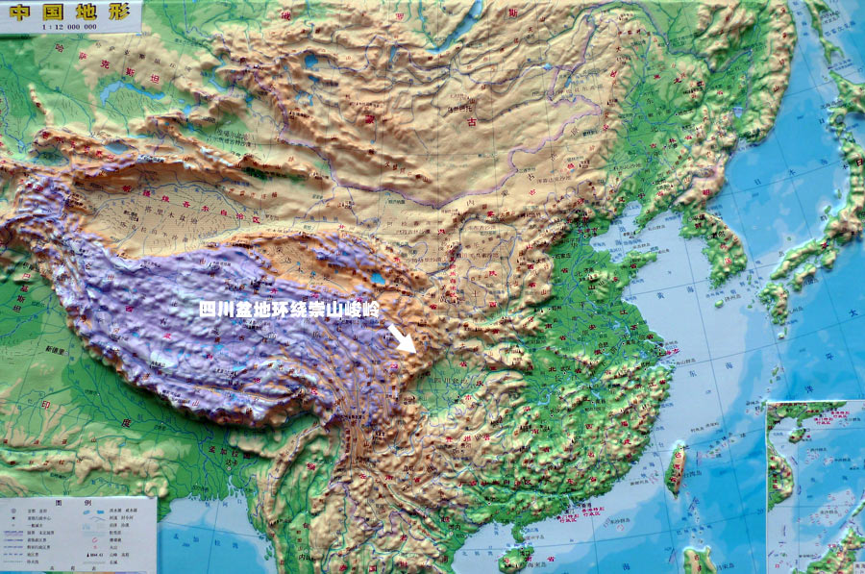
What is China’s land surface like?

Slide 77
1A(1) Geopgraphy: Text
Reading (e.g.: take turns)
Discussion
News (new developments, new vocabulary)
  „Nine-dotted line“
  Islands in the South China sea
  „Greater China“

Slide 78
1B(2) Economic Reform and
Opening Door Policy: We Chat Quiz
Please answer the following questions by sending the information LIVE to the TA Carol – DO NOT POST IN GENERAL GROUP!!!

Slide 79
1B(2) Economic Reform and
Opening Door Policy: We Chat Quiz
Please answer the following questions by sending the information LIVE to the TA Carol – DO NOT POST IN GENERAL GROUP!!!

Slide 80
1B(2) Economic Reform and
Opening Door Policy: We Chat Quiz
What Special Economic Zones can you name?

Slide 81
1B(2) Economic Reform and
Opening Door Policy: We Chat Quiz
What Special Economic Zones can you name?
Shenzhen, Zhuhai, Shanto, Amoy; Yangzi River Delta, Pearl River Delta, Southeast Area of Fujian Province, Bohai Bay; Hainan Island: special economic area; Pudong

Slide 82
1B(2) Economic Reform and Opening Door Policy
New: On August 2019 Xinhua announced 6 new pilot free trade zones in Shandong, Jiangsu, Guangxi, Hebei, Yunnan and Heilongjiang, bringing the total to 18
Source: http://www.xinhuanet.com/english/2019-08/26/c_138339873.htm or https://bit.ly/2n5Cqax

Slide 83
Questions concerning Section B, Unit One
1. When did New China begin to open to the outside world?
2. What changes have taken place in China’s economy?
3. How many special economic zones of China can you name?
4. What progress has been made in China’s economy?
5. What problems are there with the economic development?
6. How shall we adapt state enterprises to the situation?

Slide 84
Questions concerning Section C, Unit One
1. What do you think of Confucius’ saying---“nothing is lofty except schooling?”
2. What do you know about China’s educational system?
3. What do you think of the Hope Project?
4. What do you know about China’s adult education?
5. What progress has been made in traditional Chinese medicine recently?

Slide 85
1C(3) Education and Public Health
Discussion
News?

Slide 86
Preparation for next week
Please prepare all texts of Unit 1, look for related sentences in the internet, translate, write 1 translation tip

Slide 87
Always here for you!
随时为你们服务
Full Professor Dr. Ole Döring
Full Professor Dr. Cord Eberspächer 吴漠汀
Distinguished Professor Dr. Martin Woesler 吴漠汀
湖南师范大学特聘教授，博士导师
Office / 办公室: 外国语学院415
国际汉学中心309
Phone / 电话: (150) 1138 8818
(德国+49 178 2073538)
Email / 电子邮件: wmt@hunnu.edu.cn

Slide 88
Thank You

