Slide 1

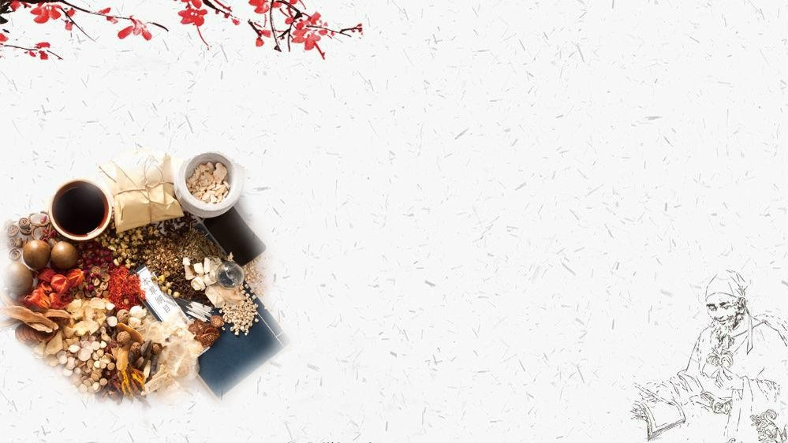
Development
of
Chinese
Medicine
By Tang Bei & Wang Meiling

Slide 2
Contents
1. Definition
2. Development history
3. Summary

Slide 3
Definition
Trational Chinese Medicine/Materia Medica
1. drugs in Traditional Chinese Medicine
2. Chinese traditional pharmacology and pharmacology monographs
e.g.: Compendium of Materia Medica

Slide 4



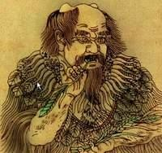

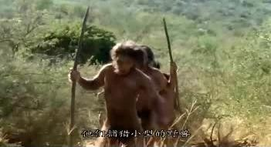
primitive society (ancient times - 21st century B.C.)
accidently eat → gradually learn → accumulate experience
“Shennong tries everything”
TCM originated from life and production practice

Slide 5



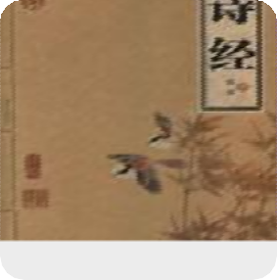
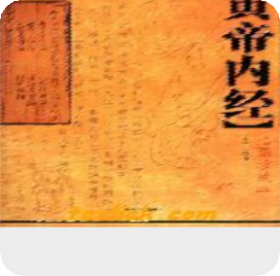


Xia, Shang, Zhou and pre Qin (21 century B.C. - 475 B.C.)
【oral transmission → record the knowledge of drugs in words】
the book of songs： the earliest known books recording medicine knowledge
Shanhaijing：has an important influence on the development of pharmacology
Inner Canon of the Yellow Emperor ：
the basis of Pathology, acupuncture and diagnostics

Slide 6

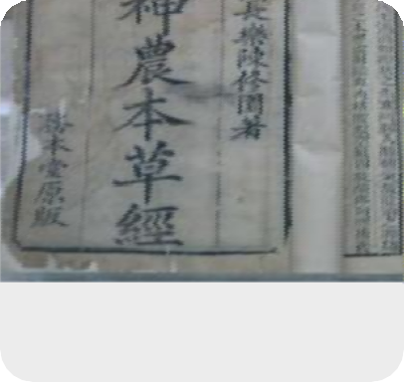

Qin and Han Dynasties (475 B.C.-265 A.D.)
【 The Herbal Canon of Shen Nong】
completed in the early Eastern Han Dynasty
features: 1). record the first three-grade classification method 2). a brief and comprehensive discussion on the basic theory of TCM 3). The drug was simple and tested, and has been used ever since

Slide 7

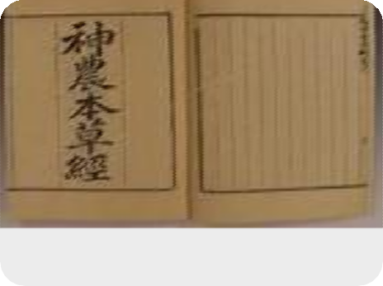

Qin and Han Dynasties (475 B.C.-265 A.D.)
【 The Herbal Canon of Shen Nong】
Academic value:
the earliest extant herbal monograph laid the foundation for the compilation of large-scale backbone materia medica in China.

Slide 8



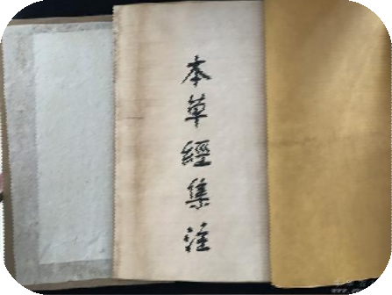

Jin, Sui, Tang Dynasties (265A.D.-960 A.D.)
【Shen Nong's Herbal Classic notes】
Author:Tao Hongjing
Features: 1). the first to classify drugs according to their natural attributes; 2). the first to create “universal drugs for various diseases”.
Academic value: the second classic of Materia Medica laid the foundation for the compilation of large-scale backbone materia medica in China.

Slide 9
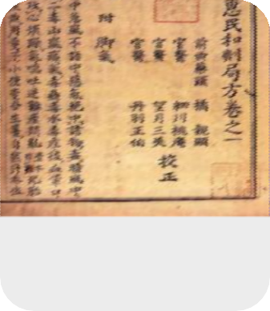
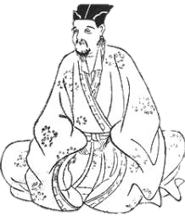

Song, Liao, Jin and Yuan Dynasties (960 - 1368)
【 Kaibao Material Medical】
the rise of official herbal
21 volumes and contains 983 kinds of new and old medicines
made a great contribution to the collation of herbal literature before the Song Dynasty

Slide 10
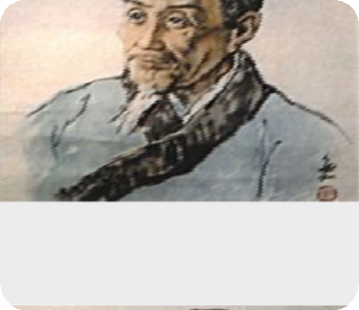
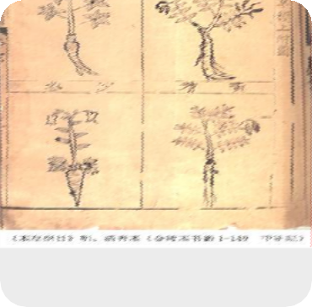


Ming and Qing Dynasties (to the Opium War) (1368 - 1840)
【 Compendium of Materia Medica】
Academic values:
1. summarize the theoretical content of drug properties before the Ming Dynasty, and preserve a large number of medical literature
2. The part of main drugs for all diseases is a model for classification of diseases and syndromes according to efficacy.

Slide 11
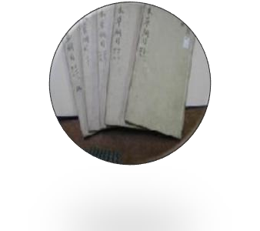
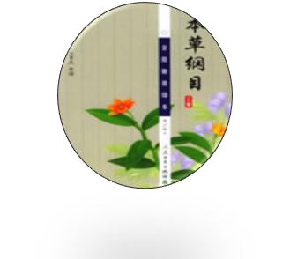
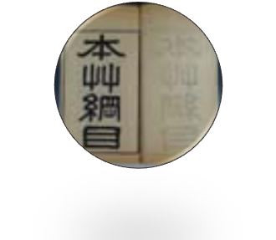
Ming and Qing Dynasties (to the Opium War) (1368 - 1840)
【 Compendium of Materia Medica】
Influences:
1). a comprehensive summary of pharmacology in China before the 16th century
2). provides useful information and experience for the research and application of herbal medicine
3). an important milestone in the history of pharmacy in China

Slide 12
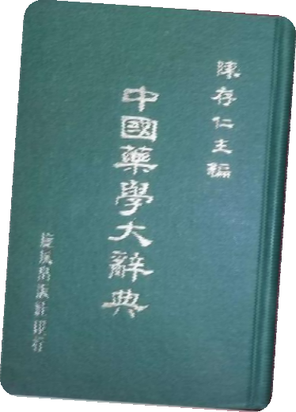

The period of the Republic of China (1911-1949)
The school of traditional Chinese medicine was established, and a number of Chinese medicine teaching materials emerged, which enriched the discussion on the functions and indications of each medicine.
Chinese Pharmacy Dictionary :
a large reference book of pharmaceutical dictionary, with 2 million words and 4300 entries.

Slide 13
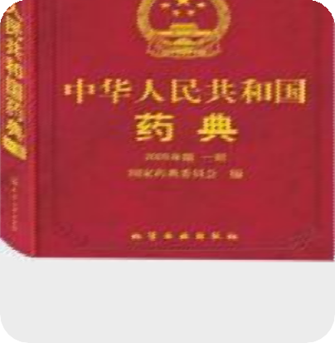

After the founding of People's Republic of China (1949 - present)
The state has organized experts from all walks of life to preserve and sort out special books on classical Chinese medicine, and has compiled many large-scale works, such as Chinese Medicine Record, National Collection of Chinese Herbal Medicine, Traditional Chinese Medicine Dictionary.
The Pharmacopoeia of the People's Republic of China: compiled by the Chinese Pharmacopoeia Committee, which contains 5608 kinds of drugs.

Slide 14
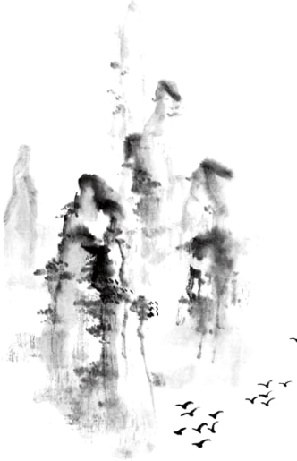
Development of the TCM: 1). simple to complex, low to high end 2). related to politics, economy, science and culture in various periods of society. 3).systematic and scientific summary of practical experience and a great treasure house In the near future: carry forward the past open up in the future make more brilliant achievements!
Summary

Slide 15
Thanks!
By Tang Bei & Wang Meiling

