Slide 1
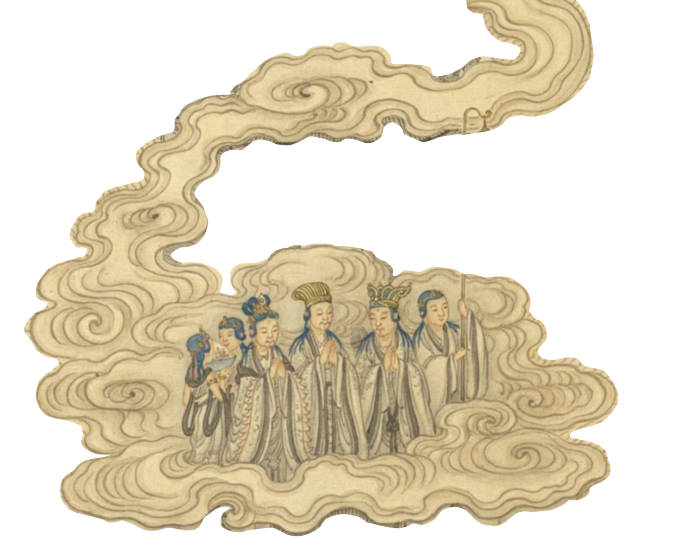
Buddhist Mythology System
During the reign of Emperor Ming of the Han Dynasty, Indian Buddhism began to be introduced into China.
The White Horse Temple in Luoyang has been revered by Buddhist disciples as the "origin of the teachings," marking it as the birthplace of Chinese Buddhism. Through long-term propagation and development, Chinese Buddhism has evolved with distinct national characteristics.

Slide 2
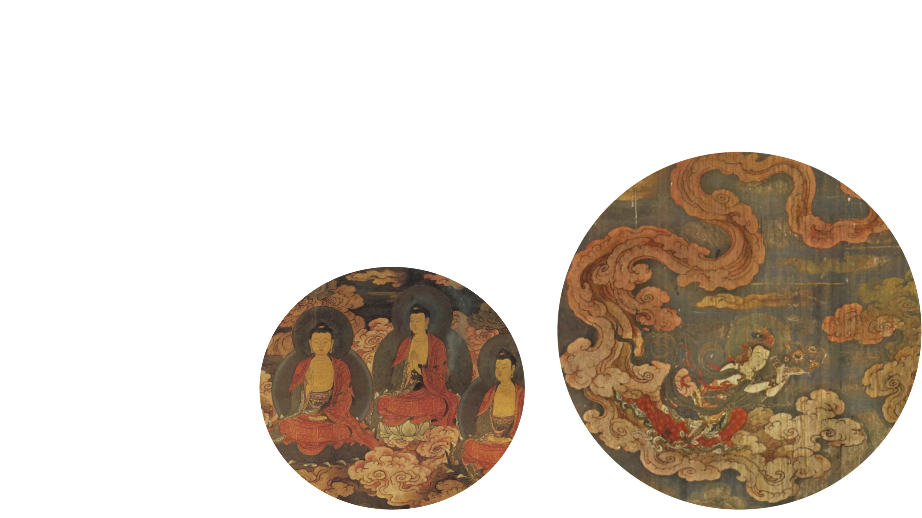
Three Buddhas of the Three Periods
Three Buddha Bodies
Four Great Bodhisattvas
Five Dhyani Buddhas
Eight Bodhisattvas
Ten Great Disciples
Eighteen Arhats
Eighteen Devas
Twenty Heavenly Guardians
Ten Kings of Hell
Main Buddhist Immortals

Slide 3
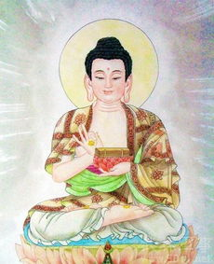
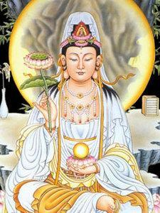
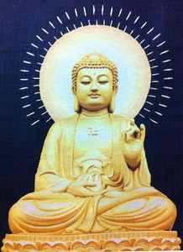
Buddha (Shakyamuni)
Bodhisattva Avalokitesvara
Amitabha

Slide 4

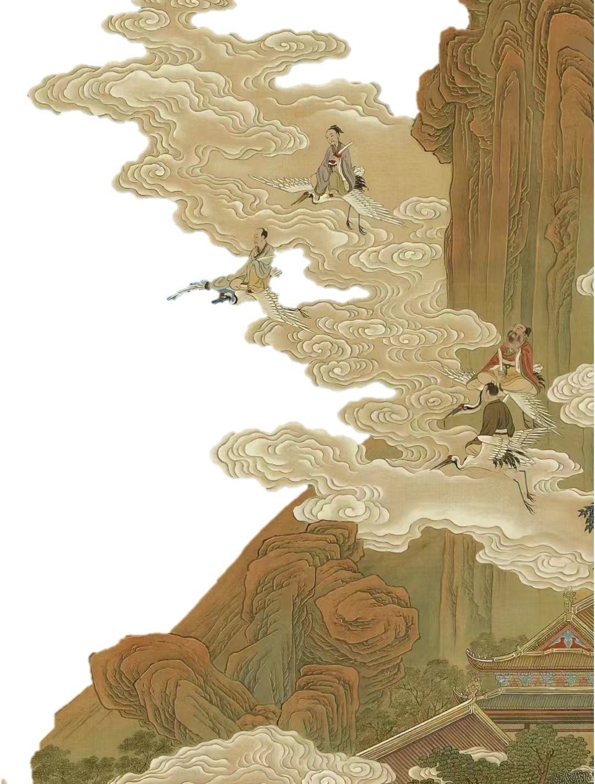
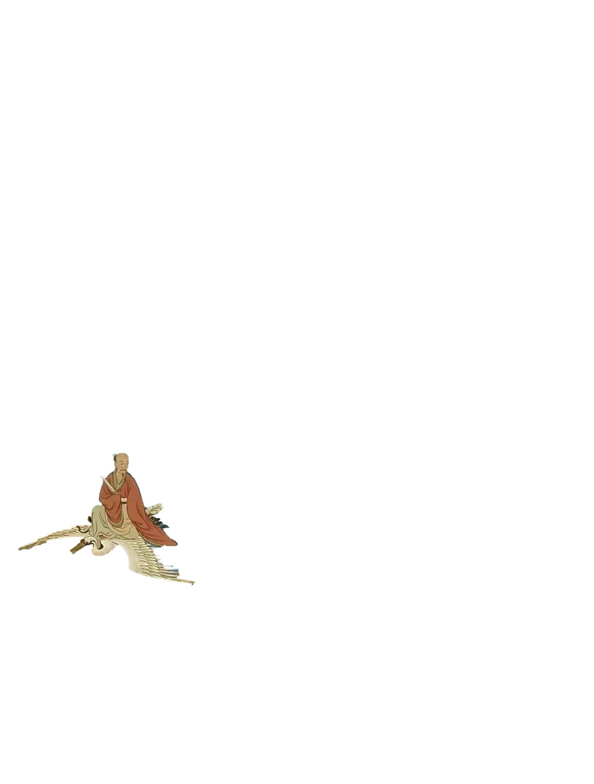
Differences Among
Shén, Dì and Xiān

Slide 5
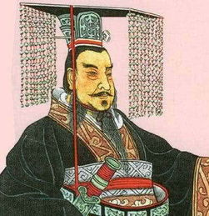
Dì 帝
Dì, sometimes translated as “thearch”, implies a manifested or incarnate “godly” power. During the time of Zhou dynasty to the Warring States, Dì is used to refer to those who have great moral cultivation and merits. And then it becomes a term of emperor since Qin dynasty.

Slide 6
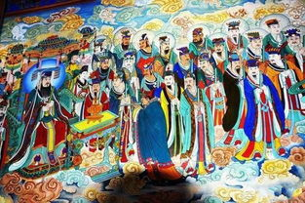
Shén 神 VS Xiān 仙
Although the usage of the two is sometimes blurred, it corresponds to the distinction in Western cultures between “god” and “deity”.
The gods usually have their own position and take charge of different things. While immortals, unlike gods, have no official positions. It is that certain humans develop the ability to live indefinitely, avoiding death, and becoming divine immortals.

Slide 7
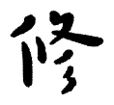
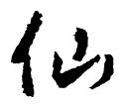
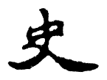
China’s Folklore of
Immortal Cultivation

Slide 8
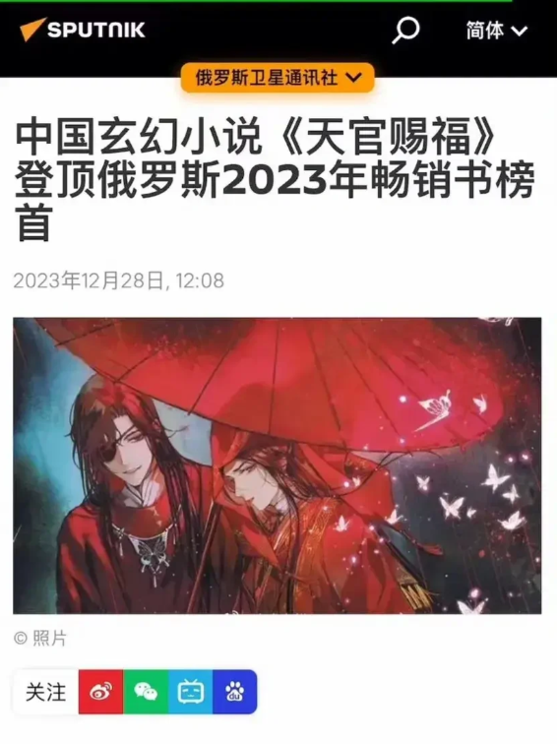
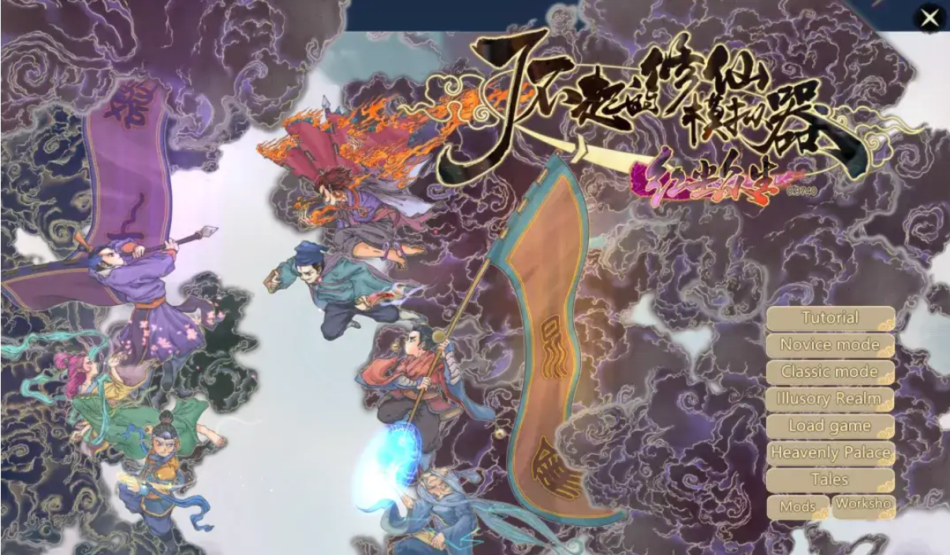
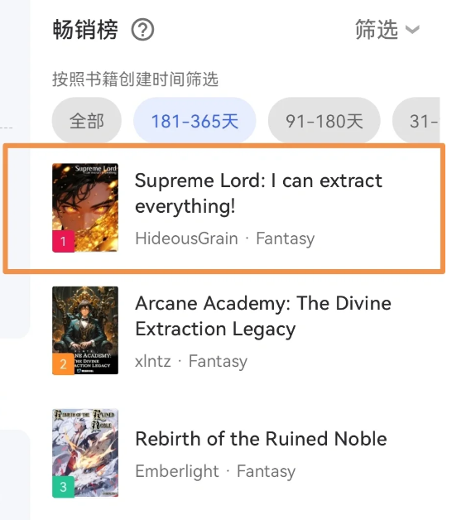
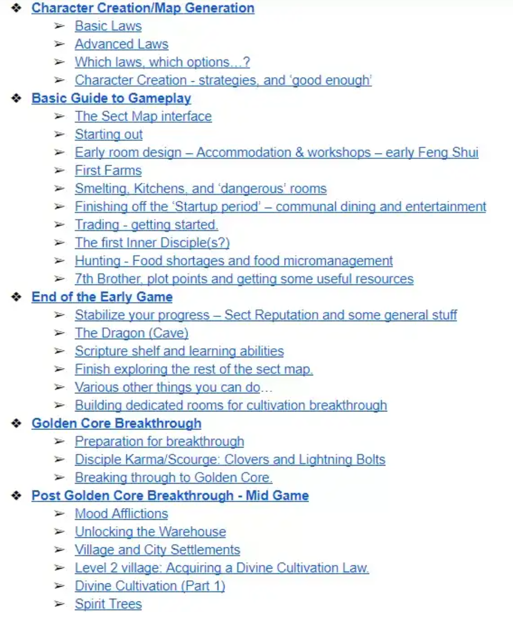
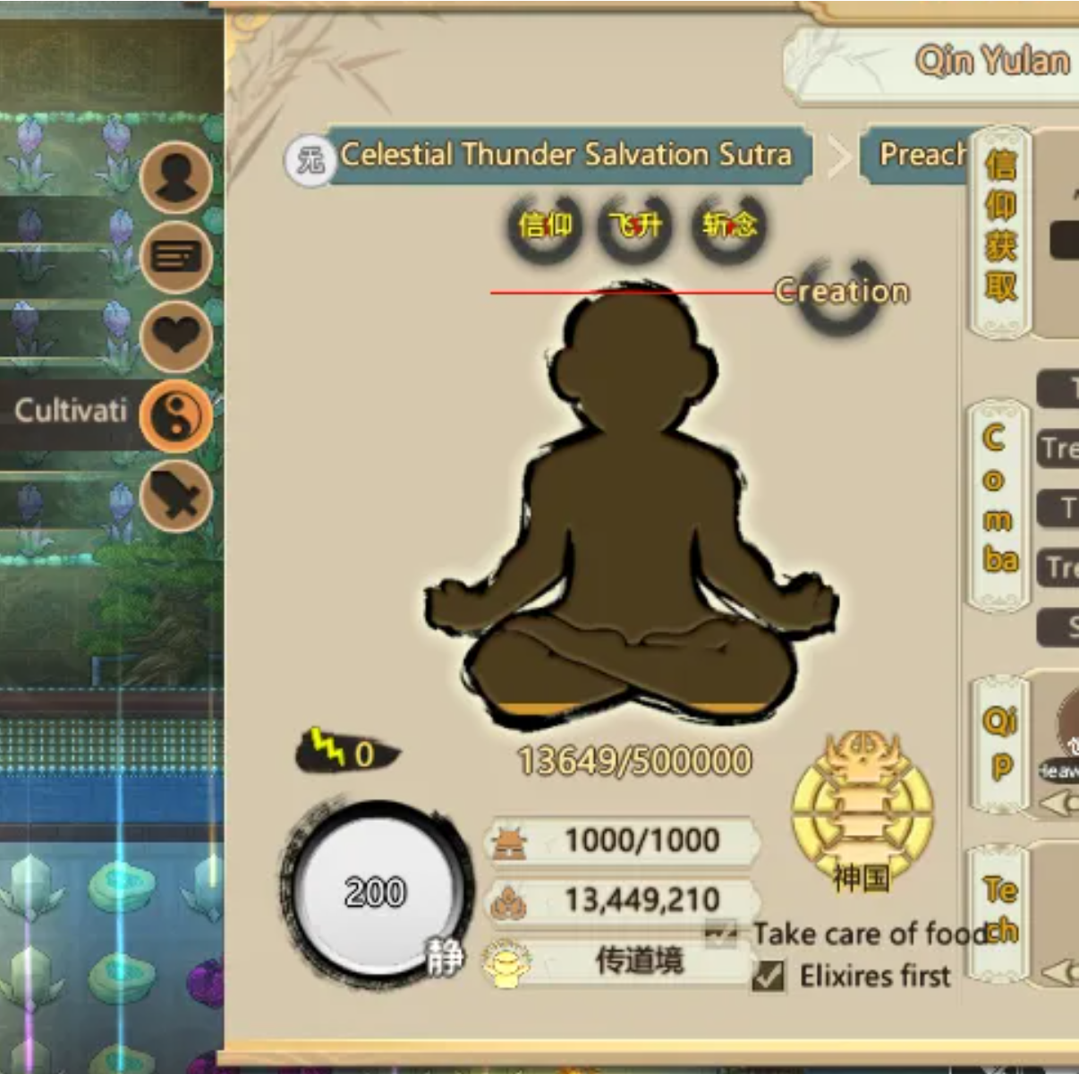
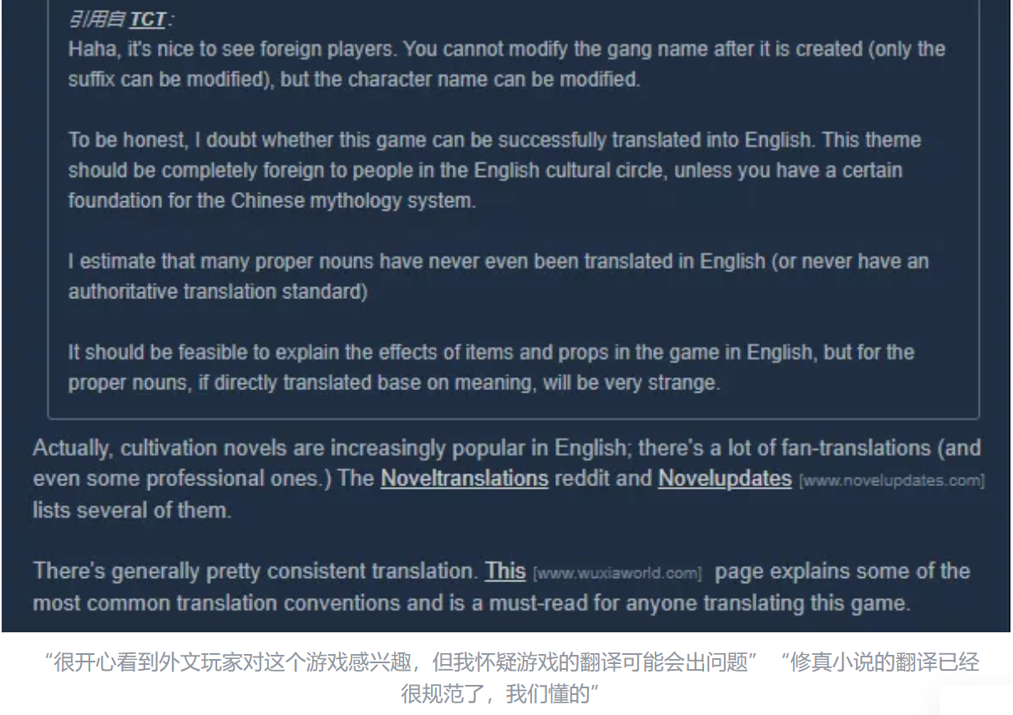
修仙 immortal cultivation

