Slide 1
The Merchant Class in the Ming Dynasty
Vernacular novels and fiction in China
Brandon Heil

Slide 2
Historical Background
Four Occupations
The four occupations, 士農工商, were possibly based off of Confucian principles and date back to the Zhou Dynasty.
They were divided in order of importance from the Shi, the Nong, the Gong, and the Shang.
The Shi were the gentry, the Nong were the peasant farmers, the Gong were artisans or craftsmen, and the Shang were merchants.

Slide 3
The Shi were held as the highest of the four occupations, while the Nong, the farmers, produced food and were thus important to society. The Gong sometimes formed guilds, if they happened to become successful enough; they were not believed to be as important as the Nong.
The Shang were considered the lowest of the four occupations because they did not produce goods, but profited on the work of the Gong and Nong. Even so, they were valuable and necessary to society.
Throughout the various Chinese dynasties, the social standing of the Shang changed; the four occupations were held more as an ideal rather than a realistic hierarchy.

Slide 4
The Song and Ming Dynasty
The Shang became more prominent in the Song and Yuan Dynasty and gained unprecedented importance in the Ming Dynasty. The class distinctions between merchant and gentry became blurred as the merchant class gained more wealth and property.
During the Ming, a class of merchant elite formed, with a profound effect on literature. This new wealth led to new cultural pursuits for the merchant class. It also opened opportunities for men of the merchant class to progress through the examination process. Essentially, wealth from merchant families allowed for pursuits, like the gentry have previously enjoyed.
At the same time, there was an awareness of class differences; writing and writers from the Shang class were often called Shishang.

Slide 5
With an increase in foreign trade, particularly things like European silver which was exchanged for goods like silk, merchants obtained more money than other classes, especially the peasants and craftsmen. While idealistically, those two groups were held above merchants, the influx of money into the merchant class allowed new social standings for merchants.
While merchants gained wealth, craftsmen, particularly those relating to printing, such as woodblock carvers and other people working within the growing publishing industry, also gained a significant amount of wealth compared to previous dynasties.

Slide 6
Vernacular Writing
During the Ming, vernacular writing became more common. Due to the efforts of editors like Feng Menglong and popular novels such as Plum in the Golden Vase, vernacular writing flourished.
This type of writing became popular first in the Tang, in collections of stories akin to folklore.
In addition to story collections, colloquial songs gained popularity in the Ming. With the Revivalist School establishing a desire for poetry to express emotions, colloquial songs were popular among the cultural elite and the common people.

Slide 7
Li Mengyang
Li Mengyang was a scholar that came from a merchant family.
He was part of the Revivalist School, and he was the first to give scholarly credence to the play The Western Wing.
Li had a troubled career as a scholar due to his dedication to the Revivalist School. Eventually, he was forced to leave his career, but he remained an active, and vocal writer.
Li's interest in The Western Wing and popular song could be explained by his family origin as merchants.

Slide 8
Growth of Vernacular Writing
Vernacular writing gained prominence in two ways.
Through editors like Feng Menglong and novels like Plum in the Golden Vase, vernacular writing gained respect, putting it closer to the level of poetry, fu, and other classical writing.
Other writings, like drama and popular songs, in the Ming and other dynasties, helped lead to the importance of later vernacular writing.
With groups like the Revivalists, which valued emotion over form, vernacular works like drama and song gained eminence within the gentry.

Slide 9
Feng Menglong
Feng Menglong was an editor who compiled numerous collections of vernacular writing.
His collections of stories are similar to the older collections of strange tales, transcribed from vernacular folk stories.
One of Feng Menglong's most popular works was the Jingshi Tongyan, a collection of cautionary vernacular stories.
While he was a writer, he is best known for his work as an editor and his compilations of stories.

Slide 10
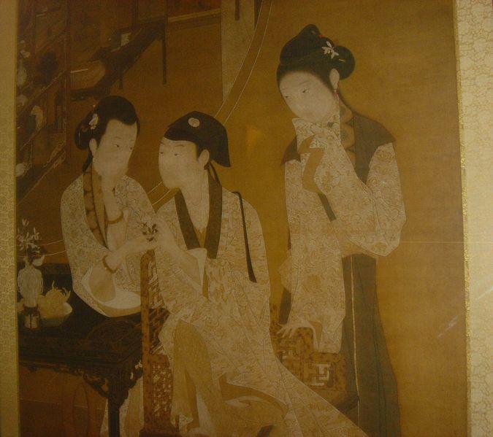
Plum in the Golden Vase
Jin Ping Mei
A novel written anonymously from the 1590s and completed only after 1606.
Throughout the Ming, it remained largely unchanged, something unique for longer vernacular fiction, like Journey to the West, which appeared in different editions with many changes.

Slide 11
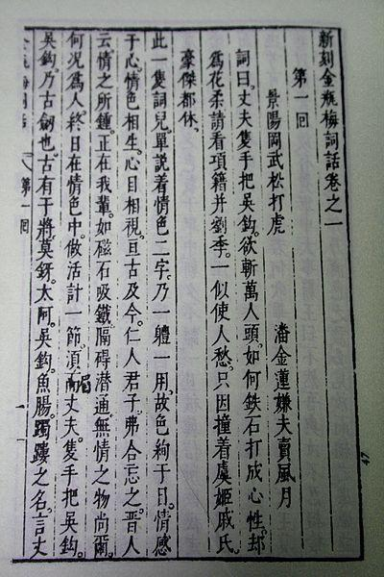
While written anonymously, it was initially distributed in a handwritten manuscript form, which implies that it was written by cultural elite.
The novel was the first written work of this length that was not based on an earlier story. It was also one of the first novels to focus on the domestic aspects of life.
During the Qing, it was considered a part of the Chinese canon, although somewhat older novels maintined precedence, often called "The Four Great Classical Novels."
Plum in the Golden Vase was banned for most of its existence because of its explicit depictions of sex

Slide 12
Many of these works dealt with the merchant class, such as the main character of Plum in the Golden Vase, Ximen Qing. While that novels investigates the fall of the Ximen household, a merchant family, the novel appealed to a wide audience.
Other works, such as Feng Menglong's collections of stories, and other vernacular writing, appealed to the growing merchant class.
During the Ming, print culture and literacy expanded and vernacular writing appealed to a broader audience.

Slide 13
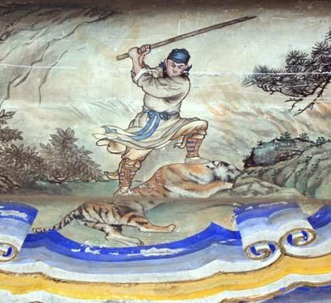
The Four Great Classical Novels
These novels are considered fundamental novels in Chinese literary history. Not all of them come from the Ming dynasty, such as the Dream of the Red Chamber, which was written in the late 18th century.
The novels include Water Margin, Romance of the Three Kingdoms, Journey to the West, and Dream of the Red Chamber. All four were written in vernacular Chinese like Plum in the Golden Vase, although these novels also had classical Chinese, as well.

Slide 14
Printed writings in the middle and late Ming began to appeal to subgenres, with categories like historical novels or a new interest in women writers.
Vernacular writing had the benefit of not being necessarily written for the elite class, although the cultural elite were the ones reading most of the texts.
Vernacular writing, however, appealed to other classes, such as the merchant elite.

Slide 15
Excerpt from Feng Menglong's "Du Tenth Sinks the Jewel Box in Anger"
The Last barbarians swept away, the imperial seat is established;
soaring dragons and dancing phoenixes--a majestic scene!
To the left, encircled in a sash of east-sea sky;
to the right, hugged by Tai-Hang's ten-thousand-mountain walls.
Halberd and spear: the nine frontiers held in sway to the utmost passes;
gown and cap: the myriad fiefdoms look up in reverence to the serene robes of state.
In a peaceful age, the people rejoice in the realm of Hua-xu;
for ever and ever, a golden jar gleaming in the sun.

Slide 16
Continued
This poem is devoted to the praise of our dynasty's founding of the capital at Yan. As for the situation of the Yan capital, it is guarded to the north by towering passes, and commands the region of central China to the south. It is truly a golden citadel, a heavenly mansion, a foundation not to be toppled in ten thousand years! In the beginning, Granddad Hong-wu swept away the barbarian dust and established his reign at Jin-ling....
Our story picks up during the twentieth year of the Wan-li period, when the Japanese Prime Minister created discord by invading Korea.

Slide 17
The first section is a poem that appears within the text. This was probably written in classical Chinese, while the second section was likely written in vernacular.
The poem draws attention to itself in the text, and unlike earlier vernacular work featuring the same mixed use of vernacular and classical writing, the poem helps to elaborate on the ideas in the story.
The poem requires more time to read, while the second section reads quickly, like western fiction.

