Slide 1
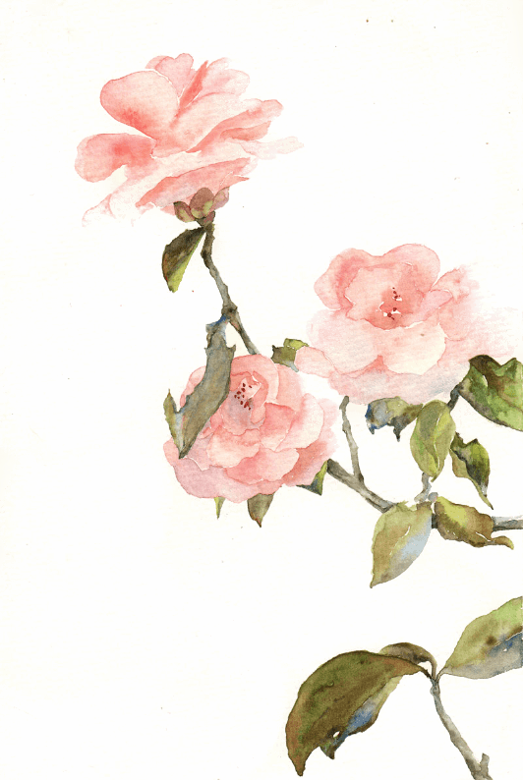




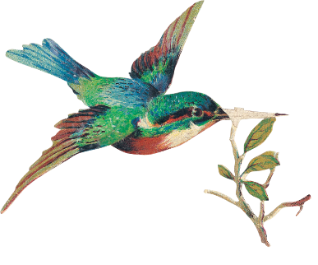
The Translation of
A Dream of Red Mansions

Slide 2

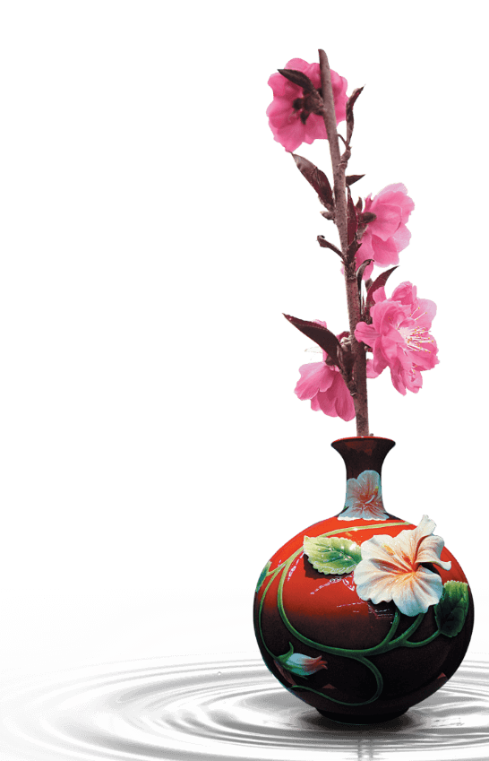
Content
Section 1 Translation History
Section 2 Translation Difficulties
Section 3 Translation Theory

Slide 3
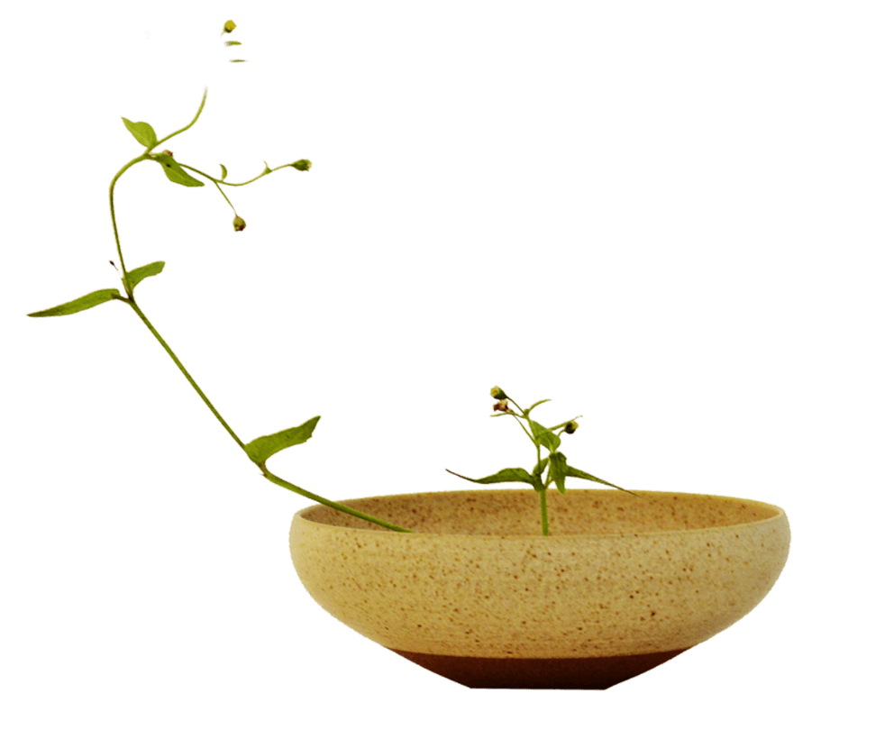

Section 1
The Translation History
of
A Dream of Red Mansions

Slide 4
1830 On Chinese Poetry —John Francis Davis
1846 The Chinese Speaker —Robert Thom
1830-1900
1868 China Magazine —Edward Charles Bowra
1892-1893 Hung Lou Meng —H. Bencraft Joly
1927 Dream of the Red Chamber —Wang Liang-Chih
History
1900-1960
1929 Dream of the Red Chamber —Chi-chen Wang
The Dream of the Red Chamber —Frorence Mchugh & Isabel Mchugh
1973-1980 The Story of the Stone —David Hawkes
1960-2020
1978-1980 A Dream of Red Mansions —
1991 A Dream in Red Mansions: Saga of a Nobel Chinese Family —

Slide 5
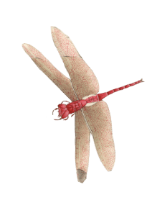
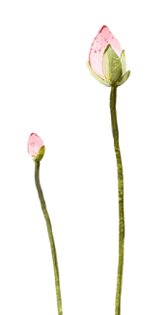
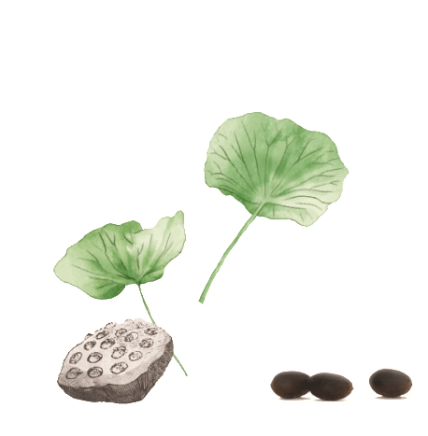
1830 On Chinese Poetry —John Francis Davis
1846 The Chinese Speaker —Robert Thom
1830-1900
1868 China Magazine —Edward Charles Bowra
1892-1893 Hung Lou Meng —H. Bencraft Joly
Similarities: i. The identity of the four translators
ii. The translation purpose
iii. Irregular publishing method and limited scope of circulation
iv. The tendency of being loyal to the original text in translation
1830-1900

Slide 6




Robert Thom’s translation:
EXTACT
FROM THE
HUNG-LOW-MUNG, CHAPTER VI
‘An Yung-foo yï-tsïh-chung,
Now as regards the interior of the Town-mansion of the Yung family,
hô-soan-ke-laï Jin-Kow suy püh
on summing them up, altho’the inmates may not be accounted many,
to,tsung sháng che heá,yäy yew san pïh
still with one and another they amounted to some three hundred and odd
yü k’ow; szé suy püh to, yï-téen mouths(to feed;)and the business (transacted) altho’not much, yet every
yäy yew yee ürh-she keen
day they had always some ten or twenty cases(to attend).
红楼梦 第六回
按荣府一宅中合算起来人口虽不多从上至下也有三百余口事岁不多也有一二十件

Slide 7
1927 Dream of the Red Chamber —Wang Liang-Chih
1929 Dream of the Red Chamber —Wang Chi-chen
1901-1960
1957 The Dream of the Red Chamber —Frorence Mchugh & Isabel Mchugh
1958 Dream of the Red Chamber —Wang Chi-chen
Similarities: i. The superficial intervention of European and American sinologists in translation
ii. Translators’ use of the achievements of the new redology
iii. The simplification of the content and language of the original text
iv. The salient market orientation
1830-1900

Slide 8
H. Bencraft Joly’s translation:
As regards the household of the Jung Mansion, the inmates may, on adding up the total number, not have been found many; yet, counting the high as well as the low, there three hundreds persons and more. Their affairs may not have been very numerous, still there were, every day, ten and twenty matters to settle.
红楼梦 第六回
按荣府一宅中合算起来人口虽不多从上至下也有三百余口事岁不多也有一二十件
Wang Chi-chen’s translation of 1929:
Although the Yungkuofu was not unduly large, there were over three hundred months from master to servant, and mistress to maid. Although the household duties were not unduly burdensome, there occurred daily at least a score of tasks and cares to be attended to.
Wang Chi-chen’s translation of 1958:
Although the Yungkuofu was not unduly large, there were over three hundred months from master to servant, and mistress to maid. Although the household duties were not unduly burdensome, there occurred daily at least a score of things to be attended to.

Slide 9
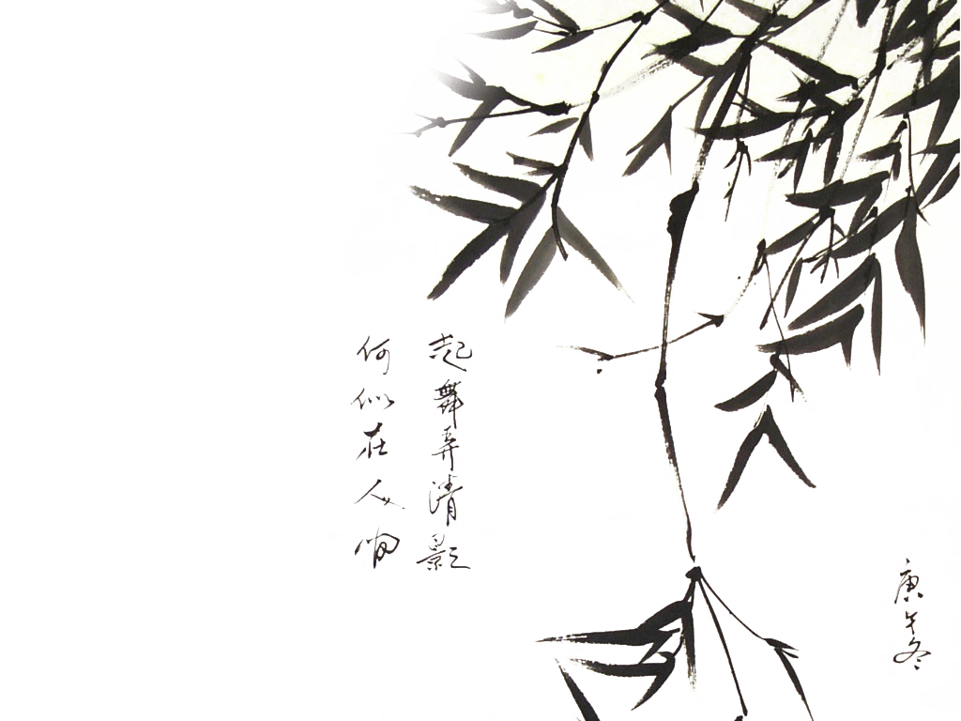

The transliteration of characters’ name in 1800s :
宝玉 Pao Yu
雨村 Yu Tsun
士隐 Shih Ying
The free translation of characters’ name in 1900s :
黛玉 Black Jade
宝钗 Precious Virtue
袭人 Pervading Fragrance
平儿 Patience
鸳鸯 Faithful Goose —Wang Liang-Chih
王熙凤 Phoenix
元春 Cardinal Spring
迎春 Welcome Spring
紫鹃 Purple Cuckoo —Wang Chi-chen
袭人 Pearl
湘云 Little Cloud
惜春 Grief of Spring —Frorence Mchugh & Isabel Mchugh

Slide 10
1973-1980 The Story of the Stone —David Hawkes & John Minford
1961-2020
1978-1980 A Dream of Red Mansions —Yang Hsien-yi & Glad-ysYang
1991 A Dream in Red Mansions: Saga of a Nobel Chinese Family —Huang Xinqu
Similarities: i. Total translation
ii. The academic turn of translation
iii. The pursuit of canonization
iv. Wide recognition from professional readers
1830-1900

Slide 11
Truth becomes fiction when the fiction's true, Real becomes not-real when the unreal's real. —David Hawkes
When false is taken for true, true becomes false; If non-being turns into being, being becomes non-being. —Yang Hsien-yi
假作真时真亦假，
无为有处有还无。
Happy Red Court —David Hawkes
Green Delights —Yang Hsien-yi
怡红院
The Naiad’s House —David Hawkes
Bamboo Lodge —Yang Hsien-yi
潇湘馆
Yesterday her lord’s bones laid in clay; On silken bridal bed shall lie today. —David Hawkes
Yesterday, yellow clay received white bones; Today, red lanterns light the love-birds’ nest. —Yang Hsien-yi
昨日黄土陇头送白骨，
今宵红灯帐底卧鸳鸯。

Slide 12
Section 2
The Translation Difficulties
of
A Dream of Red Mansions

Slide 13
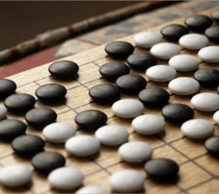
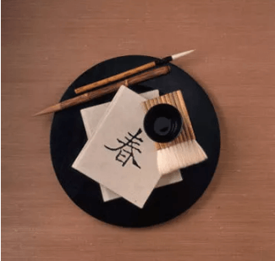
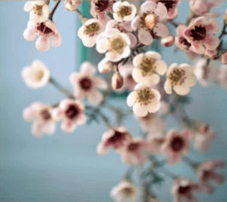
01
02
03
Content
Language
Culture

Slide 14
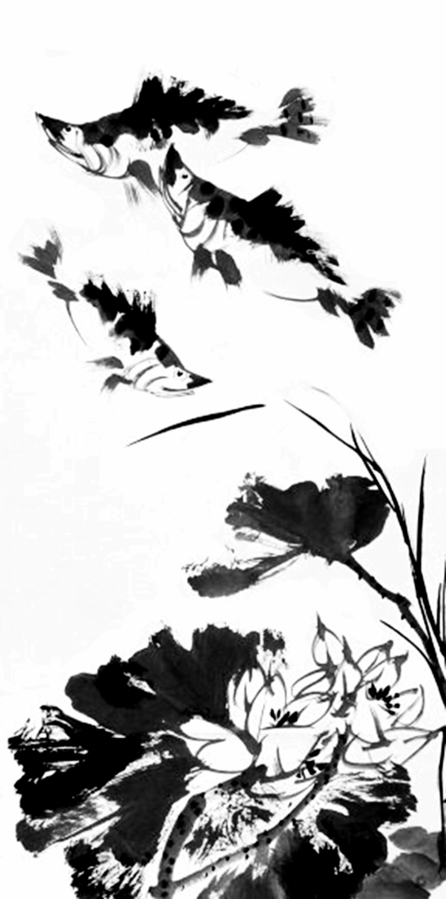
Language | Characteristic
style | fresh, interesting, implicit, vivid, succinct, etc.
Language of characters | The personality of each character is perfectly revealed by his or her words.
Linguistic form | Classical Chinese, colloquialism, dialect
Rhetoric | Homophonic, argot, pun, duality, etc.
words | Overlapping verbs, erhuaci, reduplicatives, onomatopoeia, etc.

Slide 15
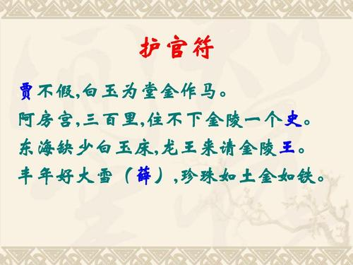
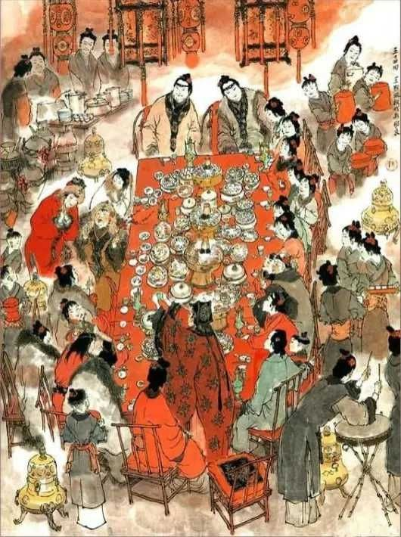
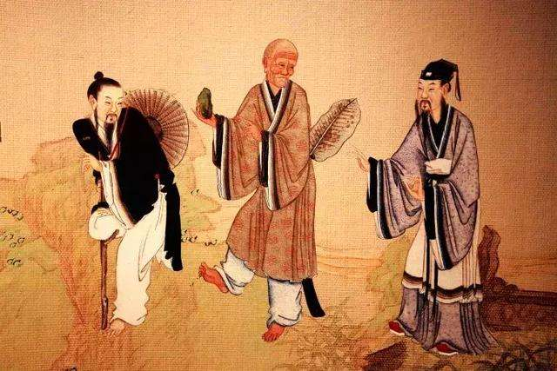
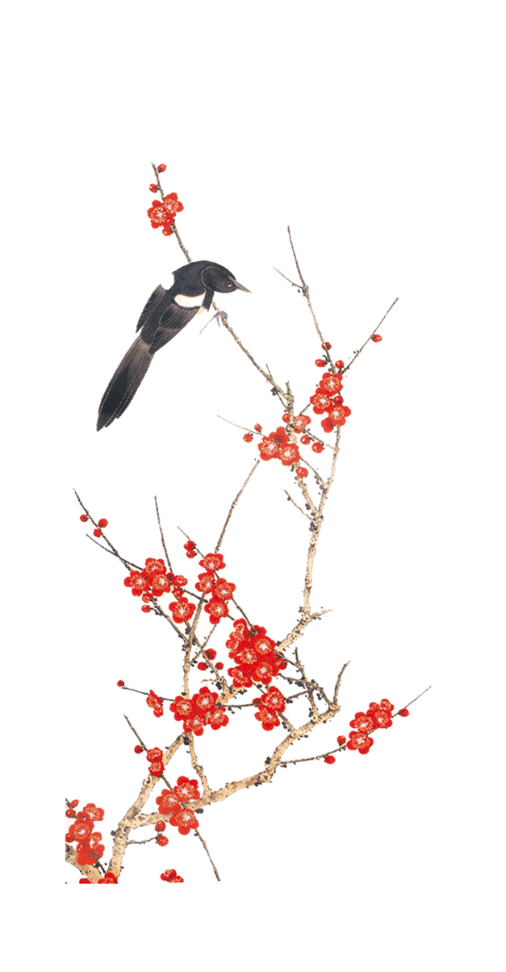
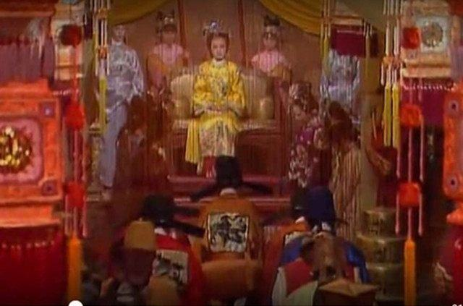
Family Culture
Cultural Life
(Tea Culture,
Wine Culture)
Culture
Religion Culture
Court Culture

Slide 16
1.The title of the book
8.Food (160)
2.Characters’ name (female:480 male:495)
Content
9.Religious theory (>370)
10.Traditional opera (>260)
3.Idiom (>900)
11.Official title（>140）
4.Poem (>260)
12.Etiquette and custom (156)
5.Buildings (102)
13.Personal appellation (129)
6.Medicine (179)
14.System of decrees and regulations
(113)
7.Clothes and accessories (208)
15.Gardens, Solar terms, Songs, Art, etc. (max≈100,min≈40)

Slide 17
Section 3
The Translation Theory
of
A Dream of Red Mansions

Slide 18
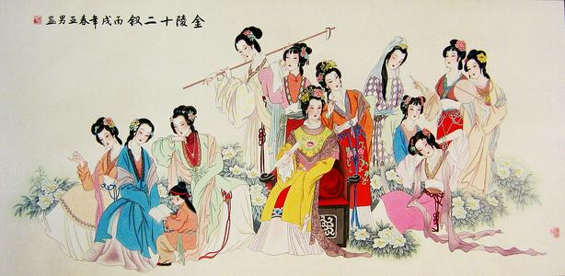
Question:
What kind of theoretical viewpoint should the translation of A Dream of Red Mansions be based on?

Slide 19
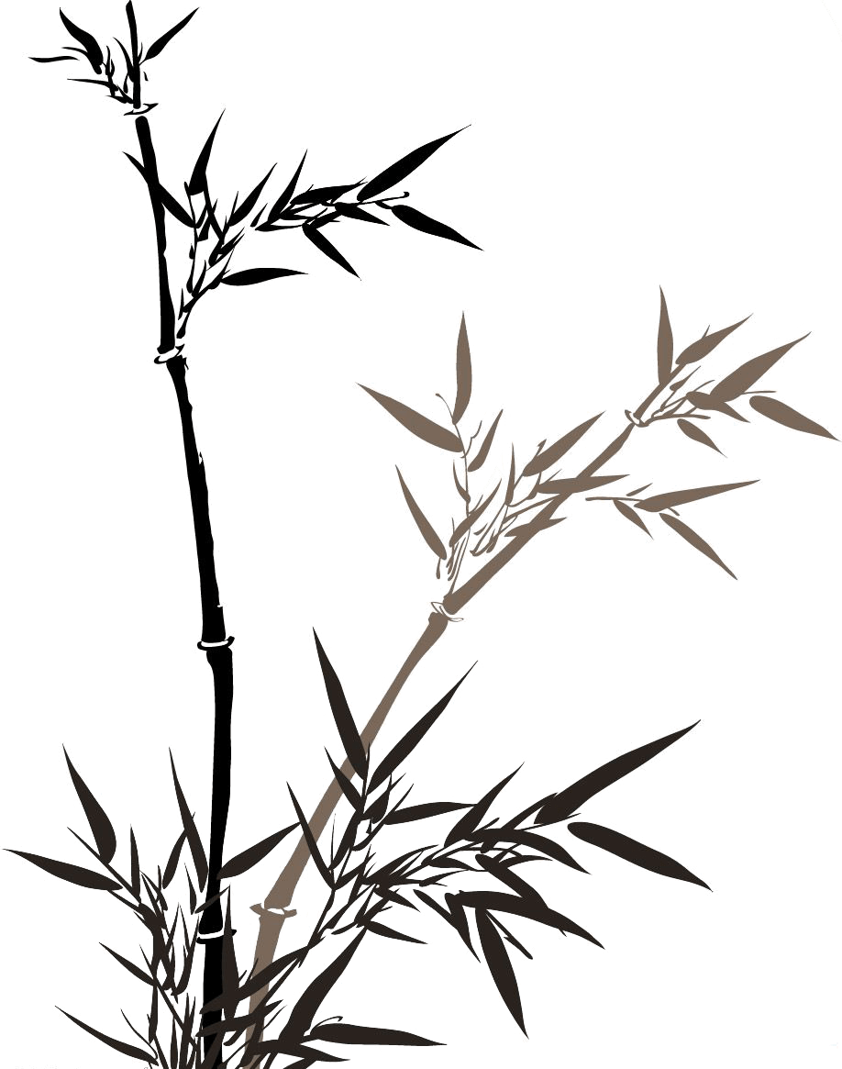
Chinese translation theory:
Buddhist Scripture translation
Faithfulness, expressiveness and elegance
Literal translation, Free translation……
Sublimation……
Linguistics Culture
Manifestation
Connotation
Surface connotation
Connotation
(Cultural connection)
Deep connotation

Slide 20
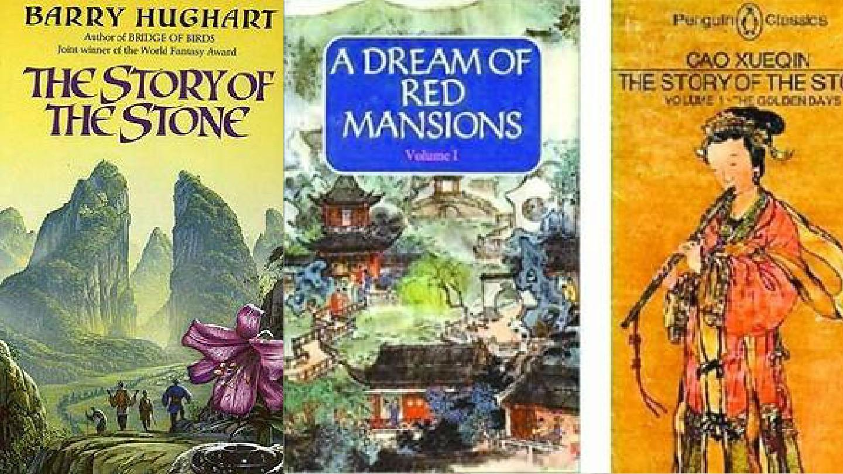

The best way to analyze the translation theory of A Dream of Red Mansions :
Comparative Translation Studies

Slide 21


Thank you!

