Slide 1
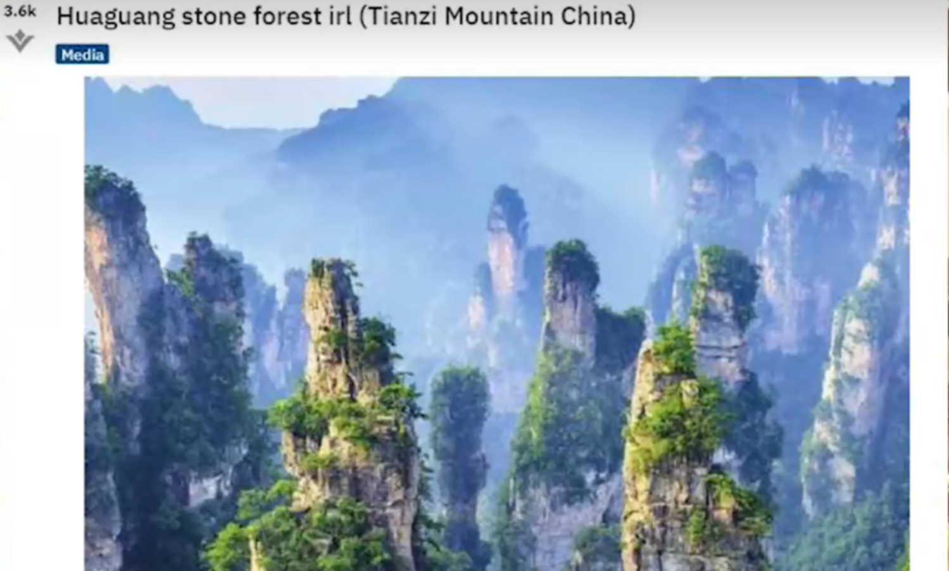
Three Famous Chinese Mountains

Slide 2
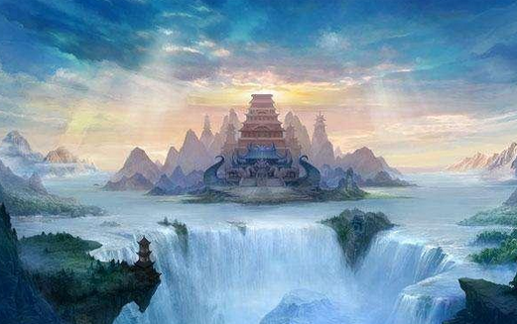
mythological legends
Penglai
Fangzhang
Yingzhou

Slide 3
The three mountains in a geographical sense
huangshan
lushan
yandangshan

Slide 4
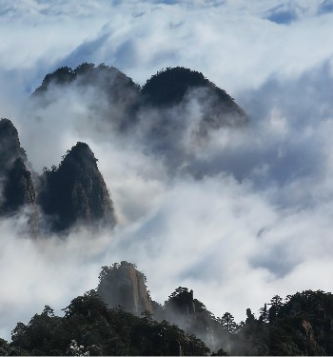
Wonderland
Huangshan
peculiar pines
grotesque rocks
sea of clouds
Hot Springs
Having visited the Five Great Mountains (Wu Yue), one need not look at other mountains; having visited Huangshan, one need not look at the Five Great Mountains.

Slide 5
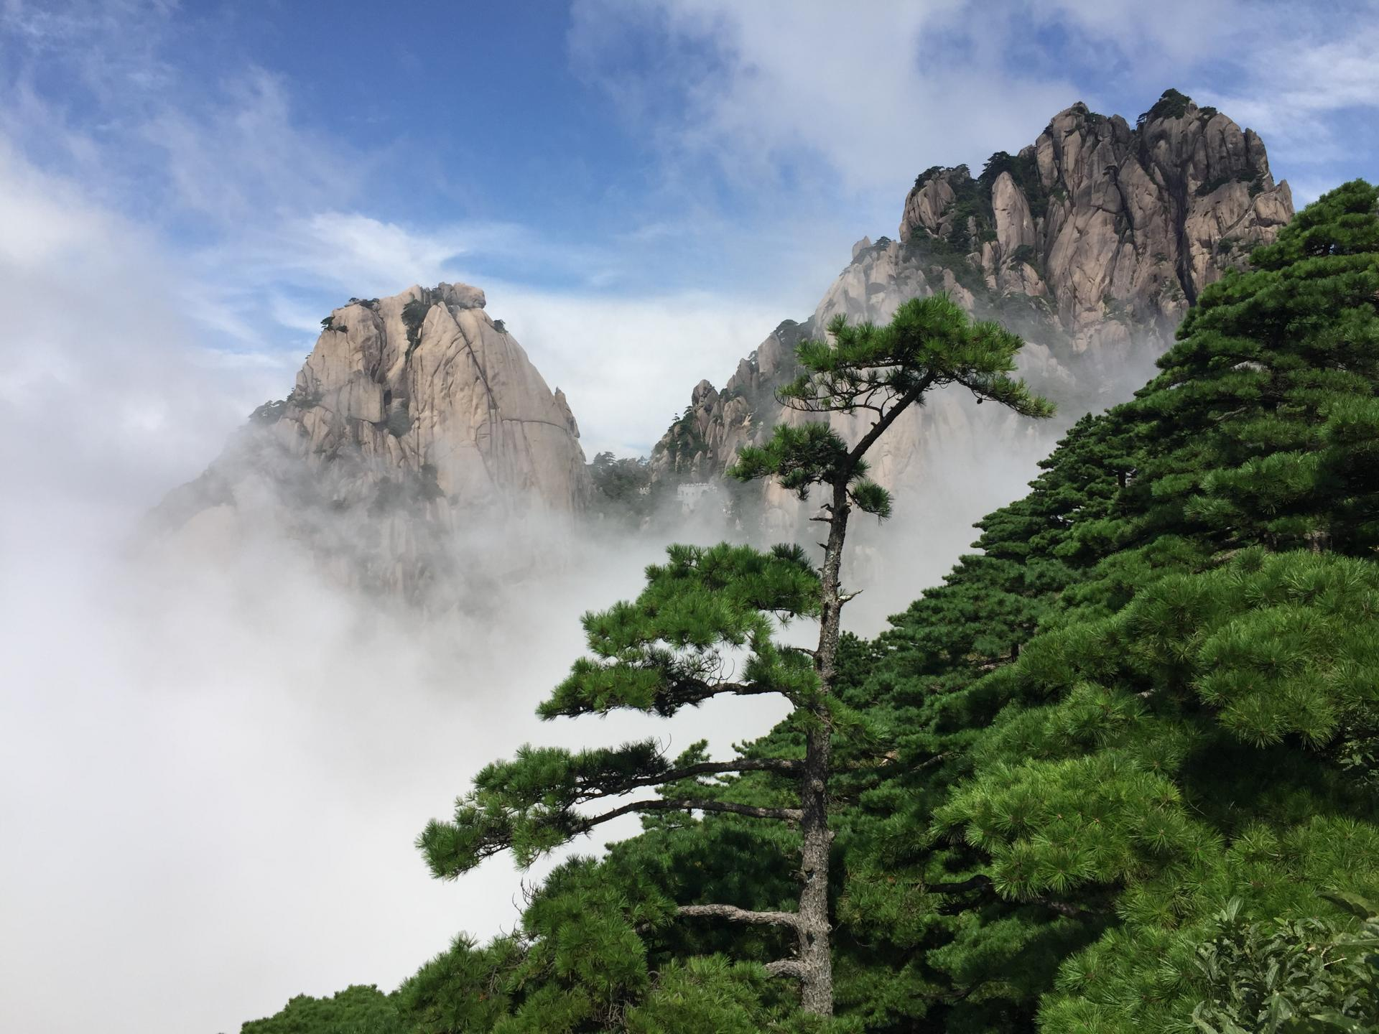
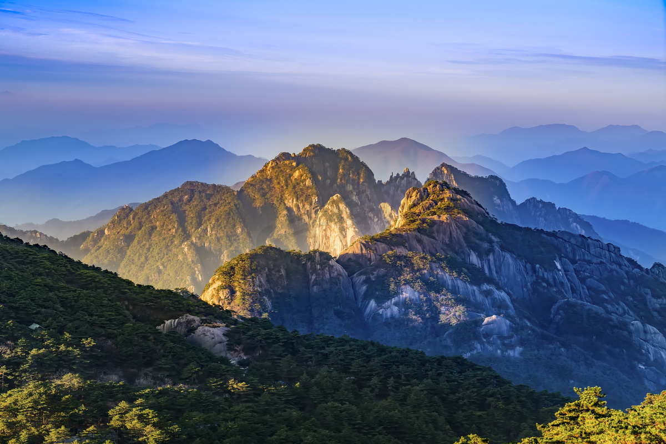
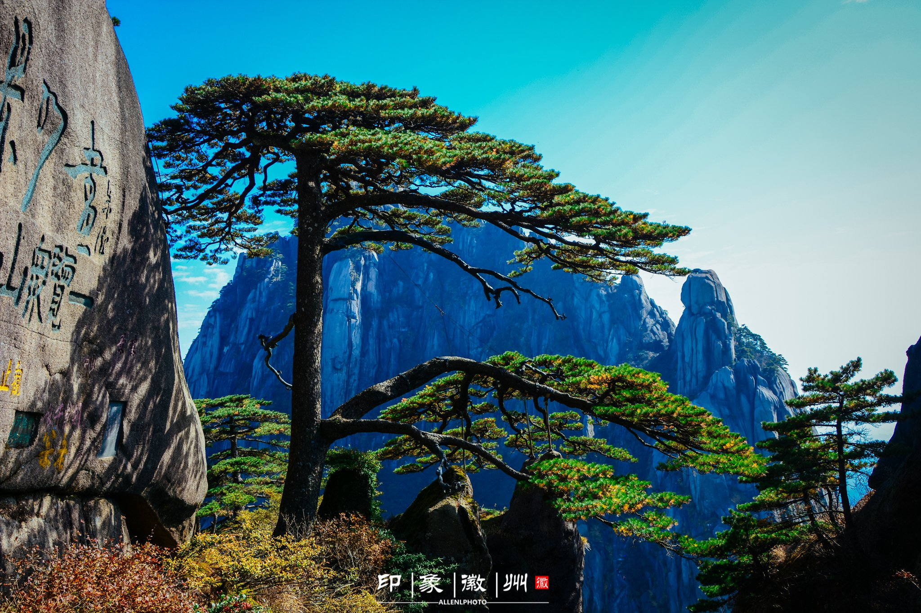
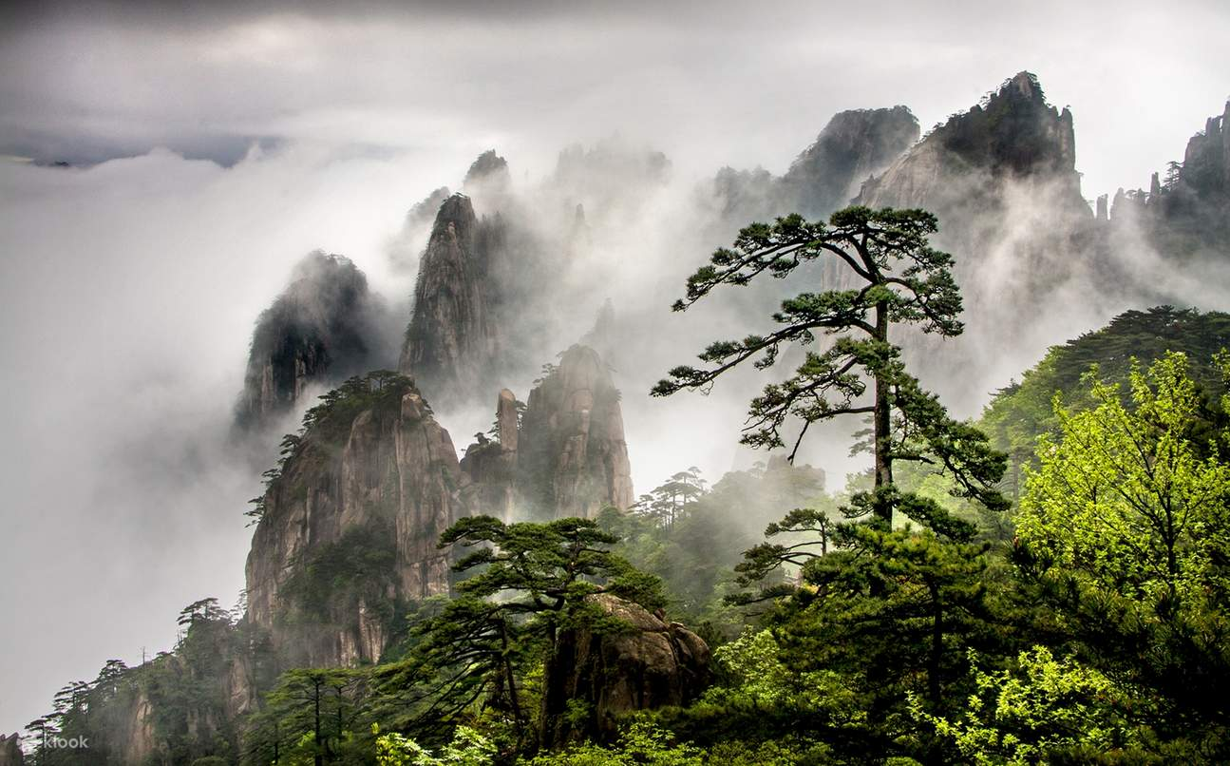
Wonderland

Slide 6
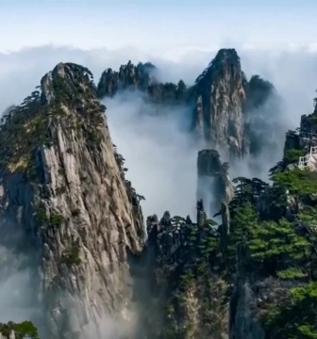
Sanctuary
Lushan
grandeur
wonder
peril
elegance

Slide 7
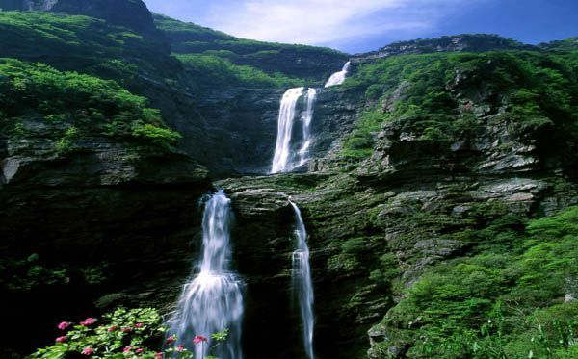
the Three-Tiered Waterfall
in three stages
155 meters

Slide 8
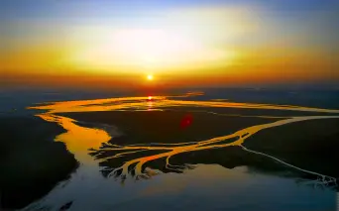
Han po kou

Slide 9
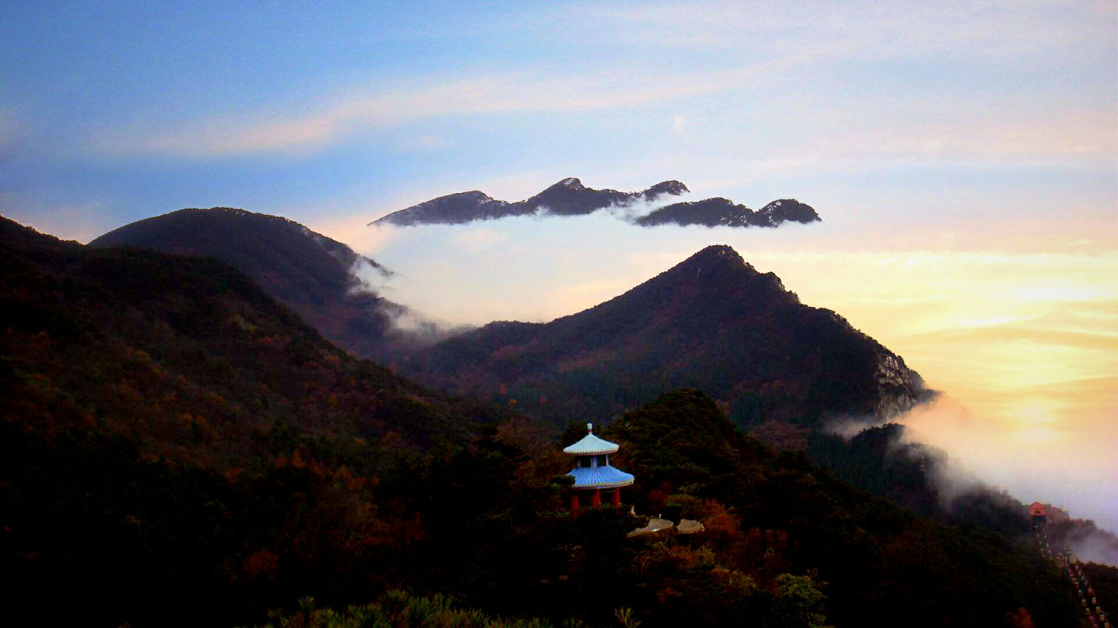
cultural famous mountain
Lushan
The Peach Blossom Spring
I cannot tell the true face of Lushan, for I am standing in the mountain itself.

Slide 10
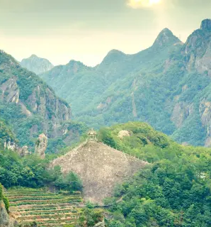
Living Rock
Yandang
peak
caves
waterfalls
rocks

Slide 11
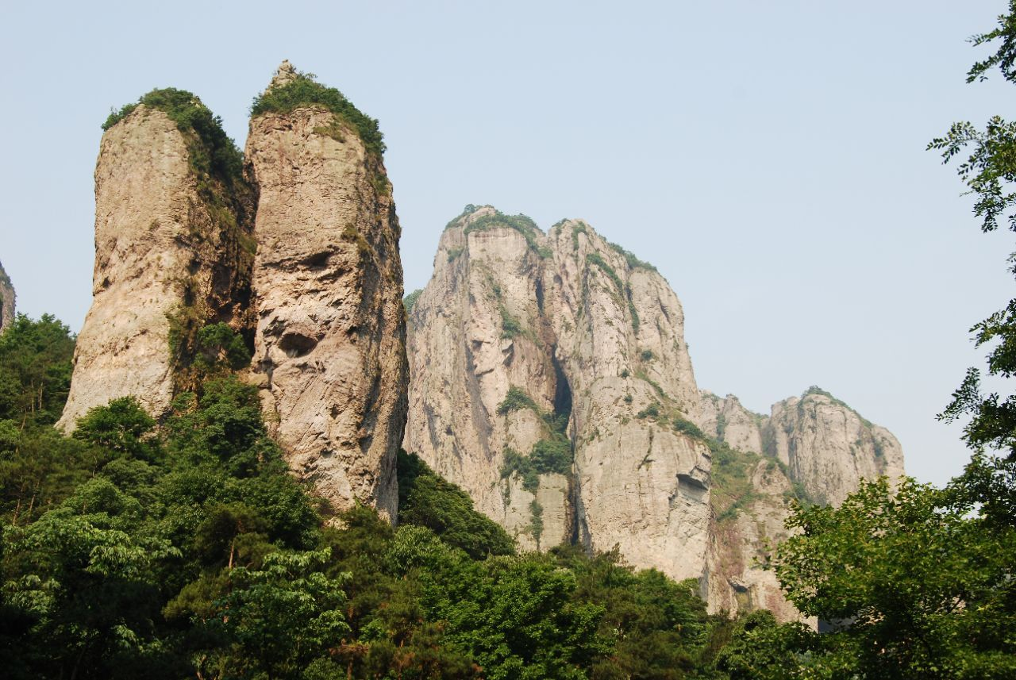
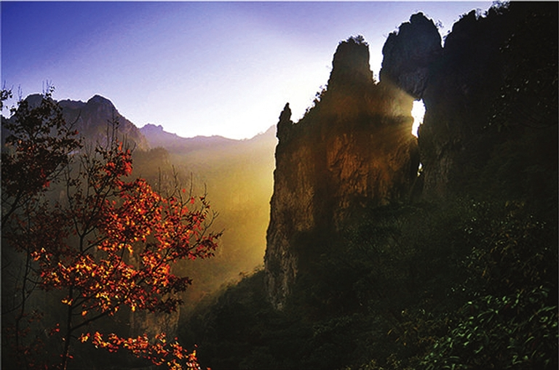
day
night

Slide 12
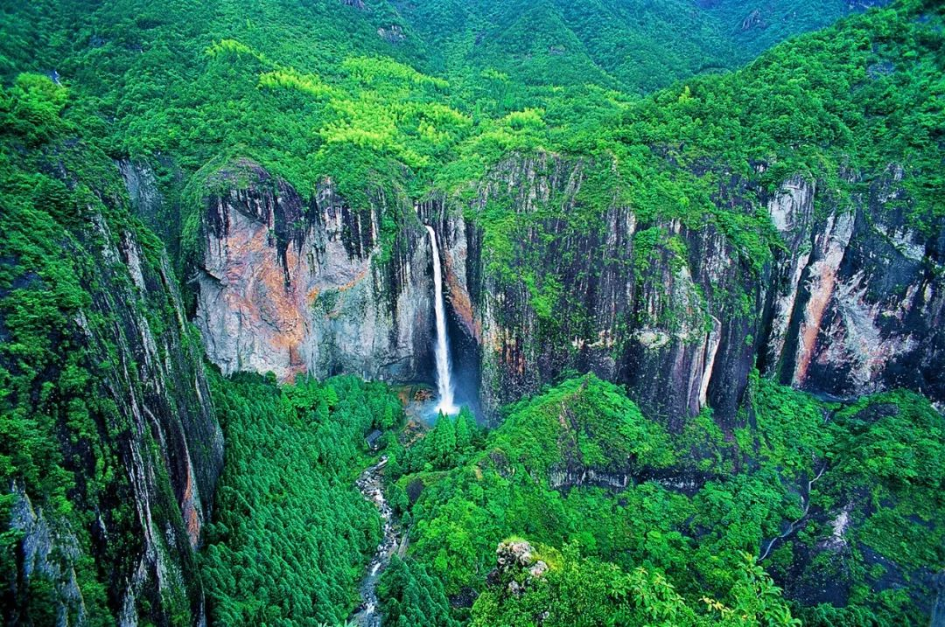
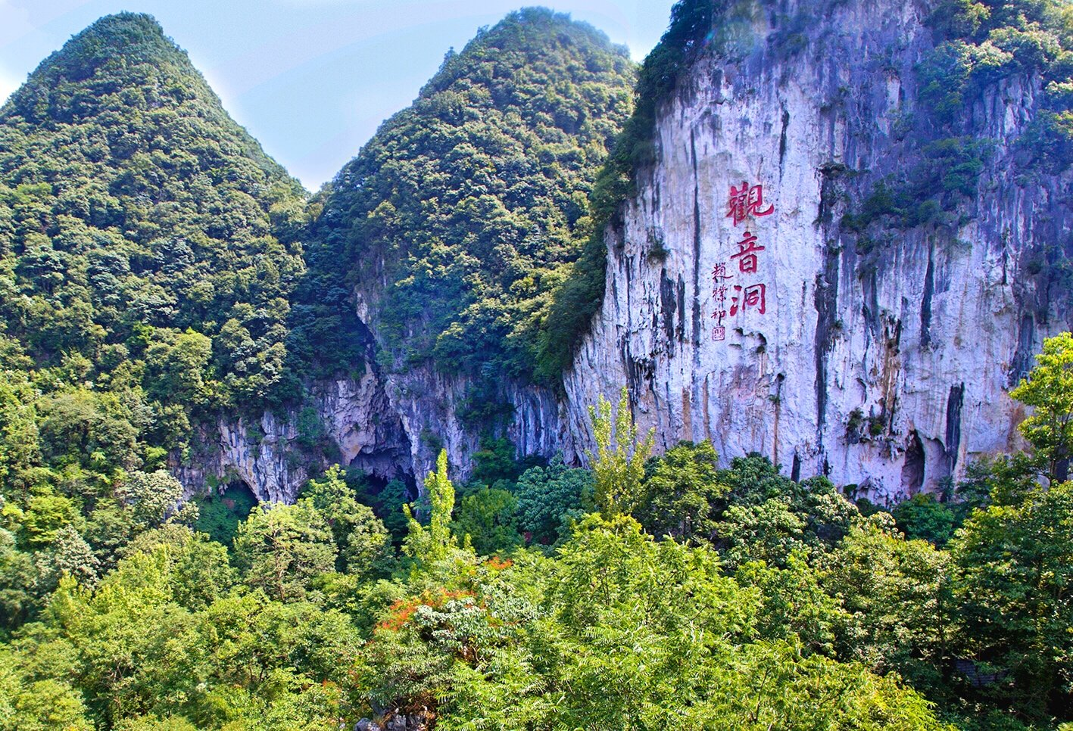
the Great
Dragon Waterfall
Guanyin Cave

Slide 13
Three Famous Chinese Mountains
they are part of history and a symbol of the Chinese people's pursuit of a better life
Climb
Share
Preserve

