Slide 1
中国文化 研究生课（研一） Kultura chińska | Chinese Culture for first year Master Students 第五周 Session 5
5月5日——6月23日，周五下午3:30-5:00和5:15-6:45, (30 x 45 分钟)
Fridays 15:30-17:00 and 17:15-18:45, May 5 – June 23 (30 x 45 min.)
教室 Classroom 413
助教： Martyna 泊语丰 Bo Yufeng
吴漠汀助理教授 Assistant Professor Dr. Martin Woesler

Slide 2
Students Introduction 自我介绍
(Later also introduce yourself shortly during the Wiki Registration.)
Lukasz 黄旭明 Huang Xuming, 茶文化 Tea culture (ceremony), 日语Japanese， 广州带4个月上广外
Martyna 泊语丰 Bo Yufeng, 高中 High School 对亚洲语言感兴趣: Asian languages => Chinese, 国际企业？
Alicja 柯之川 Ke Zhichuan, 高中：语言很有用，找了挑战，对航空业感兴趣
Marianna 麻亮 Ma Liang, 喜欢语言，挑战，翻译
Kalina 吴凯庭 Wu Kaiting, 高中：要学一个跟学校的专业完全不一样的，Gdansk BA，中国历史（基督教）跟欧洲的不同，有意思，中文老师，作家（幻想小说）
Izabela 夏颖姗 Xia Yingshan，克拉科夫，韩语，口译？英语、德语、拉丁语等等
Aleksandra 韩美琳 Han Meilin，喜欢语言，对亚洲文化感兴趣，原来喜欢韩语，然后中文，学过德语、西班牙语、英文
Weronika 舒然 Shu Ran，Gdansk，对外汉语老师、对外英语老师
Daria 史蕤 Shi Rui, Torun 大学（于台湾高雄留学9个月），远东文化系，中国文学，要一份安静的工作
Milena Szczechowska Torun 大学（于台湾高雄留学9个月），中国文学老师
Milena Swieboda 米兰 Mi Lan，高中已经开始学中文，要当翻译（笔译）

Slide 3
Self-Introduction 自我介绍
AMU: Adiunkt 助理教授
HUNNU: Xiaoxiang Scholar Dist. Prof., PhD supervisor 潇湘学者特聘教授、博士导师
Academian, Europ. Acad. of Sciences & Arts, Salzburg 欧洲科学院院士
Jean Monnet Chair Professor 让莫内主席教授
Int‘l Chinese Studies Centre, Director 外语学院国际汉学中心主任
German China Association, President 德中協會主席
World Association of Chinese Studies, President 世界漢學研究會會長
Bochum, Peking, Harvard, Mainz/Germersheim, Witten, Harvard, Orem/USA, Rome, Peking Normal & Witten波鸿，北京，哈佛，美因茨/盖默斯海姆，威腾，哈佛，奥勒姆/美国，罗马，北师大&威腾
Essays (Western influence, social impact, cf.: blogs) 散文（西方的影响，社会影响）
Early literary translations 早期文学翻译
Literature Development (Canonization etc.) 文学的发展（经典，分类）
Early Western reception of Hongloumeng 《红楼梦》在西方的早期反响
Translation workshop (volunteers?) 翻译工作坊（有志愿者可以找我报名）

Slide 4
主题 Topics
下几节课的主题（请在后面加你的名字为了表示关于这个主题做ppt）：
Topics for the coming sessions (please write your name behind a topic to give a presentation):
May 5: 组织方面的事、测试 Organizational things, quizzes
May 12: 文化叙述 The Cultural Narrative, 地理性质是文化发展的基础 Geographic Nature as a Basis for Cultural Development (text book current version page 12 ff.)
May 19: 1 审美理想和社会习俗： 湖南的伴嫁歌 Aesthetic ideals and social customs: Marriage-Accompanying Songs in Hunan 29. 2 审美理想和社会习俗：中国的婚姻习俗 Aesthetic ideals and social customs: Chinese Marriage Customs 16
May 26 1 审美理想和社会习俗：习惯，接触方式。古代和当代的接触方式Aesthetic ideals and social customs: Habits, Ways of Contacting 22. 2 审美理想和社会习俗：土家族的哭嫁 Aesthetic ideals and social customs: Crying Marriage of Tujia 36
June 2 1 审美理想和社会习俗：中国古代的四大才子 Aesthetic ideals and social customs: The Four Most Handsome Men in Ancient China 42. 2 审美理想和社会习俗： 熊猫 Animals: Panda 48.
June 16 1 建筑 Architecture 53. 2 建筑：紫禁城 Architecture: The Forbidden City 60
我们还需要找机会补两个学时的课。另外的主题 Additional topics for 2 hours catch-up:
June 23 期末考试：论文 Final Exam

Slide 5
第5周 Session 5
1. 阅读 Read pages 42-52 of our textbook
2. 填多选题线上测试 Complete the quizzes https://ks.wjx.top/vm/YyByKqx.aspx https://ks.wjx.top/vm/QjARged.aspx#
3. 记得参加100个问题的调查和欧盟调查 remember to complete the EU survey and the 100 questions questionnaire http://bit.ly/EU-SURVEY http://bit.ly/100_questions
展示 Presentations[edit]
中国古代的四大才子
舒然 Weronika Sójka 审美理想和社会习俗：中国古代的四大才子 Aesthetic ideals and social customs: The Four Most Handsome Men in Ancient China The Four Most Handsome Men in Ancient China
熊猫[edit]
史葳 Milena Antczak 审美理想和社会习俗： 熊猫 Animals: Panda Panda
Show how to use Wiki [ File:…
Surveys https://bit.ly/100_questions

Slide 6
The Four Most Handsome men in Ancient China

Slide 7
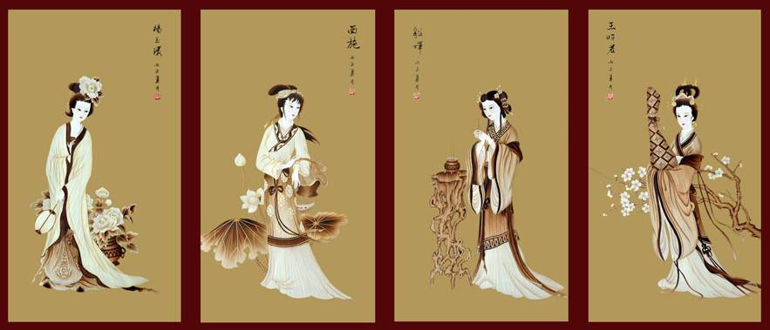
Question？
Notes:
it is worth mentioning that there were four most attractive men at that time. Despite that we consider these four men as attractive, this refers to more than just their appearance. They have a common feature: it proves that while their appearance is marvelous, they are also outstanding in literature. Namely, as a Chinese saying goes, they are endowed with both beauty and talent.

Slide 8
Who are the four most handsome men in Ancient China？
Pan An
King Lanling
Ji Kang
Wei Jie

Slide 9
Pan An
The allusion of “throwing fruit to fill a carriage” originates from Pan An, which resembles movie fans nowadays to see their idols. There is a comment on Pan An’s appearance: "No more and no less. " The history books also describe Pan An with three words “good-looking, well-mannered, and graceful”. Although these did not describe Pan An’s appearance in details, such as eyebrows and eyes or lips, from these side descriptions, we can know that Pan An’s appearance is far above ordinary people, and even his styles draw imitation from others.
Handsome

Slide 10
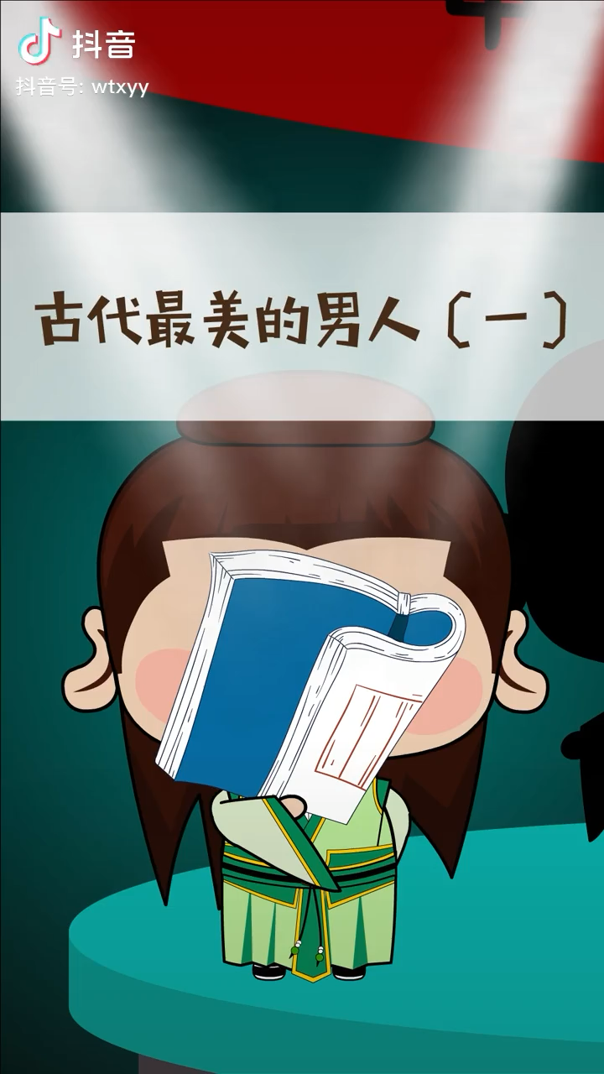
Pan An
Born in the Western Jin Dynasty, he was a writer and politician. He was good at composing verse and orders, expatiation, and skilled in the choice of words and building of sentences, which fully reflects the characteristics of Taikang literature that pays attention to the beauty of form. He was expert in composing Ci lyric of sorrow and admonishment, and his current works such as Widow‘s Fu, Mourning Poem and other famous works are all known for their narration and empathy. He also made “Xianju Fu”, some people praised his literary talent: Lu Cai is like a sea, Pan Cai is like a river.(潘江陆海）
Intelligent

Slide 11
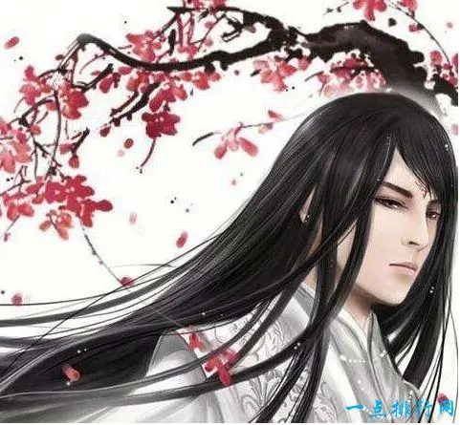
King Lanling
Gao Changgong (541-573), known as King Lanling, the grandson of Gao Huan, Emperor Shenwu, and the fourth son of Wen Xiang, Emperor Gaocheng. There is a very popular legend about King Lanling. It's believed that King Lanling was a brave and supremely skilled general. However, because he looked very sweet and it seemed hard to frighten the enemy, he often wore a half-mask when fighting, which sounds very fairytale.

Slide 12
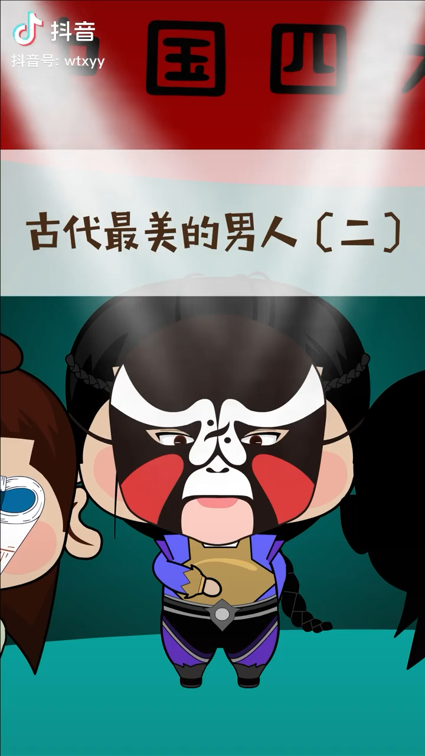
King Lanling
Nevertheless, the beauty of King Lanling is beyond doubt and otherworldly. Book of Northern Qi Dynasty described that he was friendly looking and mentally strong, with beautiful voice and appearance. King Lanling spent half his life in military affairs, and made great achievements. While this gave him glory, it also brought bad luck. There is an old Chinese saying that the glow of a inferior from massive achievements will overshadow his superior.
Although the King Lanling did not have the idea of usurping the throne, but the incumbent felt threatened because of his existence itself. In the end, a glass of poisonous wine ended the life of the Lanling King.

Slide 13
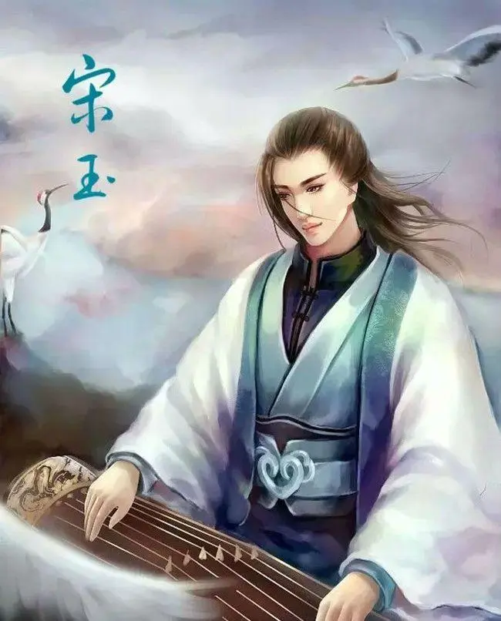
Song Yu
Song Yu (about 322 BC-298 BC), as it is widely rumored, a student of Qu Yuan, was born in the capital city of Song Dynasty during the Warring States Period (now Shangqiu, Henan). Song Yu was a writer of Ci lyric of State Chu in the late Warring States period, adept in Ci lyric and even acclaimed as a great poet after Qu Yuan' reputation. Later generations often referred to them as “Qu Song”. Rumors circulate that there are many Ci lyrics from him, and Book of Han records about 16 works, but many of them are lost today.

Slide 14
Song Yu
His works embrace Nine Discriminations, The Fu poetry of Wind and so on. He was the first to write about sadness from Autumn and to write about women. His description of women's nature exerts a great influence on later generations such as Cao Zhi. The goddess in Song Yu's The Fu poetry of Goddess embodies the essence of pre-Qin female beauty, recounting the beauty of the goddess of Wushan Mountain in details so much so that later generations have coveted for it for thousands of years.

Slide 15
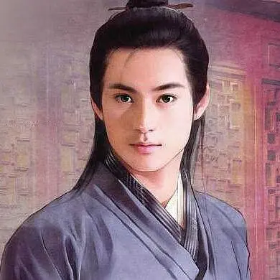
Wei Jie
Wei Jie (286-June 20, 312), a metaphysician（玄学家） and an official of the Jin Dynasty. Wei Jie was a noted talker and metaphysicist during the Wei and Jin Dynasties. He was appointed as an assistant of the prince in the matter of politics. In the fourth year of the reign of Emperor Yongjia(AD310), Wei Jie died at the age of 27. Both ancient books and ancients commented on Wei Jie's appearance. Wang Ji reckoned that, “A jade is on my side, and I feel like I am nobody”; “Wandering with Jiu is like sauntering with a pearl on the side, with him shining brightly. ”

Slide 16


Chinese Panda Diplomacy

Slide 17


https://www.ypppt.com/
Part 1： Origin and History
Part 2： Means
Part 3： Significance
Part 4： Problems and Solutions

Slide 18
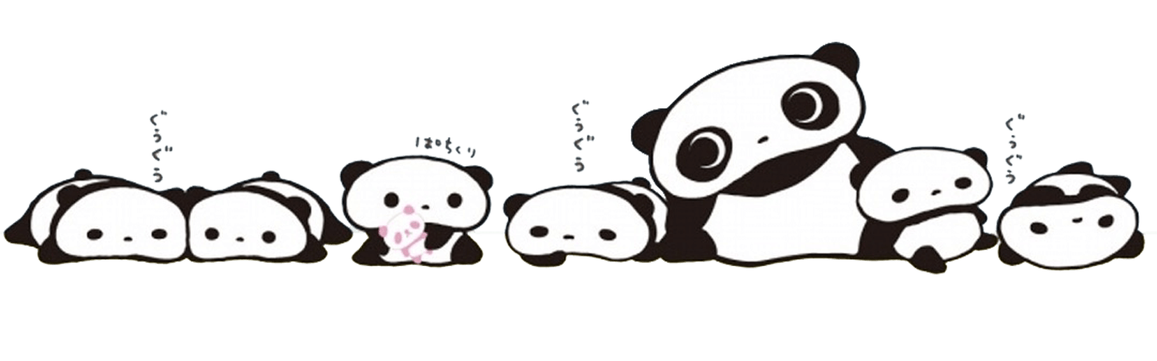
Origin and History

Slide 19
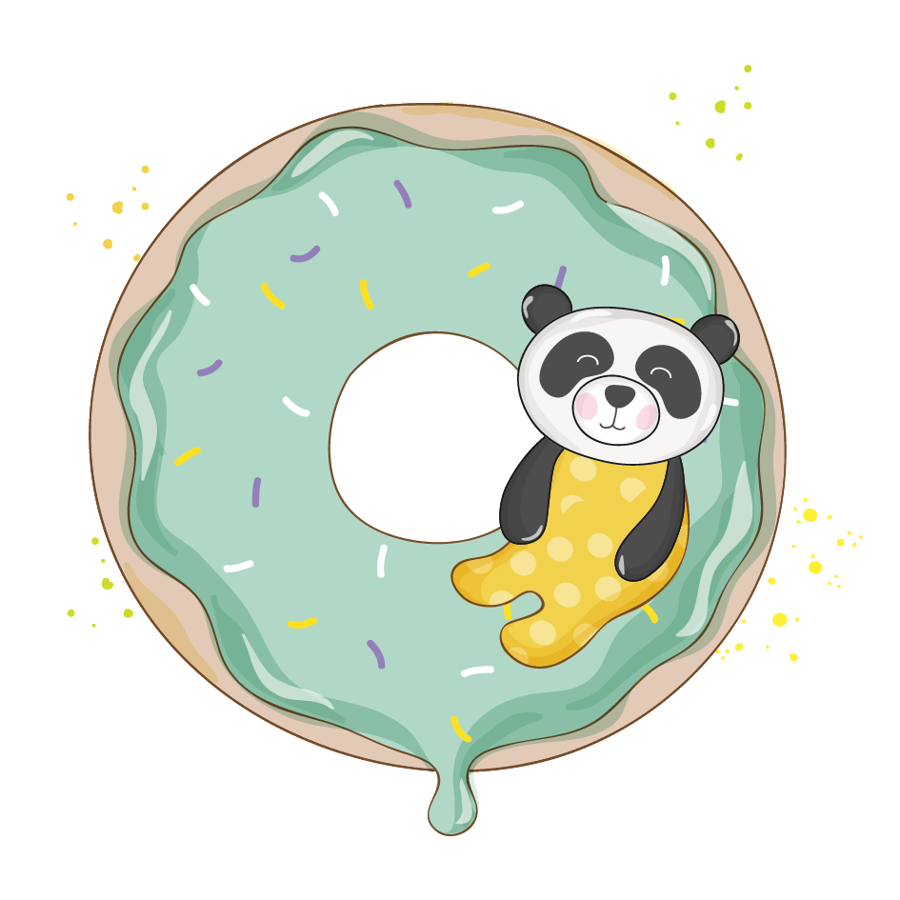
Origin-Animals play an important role in China's diplomatic activities.
qilin diplomacy--As early as the Yongle period of the Ming Dynasty, Zheng He brought back many "qilin" (giraffes) from the African continent on his way to the West.
In the early years of New China, in 1957, China gave the giant pandas Ping Ping and An An to the Soviet Union.
Vietnam, which is in the same socialist camp as China, also gave two Asian elephants to China in 1953.

Slide 20

History
It begins with Wu Zetian. Wu Zetian gave two "white bears" and 70 furs to Japanese Emperor.
Technically speaking, the first time giant panda served as the highest-level national gift was in 1941 when the Song sisters, Song Ailing and Song Meiling presented a pair of pandas to the United States as a token of appreciation for their relief of Chinese refugees.
China's most famous "panda diplomacy" dates back to 1972, when President Nixon's visit to China. Premier Zhou Enlai announced at a banquet to welcome President Nixon that giant pandas Lingling and Xingxing would be given to the United States.

Slide 21
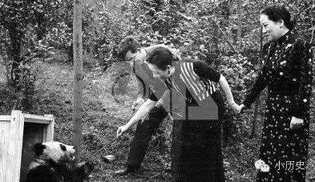
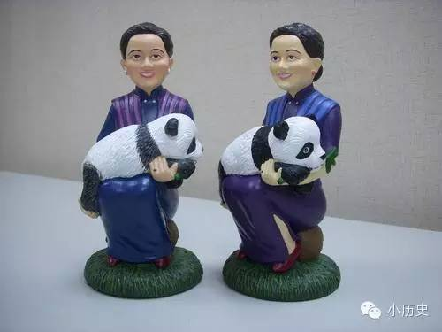

Slide 22
Means

Slide 23

Panda Touring and Leasing
In 1982, in response to a global call to protect endangered animals, the government of the People's Republic of China announced that it would stop giving pandas abroad starting in 1982.
In 1984 Olympic Games in Los Angeles, China temporarily loaned two pandas, Yongyong and Ying Xin, from the Beijing Zoo to the Los Angeles Zoo for a three-month tour to show China's support for the Los Angeles Games.

Slide 24
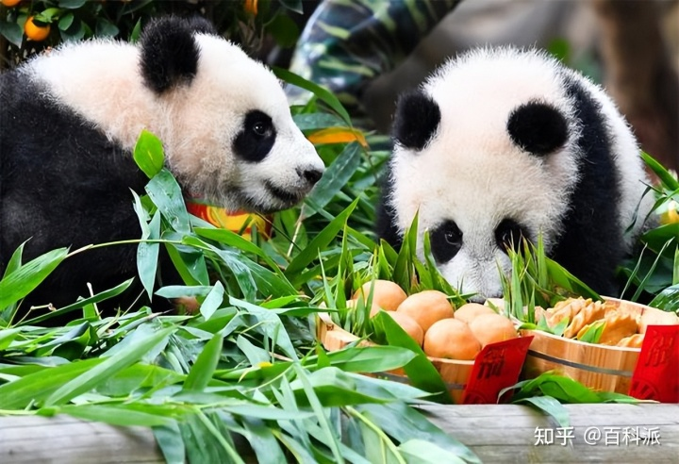
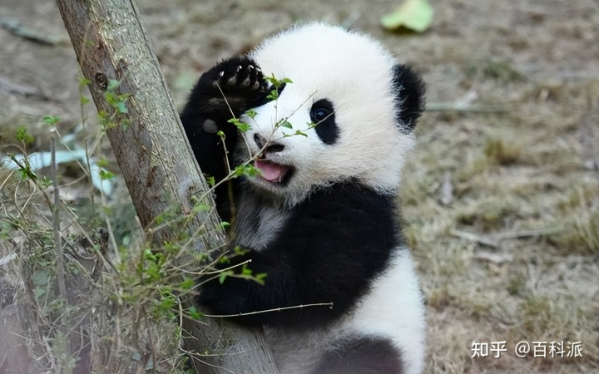
Joint Research on Giant Panda
It begins in 1994. Two pandas from the Chengdu Research Base of Giant Panda Breeding went abroad for the first time as "research and exchange ambassadors" to the Shirahama Safari Park in Japan.
Notes:
https://www.ypppt.com/

Slide 25
Significance

Slide 26

Building a good national image
enhance national cohesion;
improve the country's recognition and credibility; carry out international affairs in the international community
Creating communication topics
create a middle ground for China's diplomatic activities with other countries and create communication topics.
When common topics occur, communication between countries becomes possible.
Creating economic value
give rise to related cultural industries and many cultural products.

Slide 27
Problems and Solutions

Slide 28
Problems
Political misinterpretation
a cultural invasion
not having strong explanatory power or tendencies
Single content will cause aesthetic fatigue
lacking artistic processing and cultural connotation
difficult to raise interest and weak communication effect
Over-commercialization and dissipation of public interest
When commercial companies take advantage of the "panda fever" to over-market, people are inevitably suspicious of the panda image and even question whether the cute panda image is originally a scam by the business. When interest is dissipated, not only will the panda industry suffer, but the international influence of the "panda symbol" will also decline, which will directly affect China's international communication power.

Slide 29
Solutions
Enrich the content of communication and add more cultural connotations.
1
3
Refine the connotation of the symbol to reduce political misinterpretation.
Moderate exploitation of commercial value.
2

Slide 30
References
[1]赵丽君.“熊猫外交”的效果研究[J].公共外交季刊,2018,(01):103-110+148.
[2]张旭琰. 新中国熊猫外交的变化与挑战[D].辽宁大学,2022.DOI:10.27209/d.cnki.glniu.2022.001101.
[3]赵丽君,郑保卫.国家形象视角的“熊猫外交”研究[J].新闻爱好者,2017(12):15-19.DOI:10.16017/j.cnki.xwahz.2017.12.005.
[4]刘晓晨.从东方到西方:冷战背景下中国的熊猫外交[J].近现代国际关系史研究,2014(02):192-212.

Slide 31
以后
请参加不同问卷调查http://bit.ly/EU-SURVEY
选主题，看第二周那边，加你的名字（选下个礼拜的主题的同学麻烦准备ppt，课网页上上传）
准备下个星期的课文（主题1）
回答关于主题的问题

Slide 32
作业
请参加不同问卷调查https://bit.ly/100_questions
选主题，看第二周那边，加你的名字（选下个礼拜的主题的同学麻烦准备ppt，课网页上上传）
准备下个星期的课文（主题1）
回答关于主题的问题

Slide 33
Preparation for next week 下週的課前預習
下几节课的主题（请在后面加你的名字为了表示关于这个主题做ppt）：
Topics for the coming sessions (please write your name behind a topic to give a presentation):
May 5: 组织方面的事、测试 Organizational things, quizzes
May 12: 文化叙述 The Cultural Narrative, 地理性质是文化发展的基础 Geographic Nature as a Basis for Cultural Development (text book current version page 12 ff.)
May 19: 1 审美理想和社会习俗： 湖南的伴嫁歌 Aesthetic ideals and social customs: Marriage-Accompanying Songs in Hunan 29. 2 审美理想和社会习俗：中国的婚姻习俗 Aesthetic ideals and social customs: Chinese Marriage Customs 16
May 26 1 审美理想和社会习俗：习惯，接触方式。古代和当代的接触方式Aesthetic ideals and social customs: Habits, Ways of Contacting Milena 22. 2 审美理想和社会习俗：土家族的哭嫁 Aesthetic ideals and social customs: Crying Marriage of Tujia 36 Daria
June 2 1 审美理想和社会习俗：中国古代的四大才子 Aesthetic ideals and social customs: The Four Most Handsome Men in Ancient China 42. 2 审美理想和社会习俗： 熊猫 Animals: Panda 48.
June 16 1 建筑 Architecture 53. 2 建筑：紫禁城 Architecture: The Forbidden City 60
我们还需要找机会补两个学时的课。另外的主题 Additional topics for 2 hours catch-up:
June 23 期末考试：论文 Final Exam

Slide 34
Always here for you! 隨時隨地为你们服务
Assistant Professor (Adiunkt) Dr. Martin Woesler 吴漠汀助理教授
Office / 办公室:
Phone / 电话: +49 178 2073538, +48 152 664204 Email / 电子邮件: martin@woesler.de, martin.woesler@amu.edu.pl

Slide 35
Thank You

