Slide 1

中国文化概要
Introduction to Chinese Culture for Bachelor Students of Translation Studies
湖南师范大学 2023年3月2日-2023年3月31日
中国文化基础 周五上午8:00-9:40,604教室；第4-7周，上课时间：周一上午8:00-9:40，周三13:00-14:20；周五13:00-14:20，均在602教室。
助教：
吴漠汀特聘教授 Distinguished Professor Dr. Martin Woesler
湖南师范大学外国学院 Foreign Studies College, Hunan Normal University

Slide 2




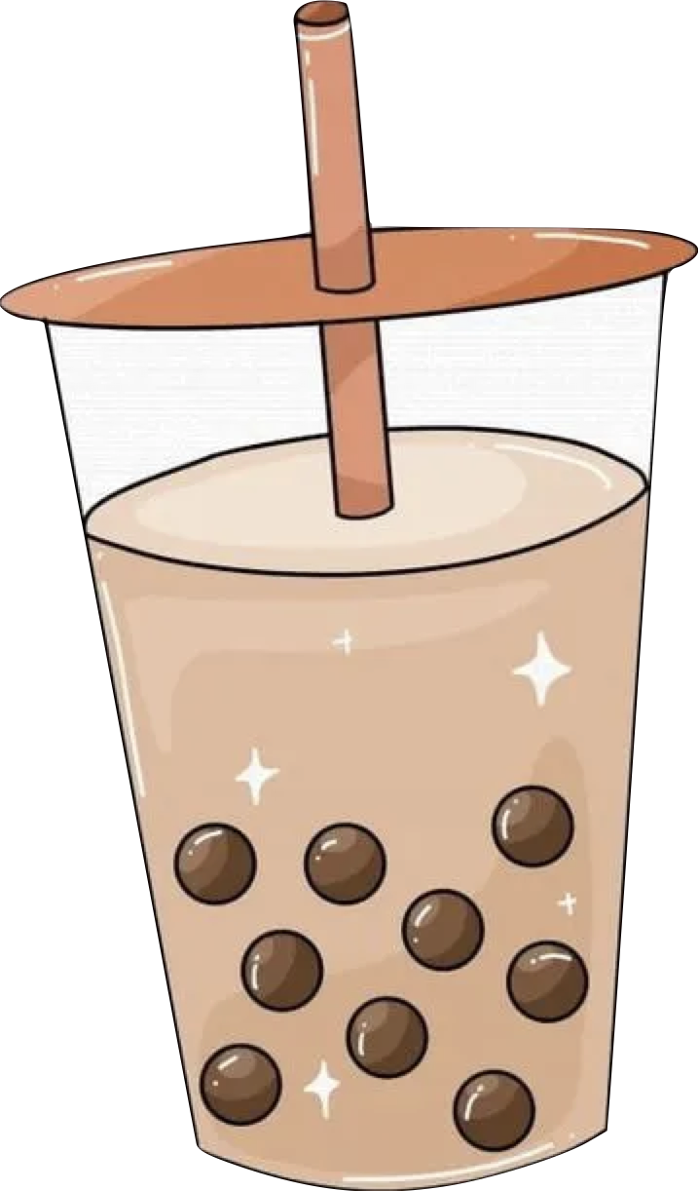
MilkTea
By:Agnes

Slide 3

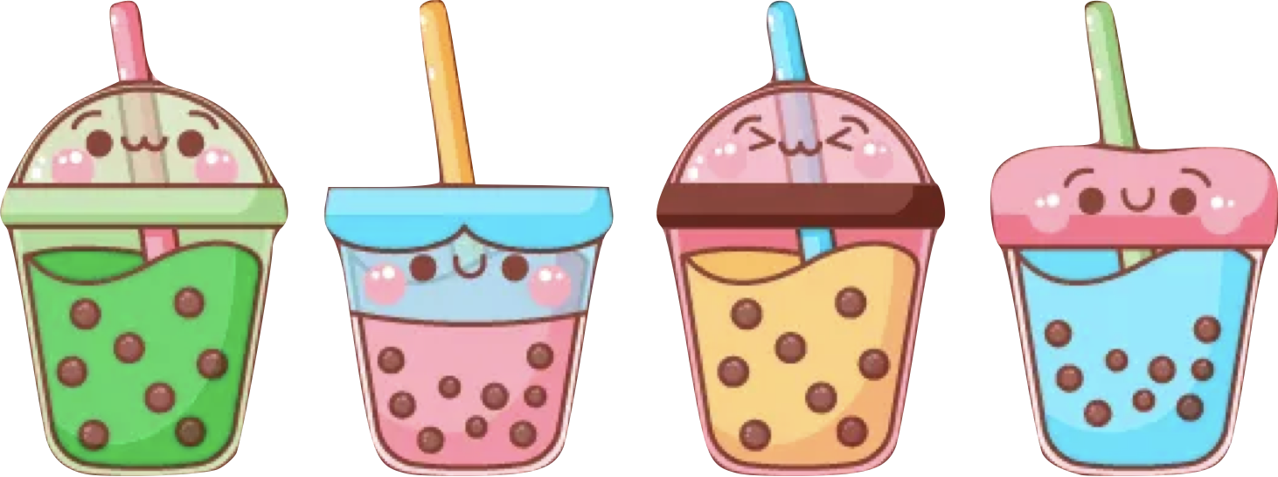
CONTENTS
The Origin of Milk Tea
The Development of Milk Tea
A Comparison of Oriental and Foreign Milk Tea
Milk Tea and Health

Slide 4
PART.01
The Origin of
Milk Tea

Slide 5
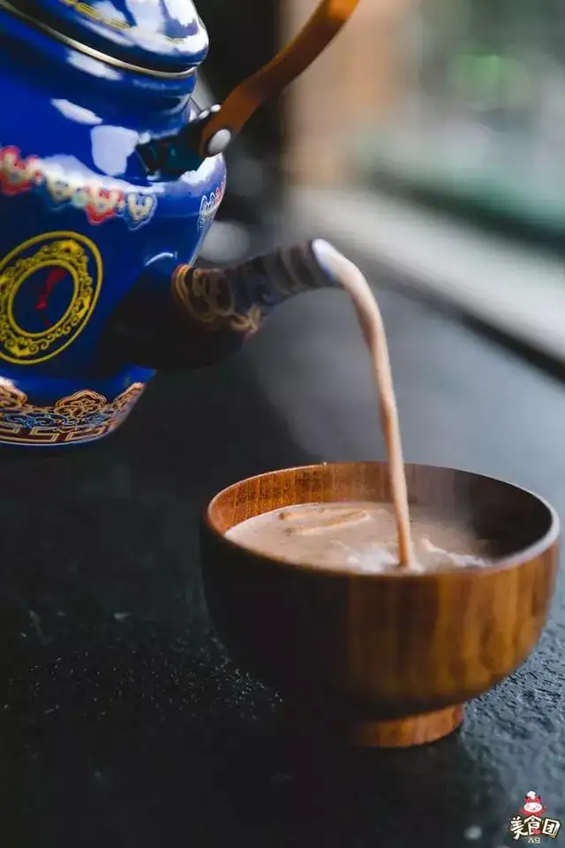
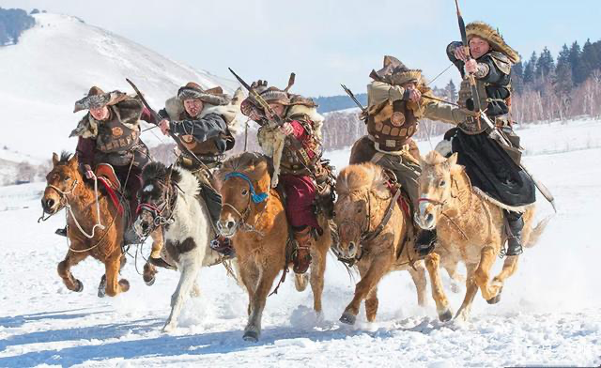
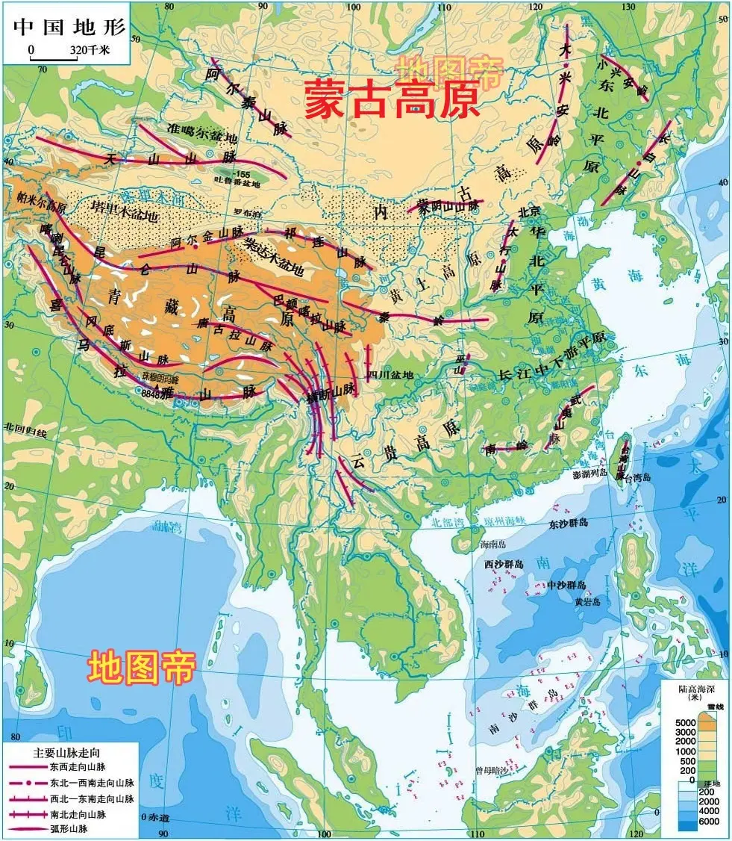
Origin
Mongolia Milk Tea
Nomadic tribes
Mongolia Plateau
Each school holds its own opinion about the origin, but in fact, if we carefully analyse the fact, we can easily find its true origin, that is - ”Mongolia Milk Tea” drunk by nomadic tribes in Mongolia Plateau. Till now, the nomadic tribes living in Inner Mongolia Autonomous Region of PRC still treat visitors with milk tea, which is an unshakable traditional custom.

Slide 6
PART.02
The Development of
Milk Tea

Slide 7
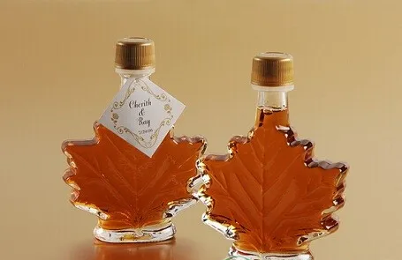
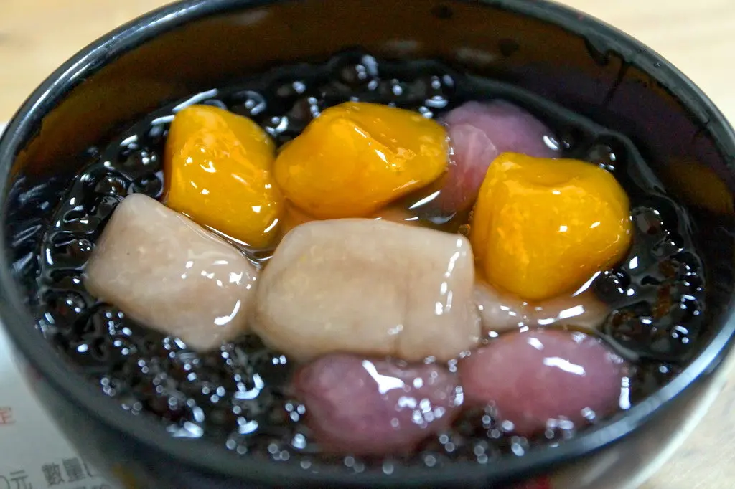
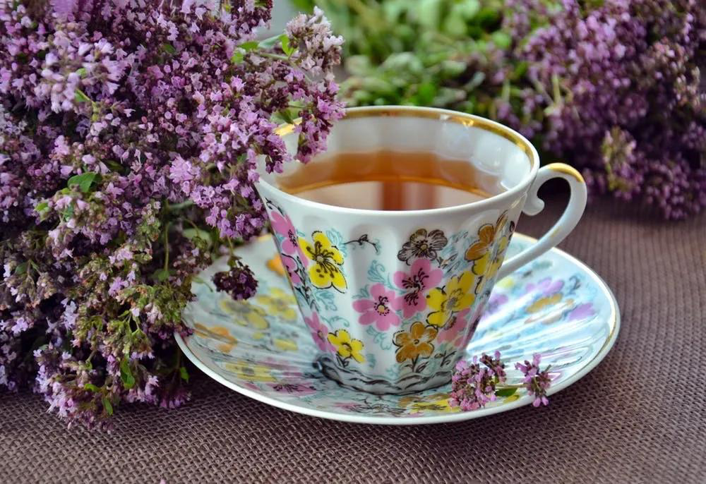
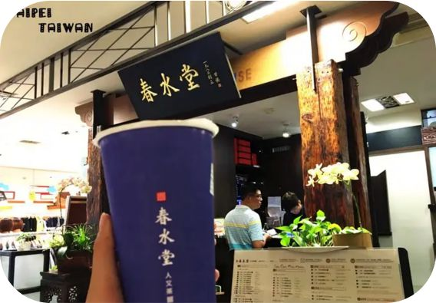
Development
Britain
Taiwan
maple sugar
snack flour
Gave birth to the rudiment of modern
milk tea and its basic ingredients.
Modern milk tea has preliminarily
come into shape.

Slide 8
PART.03
A Comparison of Oriental and Foreign Milk Tea

Slide 9
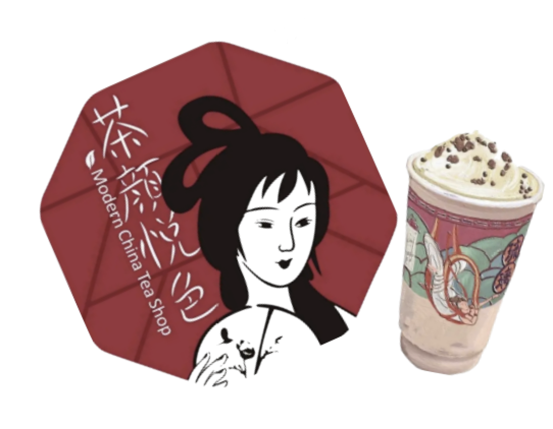
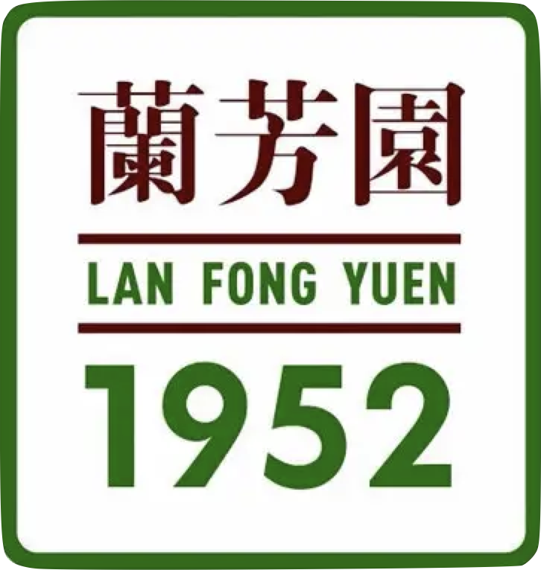
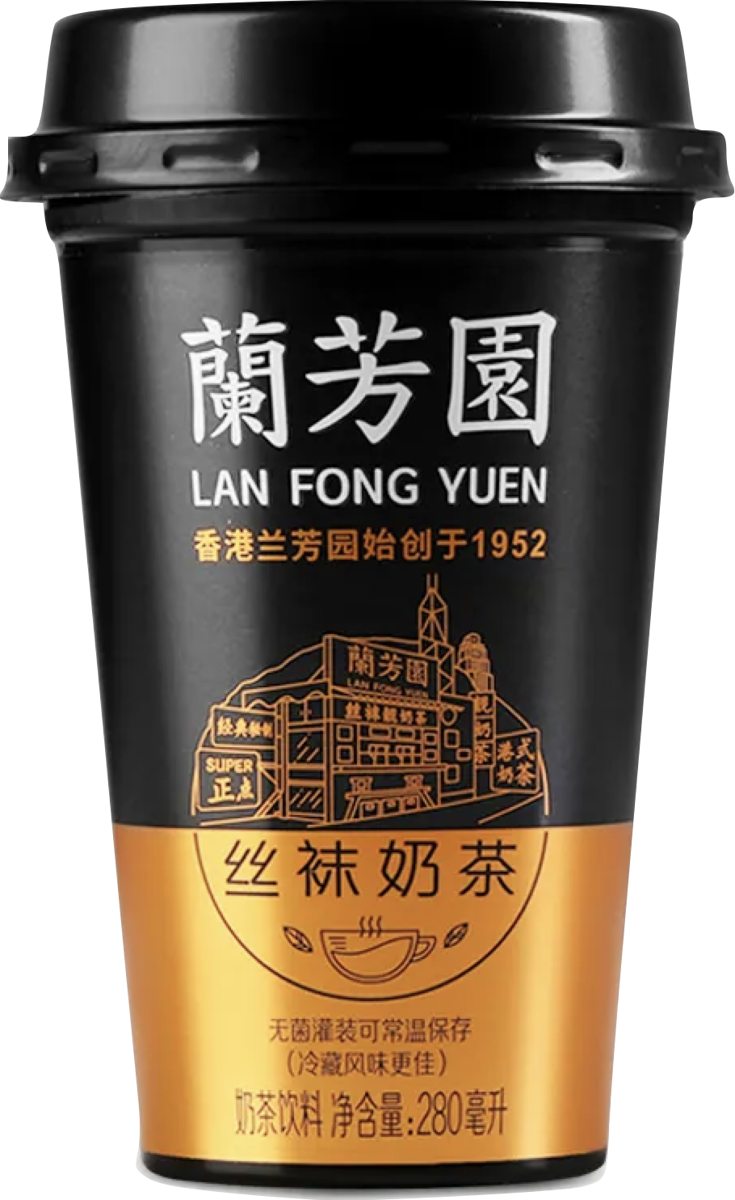
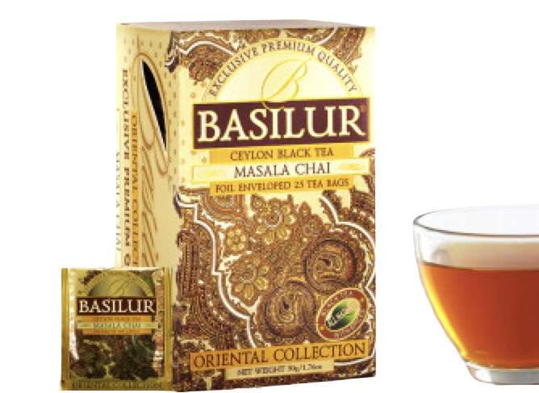
Comparison
Local Changsha Milk Tea
Hong Kong-style milk tea
Indian Masala Chai
Sexytea
Lanfangyuan
Only be drunk
in India
Founded in 2013
Founder Lin Muhe
“Black Tea Latte”
Silk Stockings Milk Tea
Various spices

Slide 10
PART.04
Milk Tea and Health

Slide 11
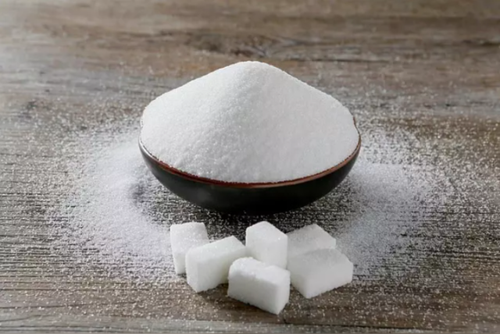




Advantages
Supplement sugar
Mitigate
fatigue
Increase
body
energy
Improve
working
efficiency

Slide 12





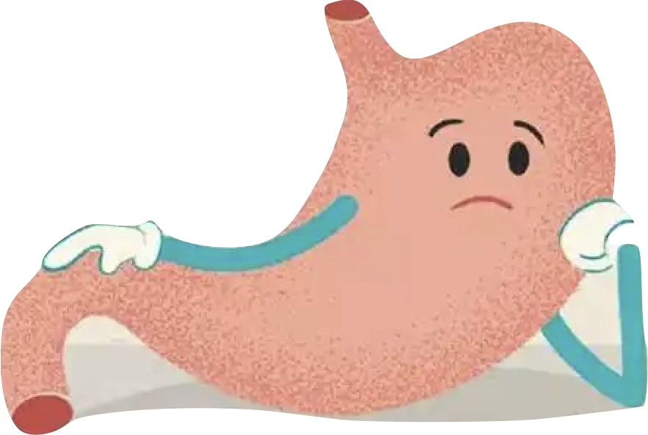



Disadvantages
Getting fat
Increasing cholesterol
Hyperlipidemia and Hyperglycemia
Damaging normal gastrointestinal function
Increasing risks of
angiocardiopathy
Causing cancer
Doing harm to liver and kidney

Slide 13
Thank You
By:Agnes

Slide 14
Milk Tea
Milk Tea
We live in a modern world with countless yummy food where youngsters can’t live without milk tea. There is even one popular cyber saying that goes like this:”Youngsters continue their lives by drinking milk tea.”
Milk tea, popular throughout the whole country, even the world, originated from bubble tea of Taiwan. Currently, we have entered “Milk Tea 4.0 Era”. Such an era has endowed milk tea with a brand-new meaning, becoming a cultural symbol of modern civilization human life, especially youngsters’ lives, namely, a pursuit of identity recognition for youngsters.（Li Xintong 2020，14）
So, is milk tea really so miraculous? Is it really so tasty? We may as well discuss the past and current situations of milk tea!
A.The Origin of Milk Tea
Each school holds its own opinion about the origin, but in fact, if we carefully analyse the fact, we can easily find its true origin, that is---”Mongolia Milk Tea” drunk by nomadic tribes in Mongolia Plateau. Till now, the nomadic tribes living in Inner Mongolia Autonomous Region of PRC still treat visitors with milk tea, which is an unshakable traditional custom.

Slide 15
Milk Tea
B. The Development of Milk Tea
Due to the rampant global expansion of British colonists, lots of oriental local products, including milk tea of China, were also transported to the occidental world. Later, it was improved and developed in Britain. Since the introduction of milk tea into Britain, due to the distinction of climate and dietary habits, British gave up the utilization of spice, but mixed sundry kinds of tea to replace spice to make milk tea, and added maple sugar as condiment, thus giving birth to the rudiment of modern milk tea and its basic ingredients.（《世界著名奶茶大全》 厨影美食）
Later, Taiwan introduced milk tea.
In the spring of 1987, manager of a Taiwanese cold drink department---Ms. Lin Xiuhui of "Chunshuitang" , added local snack flour into milk tea, and after her successful promotion to consumers, Lin and her colleagues Shen Tonge, Lin Lingru and Wang Yufeng, were inspired by cooked flour whose shape is similar to black pearl, thus creating the name “Pearl Milk Tea”(Bubble tea, currently). Henceforth, the name full of aesthetic feeling was spread.（《世界著名奶茶大全》 厨影美食） By far, modern milk tea has preliminarily come into shape.

Slide 16
Milk Tea
C. A Comparison of Oriental and Foreign Milk Tea
1. Local Changsha Milk Tea
When in Changsha, talk as Changshanese do, so let’s talk about Changsha local milk tea first. As we all know, Changsha is famed as an Internet celebrity city, mostly due to “Sexytea”. Sexytea was founded in 2013 as Changsha’s original Chinese style tea brand, uniquely practicing the creation of “new Chinese-style fresh tea”, and staying committed to growing to an original tea beverage design brand. What Sexytea brings to customers is not only a cup of tea, but also an interesting lifestyle, thus showing the beauty of China on the basis of tea. All Sexytea milk tea is produced with Nestle fresh milk and excellent quality tea leaves as ingredients.
The logo of Sexytea is mainly composed of a Jiangnan woman. A fan and a beauty vividly show the majesty and quaintness of antique Chinese style. Compared with other current milk tea brand logos, that of Sexytea has left a great impression on people.（茶颜悦色密码 2020,68）
The signature milk tea of Sexytea is “black tea latte”, comprised of Ceylon black tea, Zelanian Anchor whipping cream and American pecans. On the top of the paper cup is Anchor whipping cream with pecans. Black tea latte emphasizes both milk and tea, with each flavor balanced pretty well.

Slide 17
Milk Tea
2. Hong Kong-style milk tea
The inventor of Hong Kong-style milk tea is Lin Muhe, the founder of the time-honored brand Lanfangyuan in Central, Hong Kong. The 81-year-old "Father of Hong Kong-style milk tea" has never used silk stockings to make tea. When Lanfangyuan was firstly opened, silk stockings were not yet fashionable in Hong Kong. When Lin Muhe was about 10 years old, he worked in Hong Kong, with his wife and a clerk opened Lanfangyuan Food Stall in Baihua Street of Central in 1952. During those days, the small stall always attracted nearby dockers every afternoon, who enjoyed themselves watching Lin Muhe and his colleagues washing their tea bags to and fro. When they saw the brown color of tea bags, they thought it was silk stockings. After that, they would shout "a cup of silk stockings milk tea". This is the origin of silk stockings milk tea(currently Hong Kong-style milk tea).（《百度百科——丝袜奶茶》)
3.Indian Masala Chai
Authentic Masala Chai can only be drunk in India, which is cooked by delicate handicrafts. Due to the addition of various spices, the taste is strong, mellow, hot and spicy at the beginning. However, if the flavor is slightly changed, it will be sweet or spicy, or the various flavors will react with each other. It is just as confusing as Indian curry, but pretty fascinating. Maybe this is what Masala Chai should be. Drinking Indian milk tea is not only a baptism to taste, but also a return to primitive nature.（《世界著名奶茶大全》 厨影美食）

Slide 18
Milk Tea
C.Milk Tea and Health
1.Advantages
Drinking milk tea can quickly supplement sugar, increase body energy, mitigate fatigue and improve working efficiency.
2.Disadvantages
Drinking too much milk tea will increase the possibility of getting fat. It will also increase cholesterol, and even lead to hyperlipidemia and hyperglycemia, doing harm to liver and kidney, increasing risks of angiocardiopathy, thus affecting study and memory, and damaging normal gastrointestinal function. It will even cause cancer if drunk for a long time.
References
1.李欣童.（2020）浅谈台湾奶茶文化的三十年变迁.传播力研究,4(14)14-15
2.《世界著名奶茶大全》 厨影美食
3.《百度百科——丝袜奶茶》
4.茶颜悦色密码 （2020）国企管理,(20)68.

Slide 19
Milk Tea
Terms and Expressions
Milk tea 奶茶
Spice 香辛料
Rudiment 雏形
Sexytea 茶颜悦色
Black tea latte 幽兰拿铁
Hong Kong-style milk tea 丝袜奶茶
Cholesterol 胆固醇
Hyperglycemia 高血糖
Mongolian Plateau 蒙古高原
Maple sugar 枫糖
Bubble tea 珍珠奶茶
Internet celebrity city网红城市
Pecans 碧根果
Masala Chai 马萨拉奶茶
Hyperlipidemia 高血脂
Angiocardiopathy 心血管疾病
Gastrointestinal 肠胃的

Slide 20
Milk Tea
Questions
1.What is the origin of milk tea?
2.Who promoted milk tea?
3.What is the birth place of modern milk tea?
4.What is Changsha’s most famous Internet celebrity milk tea shop’s name?
5.Is Hong Kong-style milk tea produced with silk stockings?
6.What are the advantages of drinking milk tea?
7.What are the disadvantages of drinking milk tea?

Slide 21
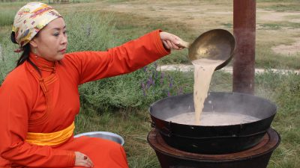
Milk Tea

Slide 22
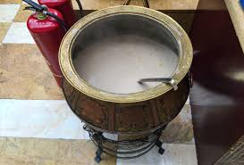
Milk Tea

Slide 23
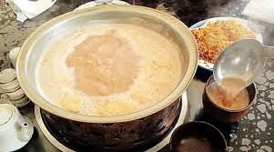
Milk Tea

Slide 24
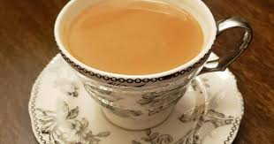
Milk Tea

Slide 25
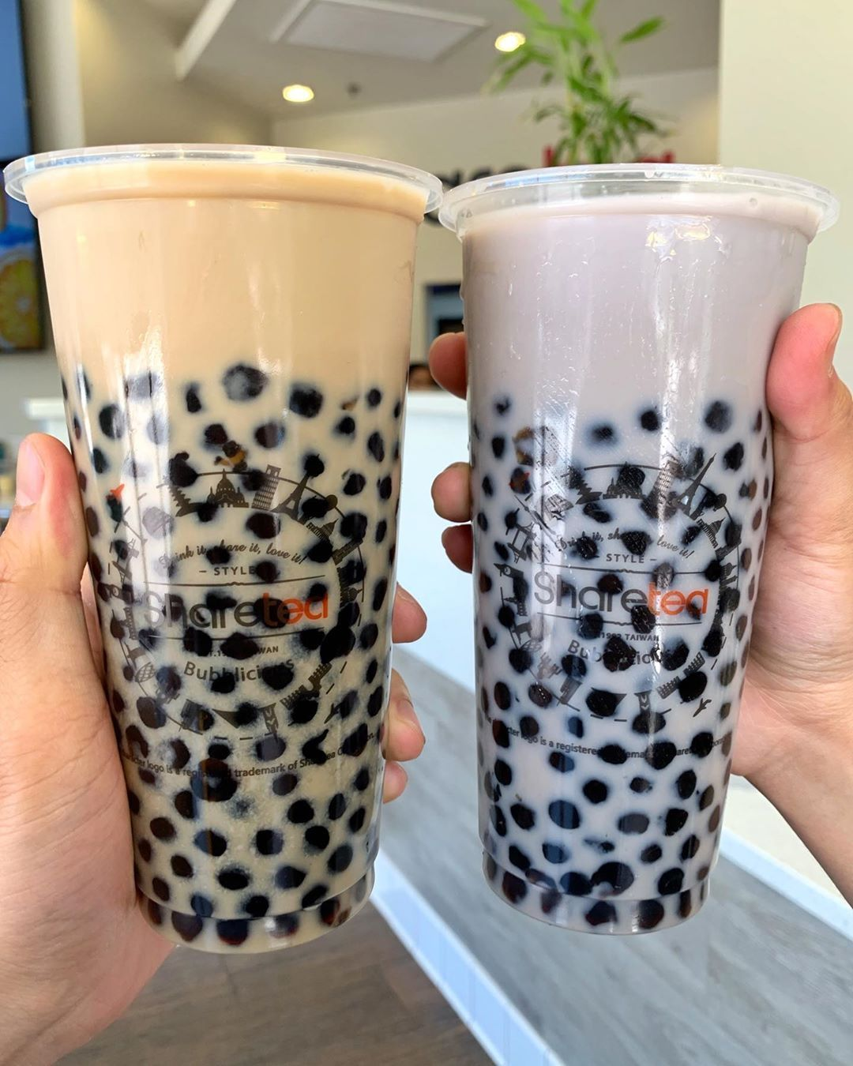
Milk Tea

Slide 26
Milk Tea
茶颜悦色

Slide 27
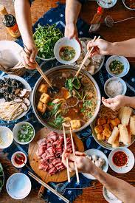
Session 2 第二次上课: Hotpot

Slide 28
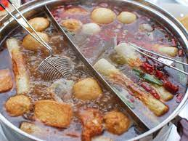
Session 2 第二次上课: Hotpot

Slide 29
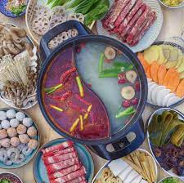
Session 2 第二次上课: Hotpot

Slide 30
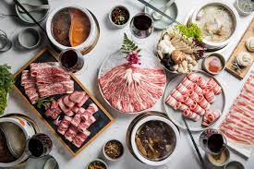
Session 2 第二次上课: Hotpot

Slide 31
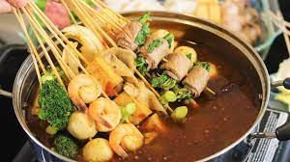
Session 2 第二次上课: Hotpot

Slide 32
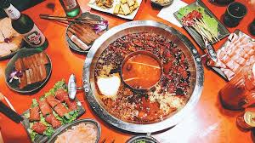
Session 2 第二次上课: Hotpot

Slide 33
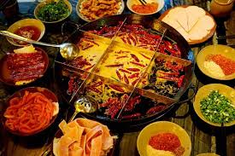
Session 2 第二次上课: Hotpot

Slide 34
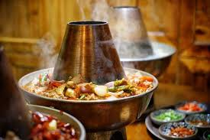
Session 2 第二次上课: Hotpot

Slide 35
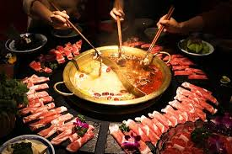
Session 2 第二次上课: Hotpot

Slide 36
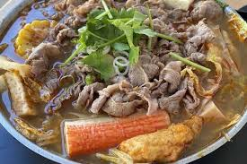
Session 2 第二次上课: Hotpot

Slide 37
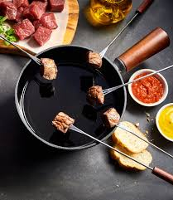
Session 2 第二次上课: Hotpot

Slide 38
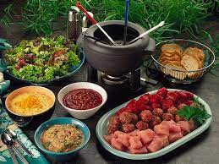
Session 2 第二次上课: Hotpot

Slide 39
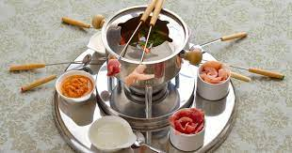
Session 2 第二次上课: Hotpot

Slide 40
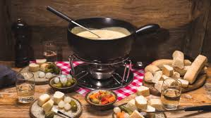
Session 2 第二次上课: Hotpot

Slide 41
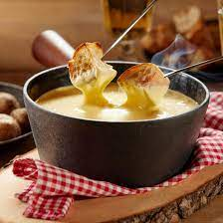
Session 2 第二次上课: Hotpot

Slide 42
Preparation for next week
Please prepare all texts, quizzes
Traditional Cuisine: The Art of Chinese Cooking
Traditional Cuisine: Two Famous Dishes
Traditional Cuisine: Breakfast Culture of Wuhan
Traditional Cuisine: Eight Major Cuisines of China

Slide 43
Always here for you!
随时为你们服务
Professor Dr. Martin Woesler
吴漠汀
湖南师范大学特聘教授，博士导师
Office / 办公室: 外国语学院415
国际汉学中心309
Phone / 电话: (150) 1138 8818
(德国+49 178 2073538)
Email / 电子邮件: wmt@hunnu.edu.cn

Slide 44
Thank You

