Slide 1
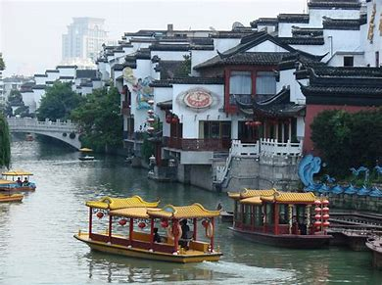
Tourism,
Nanjing—An Ancient Capital of Six Dynasties

Slide 2
Contents
1
A Brief Introduction to Nanjing
2
Scenic Spots in Nanjing
3
The Translation

Slide 3
Part 1
A Brief Introduction to Nanjing

Slide 4
A Brief Introduction
The 2,548-square-mile city of Nanjing is the capital of China’s eastern Jiangsu Province, and lies about 200 miles inland from Shanghai and the sea.
Nanjing is located in hills area of lower reaches of Yangtze River, encircled by rivers and majestic mountains.

Slide 5
Part 2
Scenic Spots in Nanjing

Slide 6
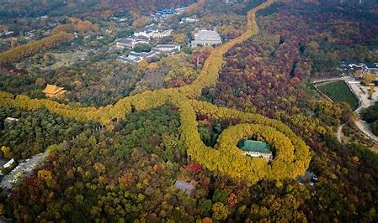
Zijin Mountain
Towering in the eastern suburb of Nanjing, Zijin Mountain has been known as one of the four most famous mountains in Southern China. It got its name because purple clouds can often be seen at the top of the mountain. The mountain is not only very beautiful, but also rich in historical and cultural relics.
The steep and lofty Zijin Mountain is home to some famous places of interest of Nanjing. It is just like a huge dragon intending to fly.
Covered by verdant trees, Zijin Mountain is seven kilometers (4.3 miles) long from west to east and three kilometers (1.9 miles) wide from south to north. It’s an AAAAA-level Scenic Area of China as well as a demonstration base of China's ecological culture.

Slide 7
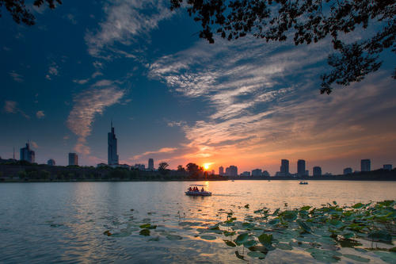
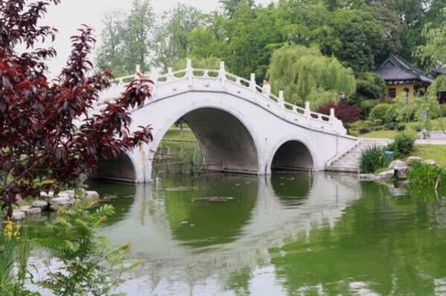
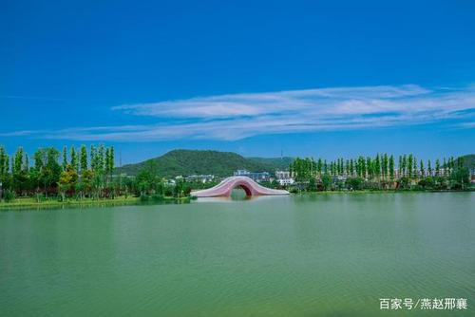
Xuanwu Lake
Situated at the foot of Zijin Mountain, Xuanwu Lake is a beautiful scenic spot protected by China. It is also one of the three most famous lakes in Nanjing.
The history of Xuanwu Lake can be traced back to the Pre-Qin period (21century BC-221 BC). The name of the lake has changed several times during the long history. The lake gained the name Xuanwu because a black dragon was said to be in the lake.

Slide 8
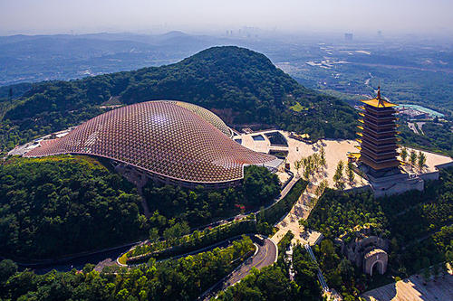
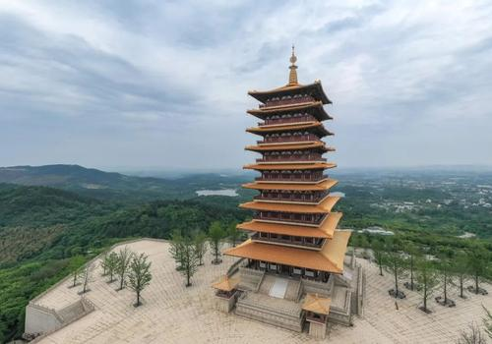
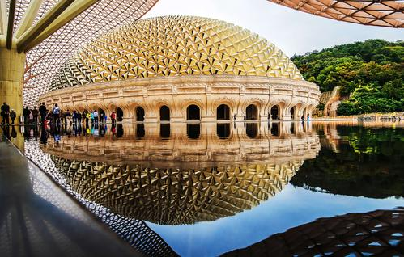
Niushou Mountain
Niushou Mountain, named after the two peaks of the east and west of the mountain which are like horns on the Niushou, is located in Jiangning District, Nanjing City, Jiangsu Province. It is a famous Buddhist mountain in China.
When you enter the east gate of Niushou Mountain, you can see the towering Buddhist Top Tower and Buddhist Top Palace. As one of the cores in the Buddhist Top Sacred Site Zone. Buddhist Top Palace is located at the west peak of Niushou Mountain. Together with Buddhist Top Tower, they constitute a new scene at the west peak of Niushou Mountain; echoing each other with the east peak of Niushou Mountain at distance, the grand spectacle of two peaks and two palaces facing the head of the ox is reappeared

Slide 9
Niushou Mountain
Niushou Mountain, named after the two peaks of the east and west of the mountain which are like horns on the Niushou, is located in Jiangning District, Nanjing City, Jiangsu Province. It is a famous Buddhist mountain in China.
When you enter the east gate of Niushou Mountain, you can see the towering Buddhist Top Tower and Buddhist Top Palace. As one of the cores in the Buddhist Top Sacred Site Zone. Buddhist Top Palace is located at the west peak of Niushou Mountain. Together with Buddhist Top Tower, they constitute a new scene at the west peak of Niushou Mountain; echoing each other with the east peak of Niushou Mountain at distance, the grand spectacle of two peaks and two palaces facing the head of the ox is reappeared

Slide 10
Part 3
The Translation

Slide 11
1
Transliteration
Tree Translation
Methods
2
Free Translation
3
Combination of Transliteration and Free Translation

Slide 12
Transliteration 音译
Generally, transliteration is the conversion of a text from one script to another.
Most system of transliteration map the letters of the source script to letters pronounced similarly in the goal script, for some specific pair of source and goal language.
南京 Nanjing
紫金山 Zi Jin Shan

Slide 13
Free Translation 意译
Free translation is a translation that reproduces the general meaning of the original text. It may or may not closely follow the form or organization of the original.
太和殿 Hall of Great Harmony
养心殿 Hall of Mental Cultivation
三潭印月 Tree Pools Mirroring the Moon

Slide 14
Combination of Transliteration and Free Translation 音兼意译
Features of the names of scenic spots
Transliteration and Free Translation
Term（专名） + General term（通名）
玄武 湖
紫金 山
In translation practices, we translate terms by transliteration or free translation （literal translation）.
General Terms are usually translated literally in free translation.
实际翻译中，专名用音译（主要是拼音法） ，也可用意译（主要是直译）；通名则一般采取意译中的直译法。
Term → Transliteration
General term → Literal translation
Term → Literal translation
General term → Literal translation

Slide 15
Term(Transliteration) General term(Literal translation)
专名音译 通名直译
紫金山 Zijin Mountain
玄武湖 Xuanwu Lake
牛首山 Niushou Mountain
天安门广场 Tian’anmen Square
……

Slide 16
Term(Literal translation) General term(Literal translation)
专名直译 通名直译
紫金山 Purple (Golden) Mountain
牛首山 the Ox Horn Mountain
九龙山 the Nine Dragon Hill
……

Slide 17
Thanks!

