Slide 1
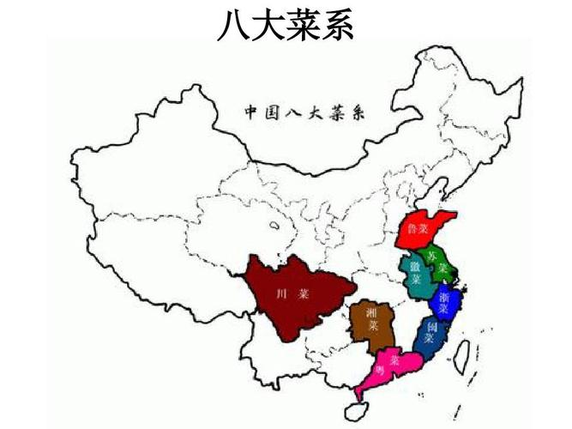
Eight major cuisines of China
刘盈池 Vivian

Slide 2
A Brief Introduction About Chinese Cuisines
As early as the Shang and Zhou dynasties, China’s food culture began to take shape. At that time, Tai Gongwang was the most representative. In the Spring and Autumn Period and Warring States Period under the reign of Duke Huan of Qi（齐桓公）, the flavors of North and South dishes showed differences. In the Tang and Song Dynasties, the southern cuisine and the northern cuisine formed their own systems. In the Southern Song Dynasty, sweet in south and salty in north was formed. At the beginning of the Qing Dynasty, Shandong Cuisine, Sichuan Cuisine, Cantonese Cuisine, and Su Cuisine became the most influential local dishes at that time, and they were called the "four major cuisines. " By the end of the Qing Dynasty, four new local cuisines, Zhejiang Cuisine, Fujian Cuisine, Hunan Cuisine, and Anhui Cuisine, were differentiated and formed, which together constituted the "eight major cuisines" of traditional Chinese cuisine.

Slide 3
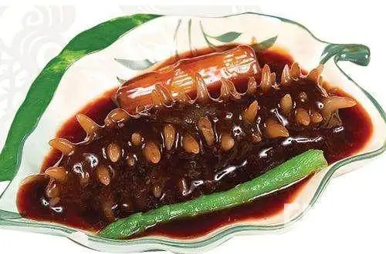
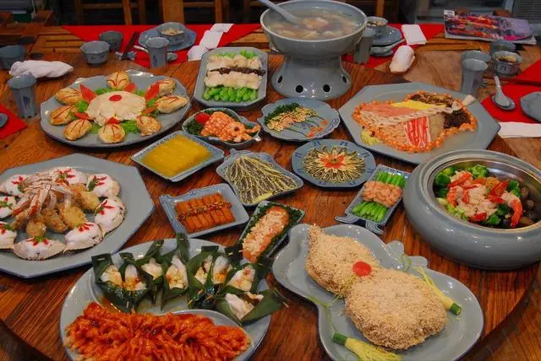
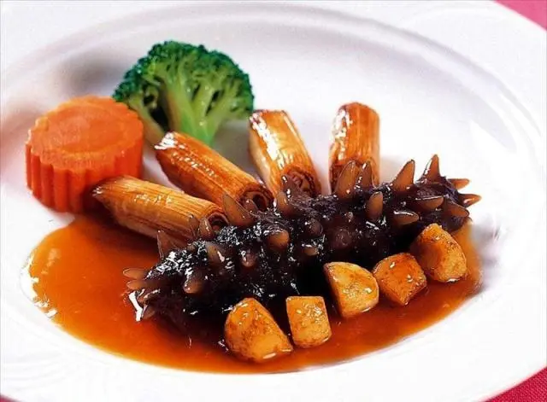
Shandong Cuisine
Chinese: 鲁菜 lǔ cài Popular in: China’s Shandong Province and Southern Liaoning Province Features: umami（鲜美）, salty, sweet and sour flavors; using much soup, scallion, ginger and garlic; good at cooking sea food
Originated in the Spring and Autumn Period (770 - 476 BC), Lu cuisine is the only self-originated cuisine among 8 Chinese cuisines which has the longest history of 2,500 years.Shandong dishes pay much attention to the quality and natural taste of food. Soup and scallion are key seasonings and sea food plays a crucial role in Shandong cuisine. Most Shandong dishes taste fresh, umami and moderately salty.

Slide 4
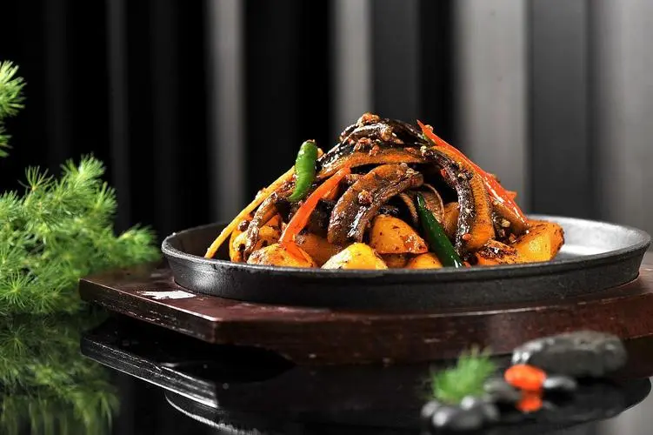
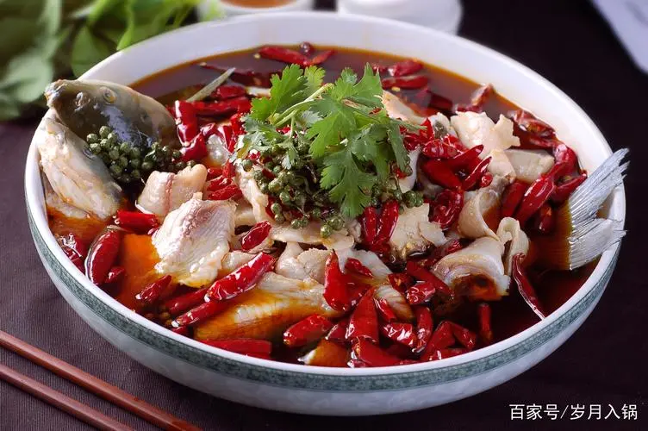
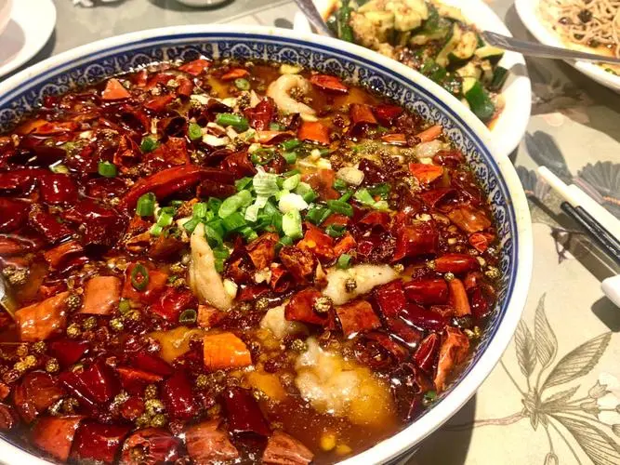
Sichuan Cuisine
Chinese: 川菜 chuān cài Popular in: China’s Sichuan Province, Chongqing Features: hot and spicy, mouth-numbing; using a lot of pepper, chili, garlic, and Pixian bean chili paste. Originated in Southwest China, Sichuan cuisine is the most popular cuisine in China. Sichuan dishes are famous with its spicy, pungent and hot flavor and red color. Sichuan chefs prefer seasonings like various pepper and chili, garlic and broad bean paste which is the soul of Sichuan dishes. Hot Pot is the most popular Sichuan dish in China and is the first choice when dining together with friends.

Slide 5
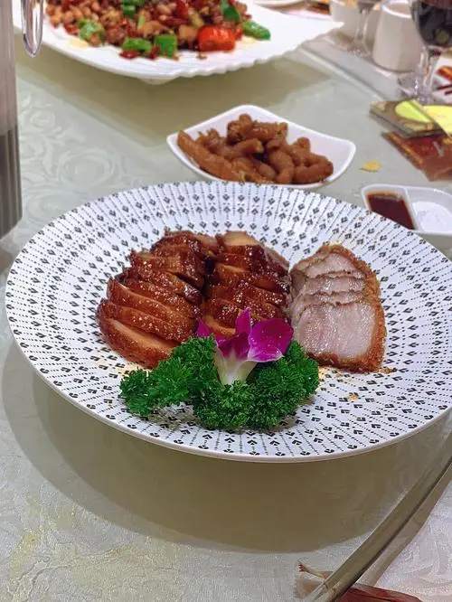
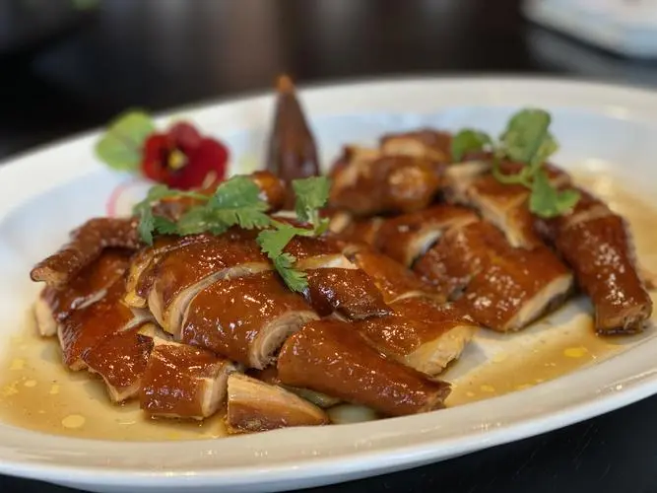
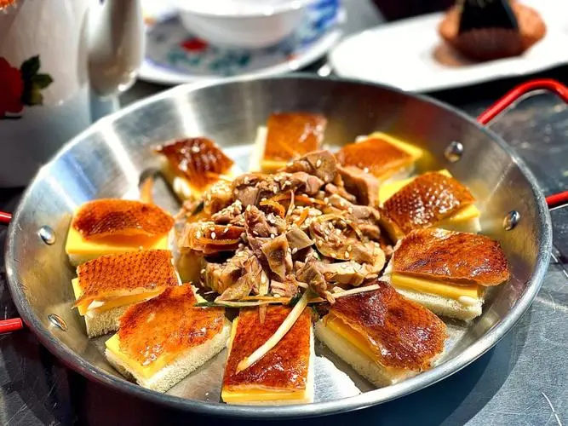
Cantonese Cuisine
Chinese: 粤菜 yuè cài Popular in: China’s Guangdong Province, Hong Kong and Macau Features: mild, fresh and natural taste; widely use of materials and rich cooking methods Cantonese cuisine is welcomed by people around the world and is the representative Chinese cuisine. The cooking methods of Cantonese dishes are always complex, flexible, exquisite, and creative. Most Cantonese dishes taste mild and fresh, preserving the natural taste of food materials. The food materials are extremely rich which include poultries, birds, sea food, land animals and various vegetables and fruits.

Slide 6
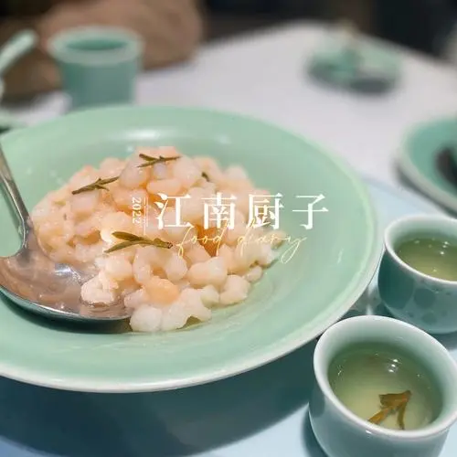
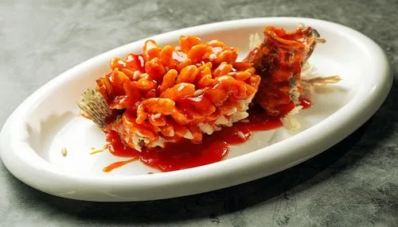
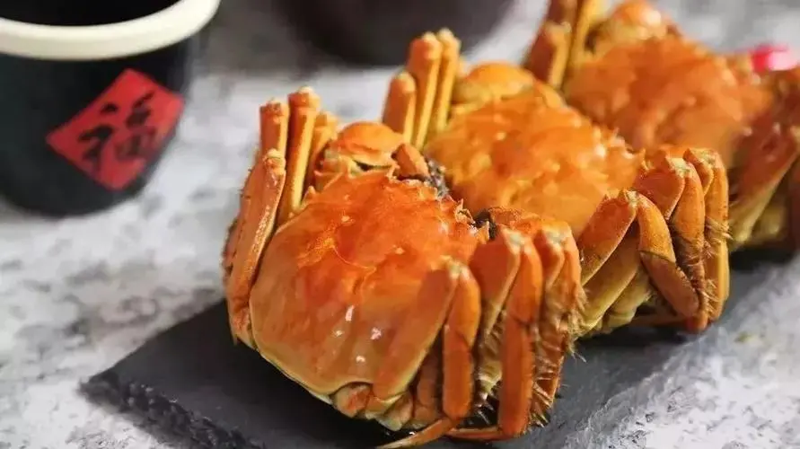
Jiangsu Cuisine
Chinese: 江苏菜, 苏菜, sū cài Popular in: China’s Jiangsu Province Features: mild, slightly sweet, and natural; exquisite cuttings and precise control of heat; delicate dish appearance Jiangsu cuisine, the representative of South China food, is famous for its delicate appearance and lightly sweet, umami, natural and mild taste. Jiangsu dishes preserve much original flavor of food materials. The main food materials are mainly freshwater fishes, river fish and sea food. The cutting is extremely exquisite and changeful and the control of heat is precise. The dishes are always served delicately.

Slide 7
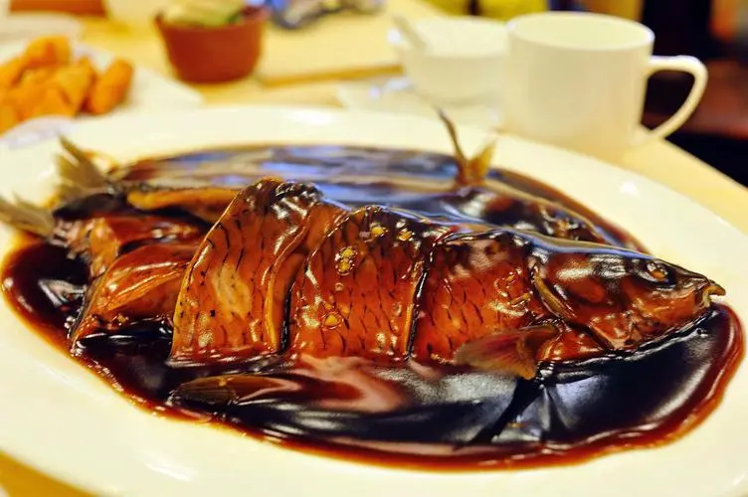
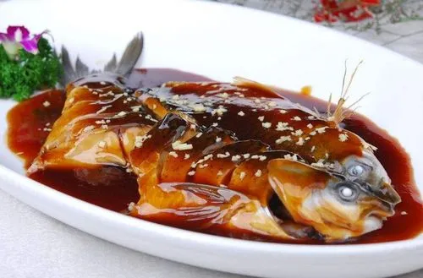
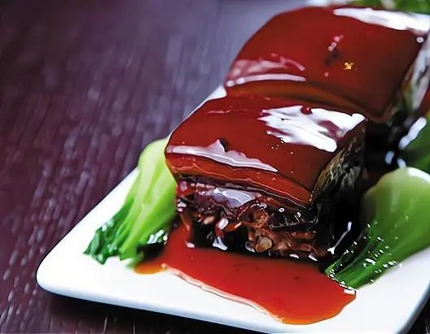
Zhejiang Cuisine
Chinese: 浙菜 zhè cài Popular in: China’s Zhejiang Province Features: light and fresh, crisp and tender; good at controlling fire heat; prefer yellow wine as special seasoning Popular in Zhejiang, Zhejiang cuisine is often lightly seasoned with appealing appearance. Zhejiang cuisine chefs prefer fresh food materials like sea food, freshwater fishes, and vegetables in season and they are extremely strict in the selection of raw materials. In addition, Zhejiang cuisine is well-known for its varied cooking methods and frying is the most frequently used.

Slide 8
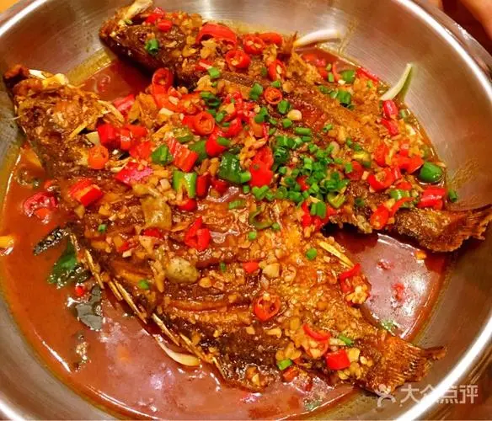
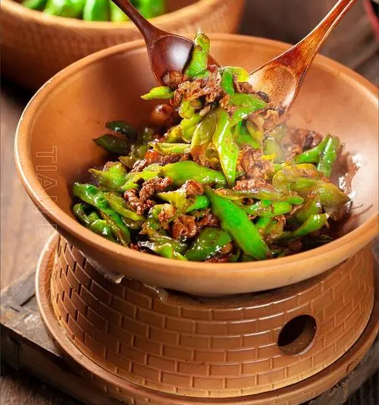
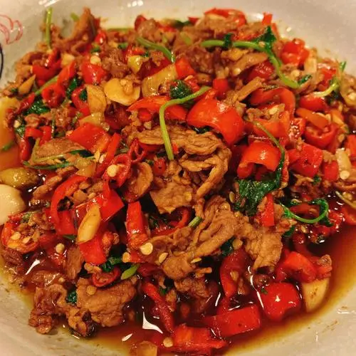
Hunan Cuisine
Chinese: 湘菜 xiāng cài Popular in: China’s Hunan Province Features: spicy, hot, salty; preference for chili & fermented soya beans; dark dish color Originated in Eastern Zhou Dynasty (770 - 256 BC), Hunan cuisine, also Xiang cuisine, is another cuisine popular throughout China with the spicy taste. Hunan dishes are even hotter and spicier than Sichuan cuisine since they have even more dried or fresh chili in dishes. Hunan people also invent sour and spicy taste and numb and spicy taste, and they like pickled(腌渍的） and preserved vegetables and meats very much.

Slide 9
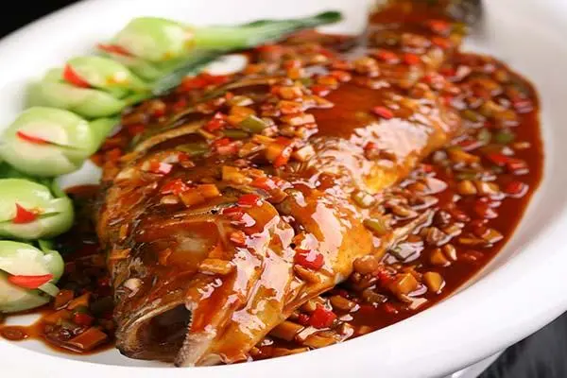
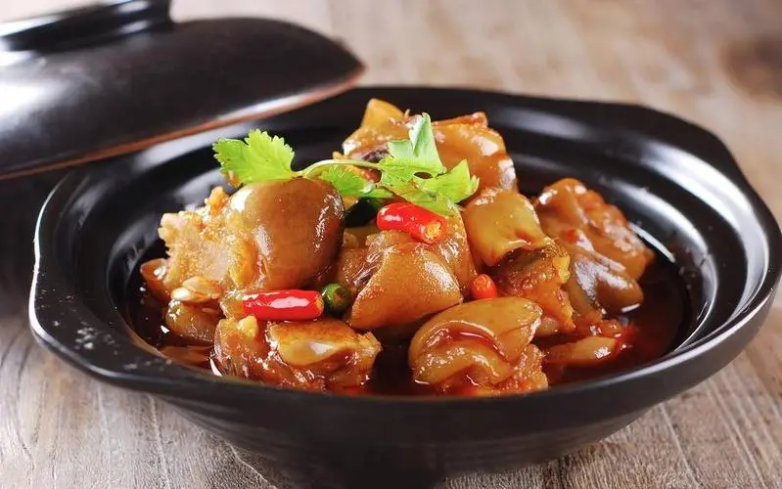
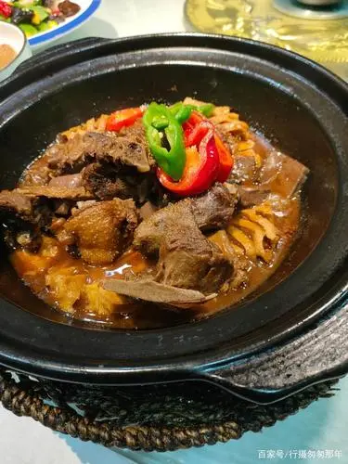
Anhui Cuisine
Chinese: 徽菜 huī cài Popular in: China’s Anhui Province Features: salty and fresh, light, preserving the original flavor of ingredients; preference for hams; light cooking methods including braising, stewing and steaming Popular in Anhui Province, Hui dishes taste salty, fresh, and light and have the unique flavor of ingredients. Hui cuisine attaches importance to dietetic（低热量的） invigoration with natural ingredients. It is worth notice that Anhui cuisine dishes have the effect of nourishing body for multiple ingredients with varied nutrition are matched scientifically.

Slide 10
Thank you！

