Slide 1
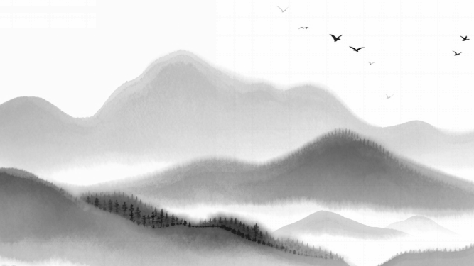
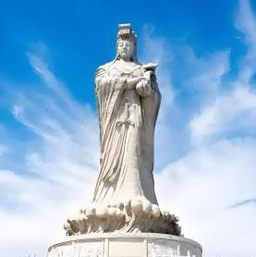
Hunan Normal University
Mazu
Culture
Yan Jidong

Slide 2
Catalogue
01
02
03
04
The Origin of Mazu
The Worship of Mazu
The Cultural Impact of Mazu
Mazu in Modern Times
Contents

Slide 3
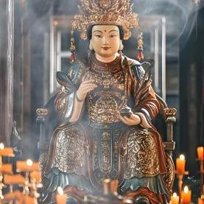
Hunan Normal University
01
PART
The Origin of Mazu

Slide 4
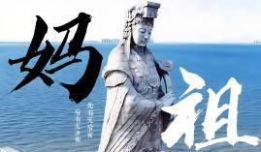
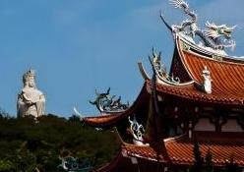
The Formation of Sea Goddess Faith
Origins of the Faith
The story of Mazu begins in the 10th century in Meizhou Island, Fujian Province. Her real name was Lin Moniang. From a young age, she showed extraordinary abilities.
Birth and Early Life
Lin Moniang was born in the 10th century on Meizhou Island. From a young age, she showed extraordinary abilities, such as predicting the weather and having a special connection with the sea.

Slide 5
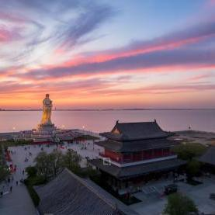
Hunan Normal University
02
PART
The Worship of Mazu

Slide 6

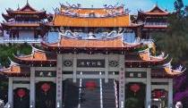
The Legend of Lin Moniang
01
02
Origins of the Faith
Temples and Festivals
After Lin Moniang's death, she was revered as the sea goddess. People believed she could protect sailors and fishermen, and her worship spread along the coasts.
Mazu temples are found in coastal areas and overseas Chinese communities. The Mazu Temple on Meizhou Island is the most famous. Annual festivals feature incense offerings, traditional performances, and grand processions.

Slide 7
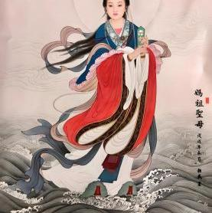
Hunan Normal University
03
PART
The Cultural Impact of Mazu

Slide 8
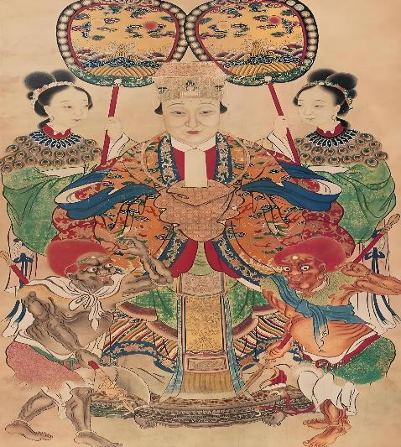
Inspiration in Literature and Art
Poems and Stories
Paintings and Sculptures
Many poets, including Su Shi, wrote about Mazu, describing her as a gentle and powerful goddess. These works have been passed down through generations.
Mazu's image has inspired countless artworks. These pieces capture her beauty and convey the deep respect and love people have for her.

Slide 9
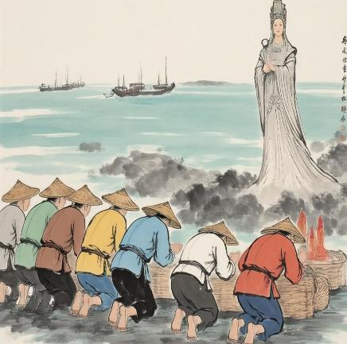
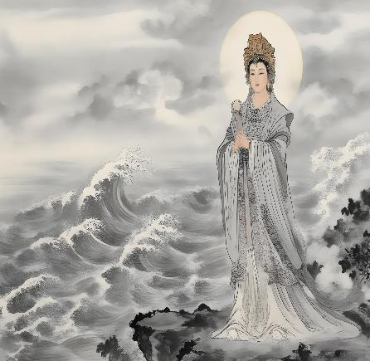
Influence on Local Customs
Fishermen's Prayers
Celebrations and Traditions
In fishing communities, fishermen pray at Mazu temples before setting sail, seeking blessings for a safe journey and a bountiful catch.
Mazu's birthday is celebrated with traditional performances and processions. These events bring communities together to honor her and celebrate their shared heritage.

Slide 10
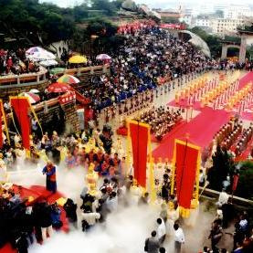
Hunan Normal University
04
PART
Mazu in Modern Times

Slide 11
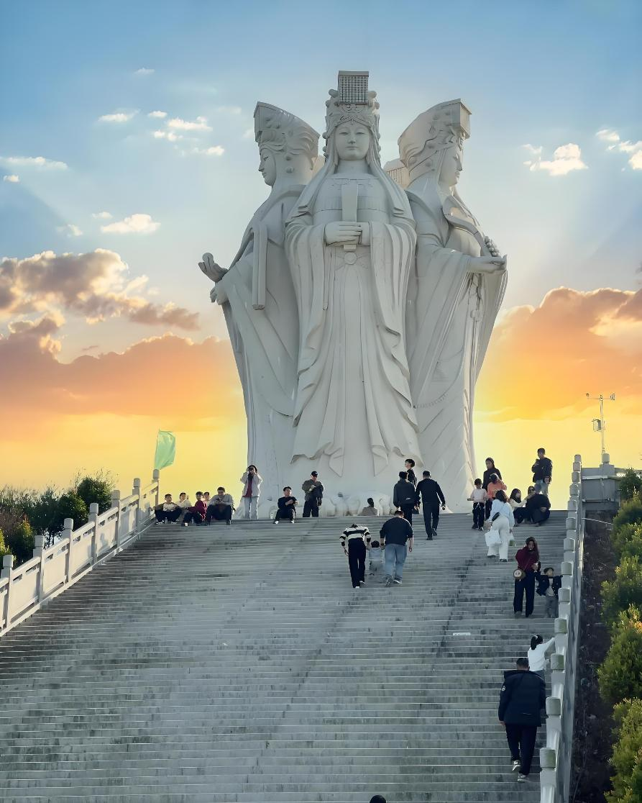
A Bridge for Cultural Exchange
International Festivals
Tourism and Global Reach
Mazu cultural festivals attract international visitors, promoting cultural exchange and understanding. These events highlight the global appeal of Mazu culture.
Mazu temples are popular tourist destinations. Visitors learn about Mazu's story, spreading her legacy and enhancing cultural awareness.

Slide 12
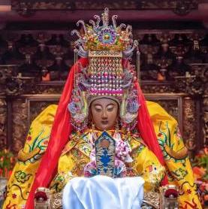
Hunan Normal University
05
PART
Conclusion

Slide 13
The Enduring Legacy of Mazu Culture
Cultural Heritage
Modern Relevance
01
02
Mazu culture is a symbol of bravery, compassion, and harmony with
nature. It is a cherished cultural heritage passed down through generations.
In the modern world, Mazu's spirit inspires respect for the environment and mutual support. Her legacy continues to guide and inspire
people today.

Slide 14
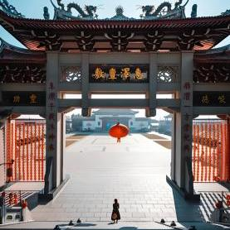
Hunan Normal University
THANK YOU
FOR Listening
Mazu culture
汇报人
Yan Jidong

