Slide 1

Chinese Characters and Scripts
presenter: 牟一泓

Slide 2

Timeline
Cursive script
Jin Wen
late Qin and early Han periods
late Shang and early Zhou dynasties
late Han Dynasty
Regular script
Shang Dynasty
Jiagu Wen
Clerical script
Running hand
late Western Zhou period
Small seal script
under the Yellow Emperor
Qin Dynasty
Great seal script
Invention of Characters by Cang Jie

Slide 3

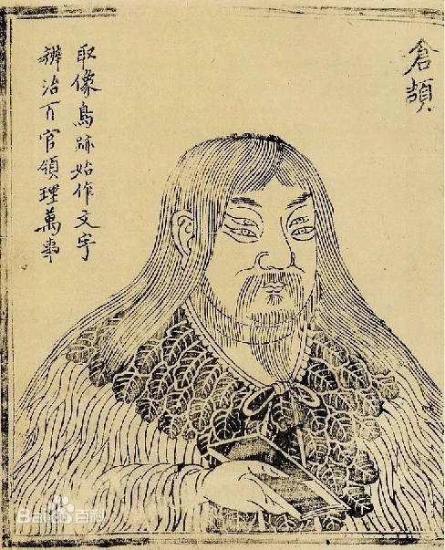
The origin of Chinese characters
Who is the legendary inventor of Chinese characters?
Invention of Characters by Cang Jie
Cang Jie has four eyes and each eye has two pupils. According to the movement trend of the stars, the footprints of birds and animals, he created characters and was revered as "Wen Zu Cang Jie"
Chinese characters evolved and developed as symbols and marks for our ancestors to keep records.

Slide 4
Six categories of Chinese characters
Pictography & self-explanatory character象形字
以实物形象为基础，简化描绘形成字体，要求形象生动、易于辨识。
Picto-phonetic character形声字
Mutually explanatory character指事字
由形旁和声旁组成，形旁表意、声旁表音，要求形声相应、易于记忆。
在象形字基础上添加指示性符号，表示抽象概念，要求符号明确、意义清晰。
Synonymous character转注字
完全同义词的转化，要求保持原意、适应语境。
Associative compound会意字
Phonetic loan character假借字
结合两个或多个独体汉字的意义，形成新字，要求意义相关、组合合理。
借用音同或音近字表示另一字，要求借字合理、避免混淆。

Slide 5


Pictography & self-explanatory character象形字
Pictography & self-explanatory character is the basis of Chinese character. It is intuitive and pictographic, easy to understand and remember.
Pictography & self-explanatory character is formed by drawing according to the shape of things.
火
日

Slide 6
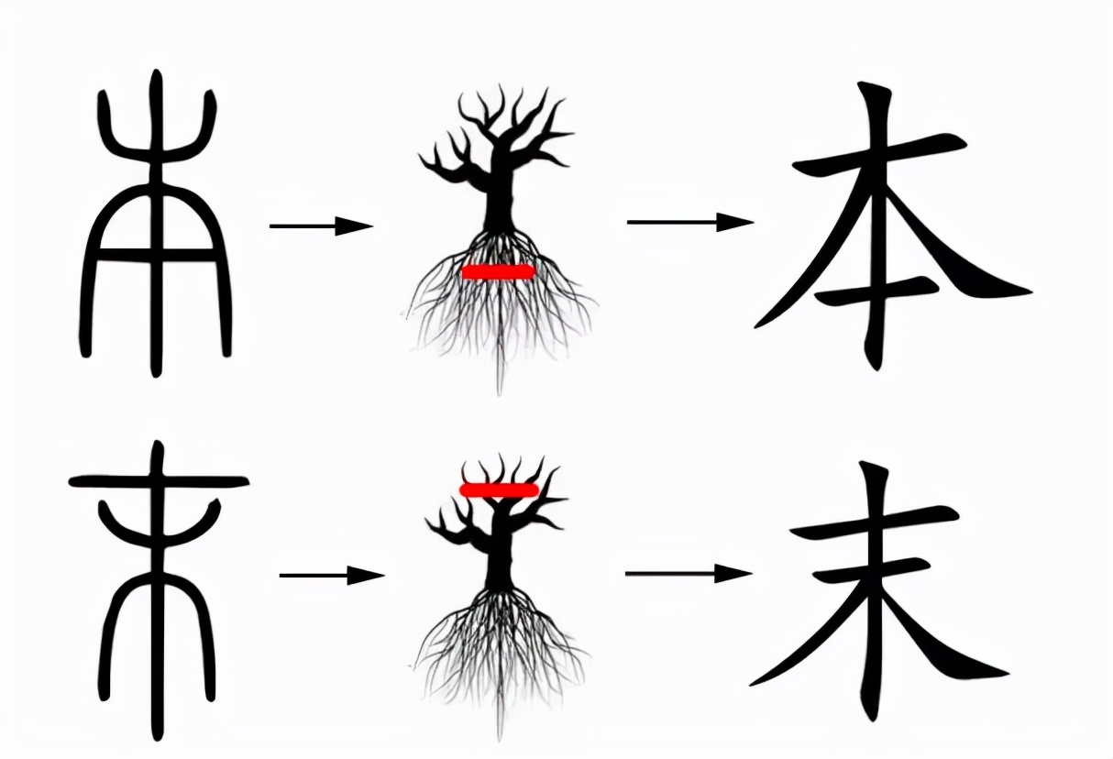
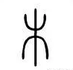
Mutually explanatory character指事字
Mutually explanatory character adds indicative symbols on the basis of pictography & self-explanatory character to represent abstract concepts.
It is indicative and abstract, and can express more complex concepts.

Slide 7
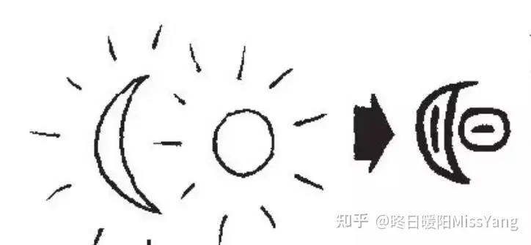
Associative compound会意字
Associative compound is a combination of two or more unique Chinese characters. Its meaning is a combination of the meanings of these characters so that it can express richer meaning.
日＋月＝明

Slide 8
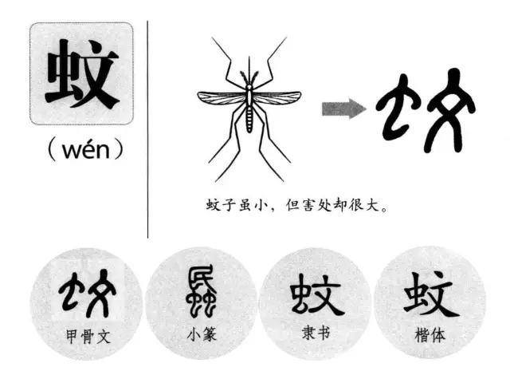
Picto-phonetic character形声字
Picto-phonetic character is composed of a meaning radical and a pronunciation radical. Picto-phonetic character has the characteristics of corresponding shape and sound and is the most numerous characters in Chinese characters.

Slide 9
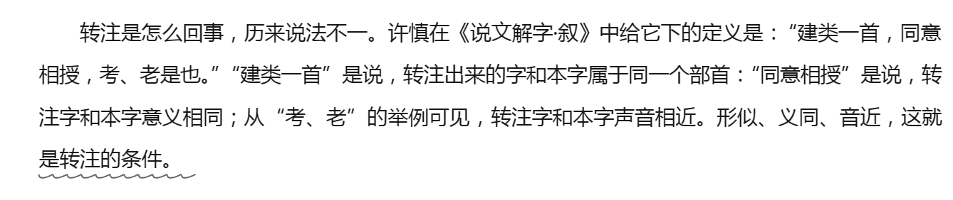
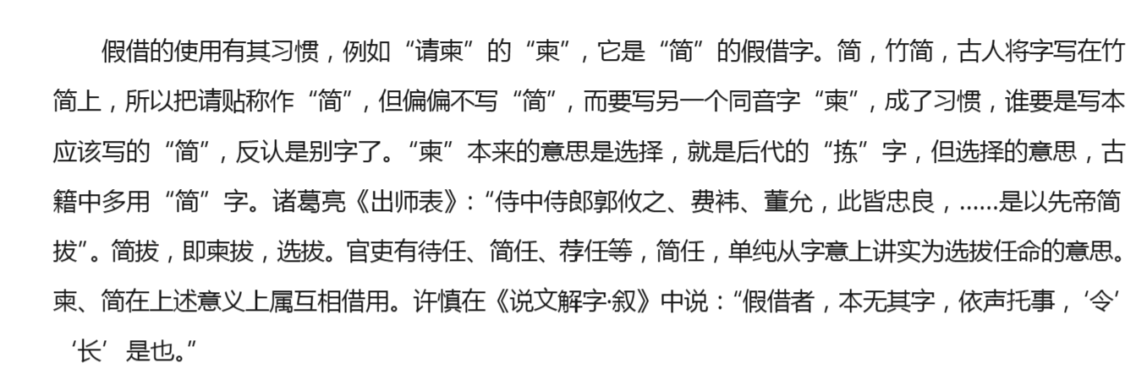
Synonymous character转注字 Phonetic loan character假借字
Synonymous character refers to the conversion character of a completely synonymous character.
Phonetic loan character borrows a word of the same or similar sound to represent another word.

Slide 10
Why did Chinese characters continue to develop in one line while many other Phonograms died out?
The biggest flaw of phonogram is that it will be bound by human image thinking. First of all, phonogram writing must be pictographic, that is, it must be strictly based on the shape of things to create glyphs. Secondly, the premise of phonogram is tangible so that it can not be used to represent a large number of abstract concepts without real form.
However, synonymous character and phonetic loan character make Chinese characters break free from the bondage of human image thinking. It is worth mentioning that if Chinese characters develop on this basis, it is likely to become phonetic characters. However, our ancestors who created Chinese characters stopped abruptly here, and turned to the phonetic and ideographic writing system dominated by the form and sound.

Slide 11
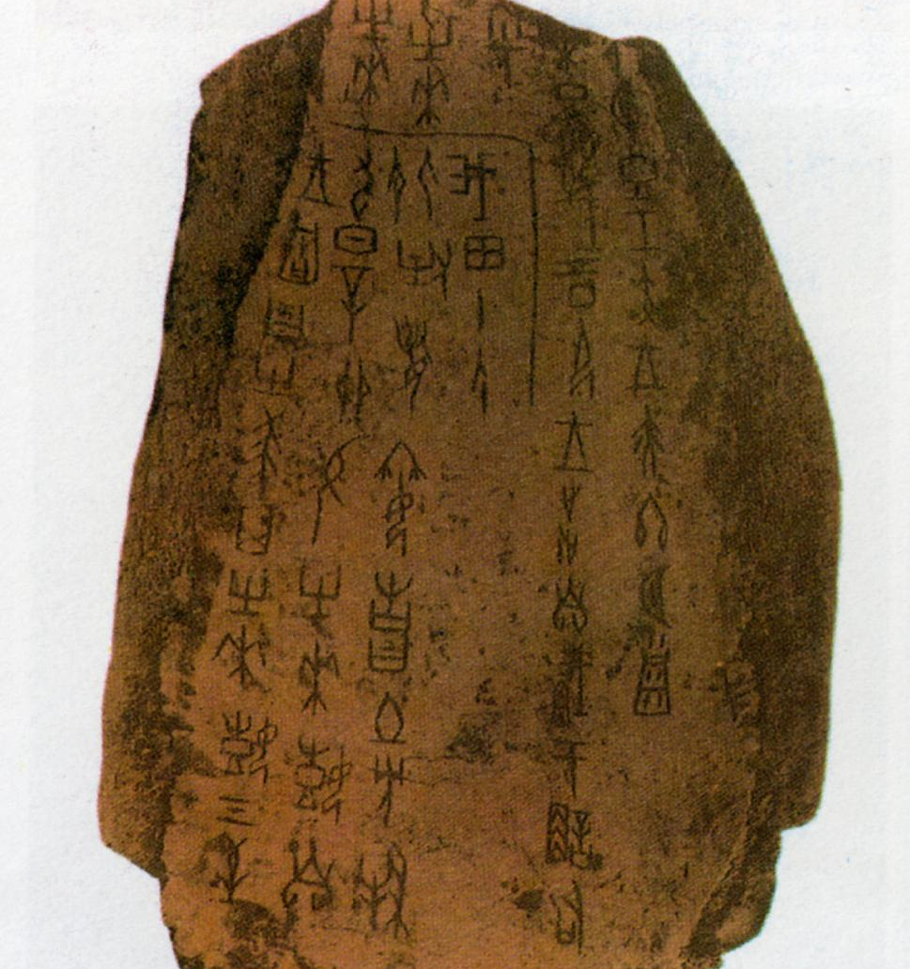
Jiagu Wen甲骨文
The oldest Chinese characters discovered so far are called Jiagu Wen (ancient Chinese characters carved on tortoise shells or animal bones), which were already well-developed characters at that time. Those characters were discovered in Anyang, Henan Province, which was the capital of the Shang Dynasty. Around 150, 000 shell and bone pieces were excavated. Of the more than 4, 600 distinct characters in these pieces, over 1, 000 have been identified. They all followed the six categories of Chinese characters.
Jiagu Wen proves the existence of the Shang Dynasty

Slide 12
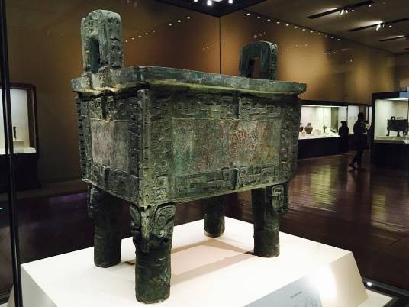
Jin Wen金文
There were characters inscribed on bronzeware during the late Shang and early Zhou dynasties, which are known as Jin Wen or Zhongding Wen. Jin Wen inscriptions on bronzeware recorded important events and activities and reflected the social life of the time. Therefore they are valuable materials for studying the history of the Shang and Zhou dynasties.
商后母戊鼎
These characters were difficult to write because of their loose structures and complicated strokes, and tended to be simplified with unbending strokes and rough-and-ready structures.

Slide 13
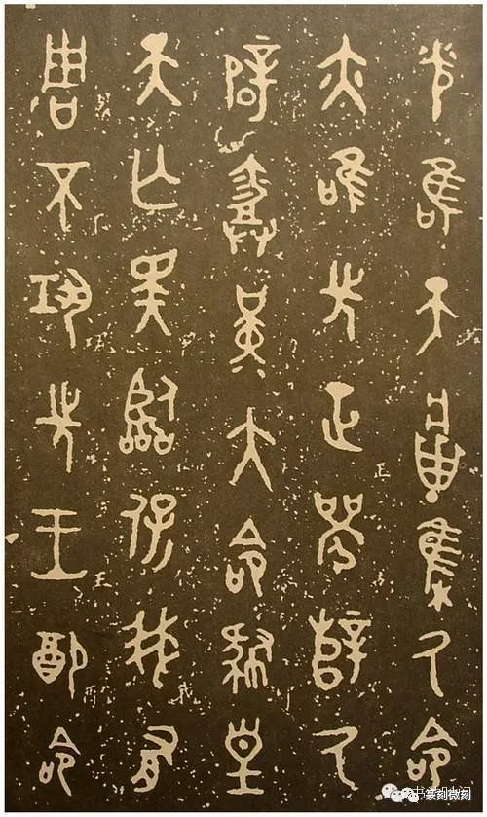
Great seal script大篆
Although Jiagu Wen and Jin Wen developed into a set of fairly comprehensive symbols for keeping records, there still existed many pictographic characters with strong elements of pictures. These characters were difficult to write because of their loose structures and complicated strokes, and tended to be simplified with unbending strokes and rough-and-ready structures.
Up to the late Western Zhou period, Jiagu Wen had been made uniform to conform to one type called Da Zhuan (great seal script).
毛公鼎

Slide 14
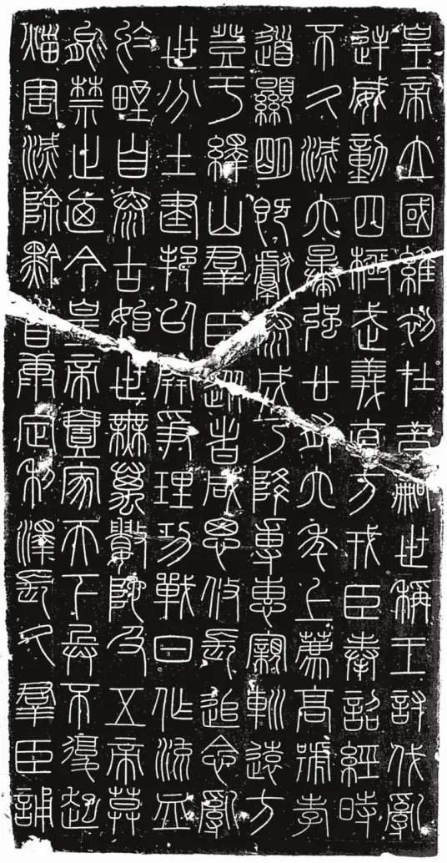
Small seal script小篆
After unifying China and establishing the feudal centralized system, the first emperor of Qin pushed forward the development of Chinese characters by having Li Si unify the various calligraphic styles that were thriving in other states and create the standardized Xiao Zhuan, or small seal script, on the basis of the script of the Qin state.
《峄山刻石》

Slide 15
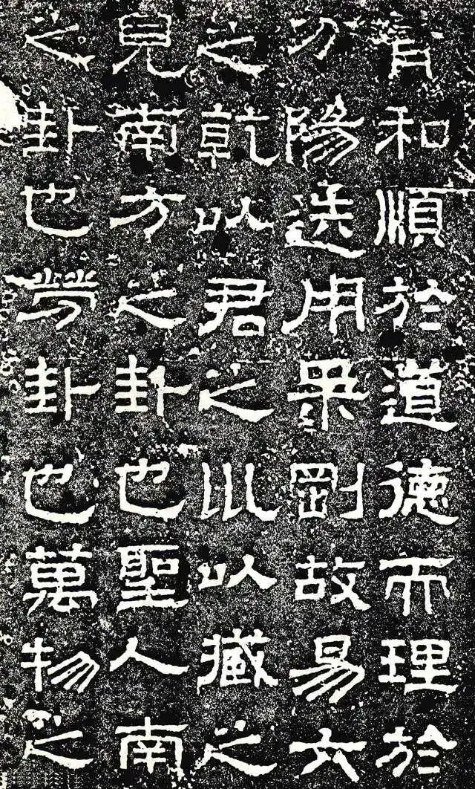
Clerical script隶书
Soon after Xiao Zhuan became the official standard script, there arose one style called Suti Zi (the commoner style), which was simplified from the script of the Qin state and used among the common people. Although Xiao Zhuan was neater than the earlier scripts, it was still troublesome for the common people. Even though it was not of the highest standard, many people preferred using Suti Zi, because it could be written more quickly and conveniently. This script came to be called Lishu (clerical script).
蔡邕隶书《熹平石经》

Slide 16
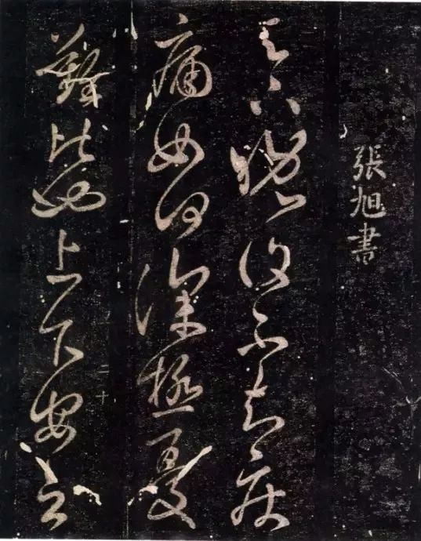
Cursive script草书
Based on the clerical script, an early form of cursive script called Zhangcao or old cursive script appeared in the late Qin and early Han periods. Its strokes were linked together. Its horizontal strokes still ran upward, while the ends of its left-falling stroke and right-falling stroke retained the clerical style.
张芝草书《晚复帖》

Slide 17
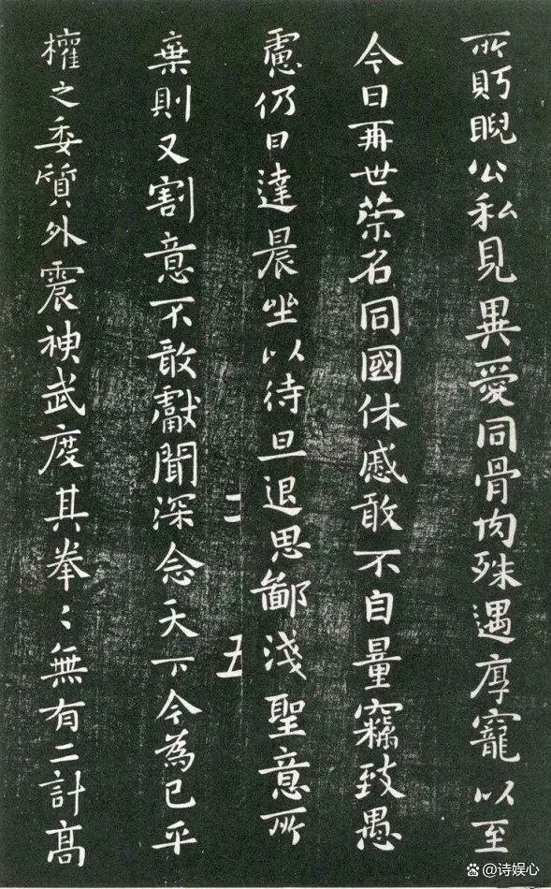
Regular script楷书
After the Eastern Han Dynasty and the Cao Wei State, a new style of script known as Kaishu came into being, evolving from the clerical and clerical cursive scripts. As the name suggests, it is “regular, ” with each of the strokes placed slowly and carefully, the brush tip lifted from the paper, and all the strokes distinct from one another.
钟繇《宣示表》

Slide 18
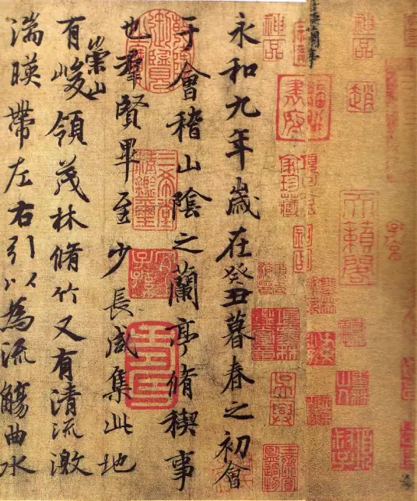
Running hand行书
The running hand appeared after the regular script. Its style was between the regular script and the cursive script. Different from other scripts, it did not have a specific style of its own. The strokes were rather flexible and natural. When carefully written with distinguishable strokes, the Xingshu characters will be very close to the regular style; when swiftly executed, they approach the Caoshu or cursive hand.
王羲之行书《兰亭集序》

Slide 19
Summary
Six categories of Chinese characters
Why did Chinese characters continue to develop in one line
The evolution of Chinese scripts

Slide 20

Thank you for your listening!

