Slide 1
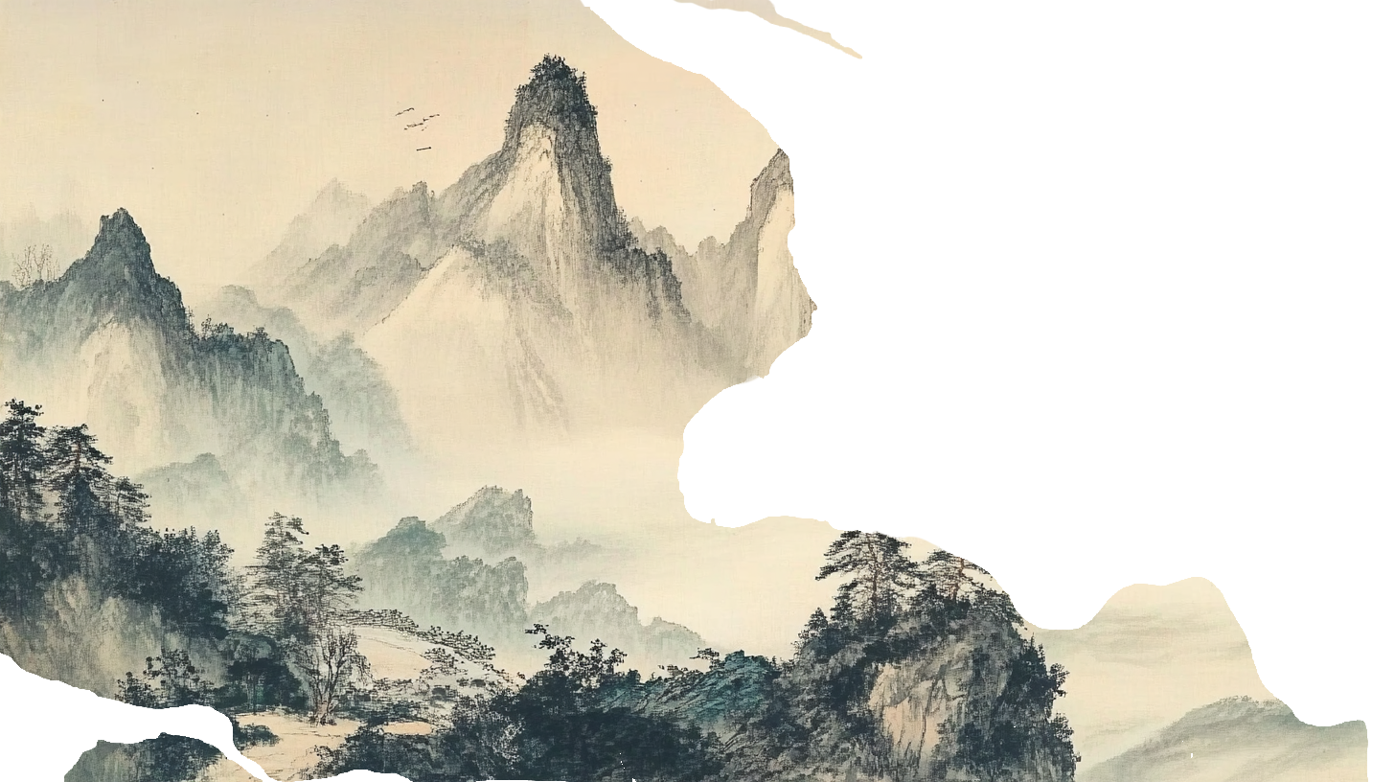
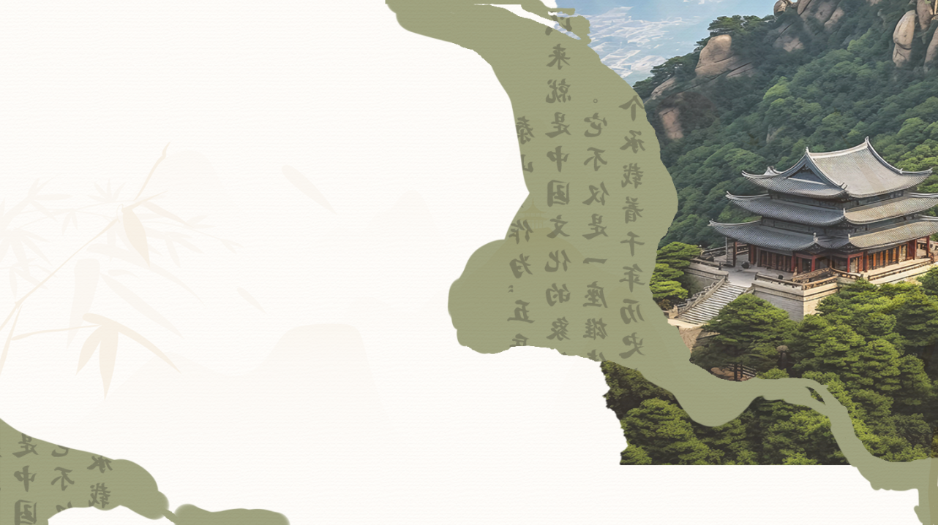

泰山
The Culture of Mount Tai
Mount Taishan is full of beautiful scenery

Slide 2
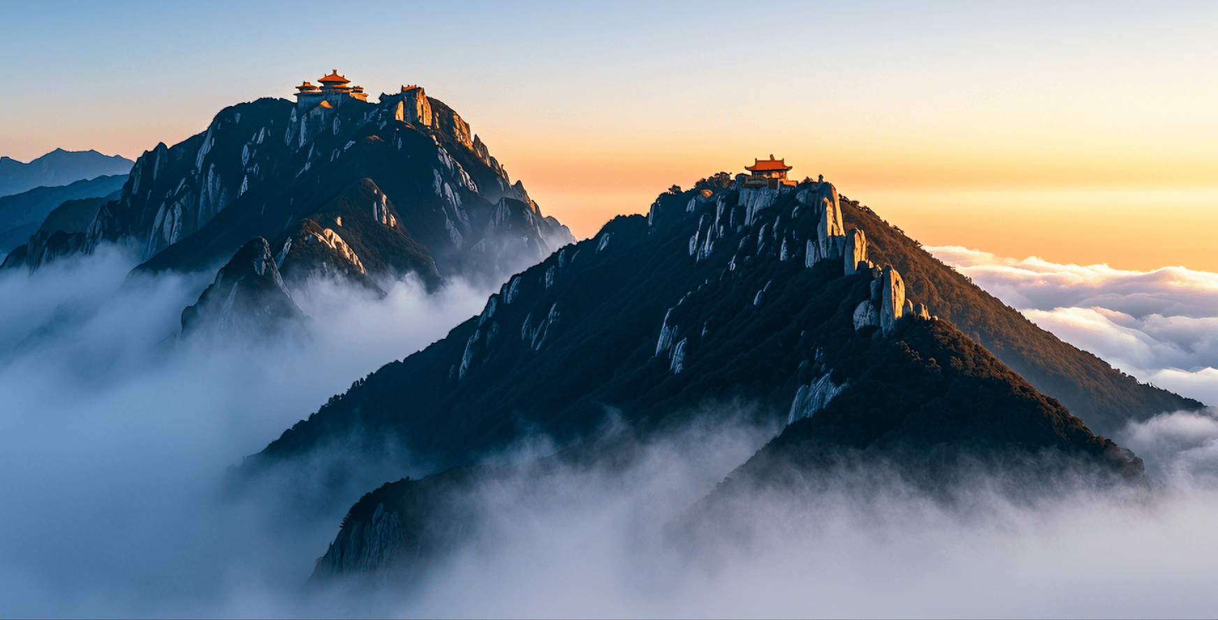
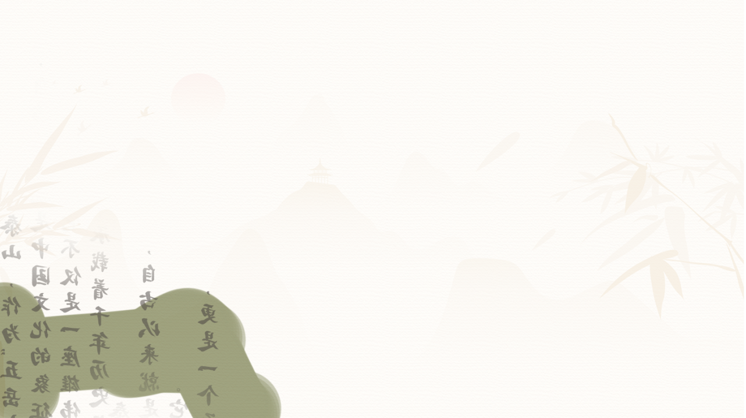
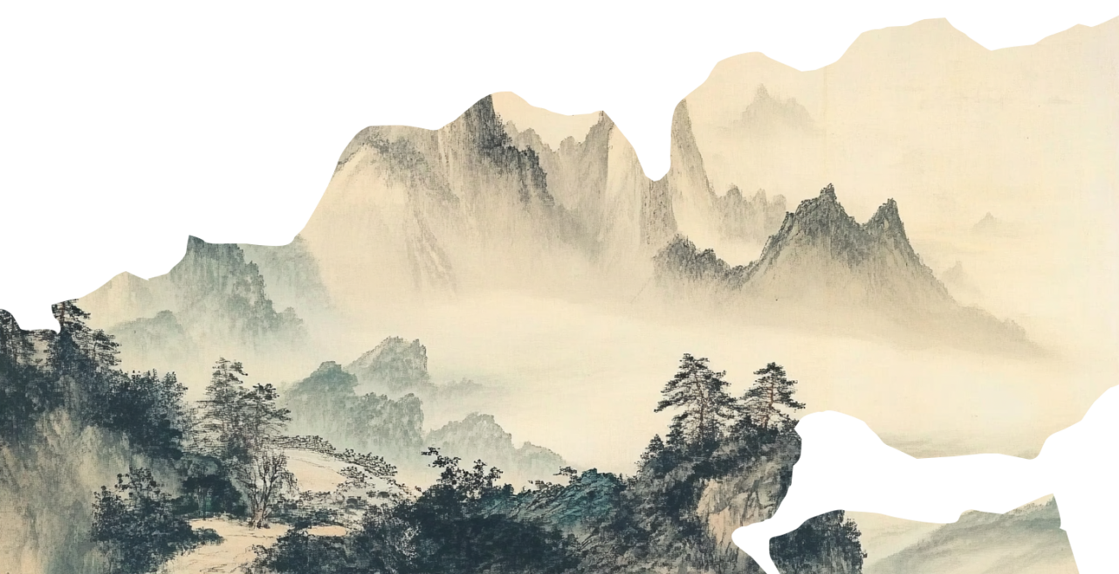

CONTENTS
03
04
泰山
02
The religious culture of Mount Tai
The Spiritual Symbolism of Mount Tai
01
The Culture of Literati
The Culture of Sacrificial Ceremony(Fengshan)

Slide 3
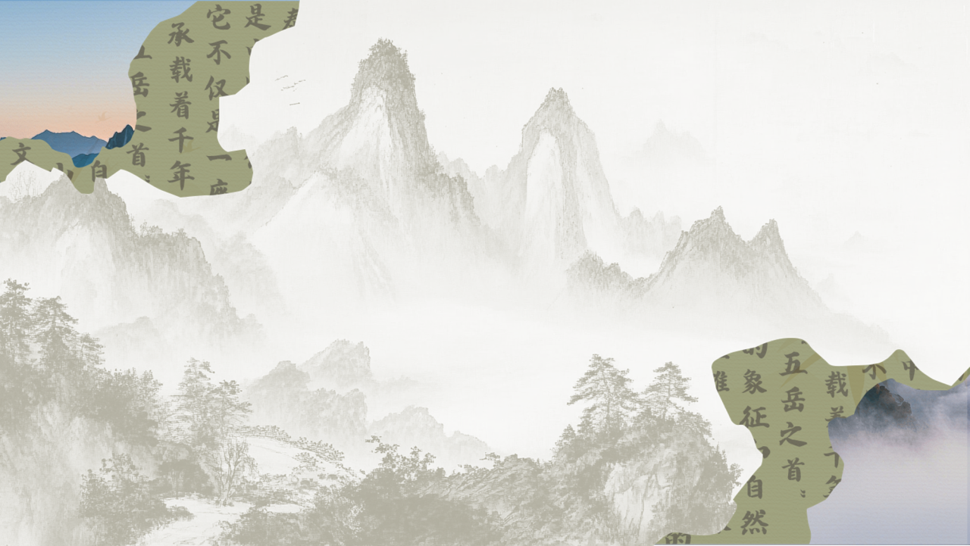
泰山
01
The Culture of Sacrificial Ceremony(Fengshan)

Slide 4

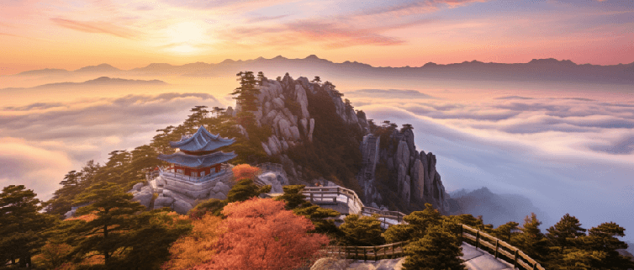
泰山
Fengshan
A grand sacrificial ceremony
Pay tributes to heaven and earth
Show off emperors’achievements
Carve emperors’achievements on huge rocks

Slide 5
泰山
Fengshan
Empress Wu Zetian
Emperor Xuanzong of the Tang Dynasty
Emperor Kangxi of the Qing Dynasty
Emperor Qianlong of the Qing Dynasty
Qin Shi Huang--the first emperor to conduct the Fengshan ceremony on Mount Tai
219 BC, after unifying the six states
Emperor Wu of Han--an important promoter of the Fengshan ceremony
Eight times

Slide 6
泰山
The cultural significance of Fengshan
Reverence for Heaven and Earth
By worshipping Heaven and Earth, emperors expressed their gratitude to nature and prayed for national peace and prosperity.
01
Consolidation of Imperial Power
Fengshan was an important means for emperors to display their achievements . They proclaimed to the world that their rule was divinely sanctioned and legitimate.
02
Cohesion of National Spirit
It carried forward the cultural traditions of ancient China and embodied the Chinese nation's reverence and gratitude towards Heaven, Earth, and their ancestors.
03
Notes:
模板来自于： 第一PPT https://www.1ppt.com/

Slide 7
泰山
02
The Culture of Literati

Slide 8


泰山
Literati Poetry
李白《游泰山六首》
姚鼐《登泰山记》
杜甫《望岳》
Gazing on Mount Tai
岱宗夫如何？齐鲁青未了。造化钟神秀，阴阳割昏晓。荡胸生层云，决眦入归鸟。会当凌绝顶，一览众山小。
天门一长啸，万里清风来。
玉女四五人，飘飖下九垓。
含笑引素手，遗我流霞杯。
稽首再拜之，自愧非仙才。
泰山正南面有三谷。中谷绕泰安城下，郦道元所谓环水也。余始循以入，道少半，越中岭，复循西谷，遂至其巅。

Slide 9
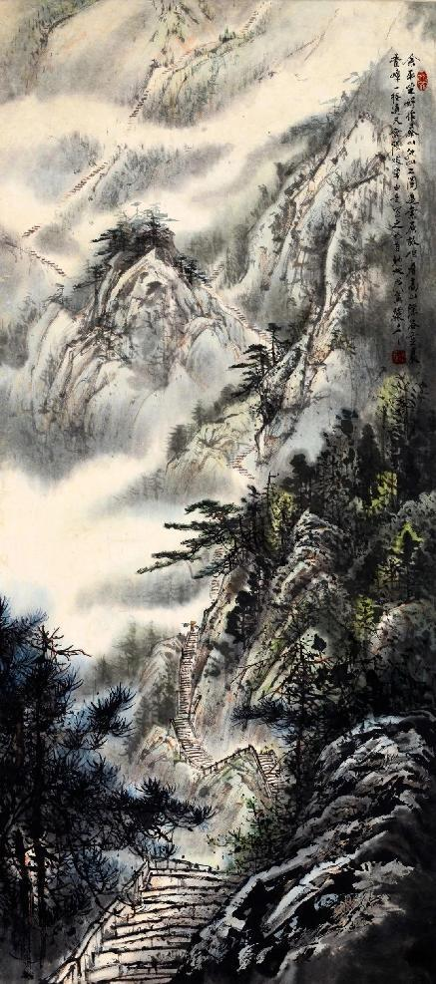
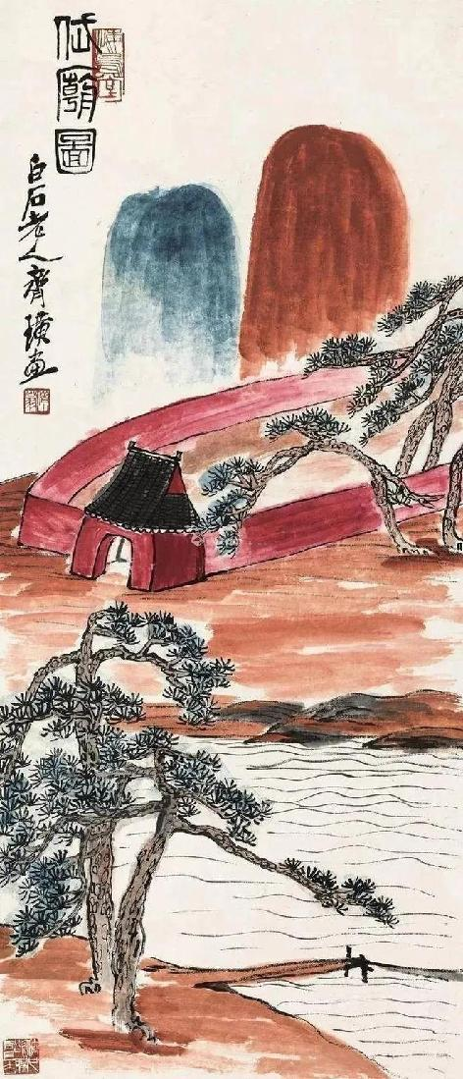
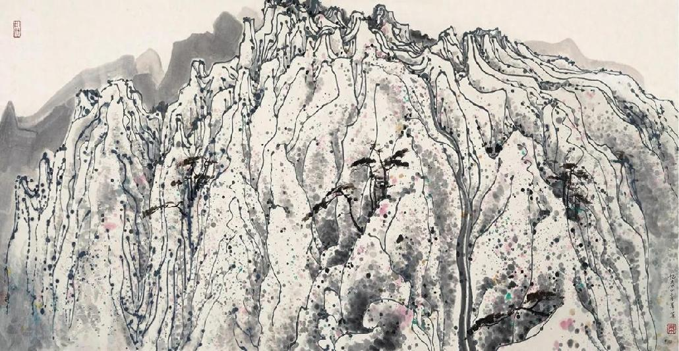
泰山
Literati Painting
吴冠中《忆泰山高峰》
冯骥才《泰山挑山工》
齐白石《岱庙图》

Slide 10
泰山
03
The religious culture of Mount Tai

Slide 11
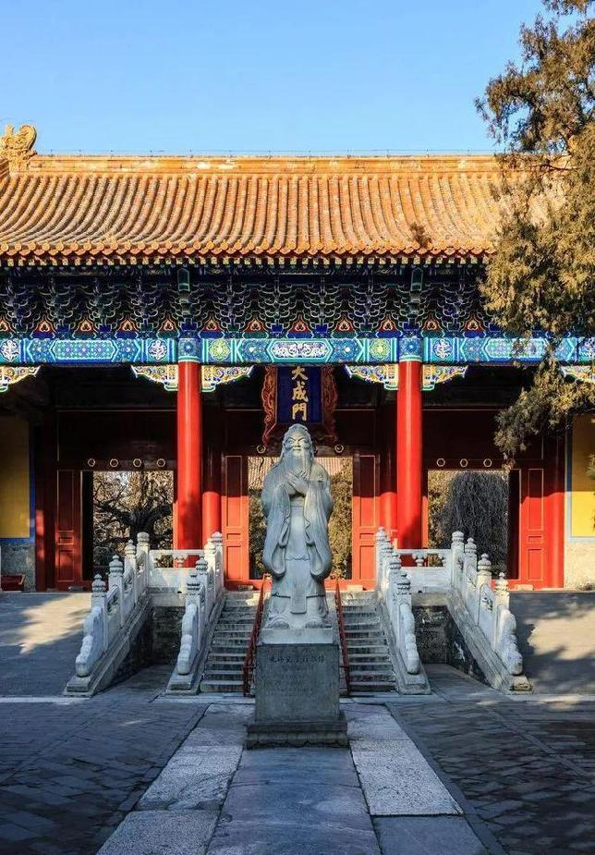
泰山
Confucianism
The world is smaller on the top of Mount Tai
--Mencius
Confucian temples

Slide 12
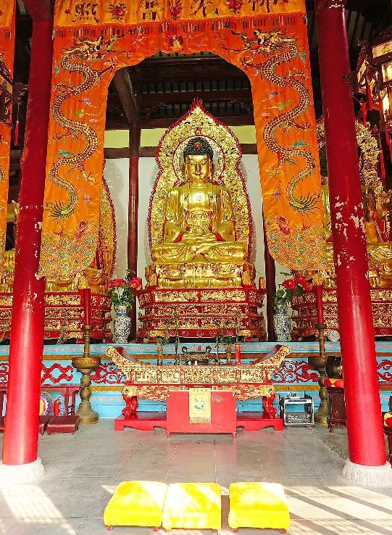
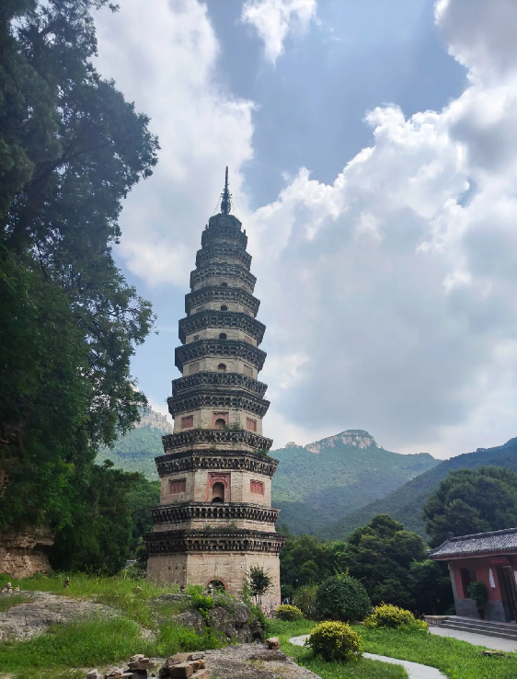
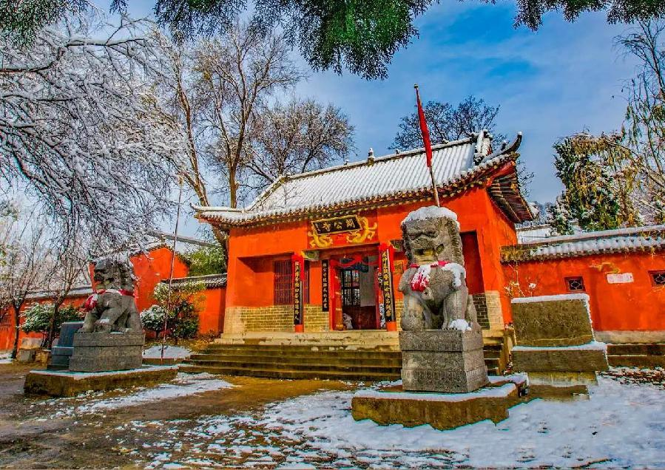
泰山
Buddhism
护国禅寺
灵岩寺
朗公寺

Slide 13
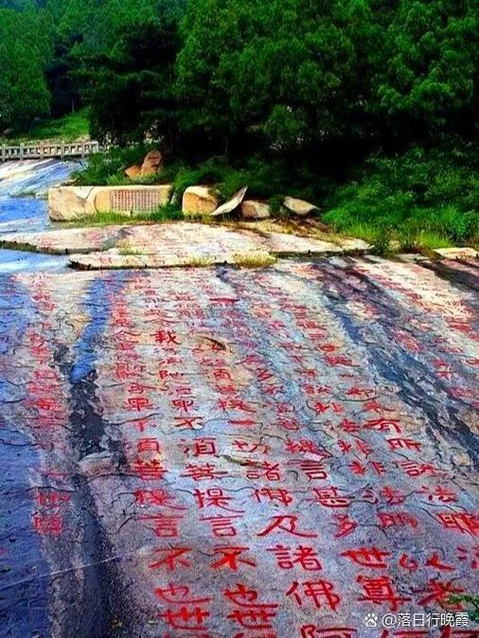
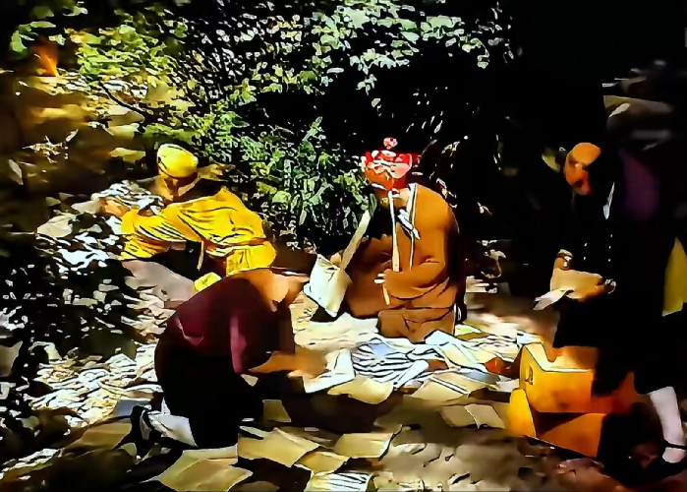
泰山
Buddhism
Journey to the West
经石峪
Jingshi Valley

Slide 14
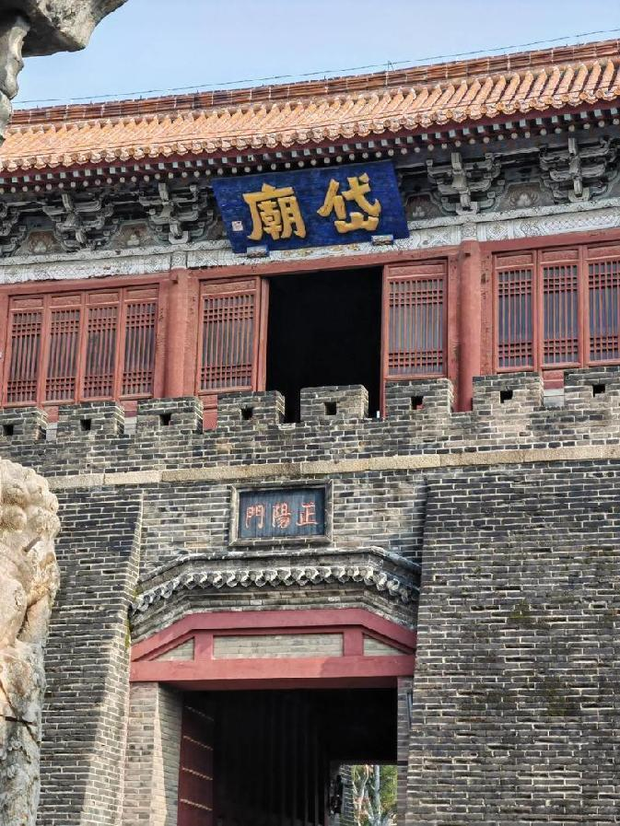
泰山
Taoism
Heavenly Gods
Emperor of the Eastern Peak（东岳大帝）/The God of Mount Tai
天齐 大生 仁圣帝
Mount Tai is as high as the heaven
Governs the growth and reproduction of all things
Loving and wise
The incarnation of Mount Tai
The messenger of communication between heaven and earth
The protector god of all emperors who were ordered by heaven to govern the world
Determining people's life and death, fortune and misfortune, as well as reincarnation
The Dai Temple

Slide 15
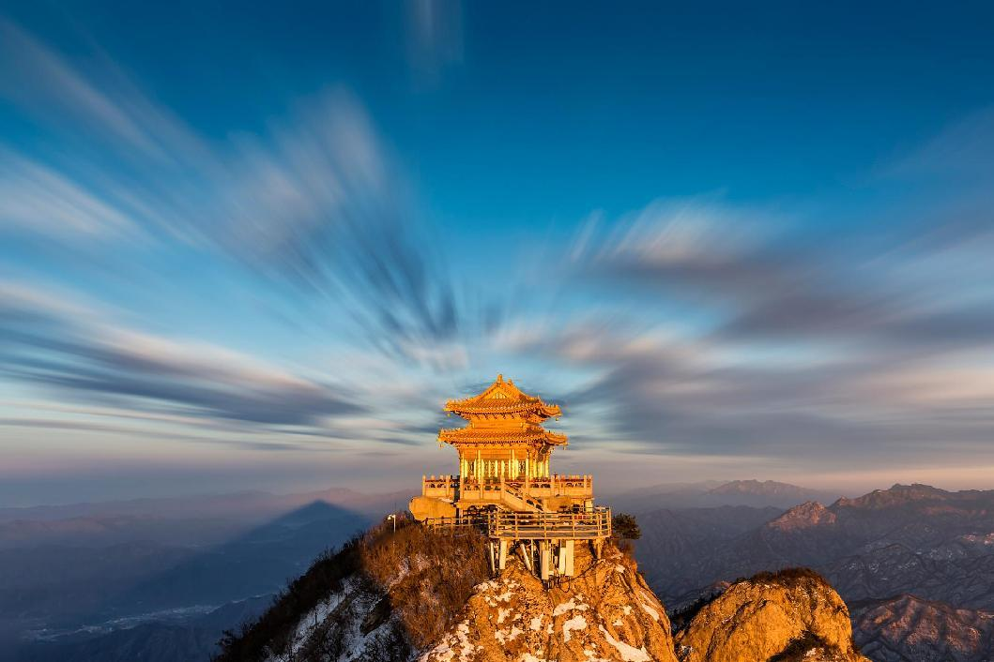
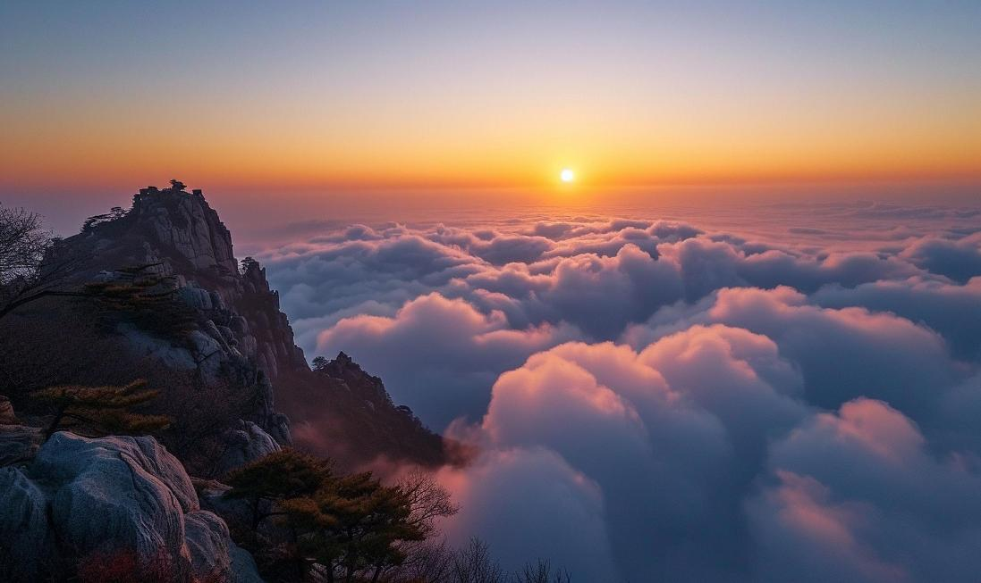
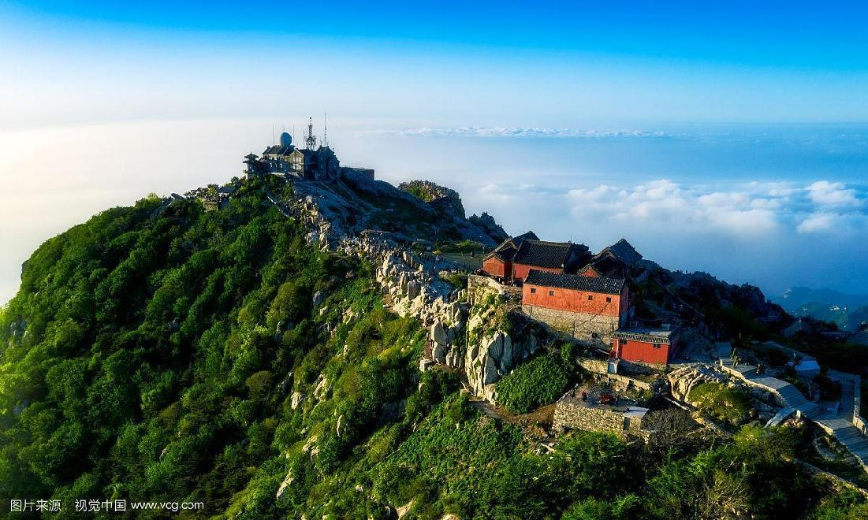
泰山
Taoism
Jade Emperor（玉皇大帝）
The Jade Emperor Peak

Slide 16
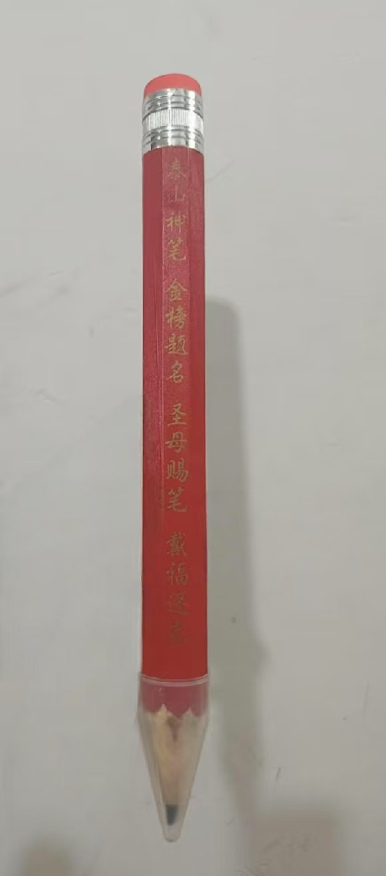
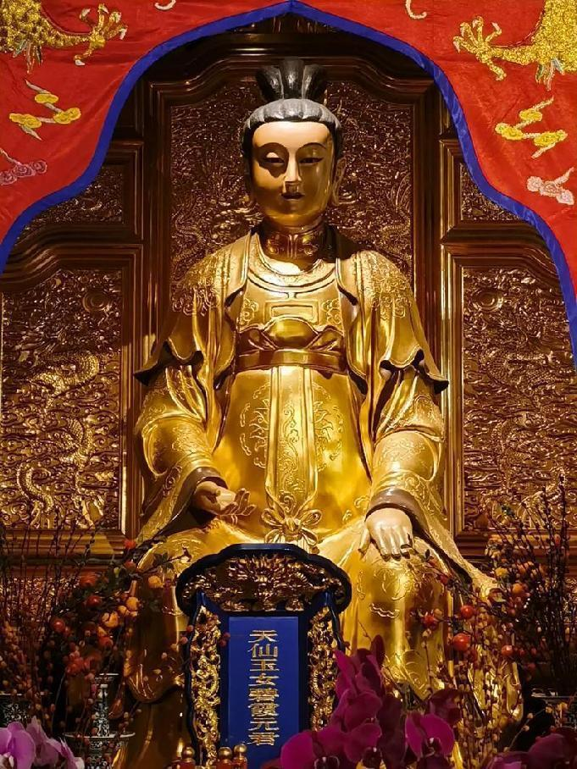
泰山
Earthly gods
Taoism
Blue Rosy Cloud Fairy (碧霞元君)
The daughter or sister of the Emperor of the Eastern Peak
The most influential god of Mount Tai
Blesses all living beings and connects the spirit across the whole China（庇佑众生，灵应九州）
Helps the weak and punishes the evil, delivers children to families in need and responds to every request

Slide 17
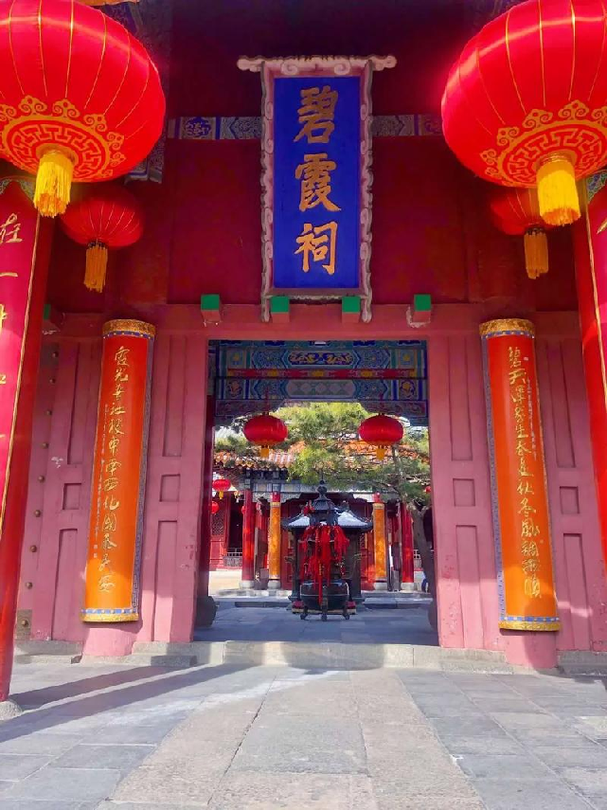
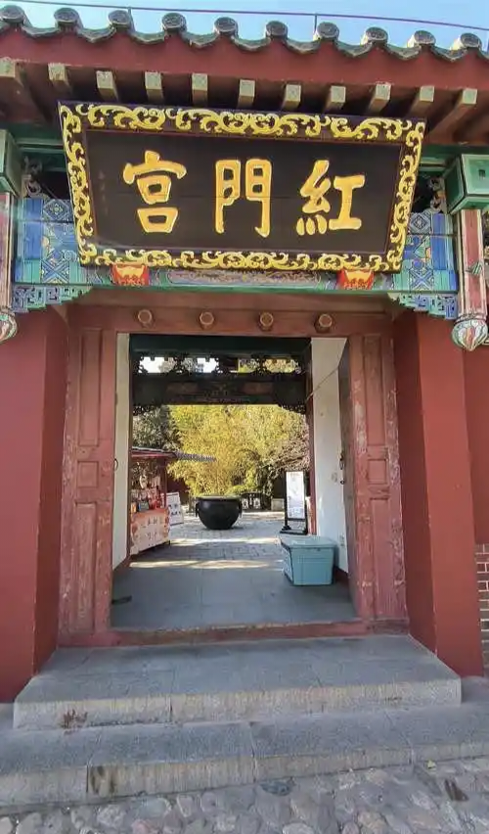
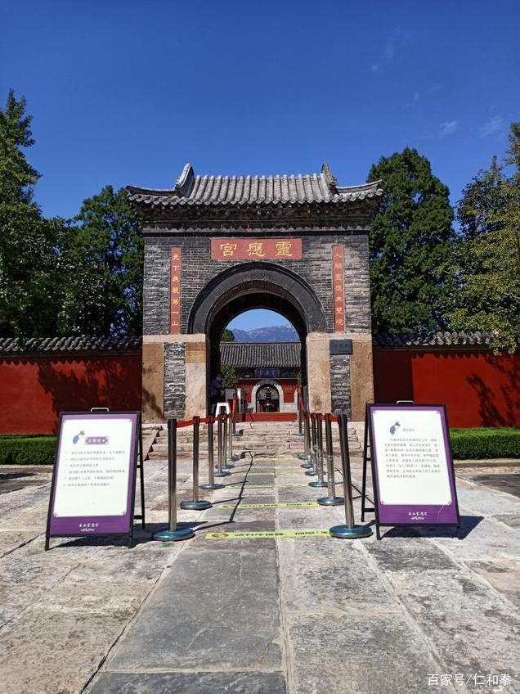
泰山
Taoism

Slide 18
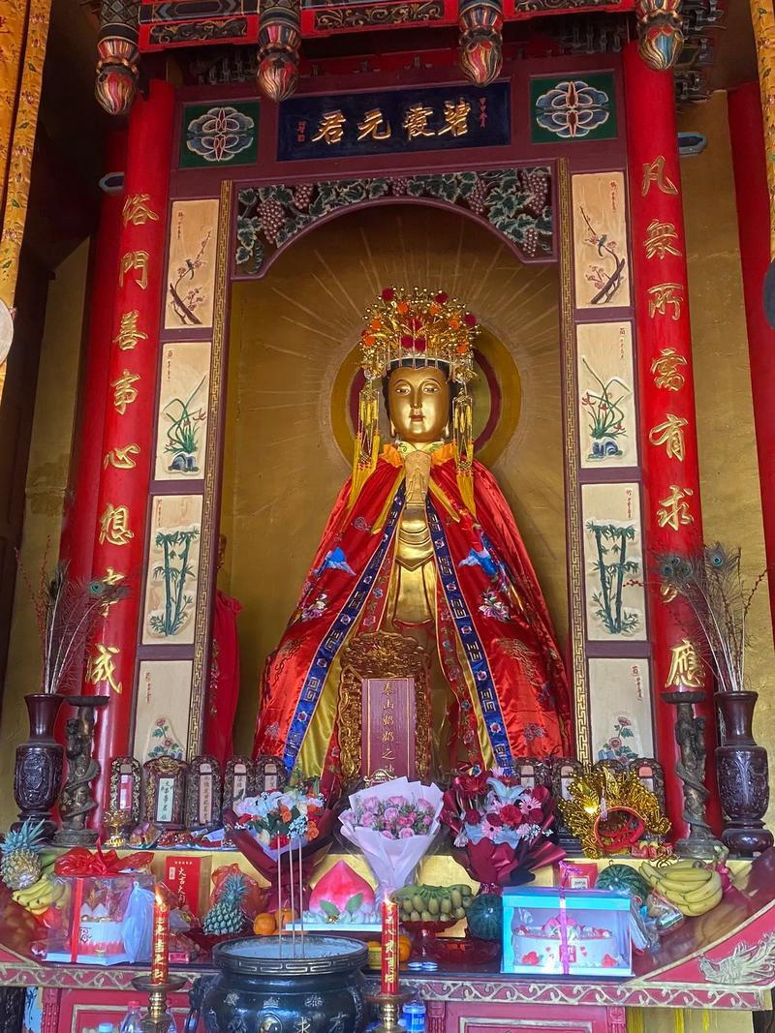
Make a wish!

Slide 19
泰山
04
The Spiritual Symbolism of Mount Tai

Slide 20
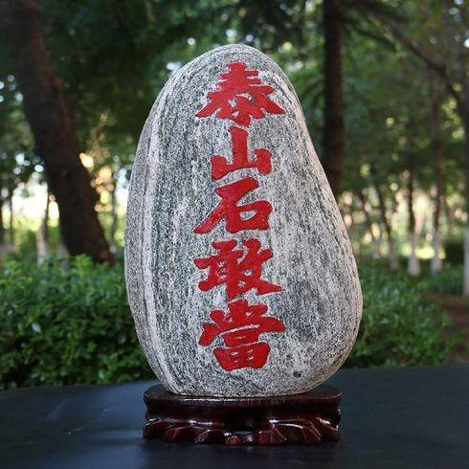
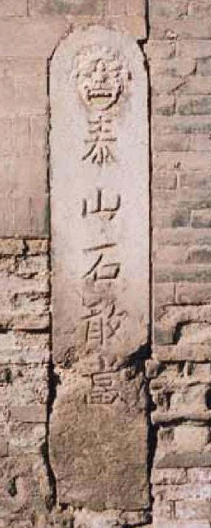
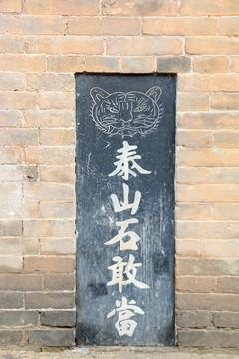
泰山
Desperate Correspondent （ 石敢当）
Used for warding off evil and protecting the home
Righteous Spirit

Slide 21
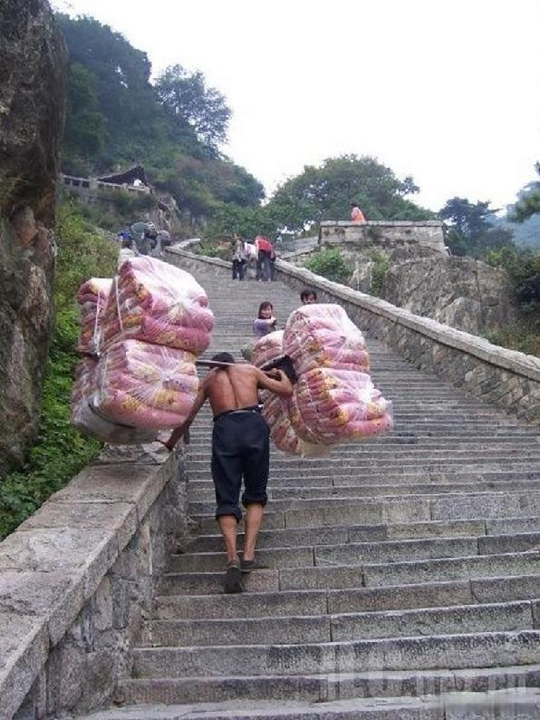
泰山
Heavers in Mount Tai 泰山挑山工
The spirit of perseverance, hard work, and taking responsibility

Slide 22
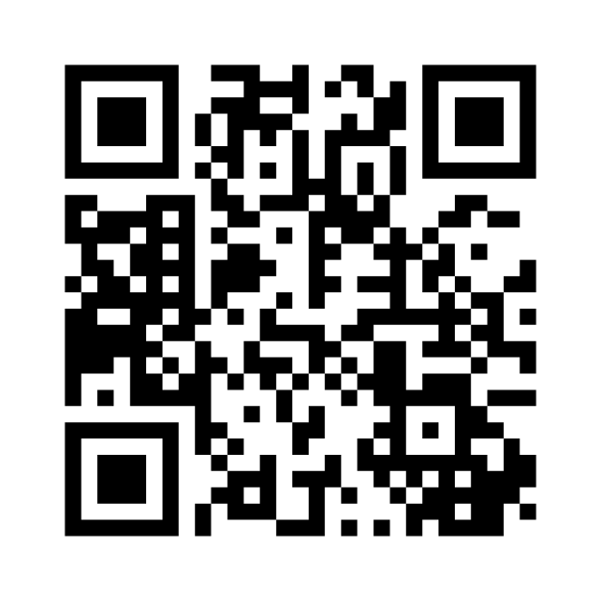

Slide 23
泰山
Thanks!
World famoushistorical city

