Slide 1
Traditional and Modern Views on Marriage and Love
Reporter: liu yunxi

Slide 2
Catalog
01
02
Marriage as a Responsibility and Social Expectation in the Past
Marriage for Personal Fulfillment and Choice in Modern Times

Slide 3
Marriage as a Responsibility and Social Expectation in the Past
PART-01

Slide 4
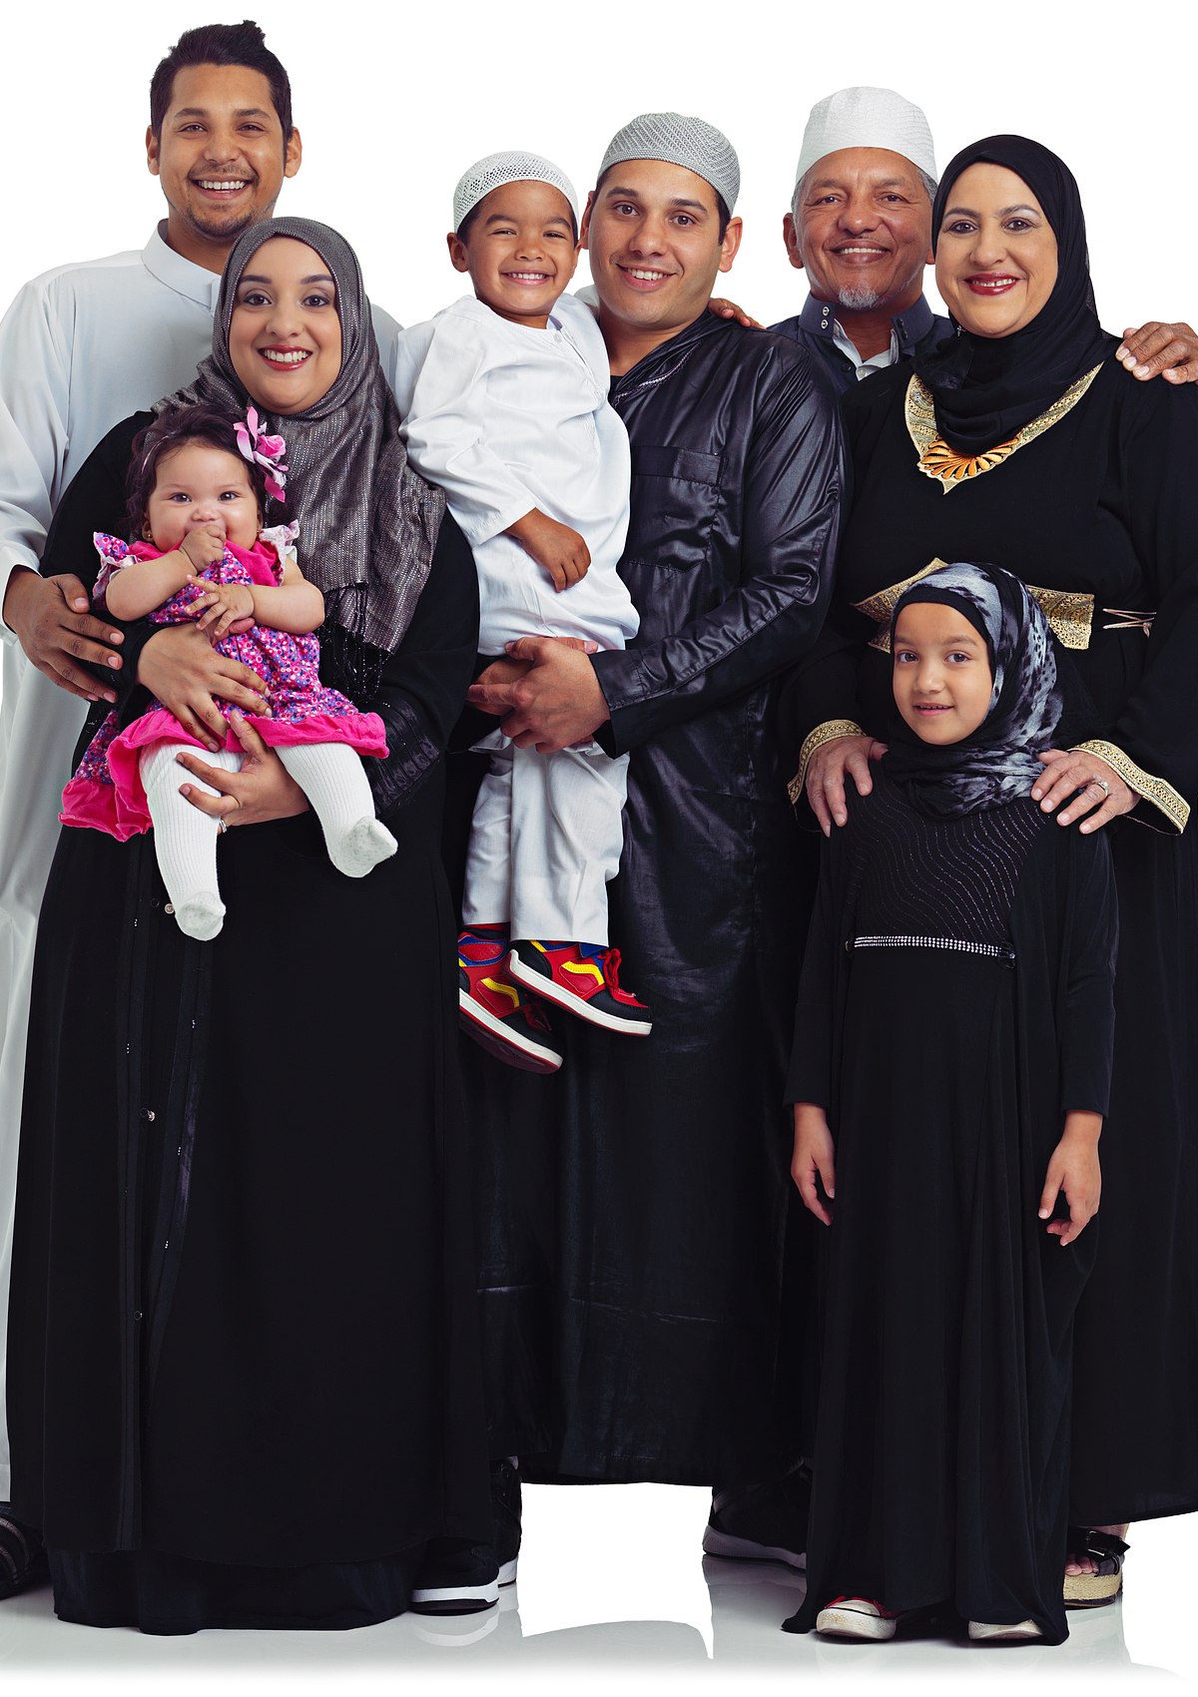
Social and Familial Pressures
Historical Perspectives on Marriage
01
In the past, marriage was often seen as a duty and a way to fulfill social and familial obligations, with less emphasis on personal choice.
Impact of Social Expectations
02
Individuals faced significant pressure to marry early to conform to societal norms and expectations, which often dictated the course of one's life.

Slide 5
Social and Familial Pressures
Family's Role in Marriage Decisions
  Families played a central role in arranging marriages, prioritizing social status, wealth, and lineage over personal happiness and compatibility.

Slide 6

Economic Dependence, Especially for Women
01、
Women's Economic Roles in History
02、
Impact of Social Expectations on Women
Historically, women often relied on marriage for economic stability, as societal norms limited their access to independent income sources.
Social expectations dictated that women should prioritize domestic duties and marriage, often at the expense of personal career aspirations.

Slide 7
Economic Dependence, Especially for Women
Changes in Women's Economic Independence
  Over time, women have gained more economic independence, challenging traditional views and altering the dynamics of marriage as a financial necessity.

Slide 8
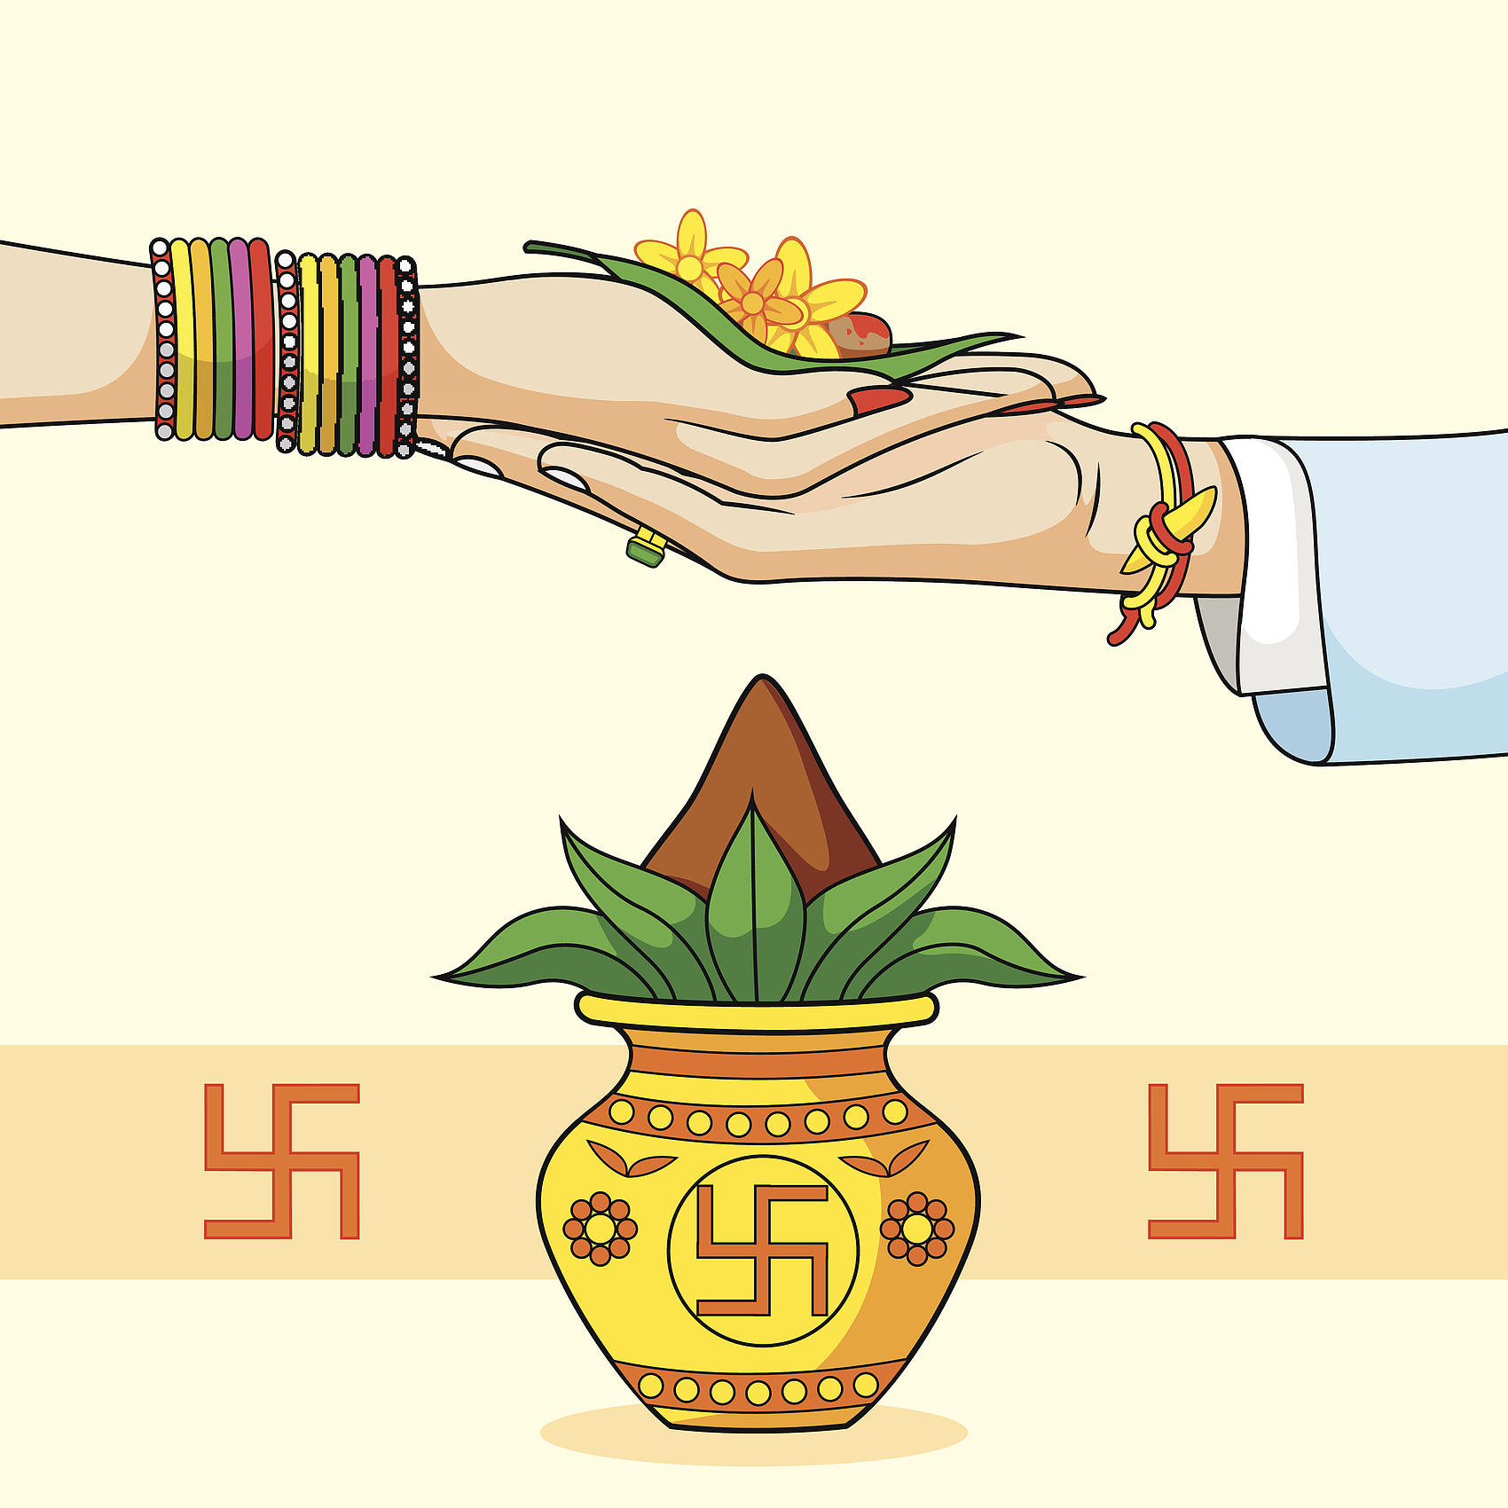
Traditional Gender Roles
Marriage as a Social Contract
Historically, marriage was often seen as a contract between families, with clear roles dictating the responsibilities of each gender.
Gender Roles in Child Rearing
Men were typically the breadwinners, while women were expected to manage the household and raise children, reflecting traditional gender expectations.

Slide 9
Traditional Gender Roles
Impact of Cultural Norms
  Cultural norms heavily influenced the perception of gender roles, with expectations for men and women being largely defined by societal standards.

Slide 10
Marriage for Personal Fulfillment and Choice in Modern Times
PART-02

Slide 11

Seeking Happiness and Companionship
Emphasizing personal happiness
Modern individuals prioritize personal happiness and fulfillment in marriage, seeking a partner who complements their lifestyle and aspirations.
Valuing choice and autonomy
With increased social acceptance, individuals now have the freedom to choose their life partners based on personal preferences and compatibility.

Slide 12


Financial Independence and Equality
The Shift Towards Financial Autonomy
The Role of Equality in Modern Marriages
In modern times, individuals prioritize financial independence before marriage, allowing for more equitable partnerships.
Equality in decision-making and financial contributions has become a cornerstone of contemporary marital relationships.

Slide 13

Flexible Gender Roles and Diverse Family Structures
Evolution of Gender Roles
Emergence of Non-Traditional Families
Explore how traditional gender roles have shifted, allowing for more equal partnerships and diverse expressions of masculinity and femininity in modern marriages.
Discuss the rise of non-traditional family structures, such as same-sex couples, single parents, and blended families, and how they reflect changing societal attitudes.

Slide 14
Flexible Gender Roles and Diverse Family Structures
Impact on Personal Fulfillment
  Examine how these flexible gender roles and diverse family structures contribute to personal fulfillment and the choice of individuals in contemporary marriage.

Slide 15
Thanks
Reporter: 迪仔仔

