Slide 1
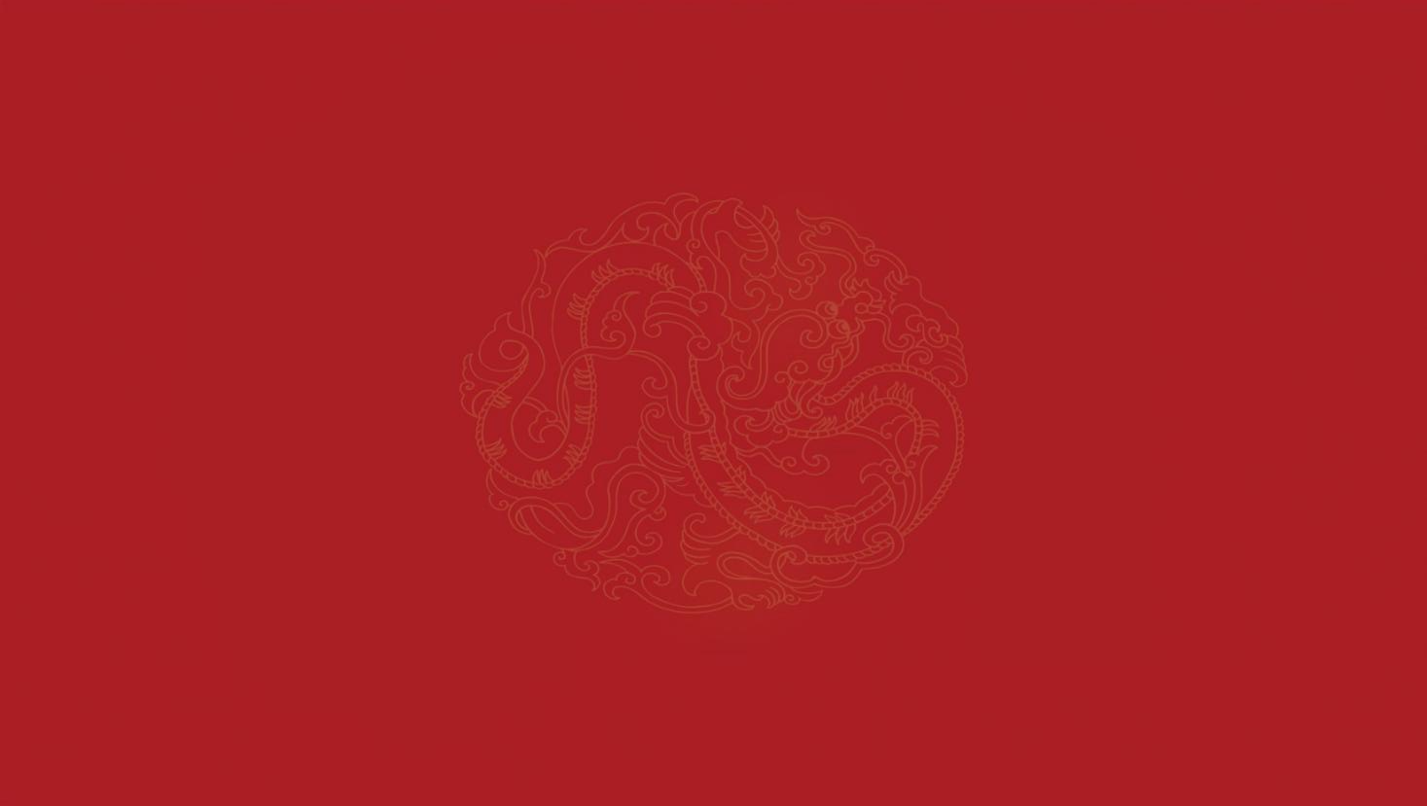
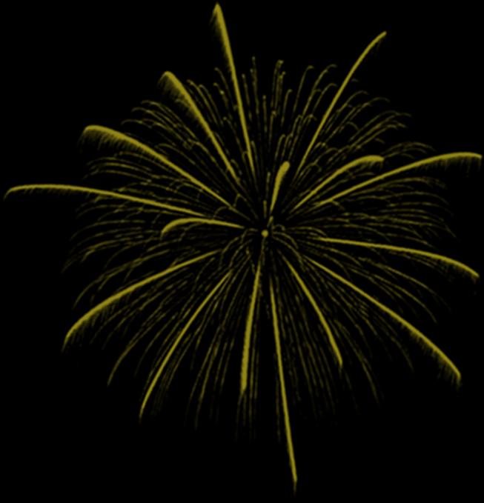
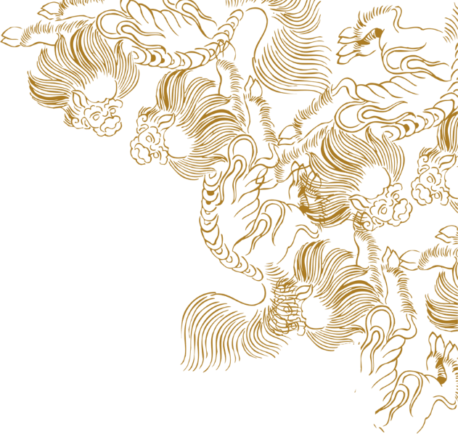
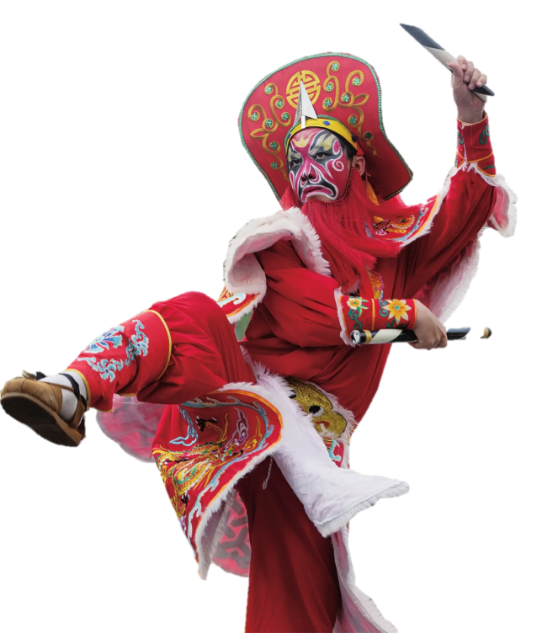

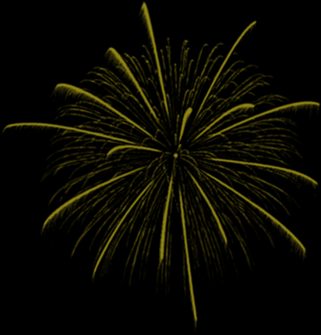
英
英
歌
歌
Yingge Dance
舞
非
舞
遗
系
姜心悦 2025.5.23
列

Slide 2
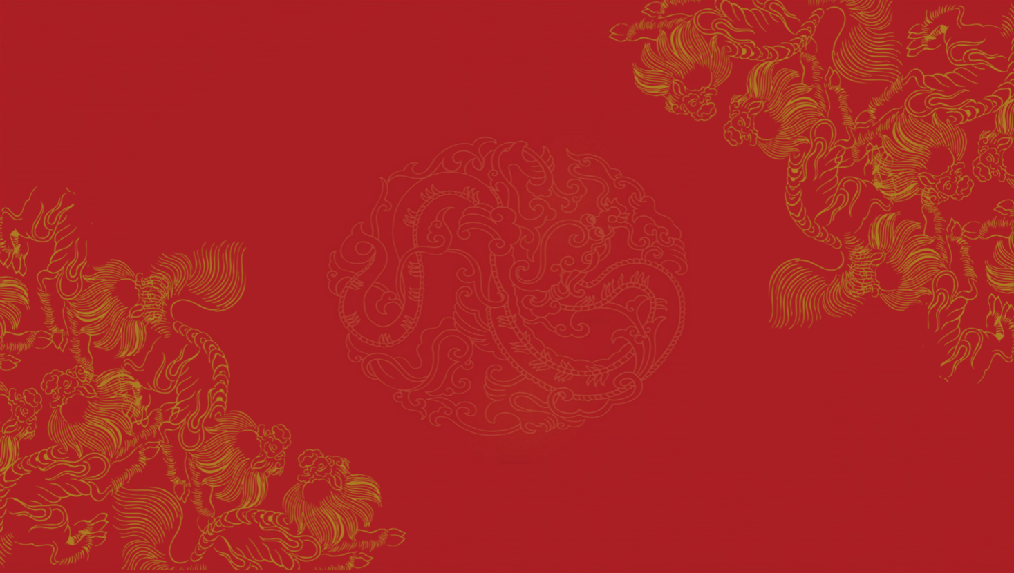


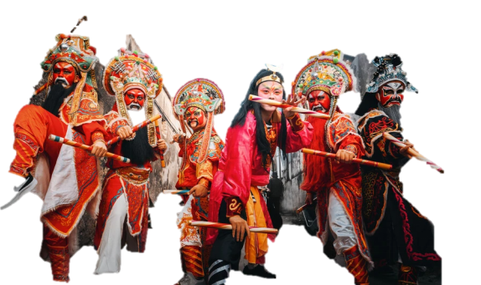
目
目
壹 Introduction to Yingge Dance
录
录
CONTENT
贰
Characteristics of the Yingge Dance
叁
Inheritance and Protection of Yingge Dance

Slide 3
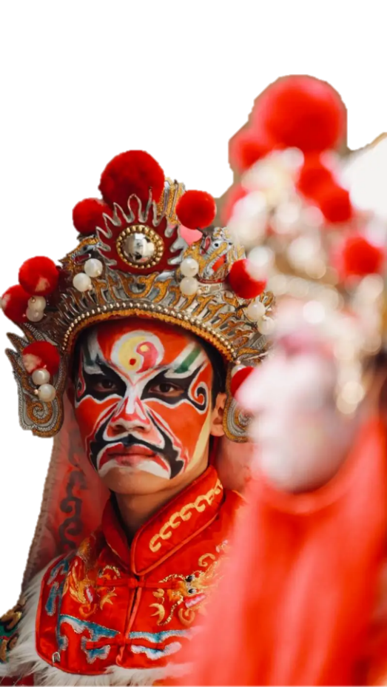
YINGGE DANCE
壹
壹
Introduction to Yingge Dance
非
遗
01
系
列
英歌澎湃
舞韵传情

Slide 4
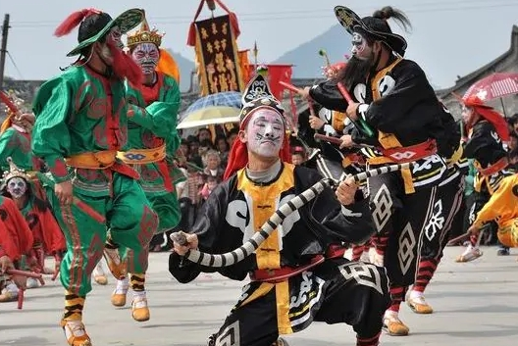
壹 Introduction to Yingge Dance
壹
a Han Chinese dance form
Shantou, Chaozhou, Jieyang, Shanwei in Guangdong Province and Zhangzhou in Fujian Province
a symbolic representative of Lingnan culture

Slide 5
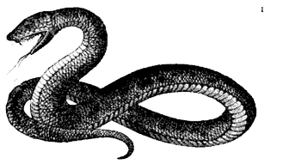
壹
壹 Introduction to Yingge Dance
The snake dance in Yingge Dance originates from the snake worship of the Minnan people.
folk arts
footwork
vigorous
Yingge Dance
dance
body movement
powerful
YINGGEDANCE
martial arts
formation patterns
bold
character modeling
costumes and props
masculine vigorous beauty
physical dynamics
sound rhythm

Slide 6
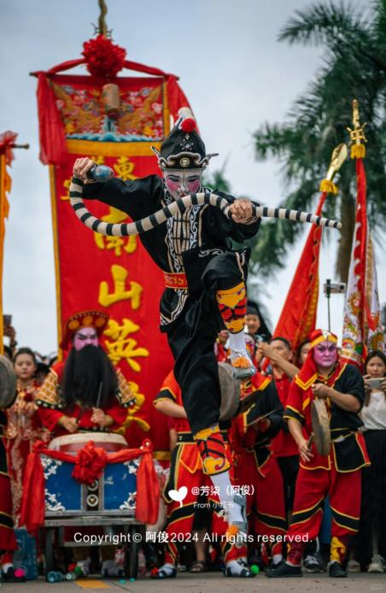
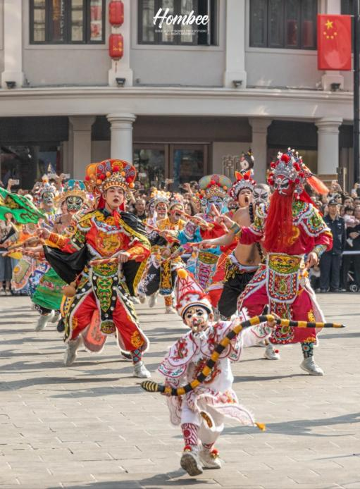
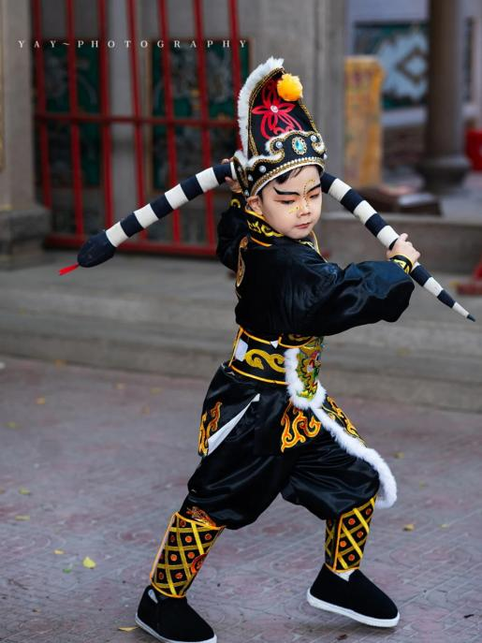
壹 Introduction to Yingge Dance
壹

Slide 7
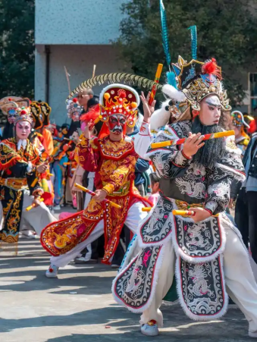
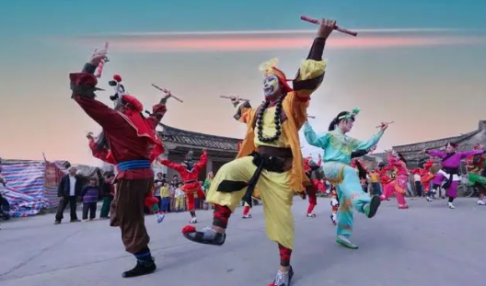
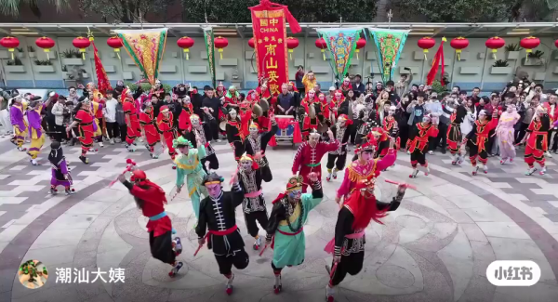
壹 Introduction to Yingge Dance
On May 20, 2006, Yingge Dance was selected into the first batch of the National Intangible Cultural Heritage List.

Slide 8
YINGGE DANCE
贰
Characteristics of
the Yingge Dance
非
遗
02
系
列
英歌澎湃
舞韵传情

Slide 9
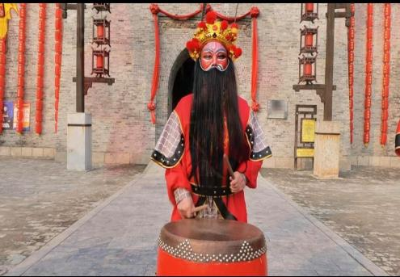
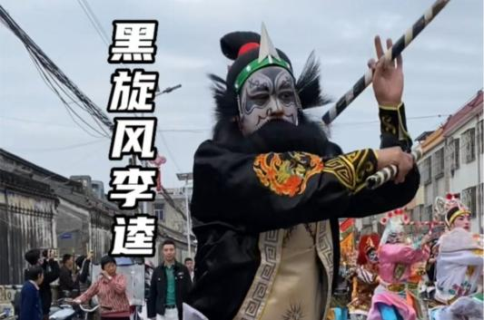
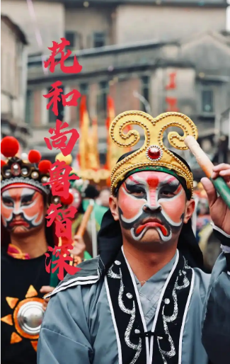
贰 Characteristics of the Yingge Dance
Facial Makeup

Slide 10
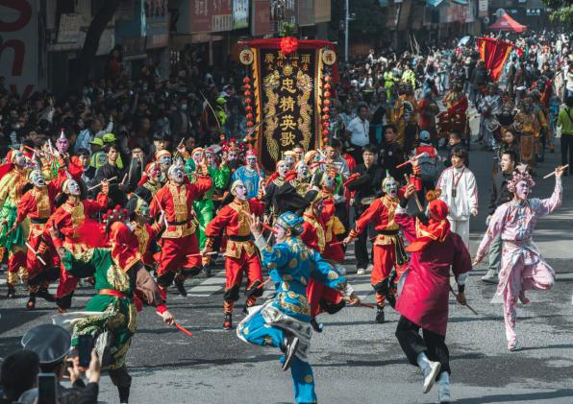
贰 Characteristics of the Yingge Dance
Cultural Meanings
the embodiment of heroes
a symbol of auspiciousness

Slide 11
YINGGE DANCE
叁
非
Inheritance and Protection of Yingge Dance
遗
03
系
列
英歌澎湃
舞韵传情

Slide 12
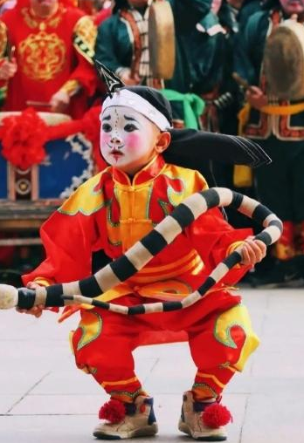
叁Inheritance and Protection of Yingge Dance
Inheritance Value
→Pray for peace and good fortune
→express love and hatred
→give voice to fighting spirit
→a vital bond to strengthen local camaraderie, neighborhood fellowship, and harmony among overseas Chinese compatriots

Slide 13
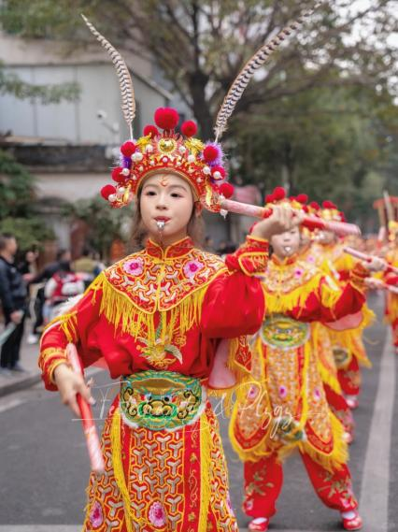
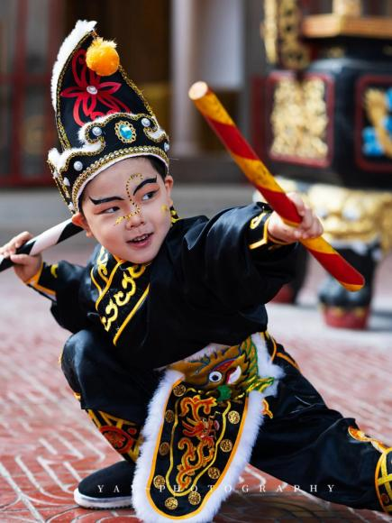
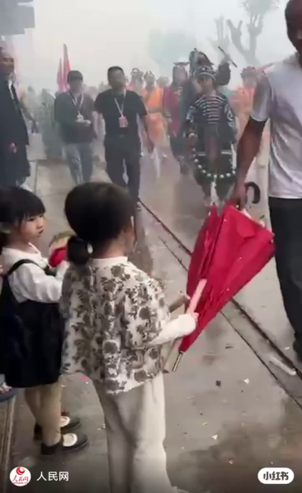
叁Inheritance and Protection of Yingge Dance
Current Situation

Slide 14
英
英
Thank you!
歌
歌
舞
非
英歌澎湃
舞韵传情
舞
遗
YINGGE
DANCE
系
列

