Slide 1
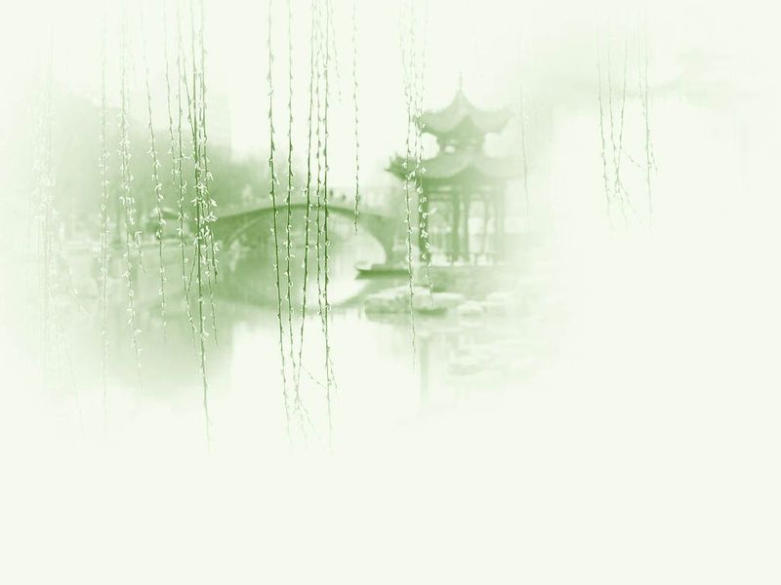
Unit 3 Crafts

Slide 2
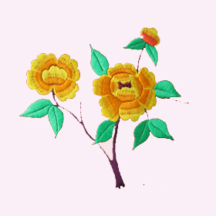
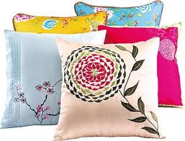
Lesson 3 Crafts
A. Embroidery

Slide 3
Questions Concerning Section A
1. What is embroidery?
2. How is the thread related to embroidery?
3. What are the 4 embroidery centers of China?
4. What do you know about Hunan Embroidery?
5. What’s 同色双面绣、异色双面绣?
6. What’s Su Embroidery famous for?
7. What kinds of thread are used in Yue Embroidery?
8. What do you know about Shu Embroidery?

Slide 4
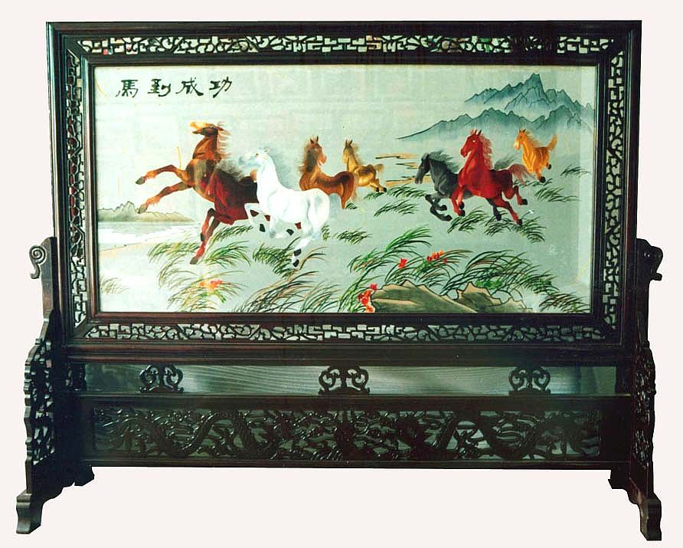
Embroidery screen

Slide 5
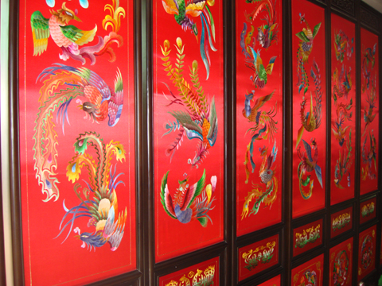
Serial screen

Slide 6
Translation exercises
不要忽略了石岛刺绣。早在隋唐时期，刺绣就在现在的石岛人民中间流传开来。石岛刺绣在设计与图案方面继承了东方艺术的精华，又吸收了西洋绘画的优点，因而形成了自己独特的艺术风格。
湘绣因工艺精湛、图案美观、色彩典雅而闻名于世。
苏绣分实用性绣品和观赏性绣品两类。实用性绣品有枕套、被面、服装、拖鞋等；观赏性绣品有挂屏、插屏、围屏等。

Slide 7
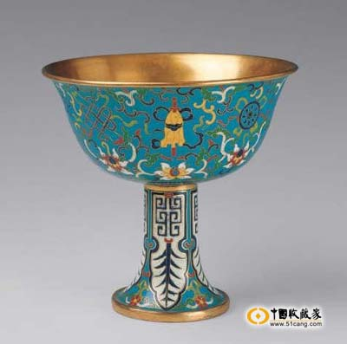
B. Cloisonne

Slide 8
Questions Concerning Section B
1. What is cloisonné?
2. How many steps are there in the making of cloisonné?
3. What material is used for the body?
4. What do you know about filigree soldering?
5. Why does enamel differ in color?
6. How many times must a cloisonné piece be fired?
7. How is cloisonné polished?
8. What is the final step?

Slide 9
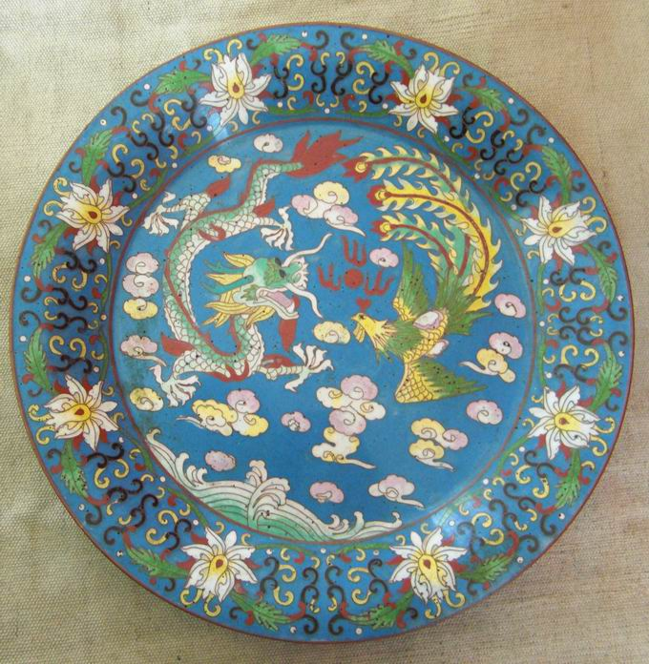
Cloisonne plate

Slide 10
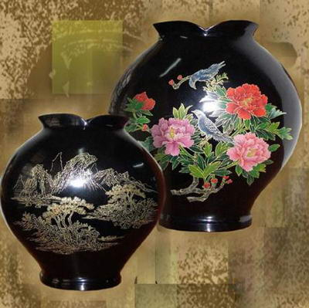
C. Lacquerware

Slide 11
Questions Concerning Section C
1. What does the Hemudu lacquer bowl suggest about the history of Chinese lacquerware?
2. What do you know about the lacquer musical instrument unearthed in Xinyang, Henan?
3. What do the Mawangdui lacquer coffins suggest about the history of Chinese lacquerware?
4. What advantages does lacquer have?
5. What do you know about the imperial lacquerware workshop in Beijing?
6. How fine is Chinese lacquerware?

Slide 12
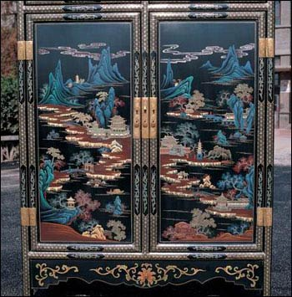
Lacquer screen

Slide 13
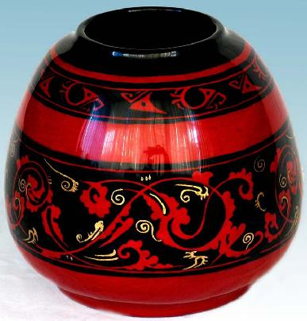
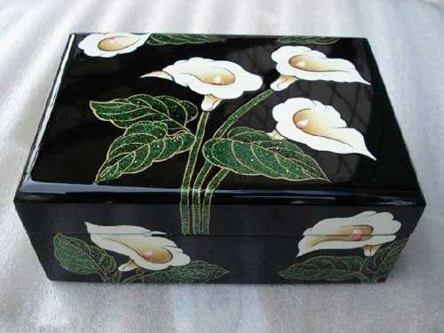
Lacquer pot and box

Slide 14
Translation exercises
马王堆出土的漆器胎质多为木胎，也有竹胎和麻布胎。纹饰线条流畅，色彩绚丽，有的还记有容量。这些制作精美的漆器标志着汉初漆器手工业的高度发展，从一个侧面反映出汉初社会的经济状况。
福建脱胎漆器不仅造型雅致，色泽鲜艳，做工精细，而且耐热、耐酸、耐碱。1959年，福州脱胎漆器厂为人民大会堂制作的一对仿古铜大狮子，仿佛有几千公斤重，实际却只有35公斤重。周总理常向外宾介绍这对狮子，至今仍传为佳话。现在，福州漆器畅销70多个国家和地区，被誉为“真正的中国民族艺术”。

Slide 15
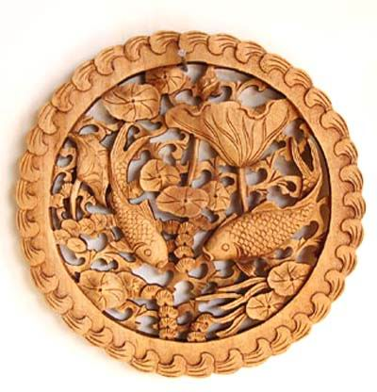
D. Carving

Slide 16
Questions Concerning Section D
1. Why has jade been cherished by the Chinese?
2. How should we judge the craftsman’s skill?
3. How long is the history of jade carving in China?
4. When did jade objects begin to be taken as symbols of personal morality or political authority?
5. What do you know about the jade carvings on permanent display at the Chinese Arts and Crafts Museum?
6. What are the most popular materials for wood carving? What are their advantages respectively?

Slide 17
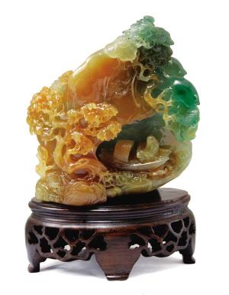
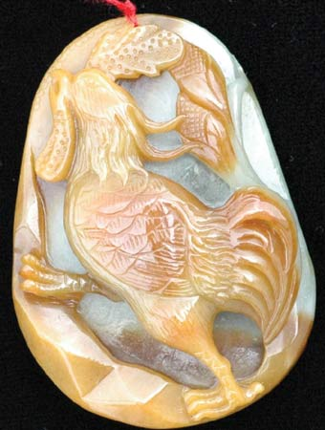
Jade carving

Slide 18
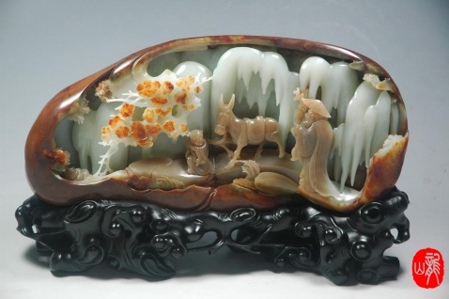
Jade carving

Slide 19
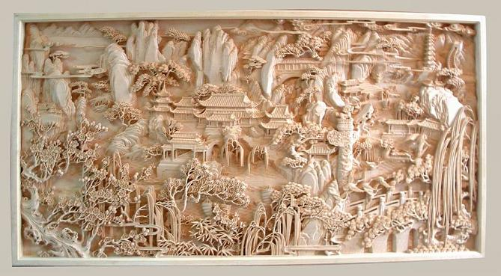
Wood carved picture

Slide 20
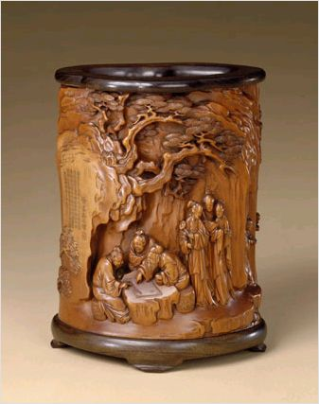
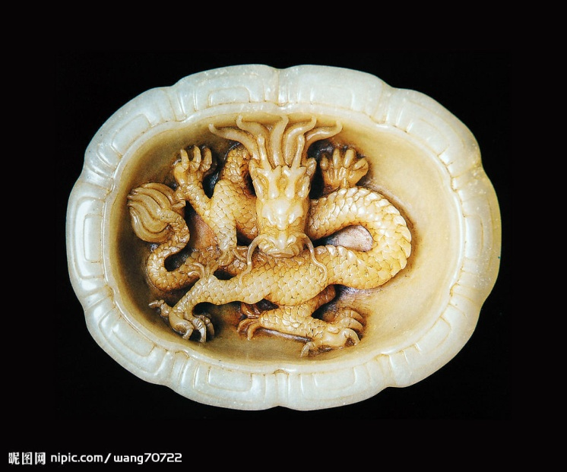
Writing brush holder (right)

Slide 21
Topics for discussion
1. With the modernization of our country and the globalization of our economy, some traditional crafts are increasingly in danger of extinction. What shall we do?
2. Other traditional crafts include clay modeling (泥塑), batik (蜡染) and kite-making. Do you know anything about them or other crafts?

Slide 22
See you next time!

Slide 23
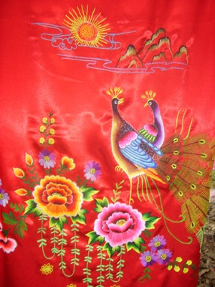
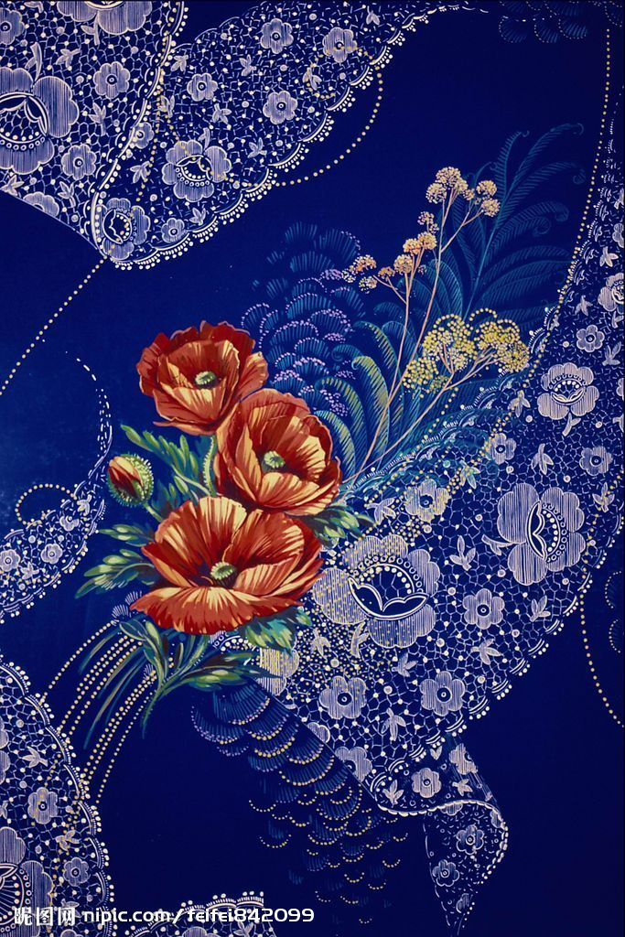
What is embroidery?

Slide 24
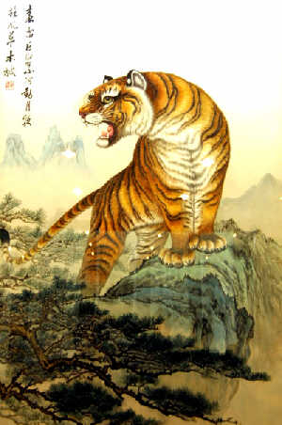
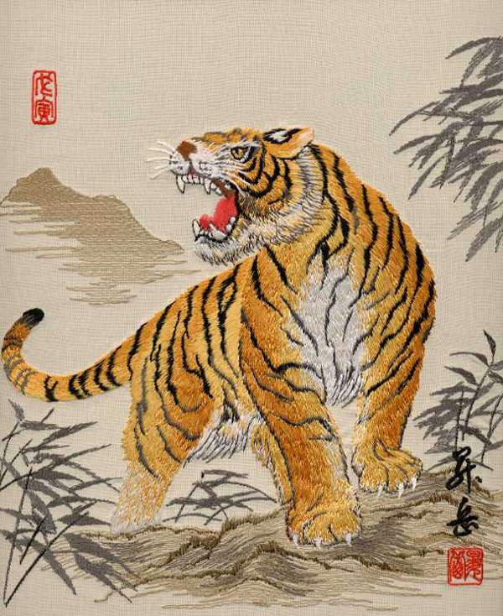
What do you know about Hunan Embroidery?
“Tiger,” a most representative work of Xiang Embroidery

Slide 25
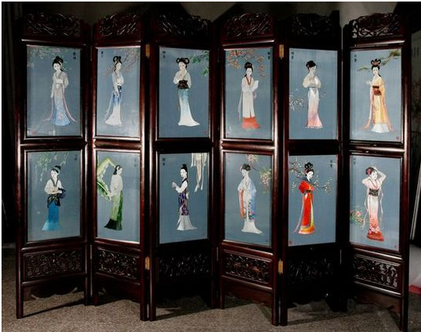
What’s Su Embroidery famous for?

Slide 26
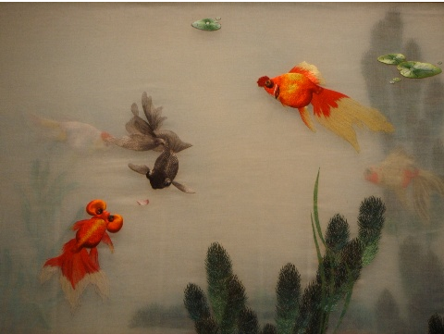
What kinds of thread are used in Yue Embroidery?

Slide 27
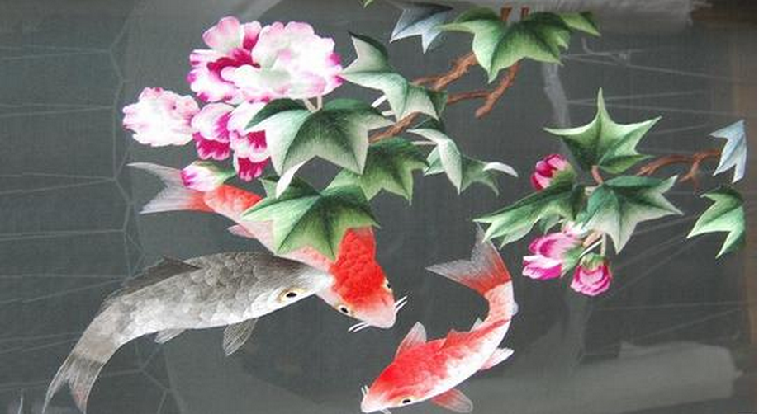
What do you know about Shu Embroidery？

Slide 28
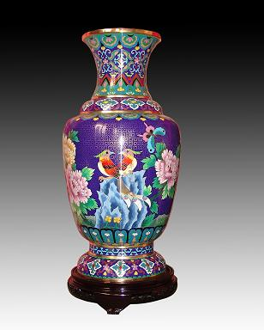
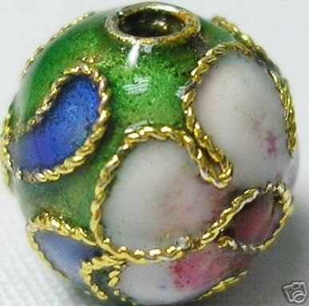
What is cloisonné?

Slide 29
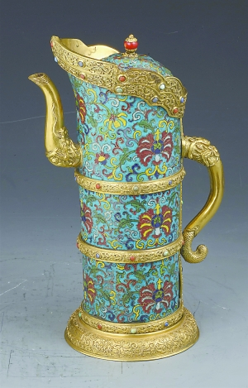
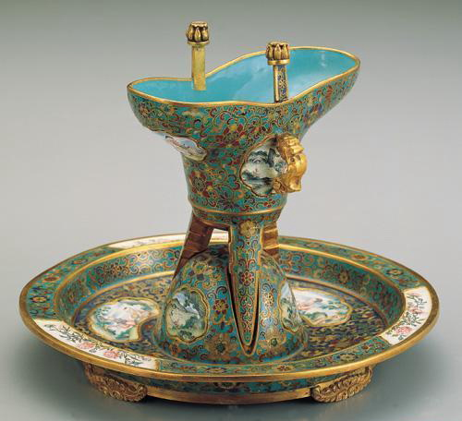
What do you know about filigree soldering?

Slide 30
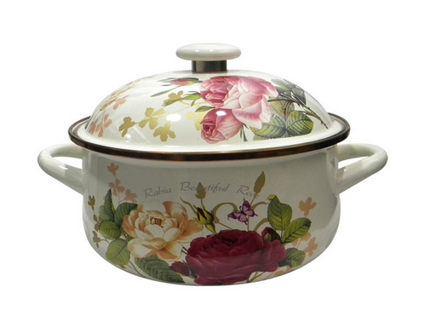
Why does enamel differ in color?

Slide 31
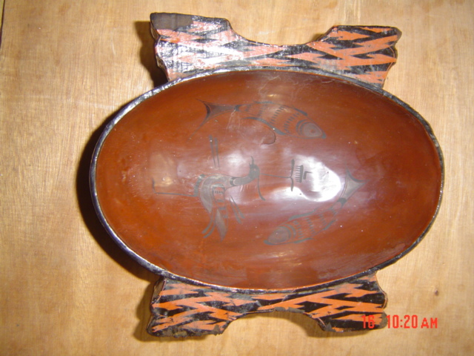
What do the Mawangdui lacquer coffins suggest about the history of Chinese lacquerware?
A lacquer cup unearthed at Mawangdui

Slide 32
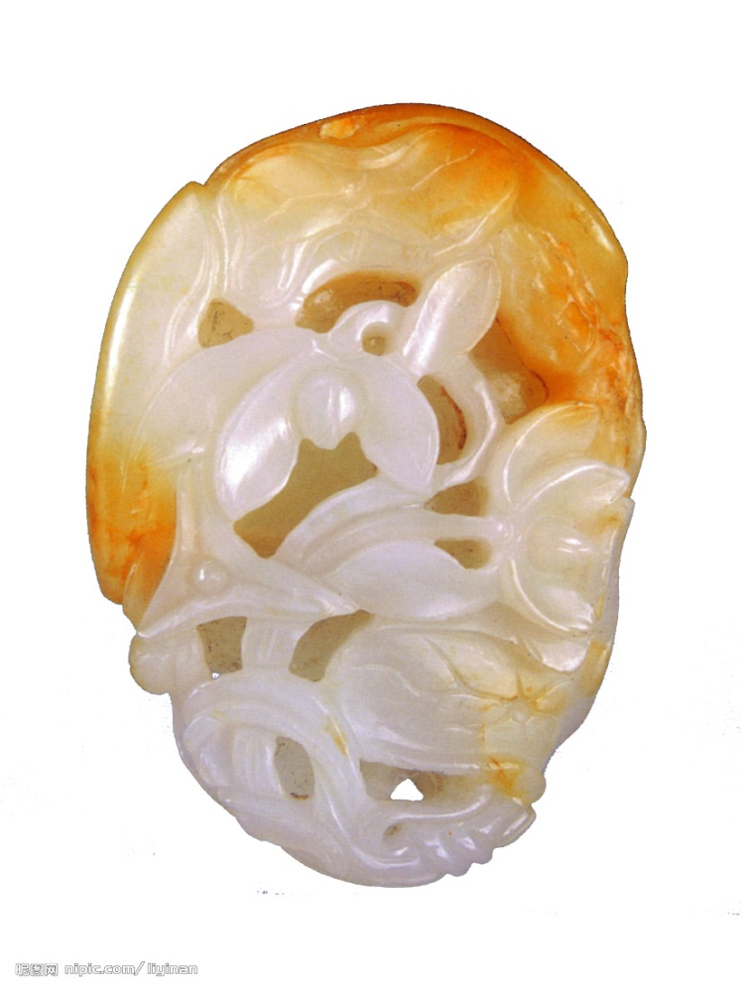
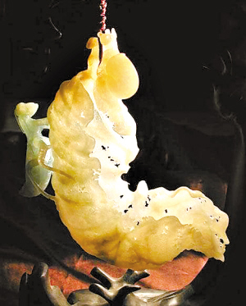
Why has jade been cherished by the Chinese?

Slide 33
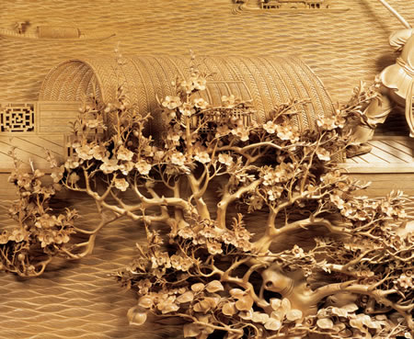
What are the most popular materials for wood carving? What are their advantages respectively?
Pierced wood carving

