Slide 1
Examples of World Literature: The tales of Mesopotamia and India
16哲学学院励耘人文科学实验班
班皓阳
201611940229

Slide 2
Catalogue
Part1: Introduction of Mesopotamian Tales
Part2:Introduction of Indian Tales
Part3:Interesting Comparison

Slide 3
Tales of Mesopotamia
3000 B.C.
Cuneiform（楔形文字）
Sumerian, Akkadian and Hittite
‘Library of King Ashurbanipal’，Nineveh
rediscovered in the 19th century

Slide 4
Famous Work
The Epic of Gilgamesh（吉尔伽美什史诗）
10 Tablets
2000B.C. 1200B.C.
Hero also fear for death and want to be immortals, and Gilgamesh was a warrior who rebelled against the gods and kept on exploring a way of being immortals. But still, he failed at last.

Slide 5
Counsel me, O ferryman Urshanabi!
For whom have my arms labored ,Urshanabi?
For whom has my heart’s blood roiled?
I have not secured any good deed for myself,
But done a good deed for the ‘lion of the ground’!
Now the high waters are coursing twenty leagues distant,
As I was opening the conduit I turned my equipment over into it.
What can I find to serve as a marker for me?
I will turn back from the journey by sea and leave the boat by the shore!
----Fr.“The Epic of Gilgamesh”

Slide 6
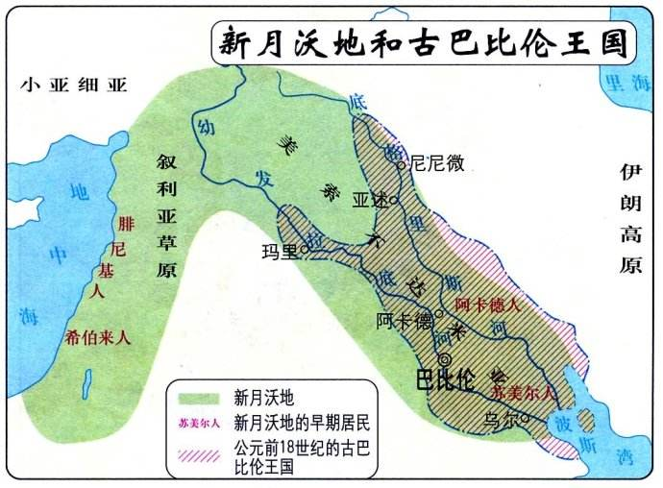
Tear of Tiamat & Euphrates and Tigris
Tales are a way to explain
the formation of this world.

Slide 7
Part2. Indian Tales

Slide 8
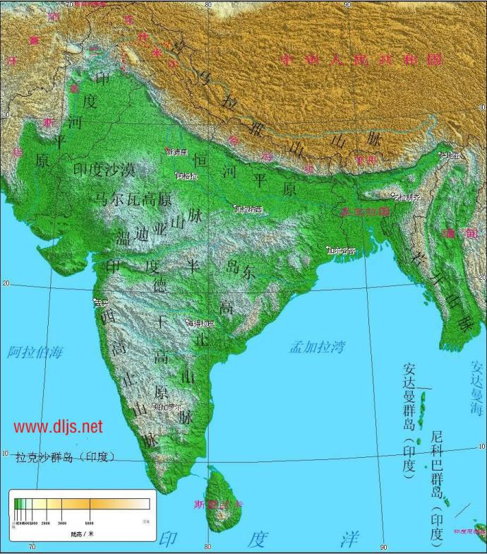

Slide 9
History
Key Word: Religion(Brahmanism, Hinduism, Buddhism, Jainism and Sikhism)
B.C.7C---B.C.6C began

Slide 10
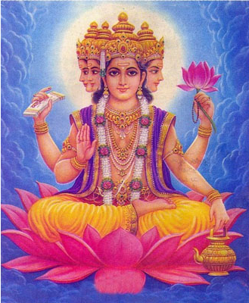
Main Gods
Brahma（梵天）
God of creation
Not most appreciated
4 faces (once 5)

Slide 11
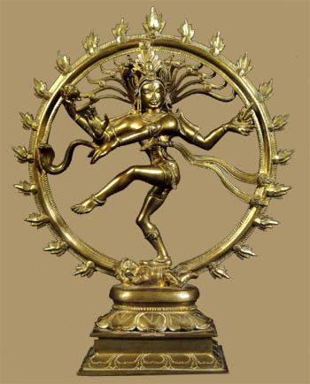
Siva（湿婆）
God of destruction
Very appreciated(Burned 1 face of Braham)
Invented Yoga

Slide 12

Visnu（毗湿奴）
God of Protection
Sleep for 1 kalpa and destroy the world
Embodiment: Turtle

Slide 13
Interesting Comparison

Slide 14
Great Flood
Mesopotamia: The Epic of Gilgamesh
India : The Great Flood（印度教神话《滔天的洪水》）
Both aim to destroy human but failed, both built boat and floated on the flood
Affected by their own geographic elements, kindness of god(gave out the secret through a dream)/human(saved the fish)

Slide 15
Geographic Effect
Civilization, religion, etc.

Slide 16
~Thanks for your listening~

