Slide 1

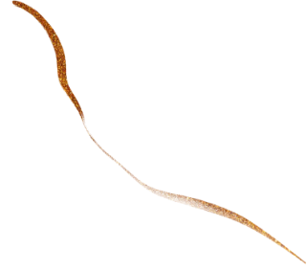
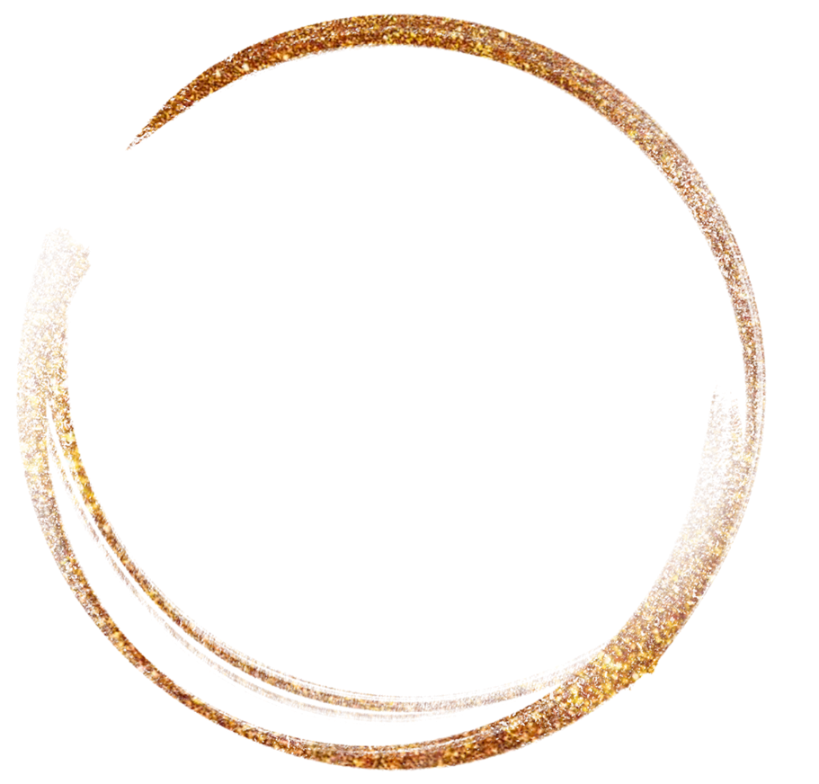
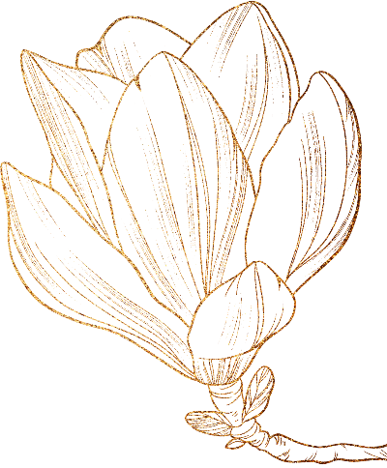
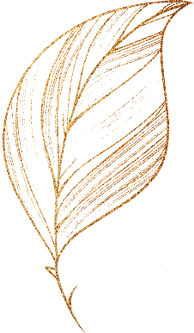

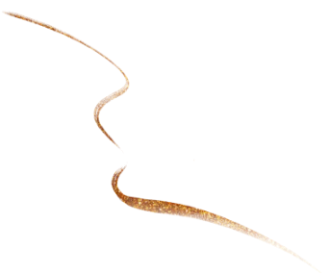
Chinese Classical Fairy Tales
——by: Deng Lulu——

Slide 2

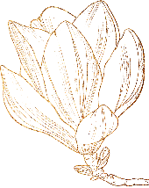
01
The Origin of Fairy Tales
CONTENTS
02
The characteristics of Fairy Tales
03
Chinese Traditional Fairy Tales

Slide 3
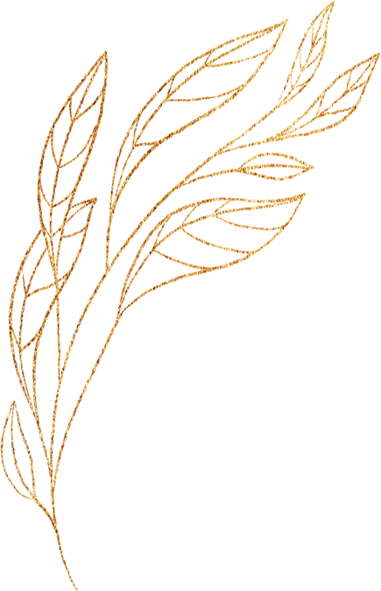
01 The Origin of Fairy Tales

Slide 4

01 Origin
Fairy tales originate from oral folk literature, evolving from myths and legends. The fairy tale is a product of the development of oral folklore, an ancient literary style, almost in a state of symbiosis with myths and legends. Originally part of traditional oral folklore, fairy tales were often told dramatically and passed down from generation to generation by word of mouth. The history of fairy tales is therefore difficult to ascertain. In particular, stories told by early illiterate storytellers often have no written record for future generations to refer to.
The term 'fairy tale' is thought to have been first coined by the French writer Ms. d'Aulnoy. In 1909, the literary scholar Sun Yuxiu（孙毓修） compiled a series of books called Fairy Tales. This was the first time the term 'fairy tale' had ever appeared in China; it was also the first time that 'fairy tale' had risen to prominence as a genre meaning.

Slide 5
02 The Characteristics of Fairy Tales

Slide 6
02 Characteristics
full of rich imagination, fantasy and exaggeration
have vivid language and strange twists and turns
use anthropomorphism to give life to flora and fauna
easy for children to read and understand
give children inspirations

Slide 7
03 Chinese Classical Fairy Tales

Slide 8
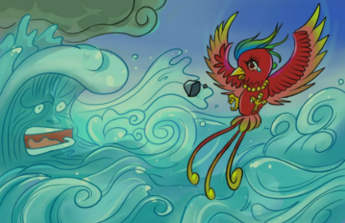
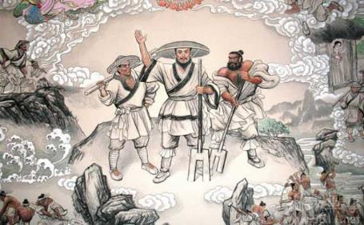
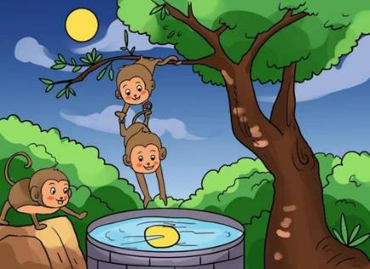
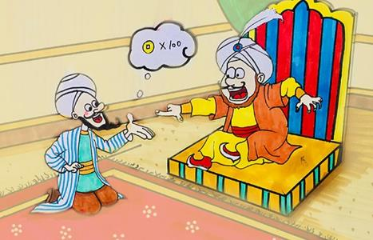
Jingei Tries to Fill the Sea
Gun-Yu heals water
The Monkey Gets the Moon
Avanti and the Emperor

Slide 9

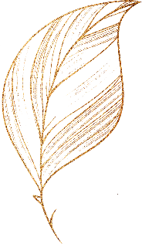

Thank you！

