Slide 1
Presentation: Chinese Rice Balls (Tangyuan)
Su Yi

Slide 2
CONTENTS
Symbolism of Tangyuan
Making Tangyuan
Legends and Stories of Tangyuan
Regional Variations of Tangyuan
Modern Innovations and Traditions

Slide 3
01
Symbolism of Tangyuan

Slide 4
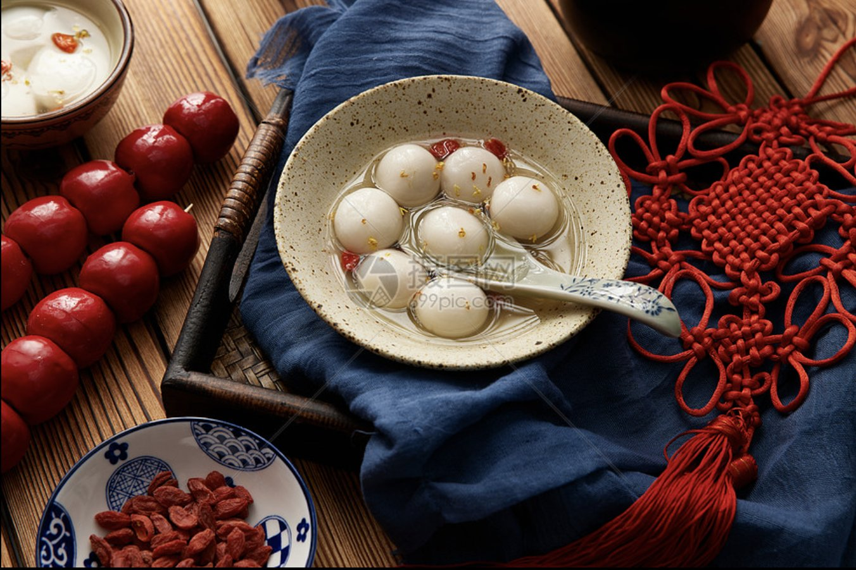
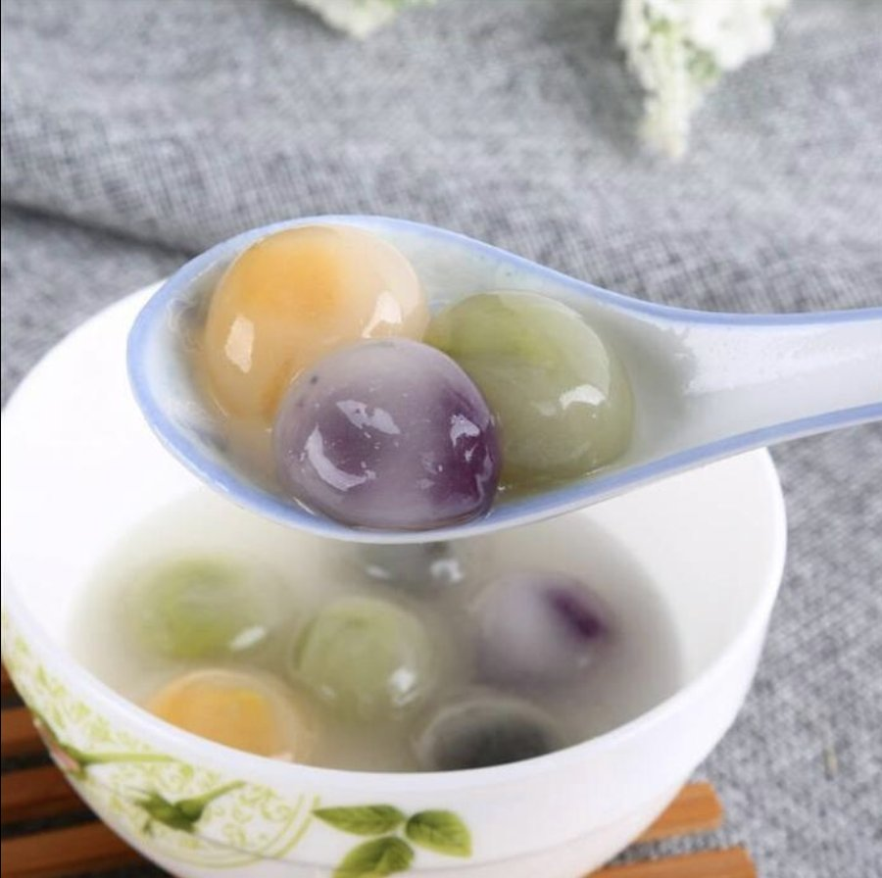
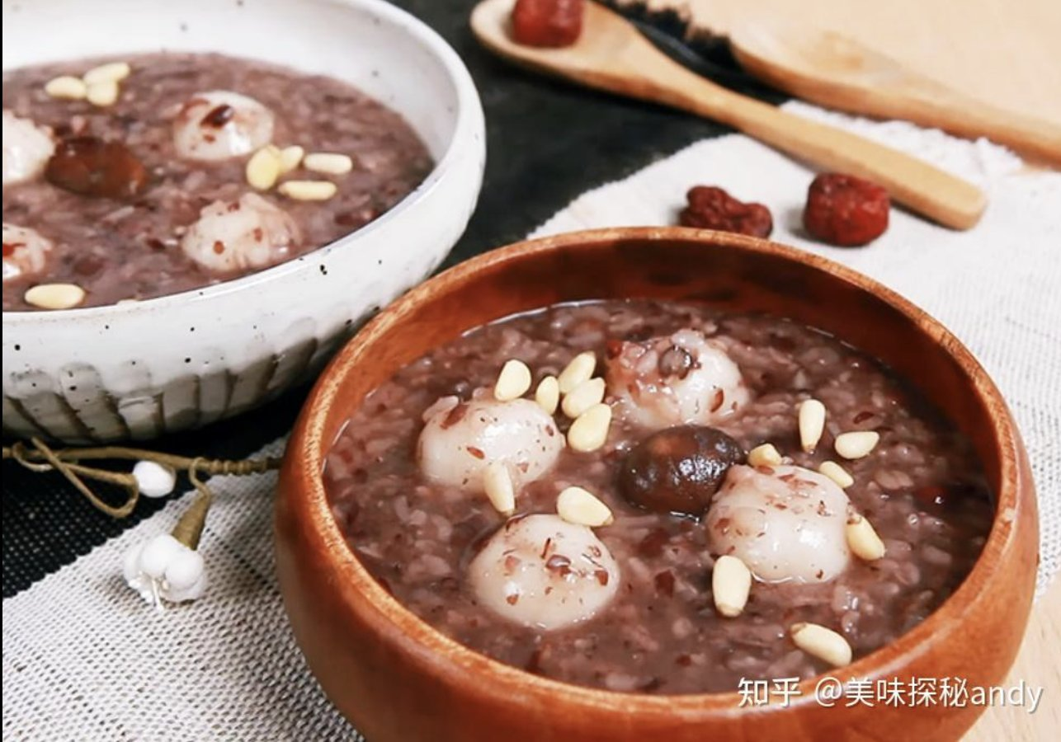
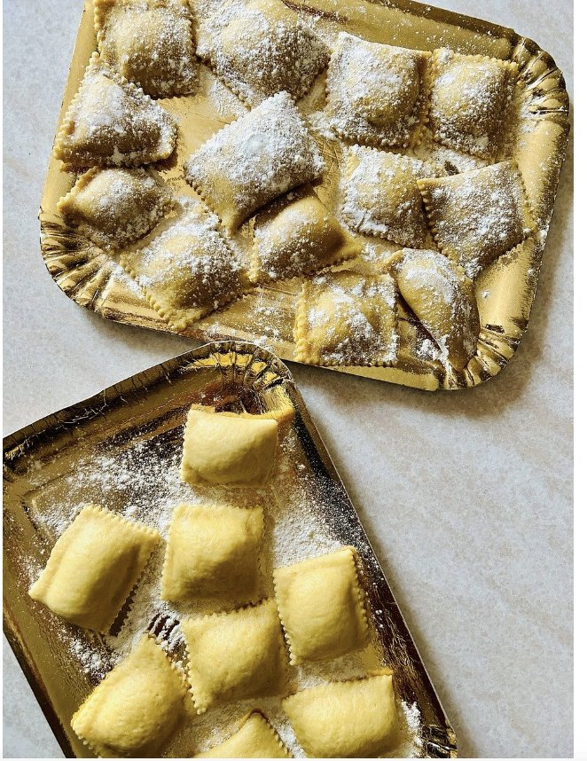
Symbolism of Tangyuan
  Rounding and Harmony:
  Tangyuan's round shape symbolizes reunion and harmony.
  International Comparisons:
  Tangyuan and Other Global Reunion Foods
  Cultural Significance:
  Tangyuan in Traditional Festivals

Slide 5
Rounding and Harmony
  Rounding and Harmony:
  The circular form of tangyuan is a symbol of reunion and harmony in Chinese culture, embodying the essence of family gatherings and happiness. This traditional dessert represents the unity and joy of bringing families together.
  Festival Food:
  Tangyuan is a traditional dish during festivals such as the Lantern Festival and Winter Solstice, serving as a symbol of reunion and festivity.

Slide 6



International Comparisons
Diverse Cultural Reunion Dishes:
Explore various foods from around the world that symbolize reunion, such as Italy's Ravioli and Japan's Mochi.
Universal Values of Family Bonding:
Show how different cultures use food to express the universal value of family reunion and bonding.

Slide 7
Cultural Significance
  Symbol of Reunion in Lantern Festival and Winter Solstice:
  During the Lantern Festival and Winter Solstice, tangyuan is a symbolic dish that expresses the wish for family reunion.
  Traditional Customs:
  Eating tangyuan during festivals is a traditional custom aimed at praying for family harmony and happiness.

Slide 8
02
Making Tangyuan

Slide 9
Making Tangyuan
  Ingredients and Fillings:
  Essential Components of Tangyuan

Slide 10
Ingredients and Fillings
  Basic Ingredients:
  Tangyuan is made with glutinous rice flour, water, and fillings such as black sesame, peanuts, and red beans.
  Preparation Steps:
  Detail the process of kneading the dough, filling, shaping, and boiling the tangyuan, showcasing the traditional craftsmanship and significance.
https://www.bilibili.com/video/BV1SpWfevEvy/

Slide 11
03
Legends and Stories of Tangyuan

Slide 12
Legends and Stories of Tangyuan
  Historical Legends:
  Tales Behind the Dish

Slide 13
Historical Legends
  Legend of Yuanxiao:
  A story from the Han Dynasty about a palace maiden named Yuanxiao, whose longing for home gave rise to the tradition of tangyuan as a symbol of reunion.
  Tang Dynasty Lantern Festival Legend:
  The custom of enjoying lanterns and eating tangyuan during the Lantern Festival symbolizes harmony and reunion.
  Ming Dynasty Love Legend:
  Tangyuan symbolizes the fulfillment of love, conveying a message of enduring affection.
  Legend of Blessing and Protection:
  Consuming tangyuan symbolizes the wish for safety and well-being.
https://tv.cctv.com/2022/02/16/VIDEMVfaa05i0BrWSzxIM2Fs220216.shtml

Slide 14
04
Regional Variations of Tangyuan

Slide 15
Regional Variations of Tangyuan
  Regional Flavors:
  Tangyuan in Different Parts of China

Slide 16
Regional Flavors
  Sweet South, Savory North:
  Southern regions prefer sweet tangyuan, while northern regions favor savory versions, highlighting regional differences in taste.
  Diverse Filling and Broth:
  Various fillings and soup bases used in different regions enrich the flavors of tangyuan, reflecting the diversity of traditional Chinese cuisine.

Slide 17
05
Modern Innovations and Traditions

Slide 18
Modern Innovations and Traditions
  Innovative Tastes:
  New Flavors of Tangyuan
  Cultural Heritage and Development:
  Tangyuan in Chinese Culture

Slide 19
Innovative Tastes
  New Flavors:
  Introducing new tastes such as fruits and chocolate to cater to modern palates.
  Balancing Tradition and Modernity:
  Tangyuan continues to be a cherished festival food in modern life, preserving traditional values while innovating to sustain cultural transmission.

Slide 20
Cultural Heritage and Development
  Symbol of Reunion and Harmony:
  Tangyuan represents family reunion, happiness, and completeness, deeply rooted in Chinese culture.
  Preservation and Evolution:
  In modern life, tangyuan retains its traditional significance while continuing to spread its cultural meaning through innovation.

Slide 21
THE END
THANKS

