Slide 1

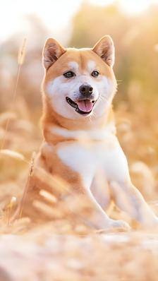
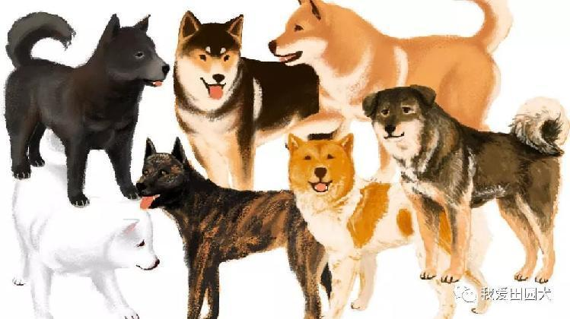

Chinese Rural Dogs
朝鲜语笔译 赵晶

Slide 2
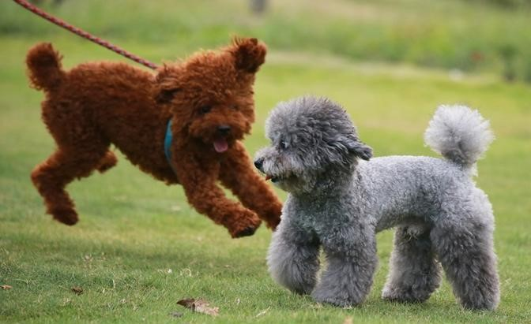
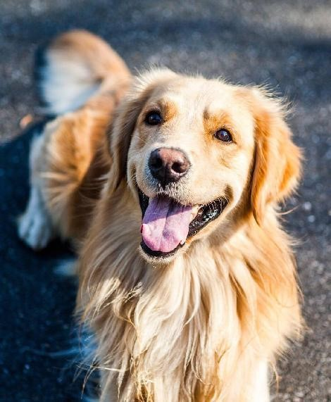
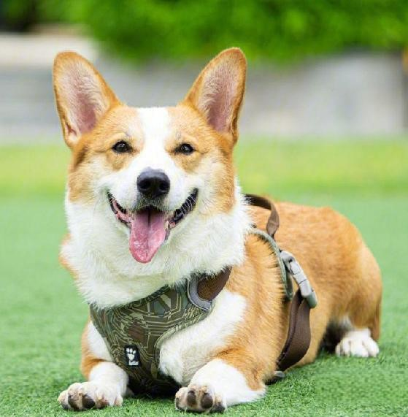
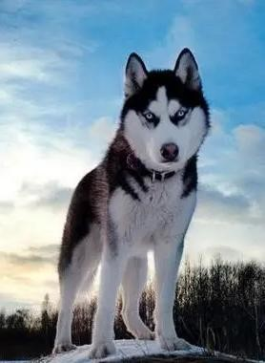
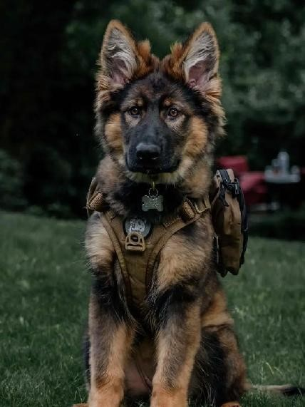
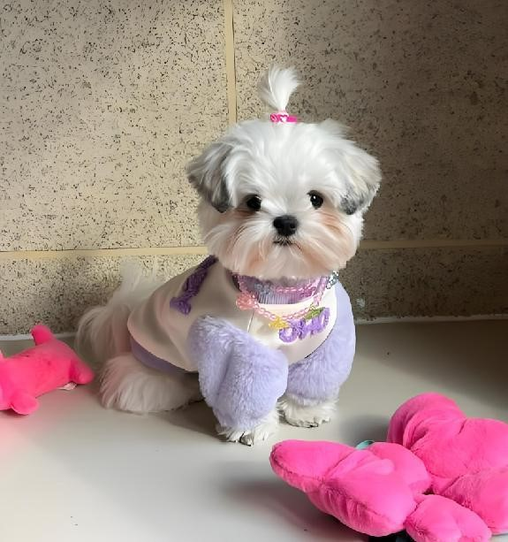
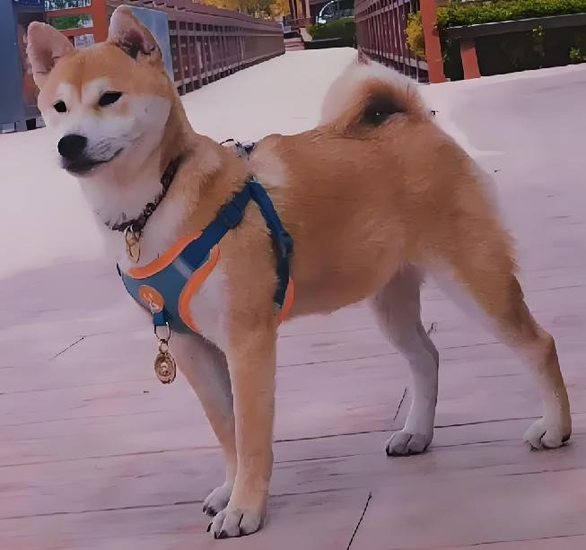
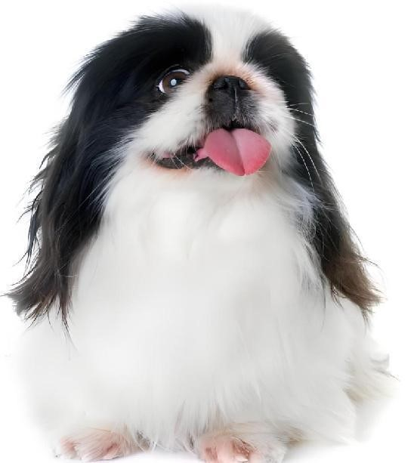
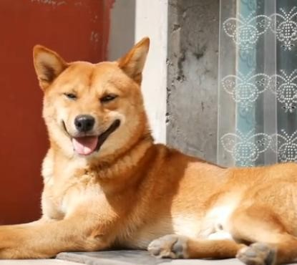
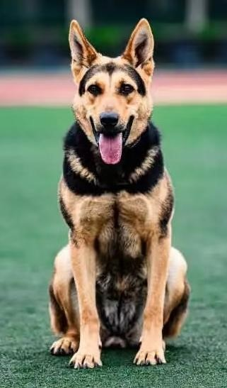

If you could have a dog, which one would it be?

Slide 3
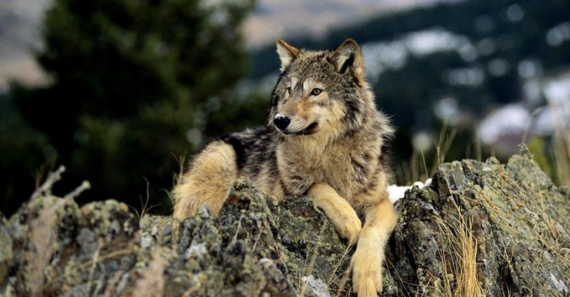
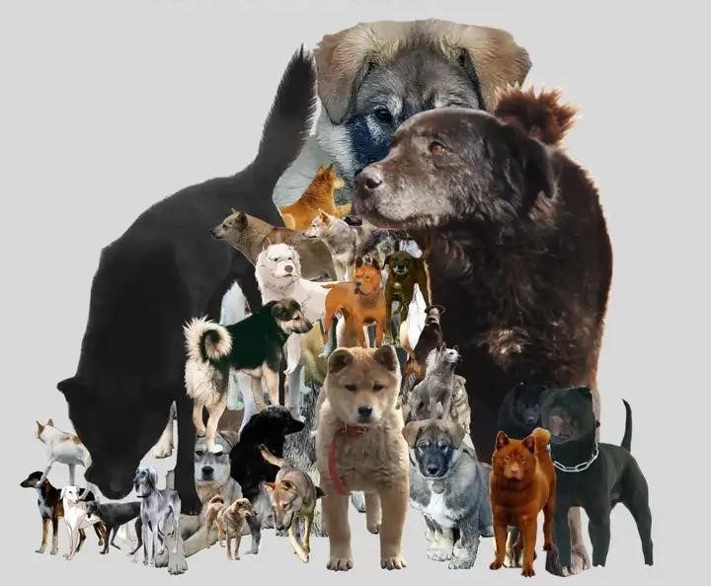
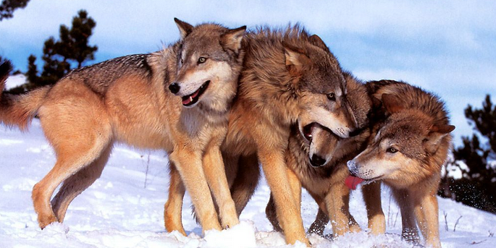
Origin of the Chinese Rural Dog
natural
selection
human
domestication

Slide 4
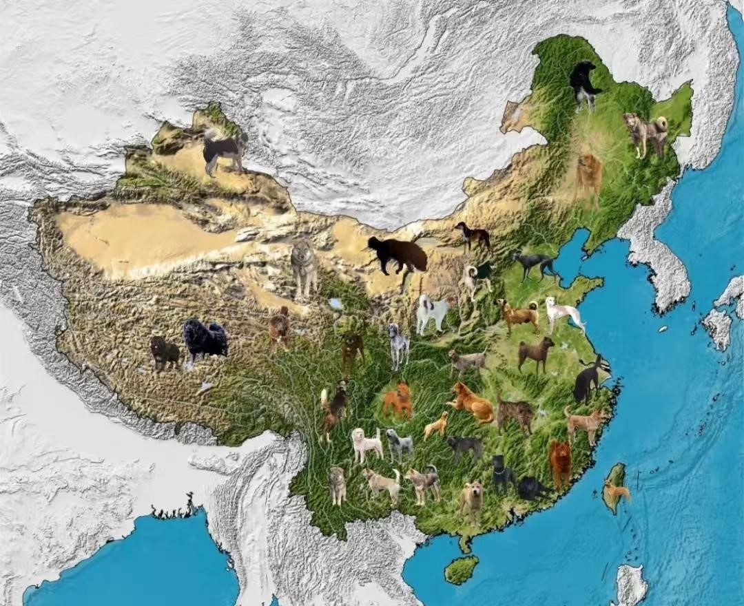
Origin of the Chinese Rural Dog
Li Si, the prime minister of the Qin Dynasty, lamented before his execution: I can no longer lead the yellow dog out with me to chase after the crafty rabbit at the east gate of CAI.The “yellow dog” here refers to the Chinese Rural dog.

Slide 5
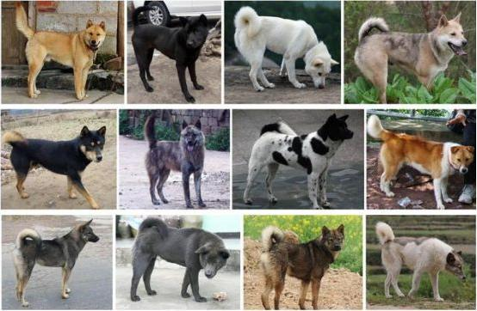
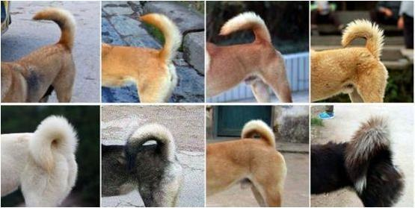
Morphological characteristics of the Chinese Rural Dog
Short mouth and a flat forehead; its tail is shaped like a sickle and is raised upwards, especially when walking; its hair is rough and easy to keep clean, and it comes in a variety of colors, mainly yellow, white and black.

Slide 6
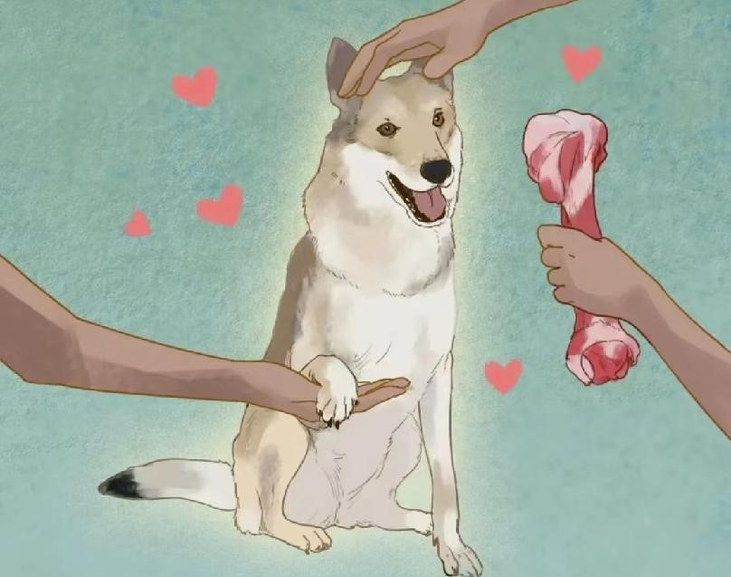
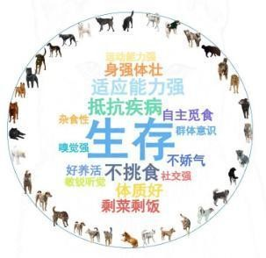
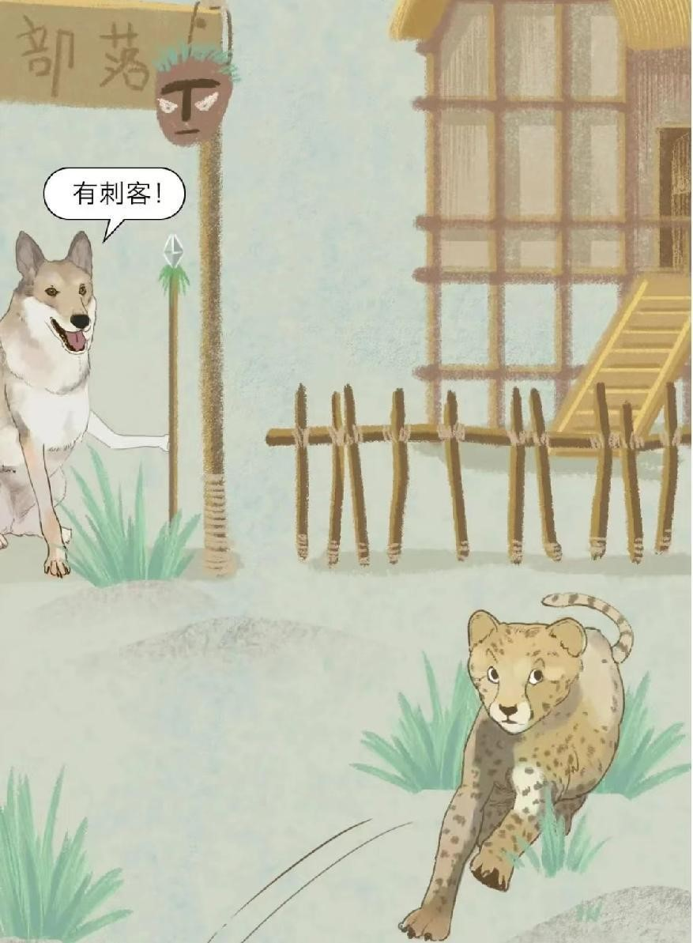
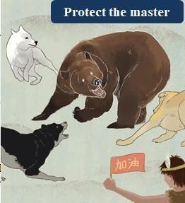
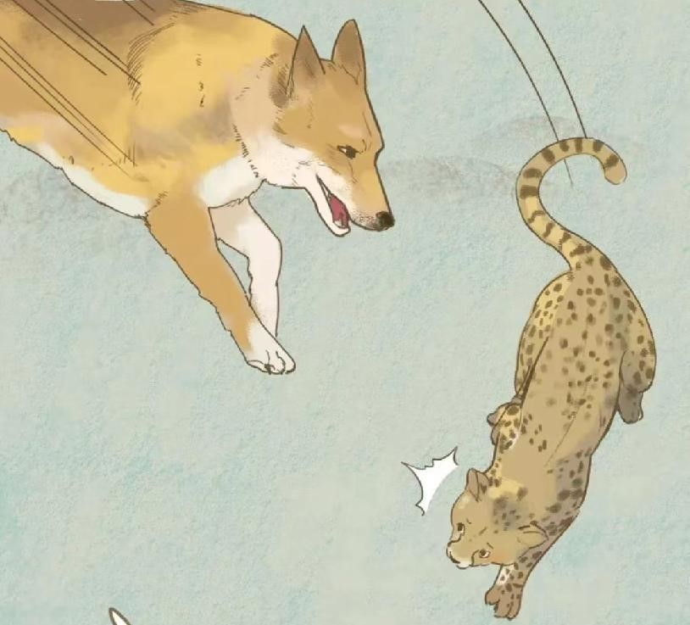
Life Habits of the Chinese Rural Dog
docile
easy to raise
hunting
Understand human nature well.
loyal
obedience
home guarding
not prone to skin diseases
strong adaptability

Slide 7
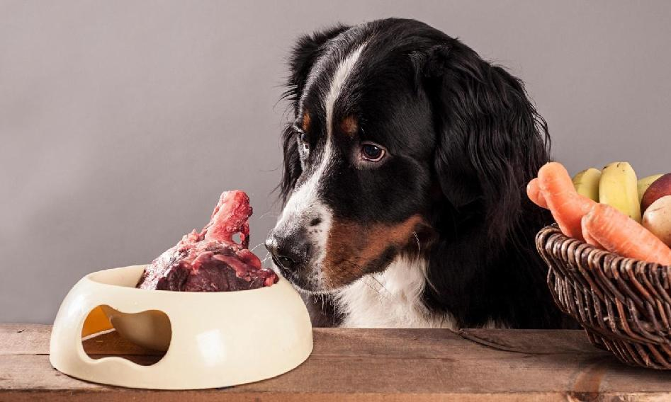
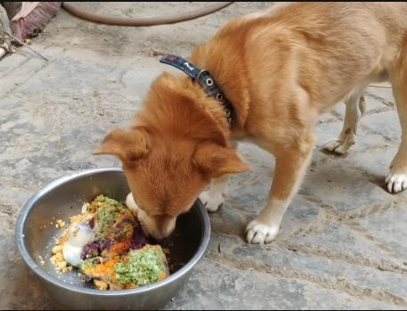
Life Habits of the Chinese Rural Dog
Chinese Rural Dog is a carnivore, when feeding needs to be formulated more animal protein to maintain the normal development and health of the dog, but in rural areas, most people are not too focused on the dog's nutritional formulations, and just feed the dog with leftovers.
Wonderful imagination
Unpleasant reality

Slide 8
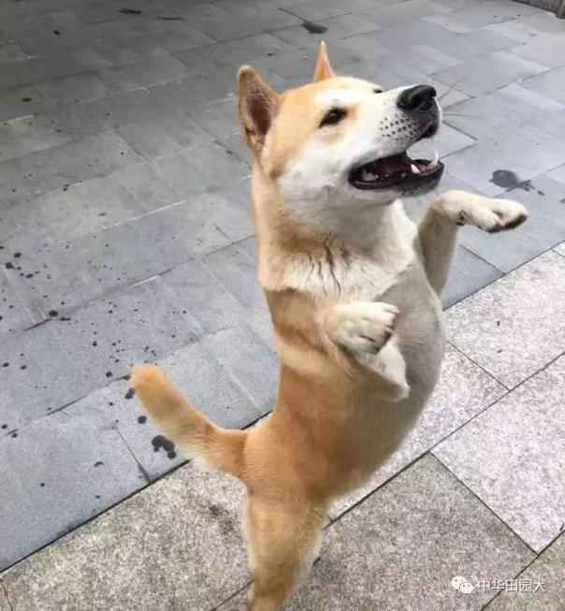
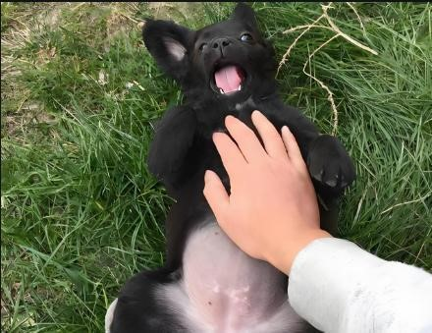
Life Habits of the Chinese Rural Dog
Chinese Rural Dogs can live in groups. They will use urine to mark territory, attract the opposite sex or as signposts. They love to have their bellies and backs stroked and like to wag their tails when they are happy. They will leave their owner's home when they realize they are going to die and wait silently for death by themselves.

Slide 9
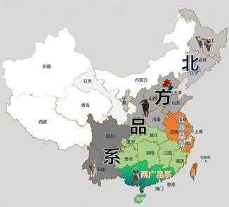
Three major strains
The Chinese Rural Dog can be roughly divided into three major strains, namely the northern strain, the Jiang Zhe strain, and the Liang Guang strain.

Slide 10
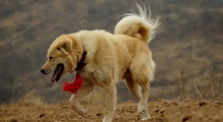
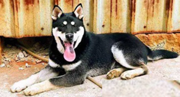
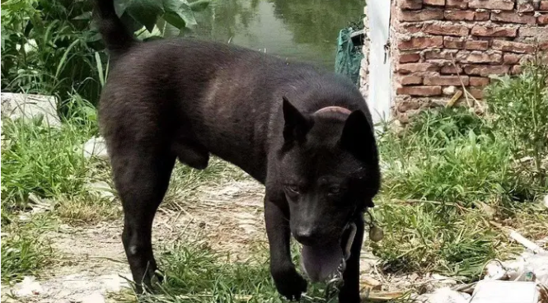

Three major strains
Classification Listings | Northern strain | Jiang Zhe strain | Liang Guang strain
Distribution | Distributed in the Northeast - Yellow River basin - Upper and Middle Yangtze River - Yunnan-Guizhou Plateau area | Jiang Zhe strain is mainly found in Zhejiang, Jiangsu and Anhui | Liang guang strain is centred on Guangdong, including parts of Guangxi and Fujian.
Characteristic | Mixed colors; ears will naturally hang down towards the front of the head in a relaxed state, with a dignified face. | Fewer mixed-coloured dogs in this region, with large, long and erect ears, pointed mouths and long limbs | Mainly solid colors. Small and upright ears, often with a flowered tongue or black tongue, and a sturdy body.
Representative varieties | Big Stupid Dog, Chai Gou | Su Quan | Sha Pi, Chao Shan Big Head, Guangdong Song Shi.
Legend

Slide 11
Three major strains
Classification Listings | Northern strain | Jiang Zhe strain | Liang Guang strain
Distribution | Distributed in the Northeast - Yellow River basin - Upper and Middle Yangtze River - Yunnan-Guizhou Plateau area | Jiang Zhe strain is mainly found in Zhejiang, Jiangsu and Anhui | Liang guang strain is centred on Guangdong, including parts of Guangxi and Fujian.
Characteristic | Mixed colors; ears will naturally hang down towards the front of the head in a relaxed state, with a dignified face. | Fewer mixed-coloured dogs in this region, with large, long and erect ears, pointed mouths and long limbs | Mainly solid colors. Small and upright ears, often with a flowered tongue or black tongue, and a sturdy body.
Representative varieties | Big Stupid Dog, Chai Gou | Su Quan | Sha Pi, Chao Shan Big Head, Guangdong Song Shi.
Legend

Slide 12
Three major strains
Classification Listings | Northern strain | Jiang Zhe strain | Liang Guang strain
Distribution | Distributed in the Northeast - Yellow River basin - Upper and Middle Yangtze River - Yunnan-Guizhou Plateau area | Jiang Zhe strain is mainly found in Zhejiang, Jiangsu and Anhui | Liang guang strain is centred on Guangdong, including parts of Guangxi and Fujian.
Characteristic | Mixed colors; ears will naturally hang down towards the front of the head in a relaxed state, with a dignified face. | Fewer mixed-coloured dogs in this region, with large, long and erect ears, pointed mouths and long limbs | Mainly solid colors. Small and upright ears, often with a flowered tongue or black tongue, and a sturdy body.
Representative varieties | Big Stupid Dog, Chai Gou | Su Quan | Sha Pi, Chao Shan Big Head, Guangdong Song Shi.
Legend

Slide 13
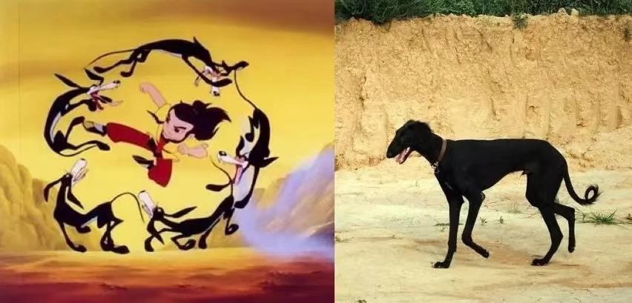
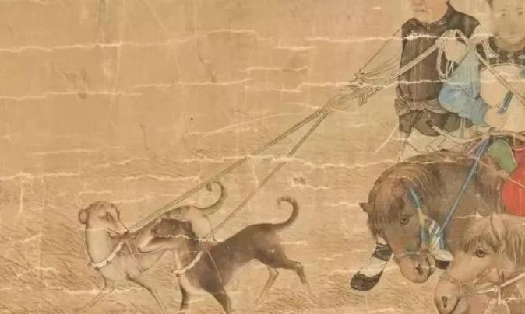
Chinese Rural Dogs with Chinese Traditional Culture
As one of the oldest dog breeds in China, the Chinese Rural Dog is a product of China's thousands of years of agricultural society, a living fossil of history and culture.
In traditional Chinese culture, dogs have always been regarded as symbols of loyalty, bravery and good fortune, so the Chinese Rural Dog is also endowed with many auspicious symbols.

Slide 14
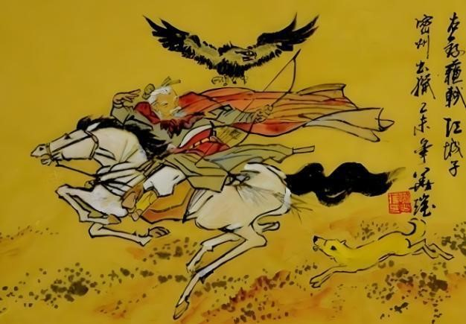
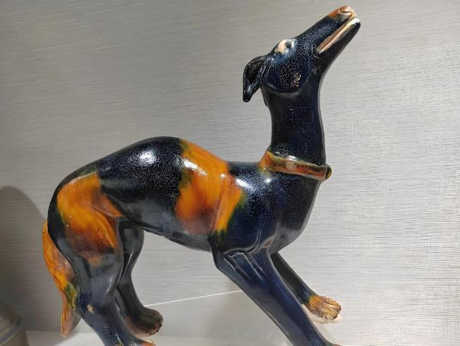
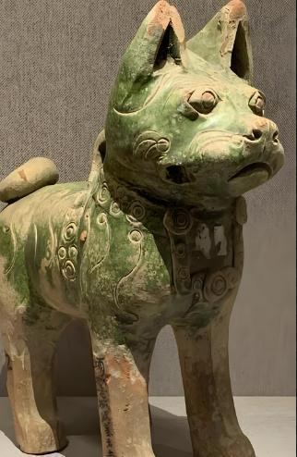
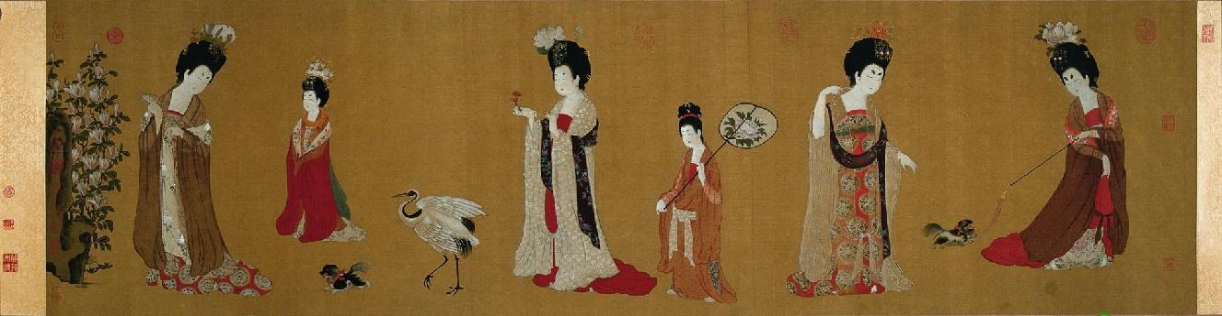
Chinese Rural Dogs with Chinese Traditional Culture
In art and literature,"The Yellow Dog on the Left, the goshawk on the Right.
In art, "A Beauty Wearing a Hairpin " .
In porcelain works, the three-colour dog of the Tang Dynasty is realistic and highly skilled in sculpture.

Slide 15
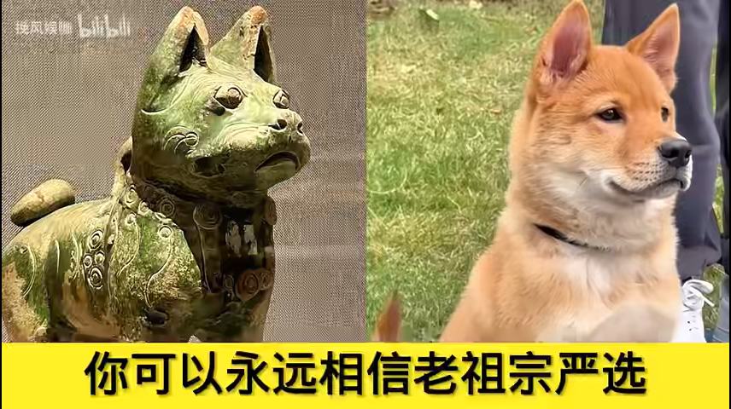

Slide 16
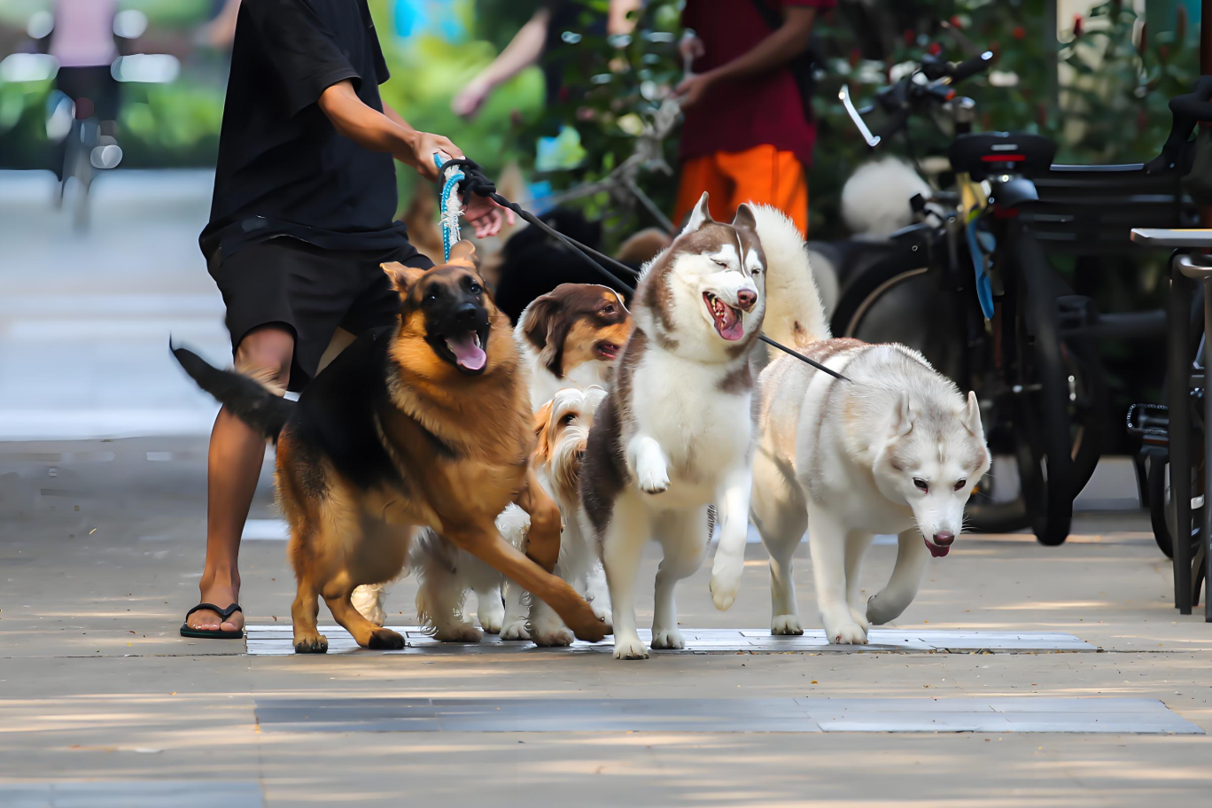
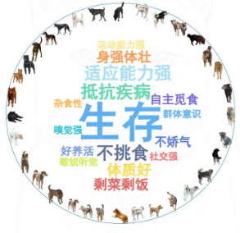
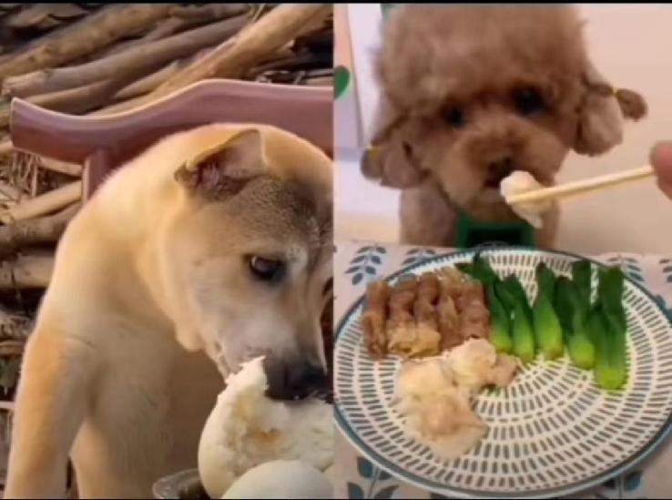
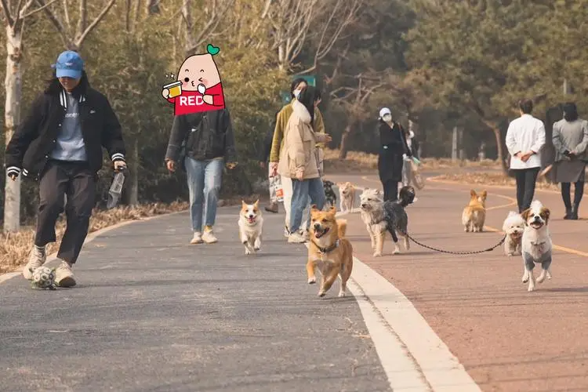
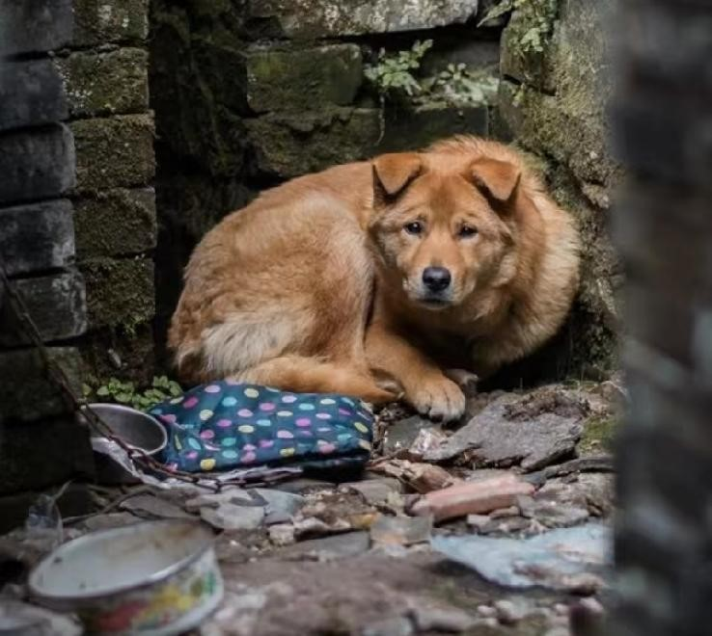
What can we do to protect the Chinese Rural Dog?
Too common
lose face
easy to raise
can be seen everywhere
low beauty-value
very dirty
savage

Slide 17
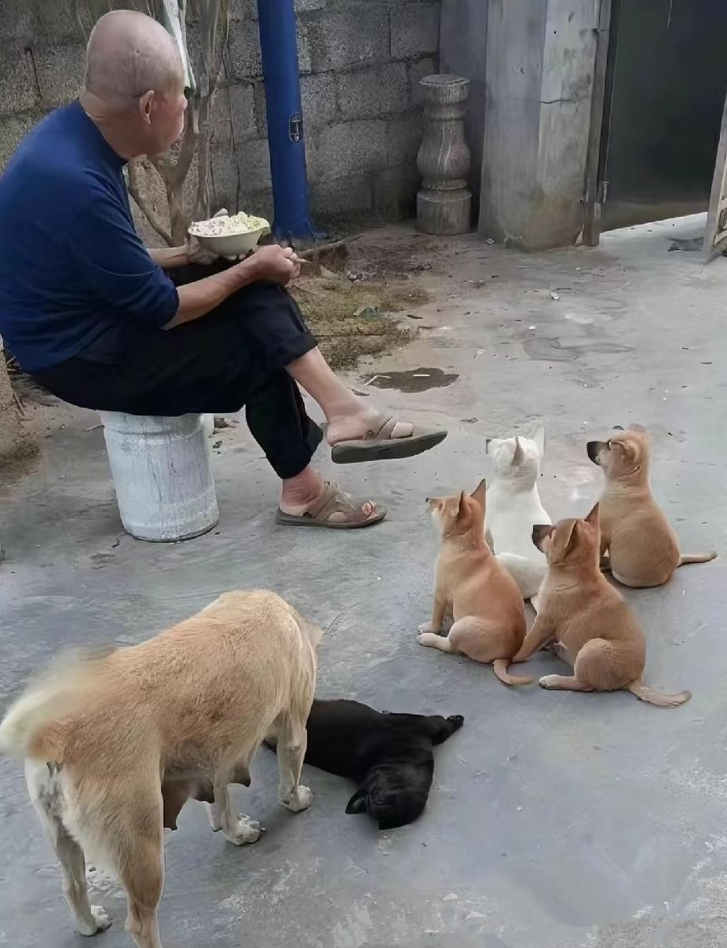
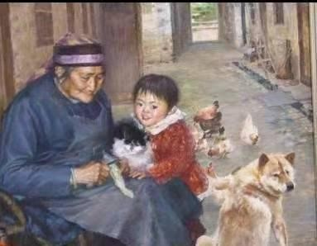
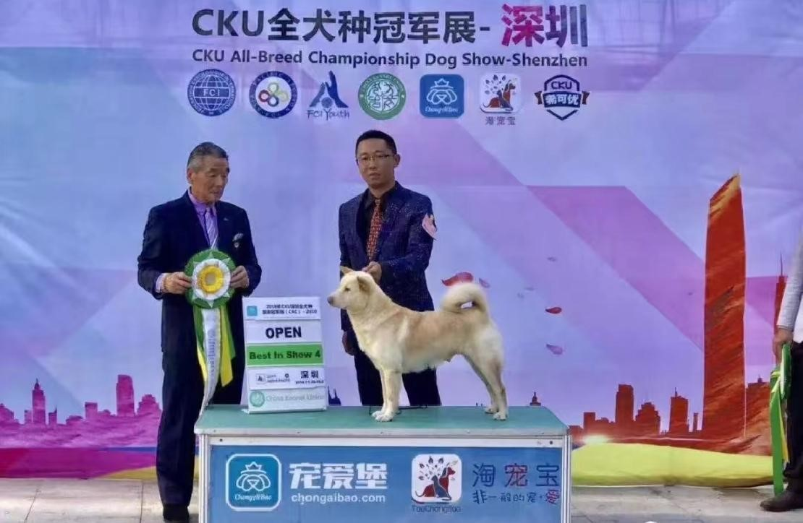
What can we do to protect the Chinese Rural Dog?
The Chinese Rural Dog is not just a breed of dog, but also a symbol of culture and spirit. It represents the diligence, wisdom and kindness of the Chinese people, and is the inheritor and promoter of our national spirit. We should act together to protect and pass on the valuable cultural heritage of the Chinese Rural Dog!

Slide 18
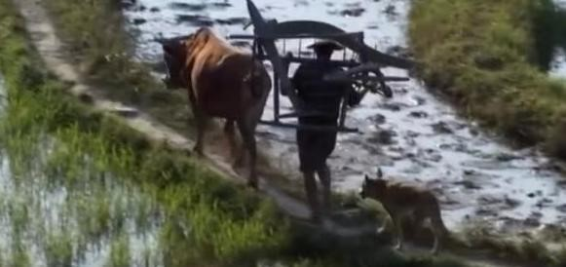
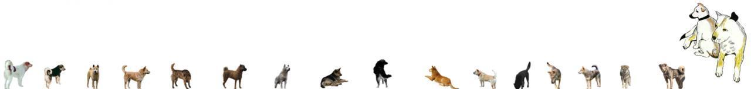

Thanks for Watching

