Slide 1
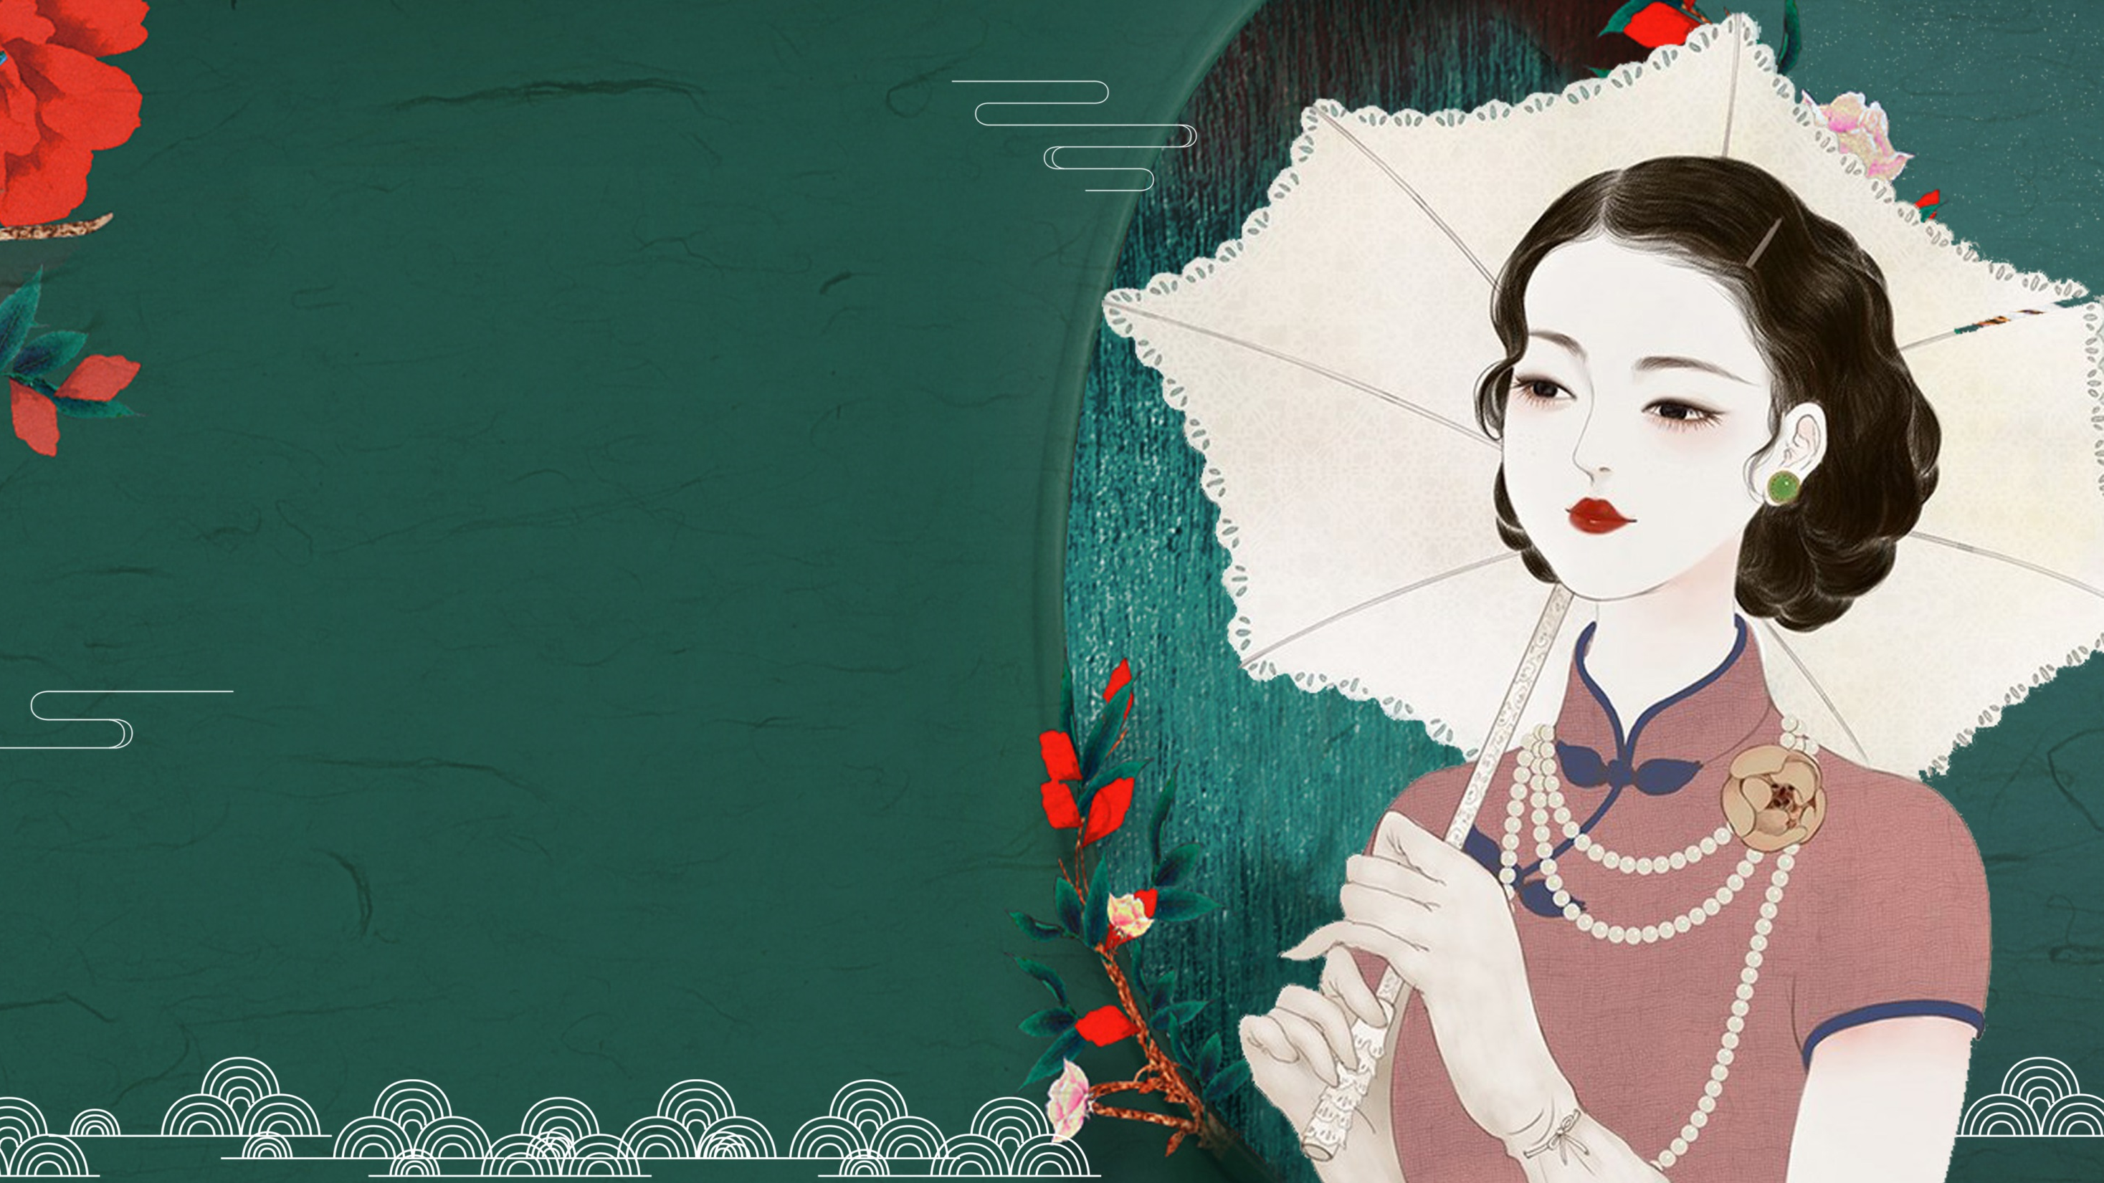

The Past and Present of
Cheongsam

Slide 2
芊芊淑女，婀娜旗袍着身，曼妙多姿，笑颜如花绽，玉音婉转流，皎皎兮似轻云之蔽月，飘飘兮若回风之流雪。
Graceful ladies, adorned in cheongsams that fit them snugly, exude an enchanting charm. Their postures are full of elegance and allure. Their smiling faces bloom like flowers, and their voices flow with a melodious and gentle tone. They are as radiant as the moon veiled by thin clouds, and as ethereal as the snowflakes dancing in the swirling breeze.
elegant
graceful
Timeless
Sophisticated
…

Slide 3
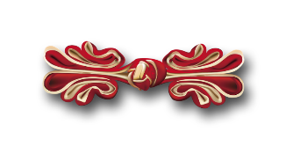
壹·The Qing Dynasty: The Origin of Cheongsam
贰·The Period of the Republic of China: The Transformation and Prosperity of Cheongsam
叁·Modern Times: The Diverse Charms of Cheongsam

Slide 4
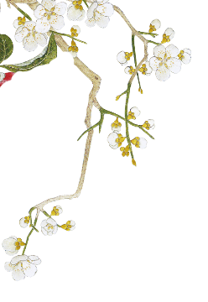

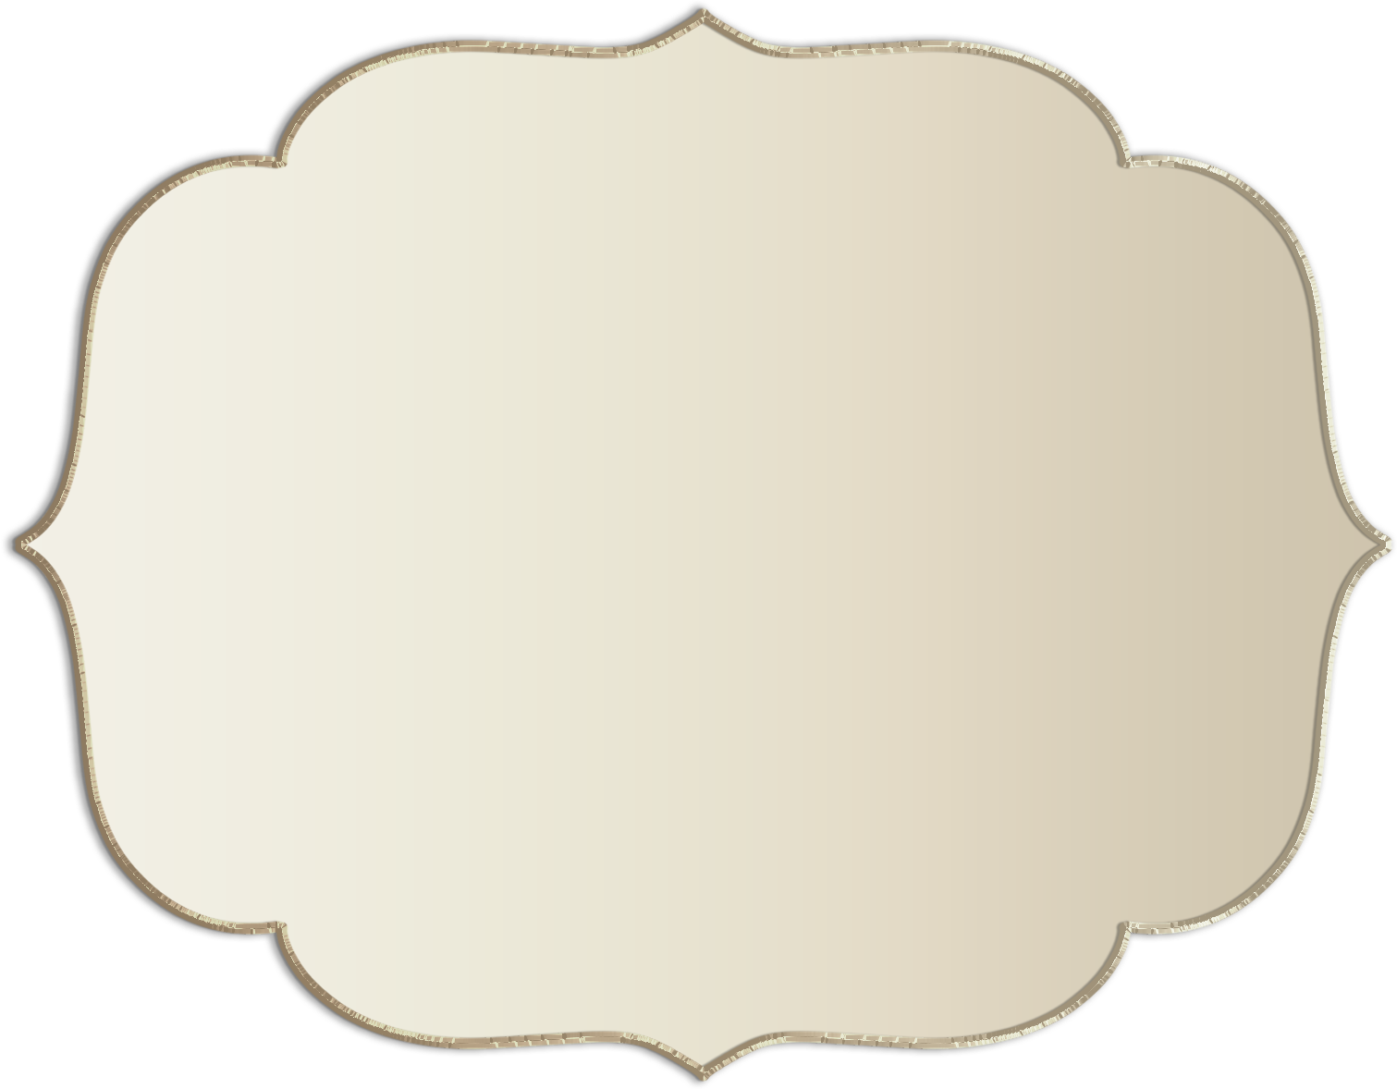
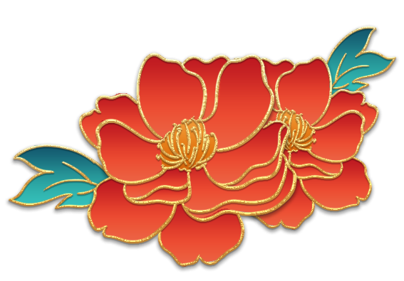

壹
The Qing Dynasty:
The Origin of Cheongsam

Slide 5
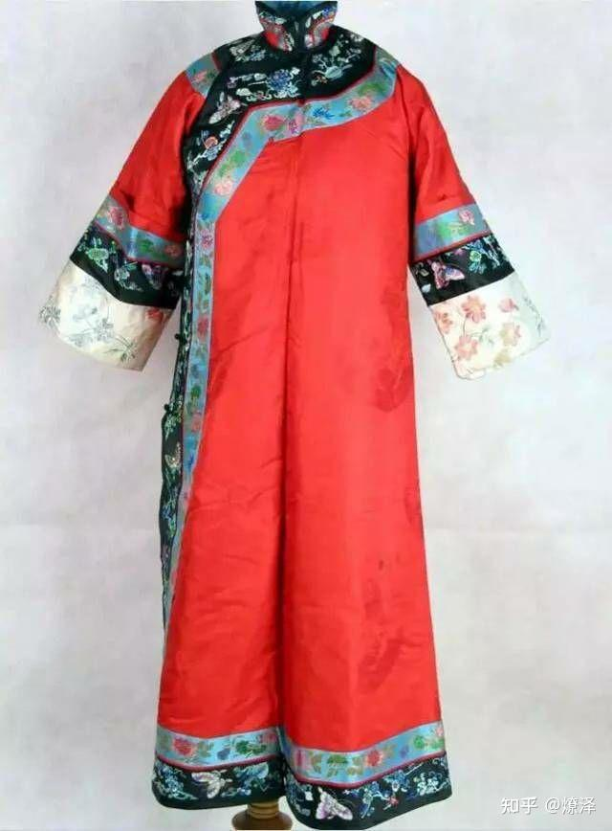
round neckline
The cheongsam originated from the women of the Manchu ethnic group in the Qing Dynasty. It was initially called qifu or qizhuang.
In the shape of a rectangle.
button loop
Slits of the lower part
Wide hem

Slide 6
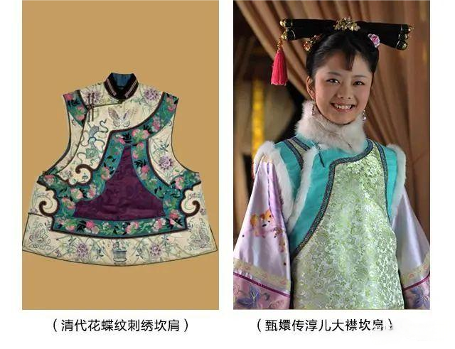
Waistcoat 坎肩 kǎn jiān
A kind of warm clothing for women
in the Qing Dynasty, usually worn over a cheongsam or a skirt.
large-lapel
in an oblique cut shape
simple and elegant
suitable for daily wear

Slide 7
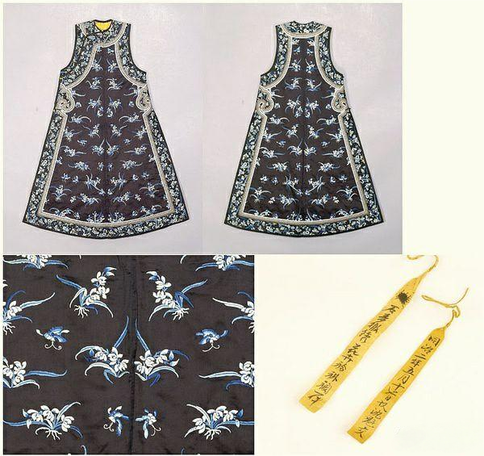
Mandarin jacket hem 褂襕 kǎn jiān
a long waistcoat
often worn over a cheongsam
a round neckline
sleeveless
longer than the knee

Slide 8
贰
The Period of the Republic of China:
The Transformation and Prosperity of Cheongsam

Slide 9
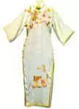
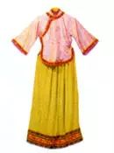
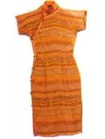
Please sort the following pictures

Slide 10
In the early years of the Republic of China：
short jackets with large round collars paired with skirts大圆角短袄裙
Mandarin collar
oblique placket
The length of the skirt reaching the ground

Slide 11
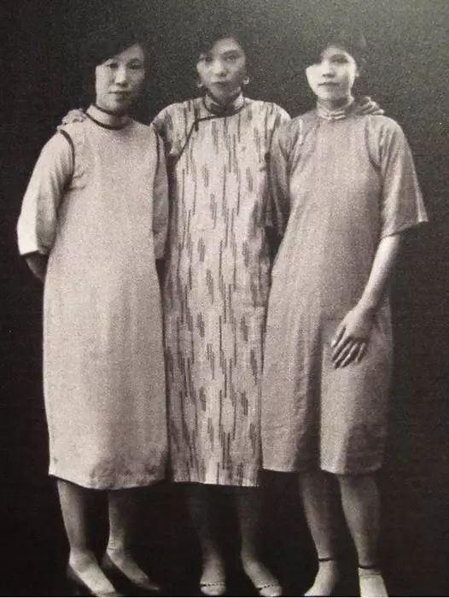
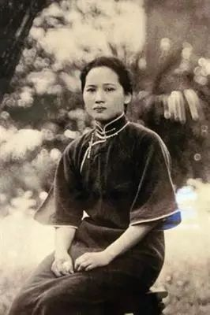
The 1920s : Shanghai Cheongsam
The short jacket and the long waistcoat combining into one.

Slide 12
The 1930s:
The Modern Era, a combination of Chinese and Western styles
Lotus leaf collars, Western-style turn-down collars, lotus leaf sleeves emerging
The hem of the cheongsam rising higher and higher

Slide 13
叁
Modern Times:
The Diverse Charms of Cheongsam

Slide 14
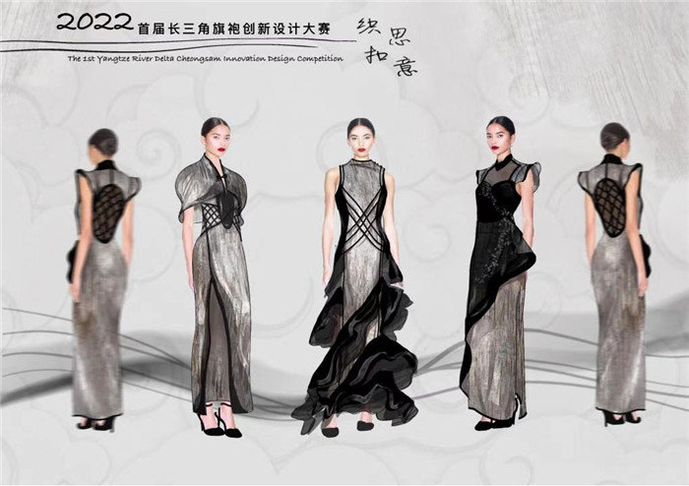
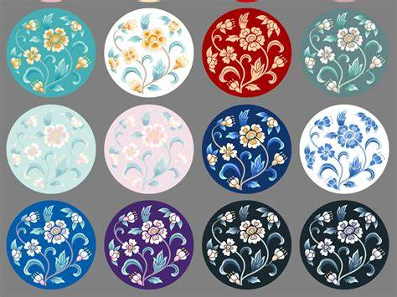
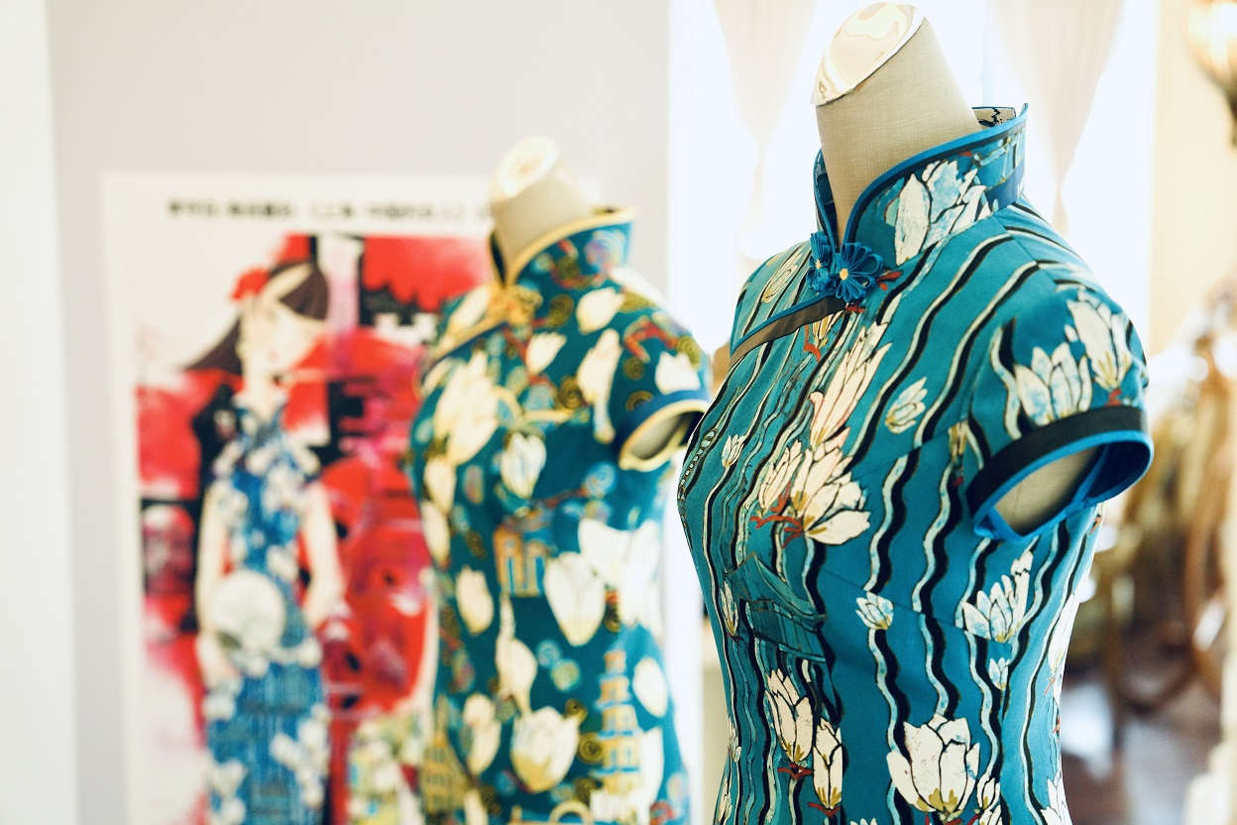
Modern Times:The Diverse Charms of Cheongsam
The deconstruction and reconstruction of traditional styles
Incorporating novel patterns and colors

Slide 15
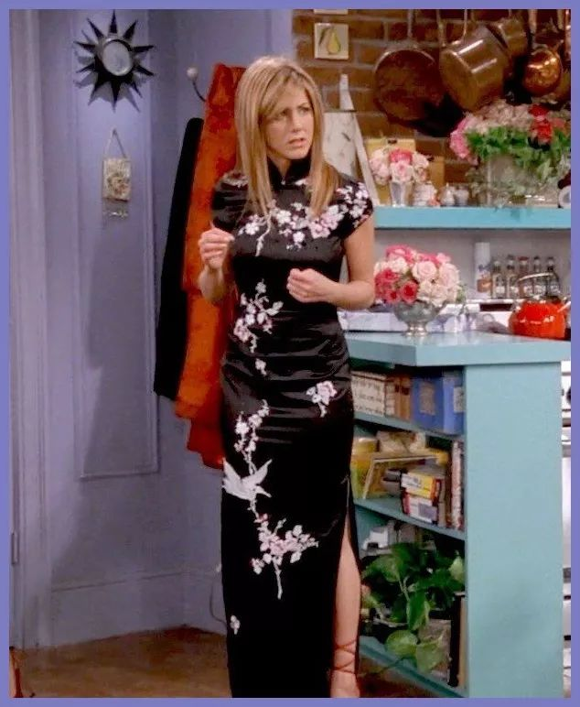
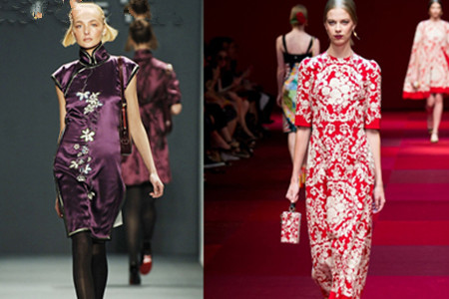
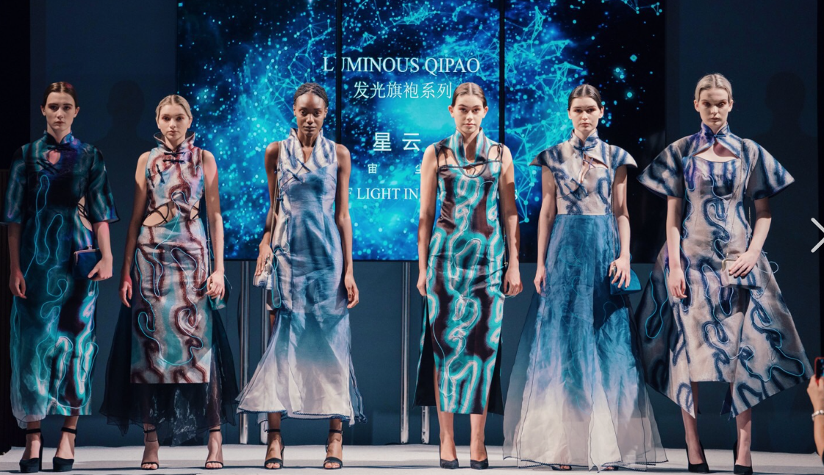

Slide 16
Thanks !

