Slide 1

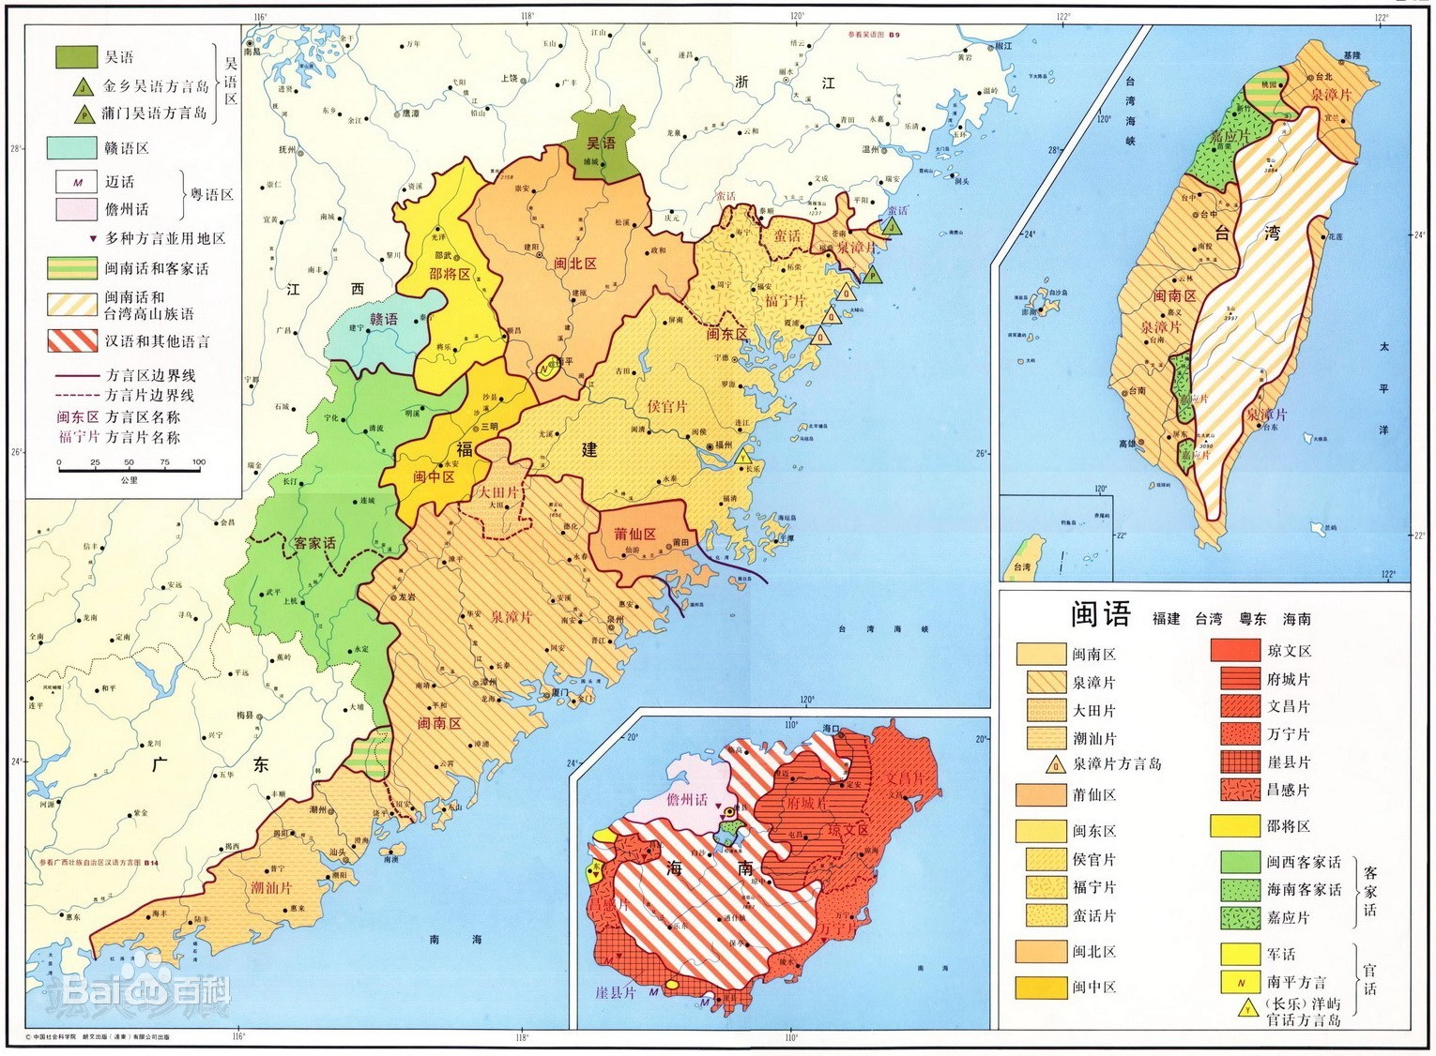
Fujian dialect （min language）（闽方言）
The Min language is spoken mainly in Fujian, Guangdong, Taiwan, Hainan and the south-western corner of Zhejiang Province.
Very difficult to understand Rather tongue-twisting
Speaks very fast

Slide 2
Hunan dialect （湘方言）
Xiangyu, also known as xiang dialect or Hunan dialect is the main language used by the Hunan people who live in xiangjiang river basin and its branches.
It is divided into two categories: new Xiangyu（represented by Changsha dialect） and old Xiangyu（represented by Shuangfeng dialect.）.
Modern Xiangyu speakers are mainly distributed in a considerable part of Hunan province in Mainland China, including Changsha, Zhuzhou, Xiangtan, Yueyang, Yiyang, Loudi, Hengyang, Shaoyang, Yongzhou and so on.

Slide 3
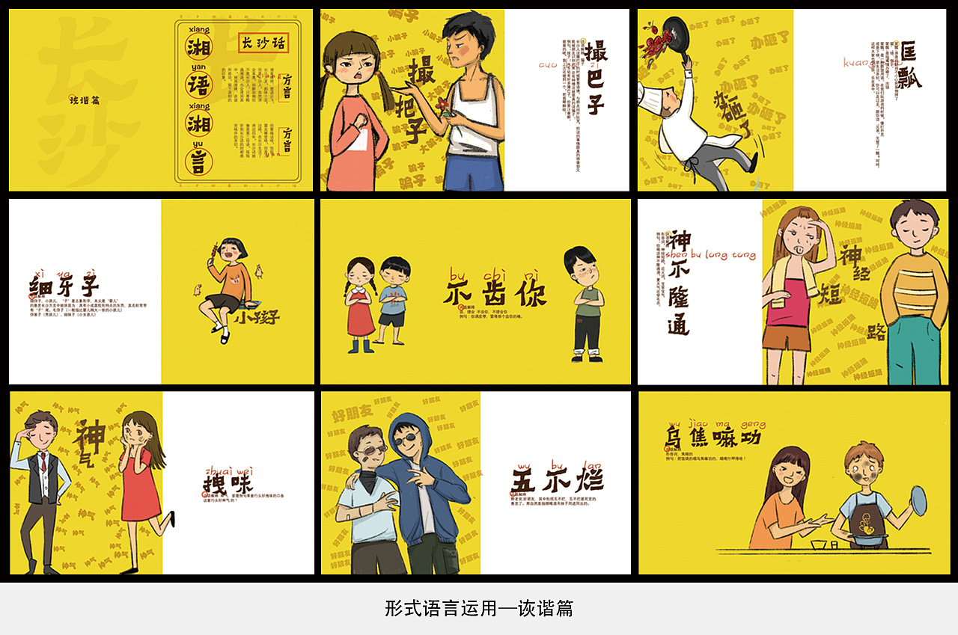
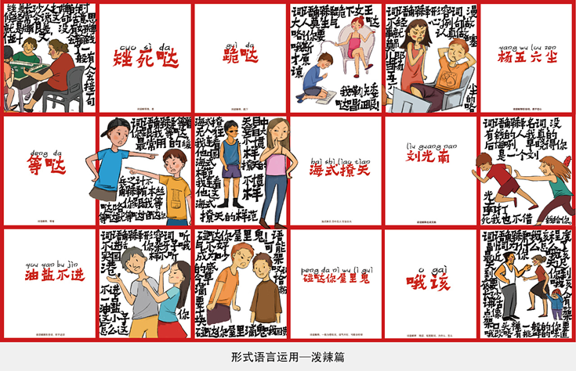

Slide 4
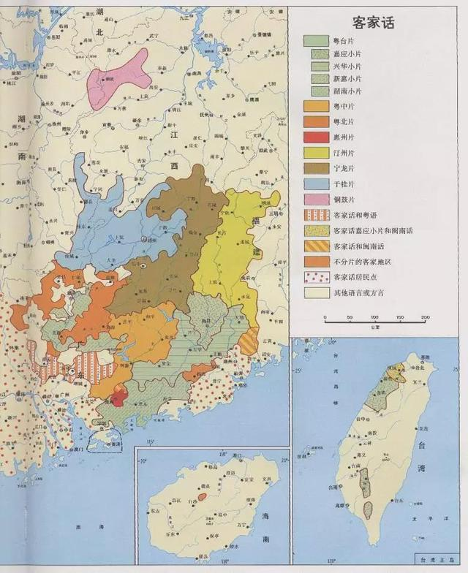
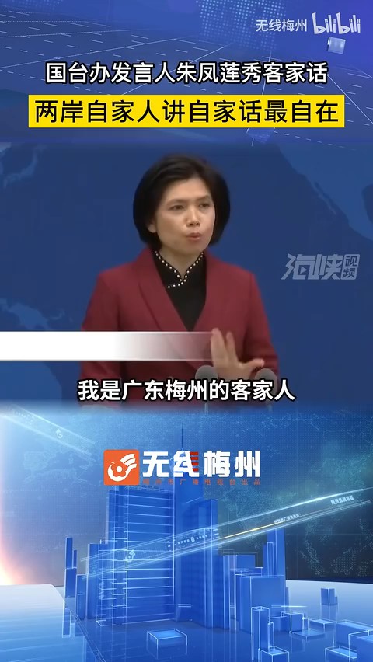
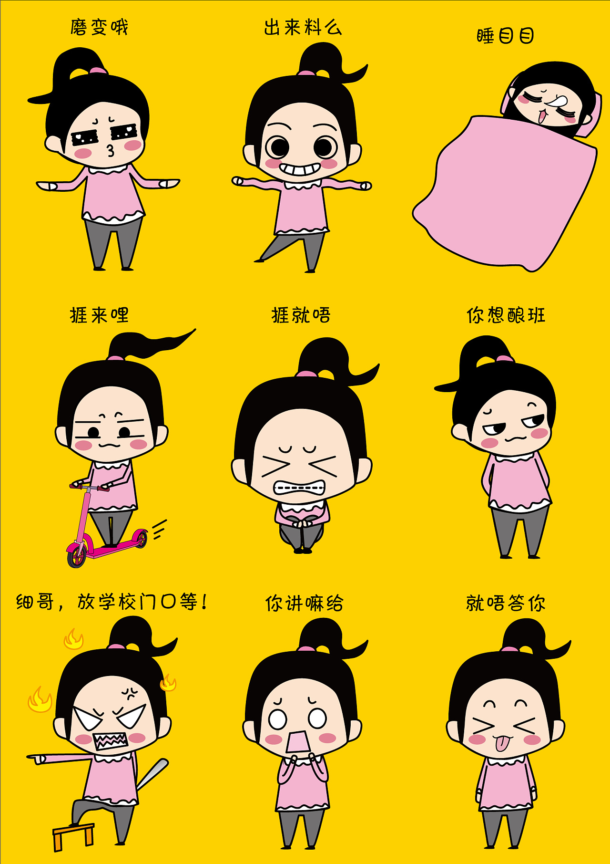
Hakka （客家话）
Hakka is one of the official languages of Taiwan, and one of the official languages of the Republic of Suriname. It was one of the main languages spoken in the Lanfang Republic; it was the “national language” of the Taiping Heavenly Kingdom.
The Hakka language is mainly distributed in Eastern Guangdong, Northern Guangdong, Southern Jiangnan, Western Fujian and the eastern coast of the Pearl River Estuary.

Slide 5
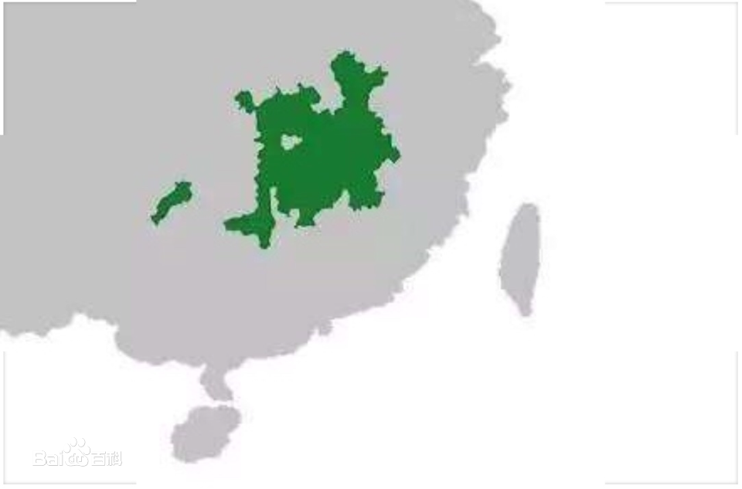


Gan dialect （赣方言）
The majority of the Gan dialect is spoken in Jiangxi province, mainly in the middle and lower reaches of the Gan River, the Fei River basin and the Poyang Lake basin, as well as in the surrounding areas, eastern Hunan and northwestern Fujian, southwestern Anhui, southeastern Hubei and southwestern Hunan.

Slide 6
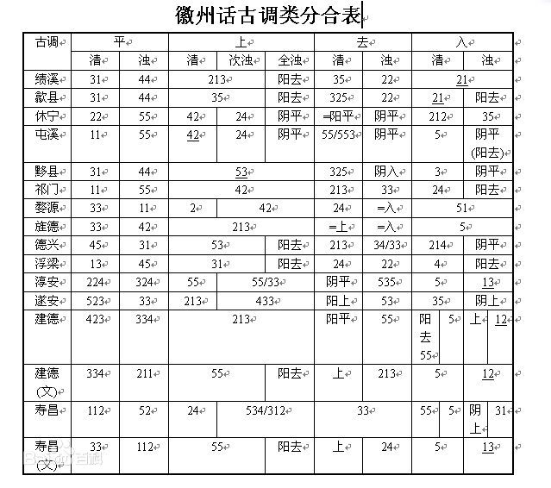
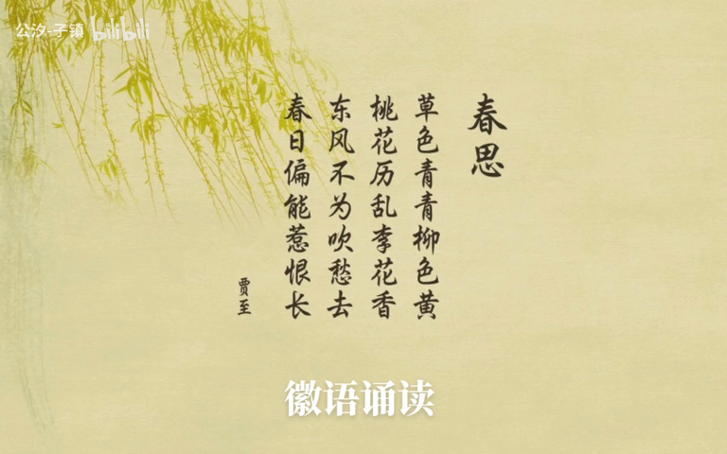
Hui dialect （徽语）
The Huizhou language, also known as the Wu language Huizhou Yan piece, was once considered a Wu dialect for a considerable period of time. And the Huizhou language is mainly found in the upper reaches of the Qiantang River.
The Huizhou dialect is quite distinctive and is a group of vernacular languages that differ greatly from Mandarin. And the dialects within each dialect area are in turn different from each other.

Slide 7
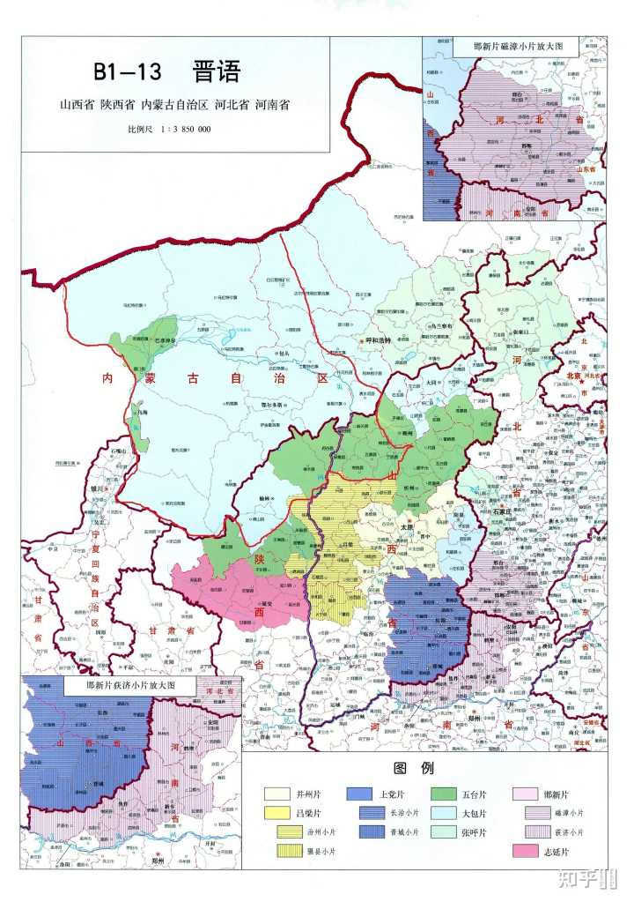
Jin dialect （晋语）
The main areas where the Jin language is spoken are Shanxi Province, central and western Inner Mongolia Autonomous Region, northern Shaanxi Province, most of Henan Province north of the Yellow River, and western Hebei Province.
The location of the Jin language on the Loess Plateau（黄土高原） and its relatively closed geographical environment are the reasons why the Jin language is more unique in the north.
Sense of Tone
Figurative
The dialectologist Mr. Li Rong said, "The dialects of Shanxi are as rich as the coal of Shanxi."

Slide 8
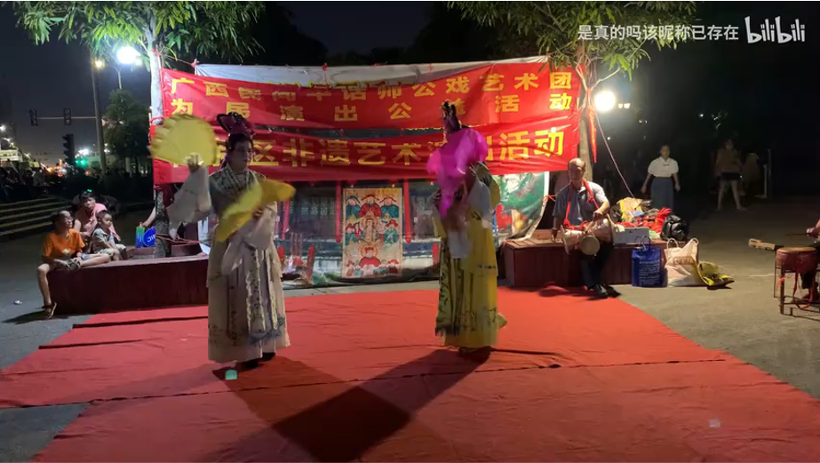
Pinghua （平话）
Pinghua is a dialect of Chinese spoken in the southwest. Some scholars or dialect books classify Ping dialect as Cantonese, while others consider it a separate dialect.

Slide 9


2019
Thanks
商务工作总结PPT模板
年终总结 新年计划 述职报告 工作汇报

