Slide 1
Discovering the Enchanting Summer Palace:
A Timeless Gem of Chinese Imperial Gardens
Li Mei Feb.28

Slide 2
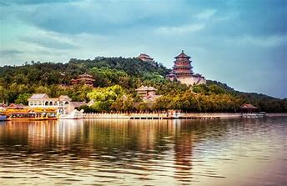
The Development of its name
Qingyiyuan清漪园 -- the Book of Songs “河水清且涟猗”
Qing --> clear
Yi --> the ripples on the water
Describe the clear waters of Kunming Lake and convey aspirations for a peaceful and prosperous era
Yiheyuan颐和园 --> nourishing harmony and tranquility颐养冲和
The Summer Palace -- English name
Its function as a summer retreat for royalty

Slide 3
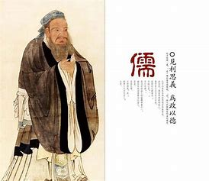
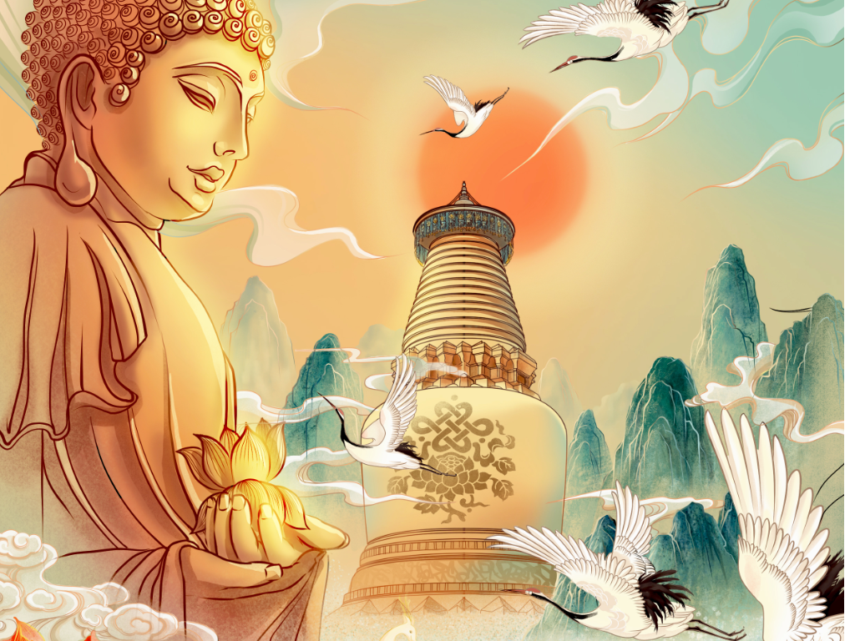
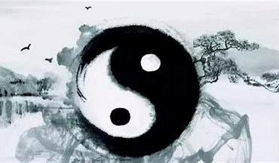
The Museum of Imperial Gardens
Confucianism
Buddhism
Taoism

Slide 4
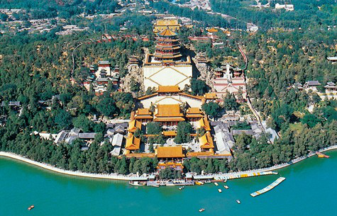
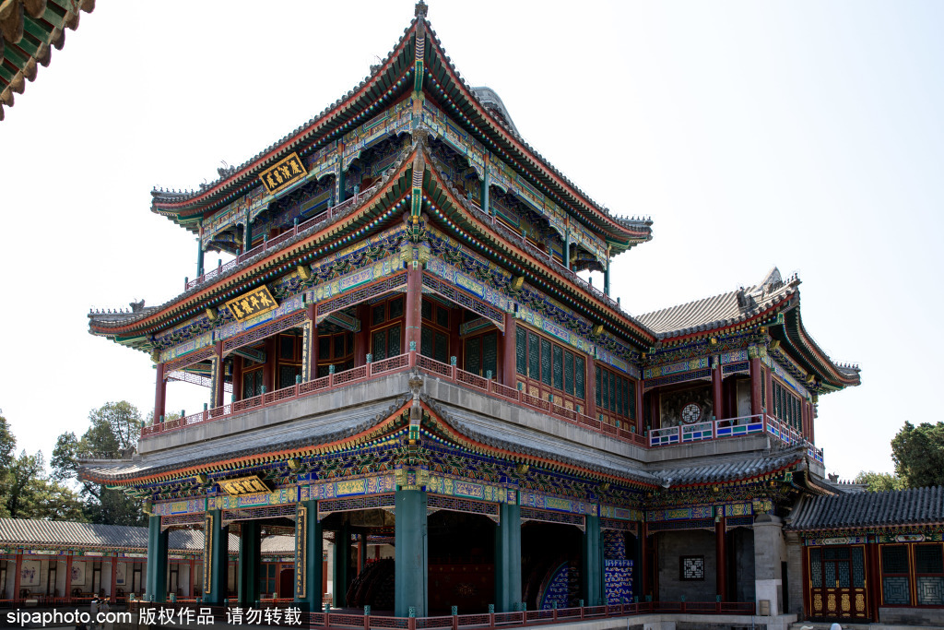
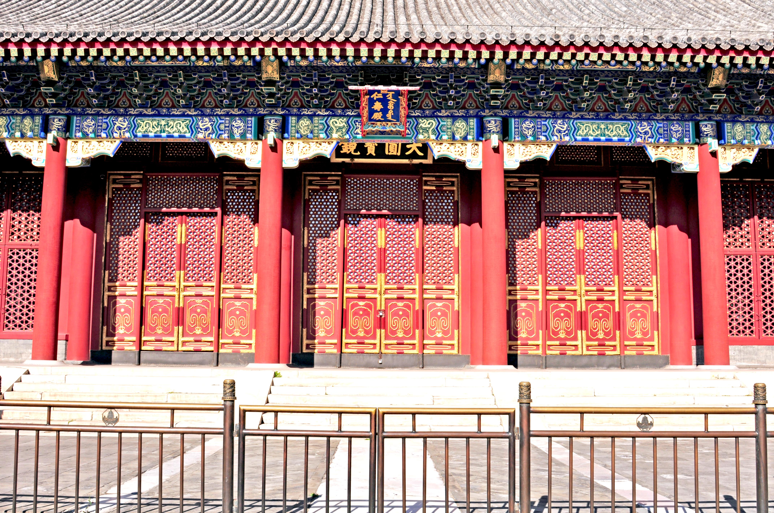
Confucianism
Renshou Hall仁寿殿
-- The Analects of Confucius “知者乐，仁者寿”
The importance of rulers governing with benevolence, bringing prosperity and well - being to the people.
Dehe Garden德和园
De德 --> virtue: a core concept in Confucianism
The pursuit of moral cultivation and social harmony.
Order & Hierarchy 守序
Layout: Longevity Hill lies at the heart, with the buildings on the front hill symmetrically distributed along the central axis.

Slide 5
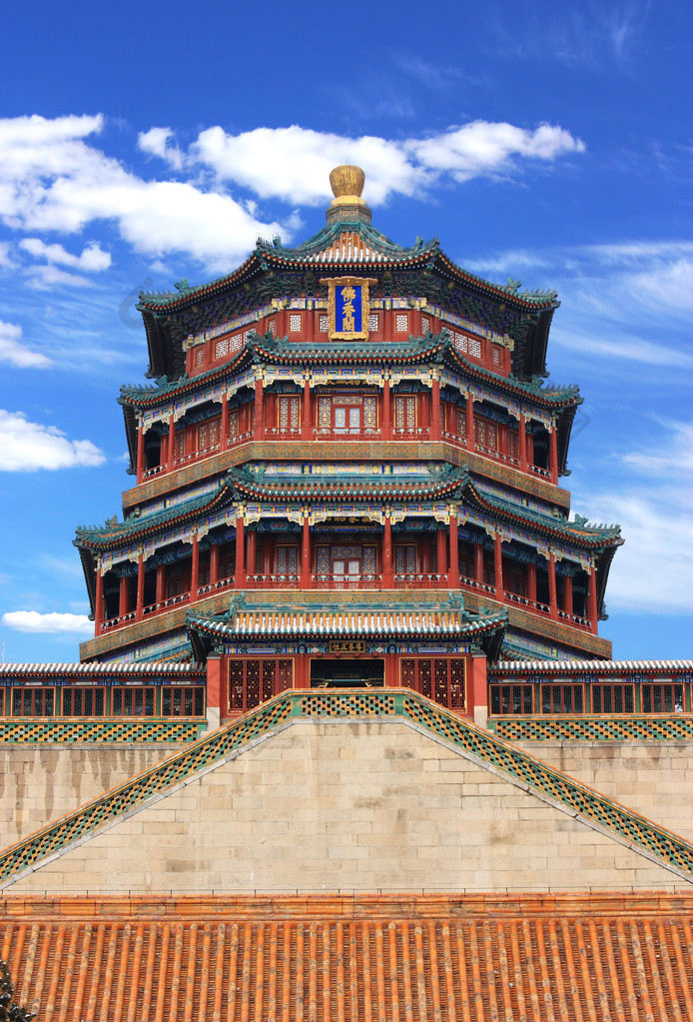
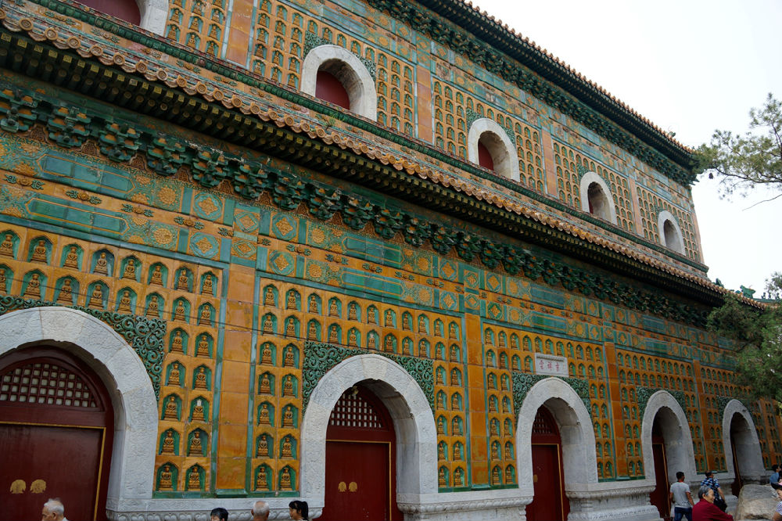
Buddhism
The Sea of Wisdom智慧海
A remarkable Buddhist hall
It enshrines the Buddha of Infinite Life. 无量寿佛
Its name is sourced from a sutra, symbolizing the boundless wisdom of Buddha.
Foxiangge佛香阁
Home to a gilded copper standing statue of the Thousand Hand Buddha. 千手观音

Slide 6
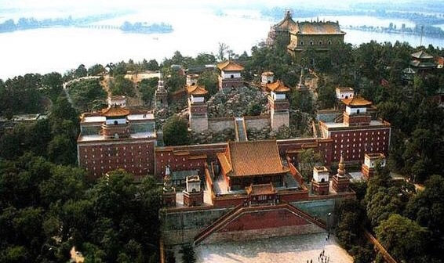
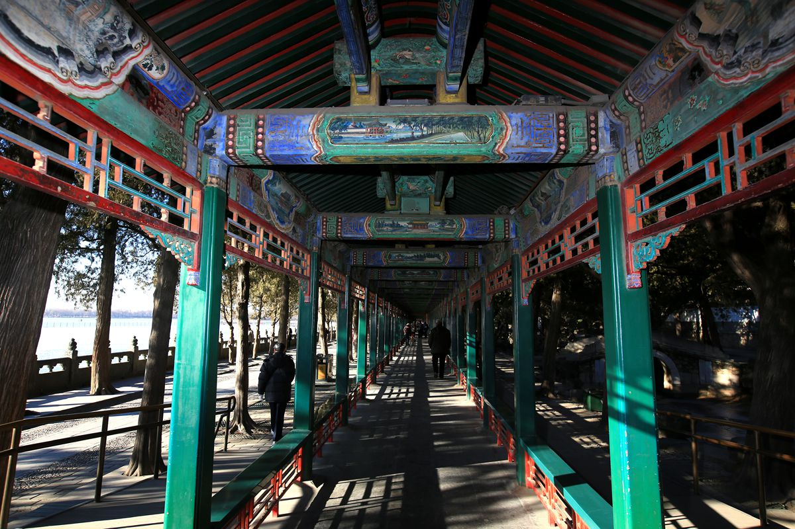
Buddhism
The Long Corridor长廊
Over 14,000 exquisite paintings on its beams
A medium to spread Buddhist teachings
The Four Great Continents Architectural Complex 四大部洲
-- A complete Buddhist universe model
Centered around the Pavilion representing Mount Sumeru 须弥山
Four Great Continents -- 东胜神洲，西牛贺洲，南赡部洲，北俱芦洲.

Slide 7
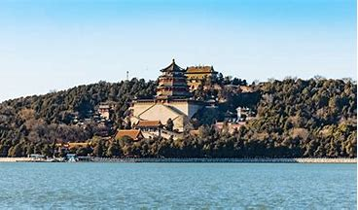
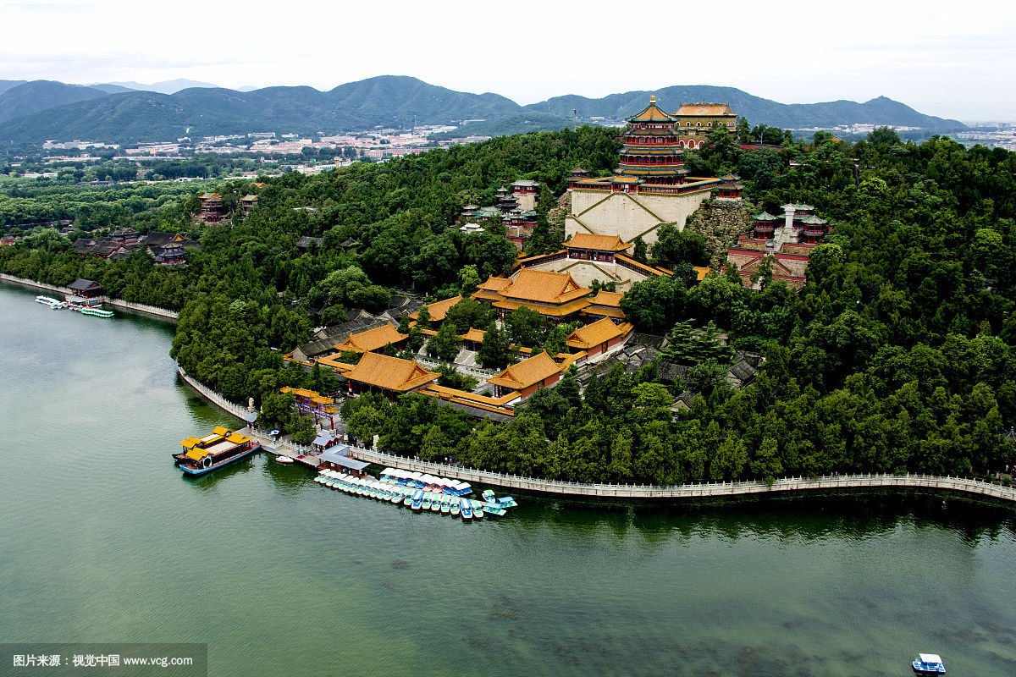
Taoism
void and solid 虚实相生
void --> Kunming Lake, represents an open water space that gives people a sense of emptiness and distance.
solid --> Longevity Hill, is home to numerous buildings.
Going with the flow of nature
顺应自然
Natural Design: The vast expanse of Kunming Lake, with its meandering shorelines, and the natural topography of Longevity Hill have been preserved with minimal artificial alteration.

Slide 8
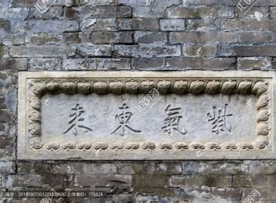
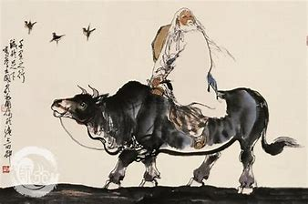
"Purple Air from the East" Gate Tower
紫气东来 城关
-- a story about Laozi, symbolizing good luck and prosperity.
During the Spring and Autumn Period, Laozi, the founder of Taoism, planned to leave for the Western Regions as the country declined. When he reached the Hangu Pass on a green ox, the guard saw a purple cloud coming from the east. Knowing it meant a sage's arrival, he welcomed Laozi. Touched by the guard's sincerity, Laozi stayed there and wrote the Tao Te Ching, a work influencing Chinese and world cultures.

