Slide 1
中國語言文化
Session 15, Thursday Dec 19, 2024, Zhishan Bldg. 至善楼105, room 105
Martin Woesler

Slide 2
Final Session
Take part in Survey
Teacher checks learning progress diaries and awards 5 extra points
Ask me anything about the Western/my personal perspective about Chinese culture
Be prepared for cultural differences if you apply for a job on the international job market

Slide 3
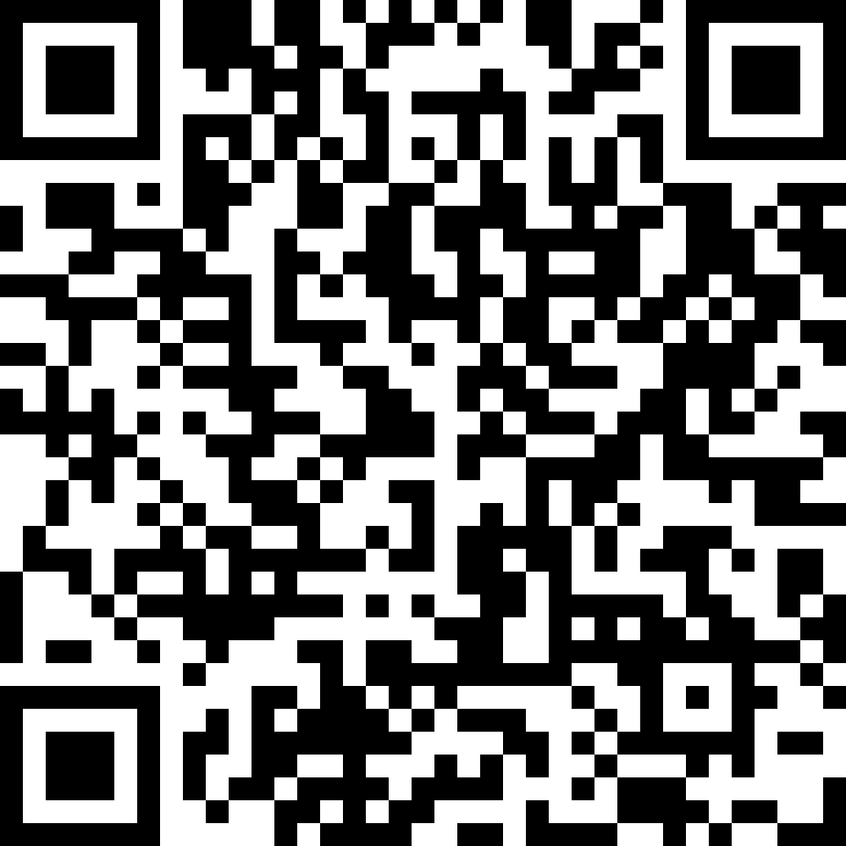
AI GROUP

Slide 4
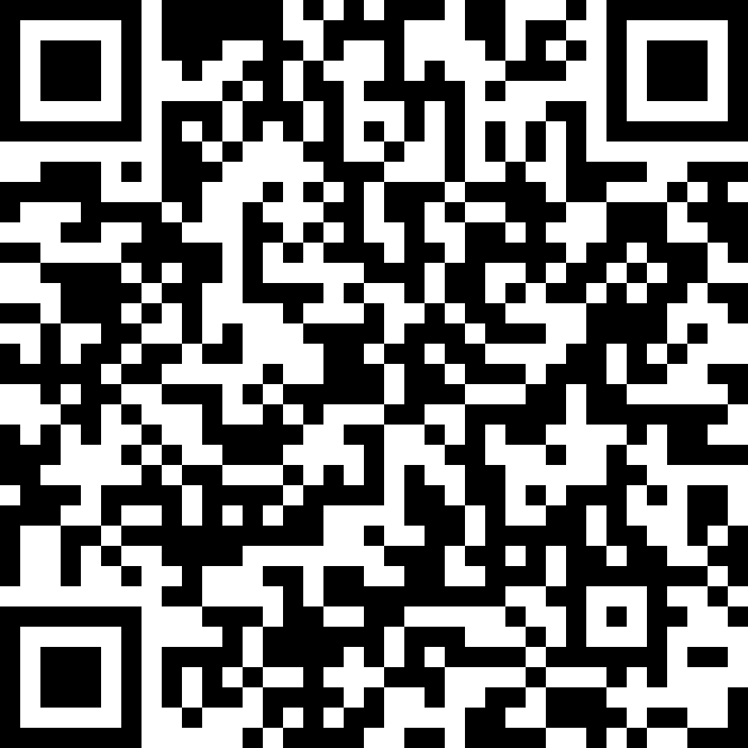
HUMAN GROUP

Slide 5

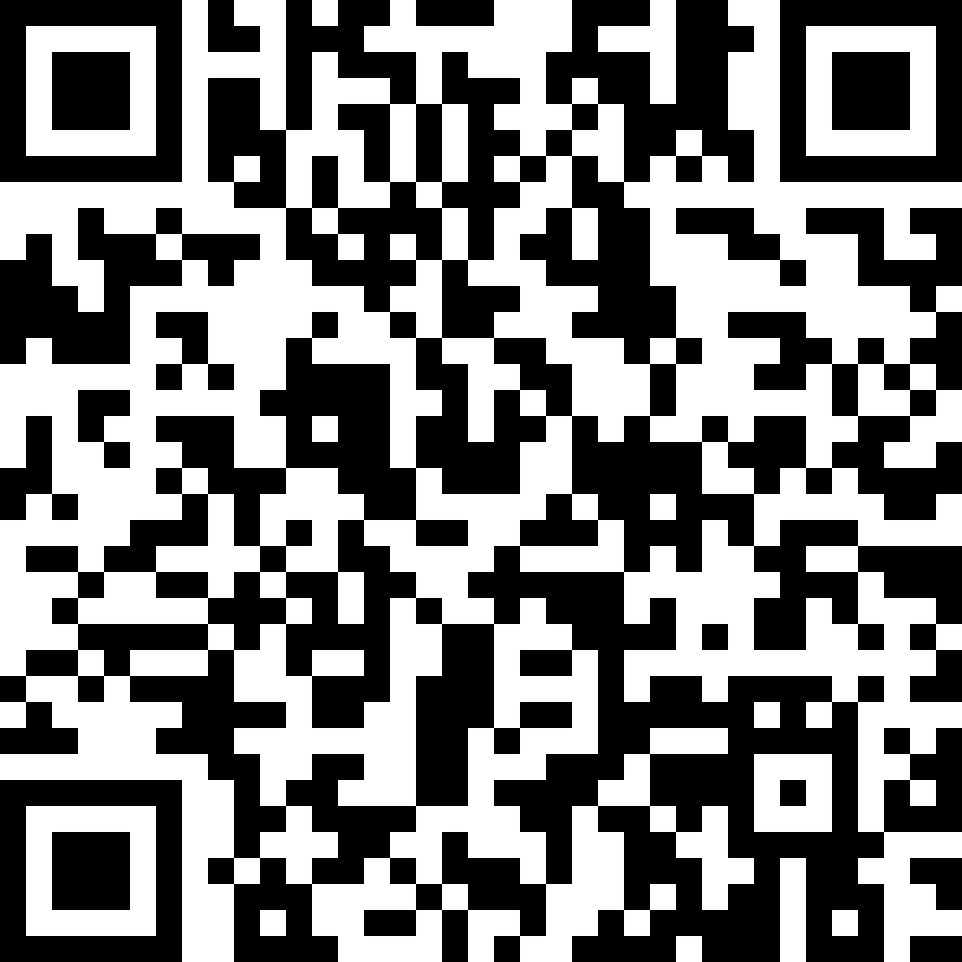
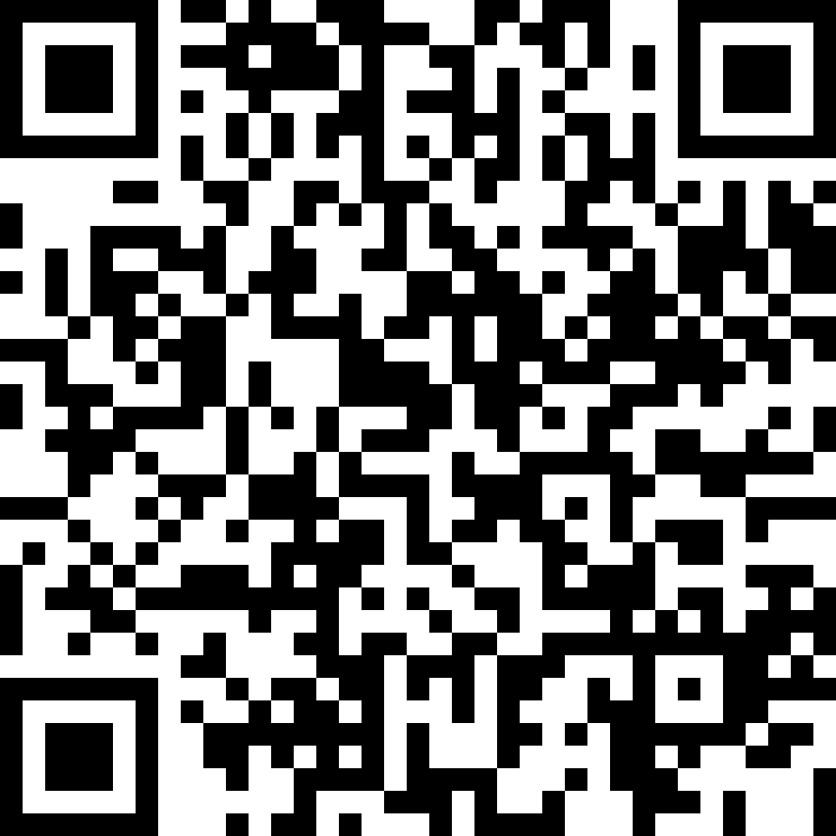
Thank you!
Please participate in this survey:
Student Life 2024 https://wn8ae3qwafbc11zv.mikecrm.com/CTrdOjm
martin@woesler.de
Please participate in this survey:
EU https://wn8ae3qwafbc11zv.mikecrm.com/9gdWrQT

