Slide 1
Chinese Movies

Slide 2
1
Film Festival
2
About Oscar
3
Directors
4
Status quo

Slide 3
01
Festivals
Around the world we have all sorts of movie festivals to celebrate and give credit for those remarkable movies, we have the most influential one, oscar.

Slide 4
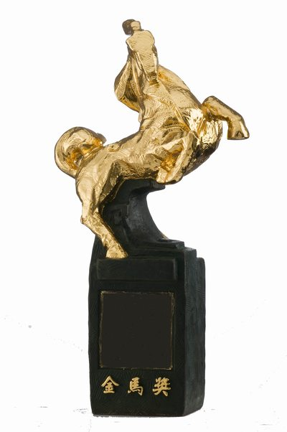

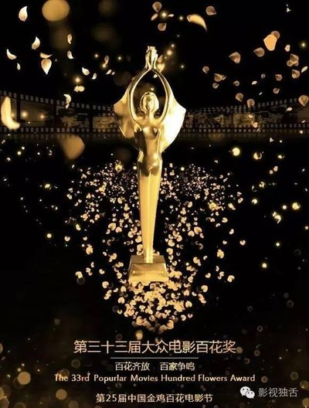
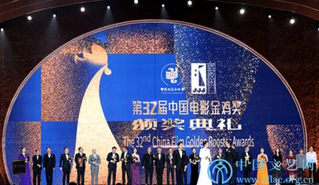
01
golden roaster awards
Golden Horse Award
hundred flowers award

Slide 5
02
About oscar
Oscar is probably the most influential festival around the world

Slide 6
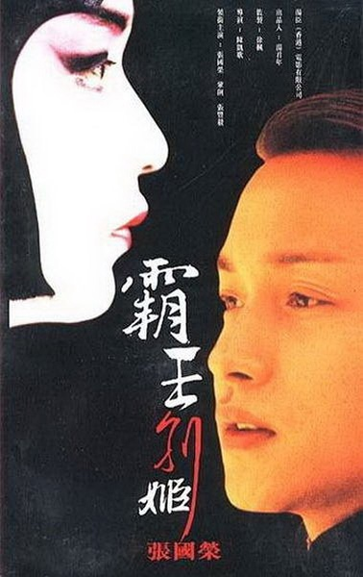
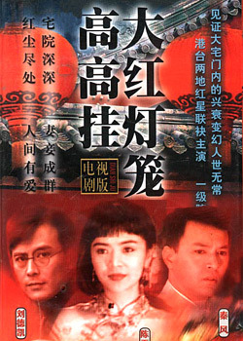
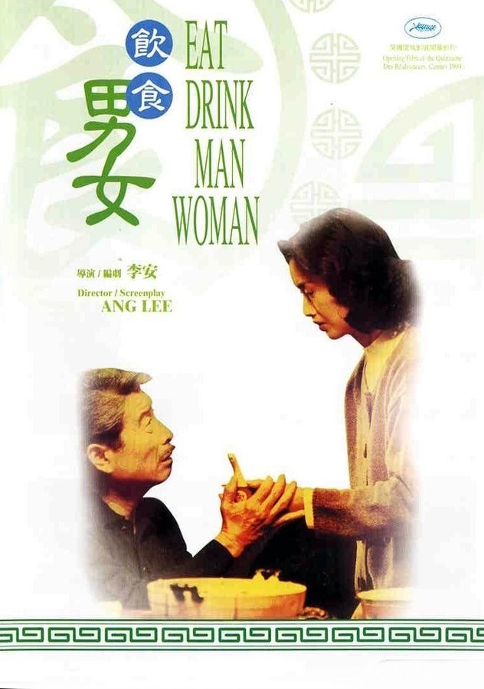
02

Slide 7
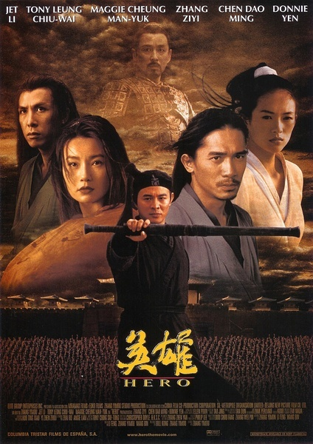
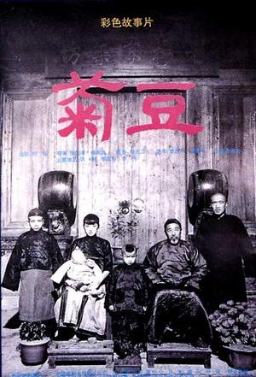
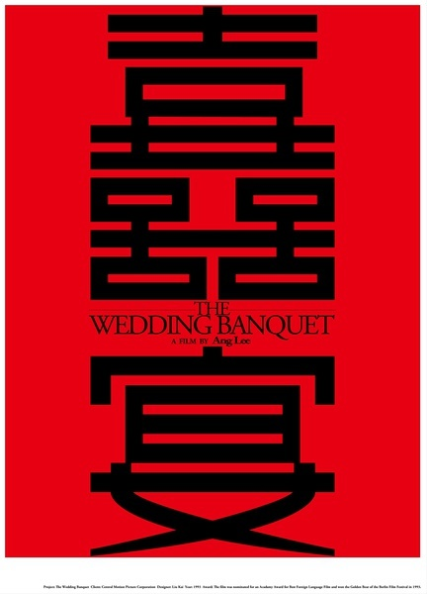
02

Slide 8
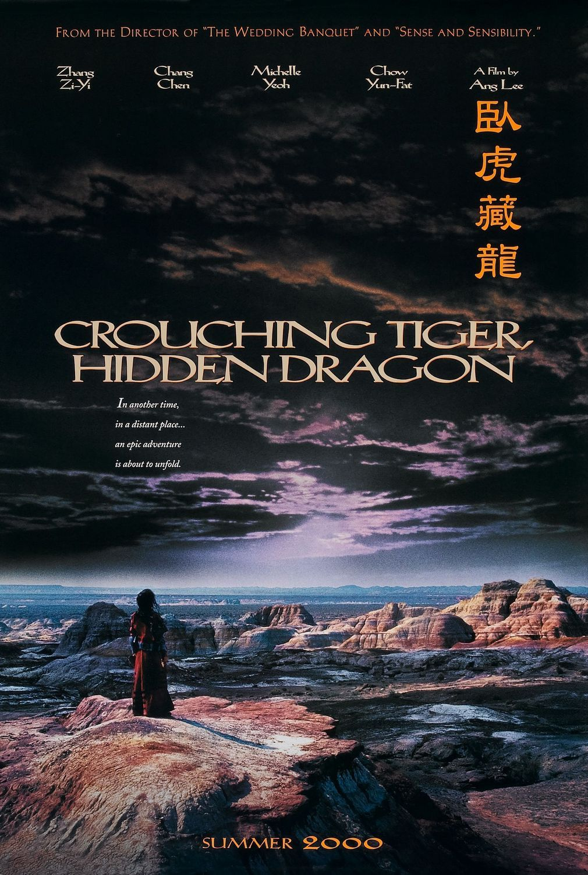
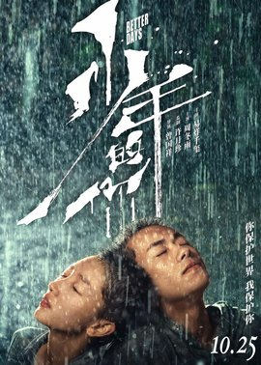
02

Slide 9
03
Directors
We have also behind these movies impressive directors including 李安, 张艺谋.

Slide 10
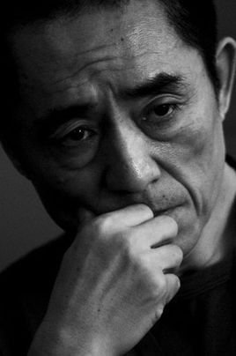
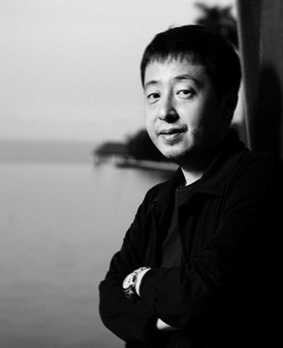
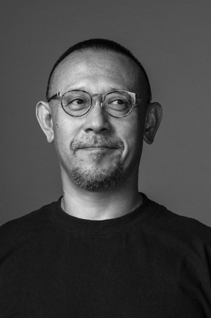
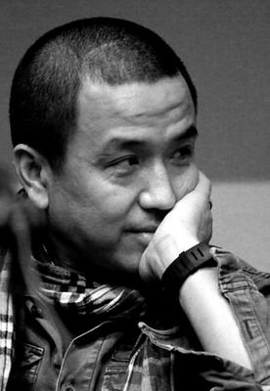
The Fifth Generation Directors
A conventional idea in chinese movie community, often refers to the young directors graduated from Beijing Film Academy in the 1980s.
Nominated four times for the Academy Award for Best Foreign Language Film.
The Sixth Generation Directors
Jiang Wen(姜文), Lou Ye(娄烨), Jia Zhangke(贾樟柯) are the most influential figures among what we called the sixth generation directors.
Their movies have totally different style from the fifth generation, or we can say, they are talented in forming their own style.

Slide 11
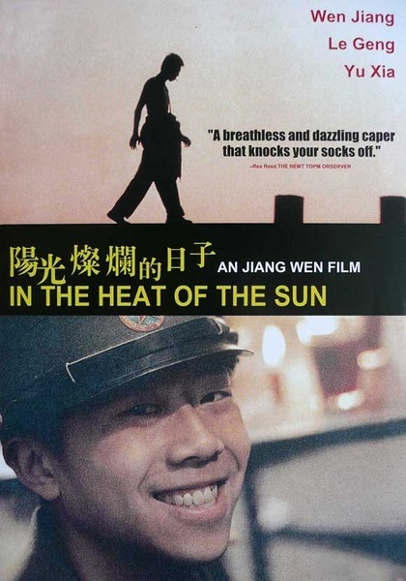
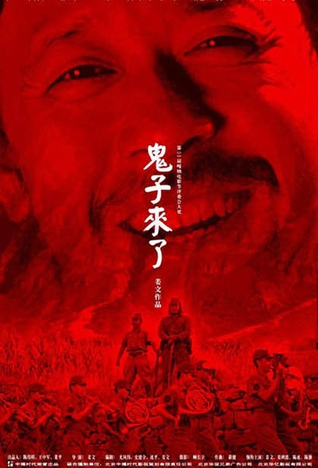

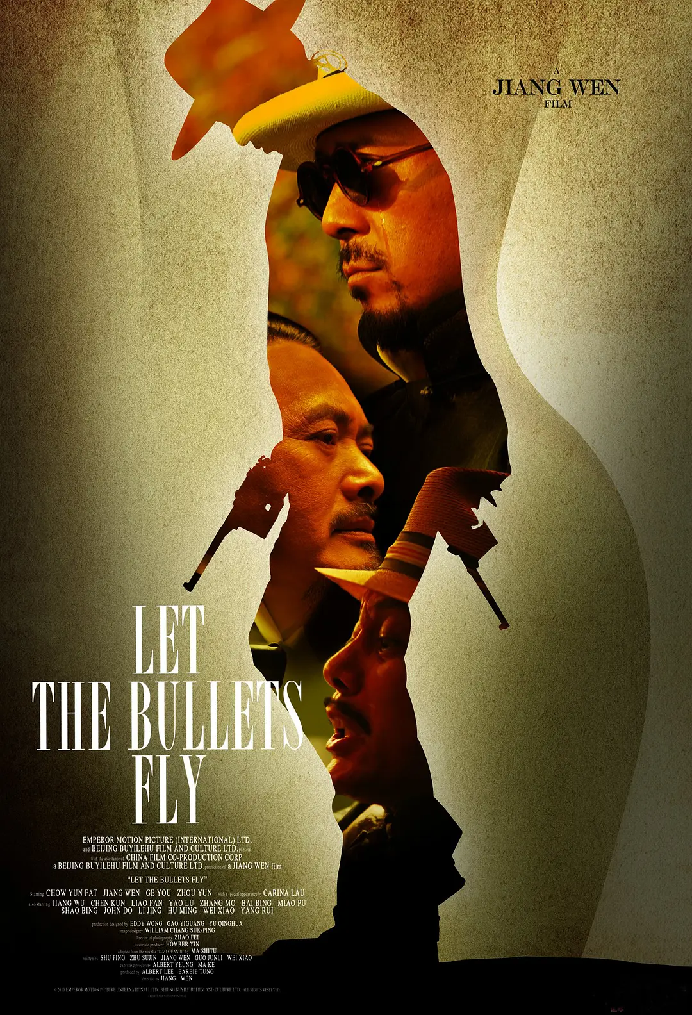
姜文
Representatives
Devils on the Doorstep (《鬼子来了》)
Let the Bullets Fly（《让子弹飞》）
In the Heat of the Sun (《阳光灿烂的日子》)
the Sun Also Aise (《太阳照常升起》)
Black Humors (黑色幽默)
Mataphors（隐喻）
Magical Realism （魔幻现实主义）
Unspoken Words （潜台词）

Slide 12
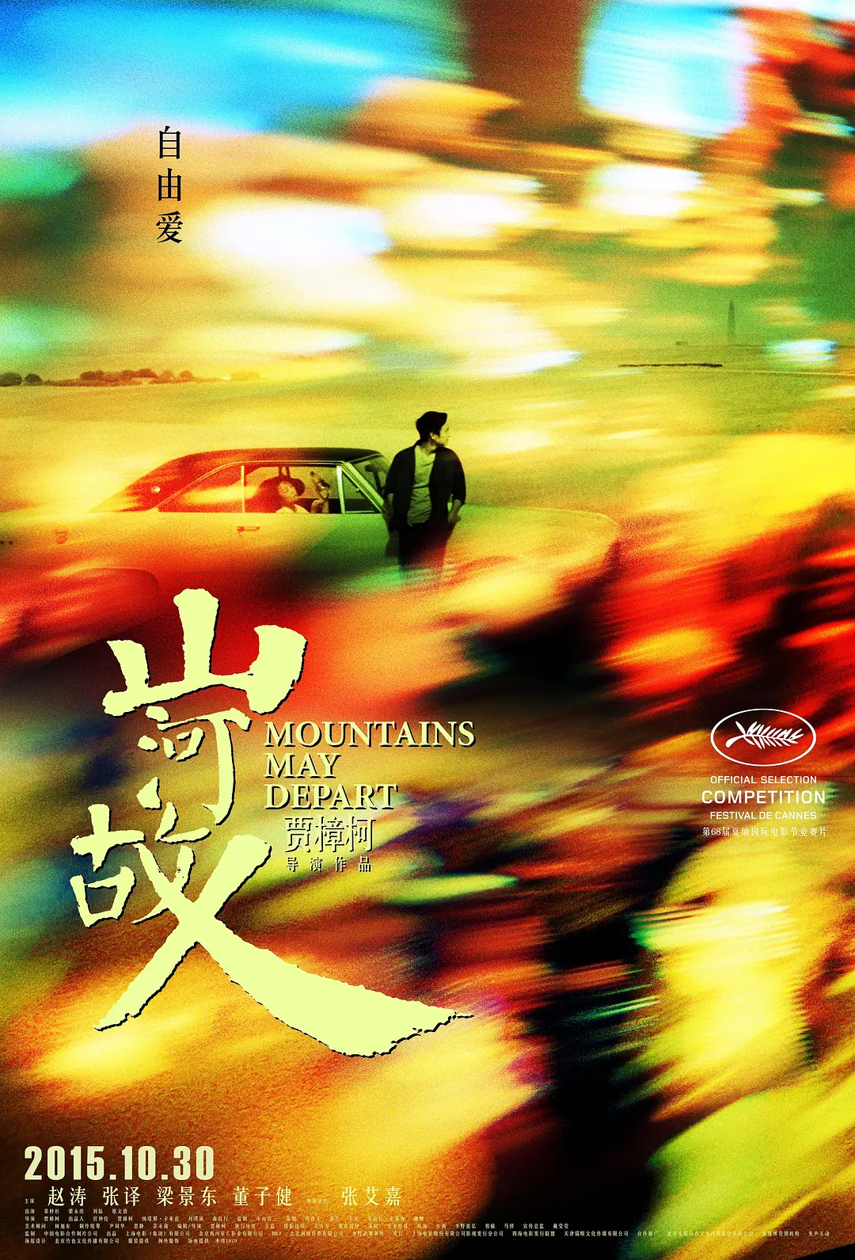
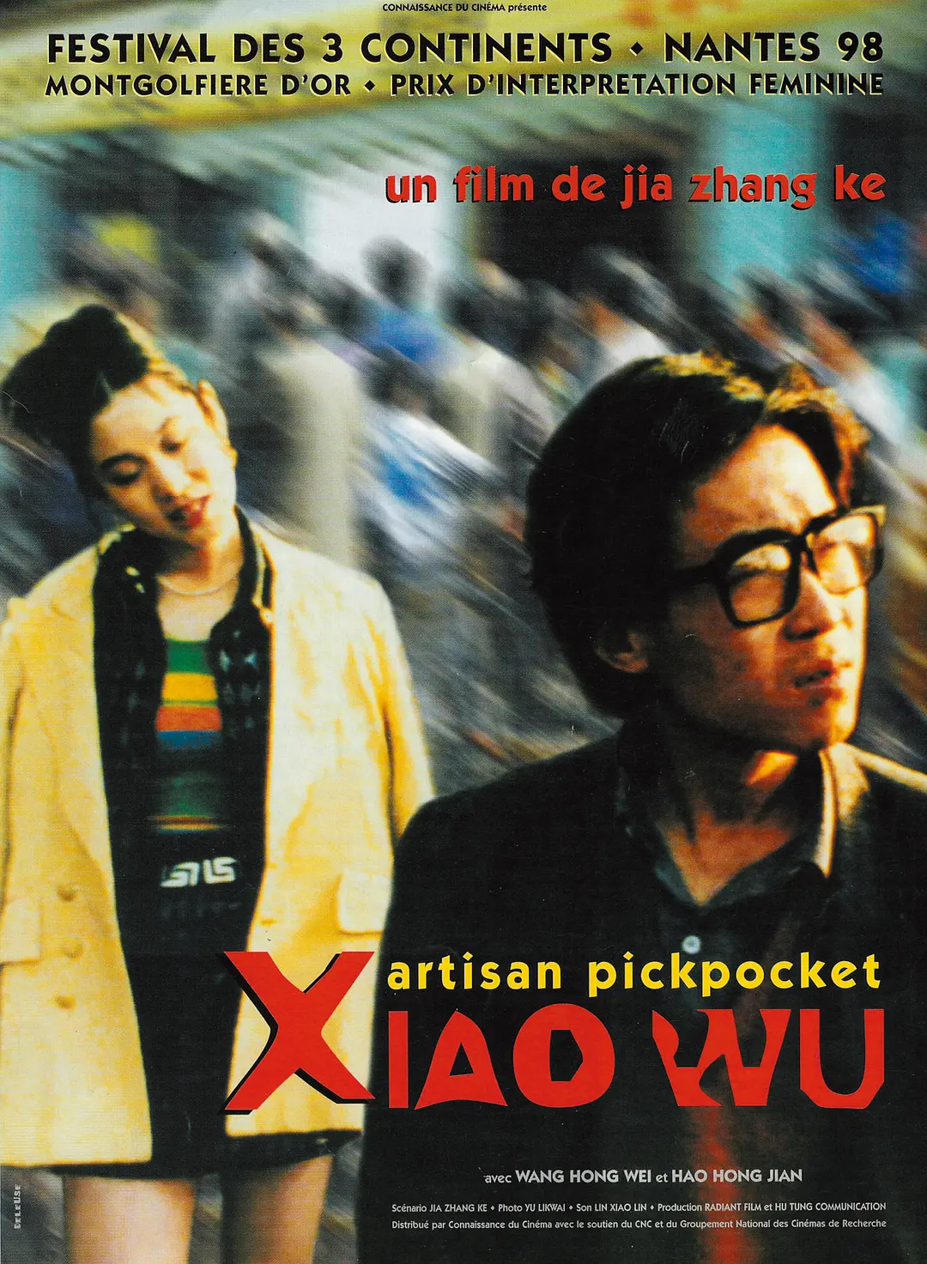

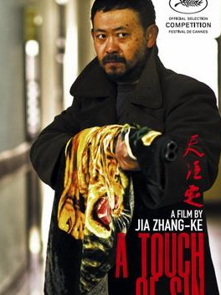
贾樟柯
Representatives
《山河故人》（Mountains May Depart）
《三峡好人》（Still Life）
《小武》 （Xiao Wu）
《天注定》（A Touch of Sin）
His movie is a special way to understand China and reinterpret the realism of Chinese films.
He foucuses on showing the changes in China and telling stories of normal people.

Slide 13
04
Staus quo

Slide 14
04
01
Film censorship system
Where crime stories are crime free, ghost tales have no ghosts and crooked politicians cant be crooked.
02
Rating system
Since China has no proper ratings system, every film must be suitable for all.
.
03
Film market
China has a large but not inclusive market.

Slide 15
THANK
YOU
The truth is that beauty is in the eye of the beholder.

