Slide 1
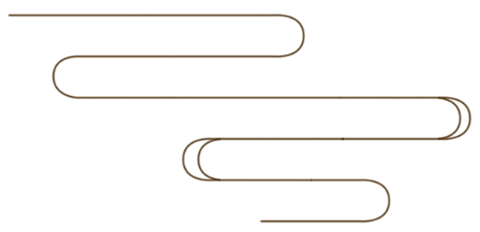
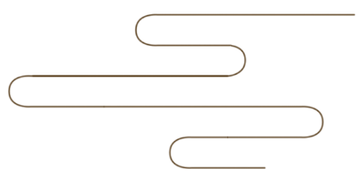
Ancient Science and Technology
——Paper-making Technology
Chen Han 陈涵
Zeng Xinyuan 曾心媛

Slide 2
Content
I. The history of paper-making technology
-Writing materials before paper
-The earliest “paper”
-“Cai Hou paper”
-The spread and influence of paper-making
II. Difficulties during translation

Slide 3
The history of paper-making technology

Slide 4
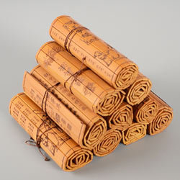
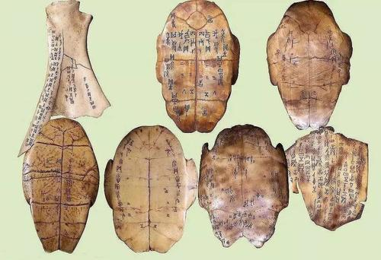
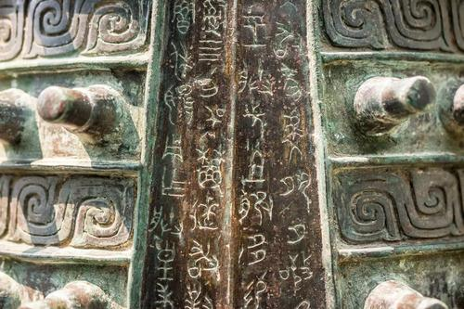
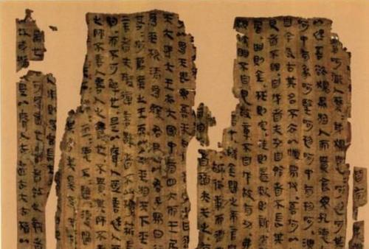
Writing materials before paper
bamboo
bone
silk
Bronzeware

Slide 5
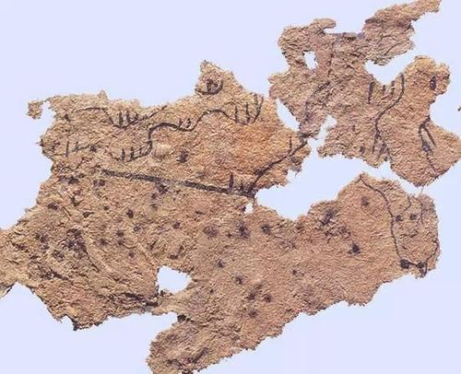
The earliest “paper”
The earliest extant paper fragment was unearthed at Fangmatan Tomb (放马滩汉墓) of the Western Han Dynasty in Tianshui (天水), Gansu Province.

Slide 6
The earliest “paper”
According to the explanation of paper in Xu Shen’s Explaining Graphs and Analyzing Characters (《说文解字》)in the Han Dynasty, the paper mentioned in some age-old documents before Cai Lun’s time was made of silk-fiber(丝质纤维). In effect, that was not paper but a by-product of rinsing silk(漂丝).

Slide 7
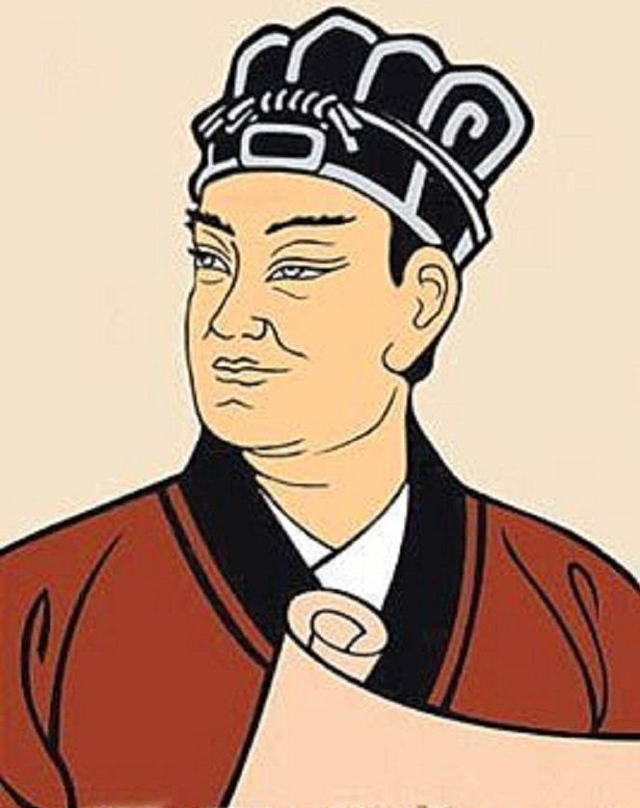
“Cai Hou paper”
Cai Lun (A.D. 50 - 121)
Chinese eunuch(宦官) and official
Once titled “Longting Hou”(龙亭侯)
In the Eastern Han Dynasty (A.D. 105), Cai Lun summarized the papermaking skills since the Western Han Dynasty and improved it.

Slide 8
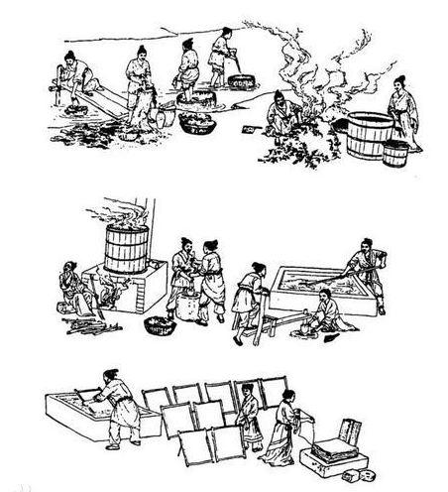
“Cai Hou paper”
He used the bark of trees, remnants of hemp(麻头), rags of cloth and fishing nets and other materials to make paper through basic procedures such as cutting, pounding, manufacturing, and drying(挫、捣、抄、烘). It was the origin of modern paper. The raw materials of the paper were cheap and easy to find, and the quality was higher than before. Thus, it was in widespread use. To commemorate Cai Lun’s achievements, future generations called this paper “Cai Hou paper”.

Slide 9
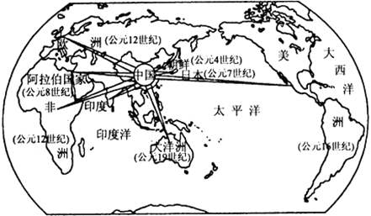
The spread and influence of paper-making
Paper-making technology did not be introduced into Europe until 12th century, owing to blockade and monopoly of the technology by Arabian. Evidences suggested that Arabian brought Ma paper (麻纸)(which is mainly made of bark of paper mulberries, and straws) technology from the Tang Dynasty into Europe.

Slide 10
The spread and influence of paper-making
In 1150, Spain built the first paper making factory in Europe, henceforth, France, German, Netherlands, Italy, and Britain acquired the technology in secession. In the 16th century, paper had completely replaced the traditional writing carrier, sheepskin, and common people could afford it, popularizing and developing cultures of different European countries, and laying a material foundation for the Renaissance.

Slide 11
II. Difficulties during translation

Slide 12
Difficulties during translation
1
Lack of background knowledge
2
Understanding of words and phrases
3
Selection of verbs involved

Slide 13
a small part or portion that remains after the main part no longer exists
He used the bark of trees, remnants of hemp, rags of cloth, fishing nets and other materials to make paper through basic procedures such as cutting, pounding, manufacturing, and drying. It was the origin of modern paper.
他用树皮、麻头及敝布、鱼网等原料，经过挫、捣、抄、烘等工艺制造的纸，是现代纸的渊源。
抄造：由纸浆到纸的生产工艺。
Manufacturing with the pulp (纸浆)

Slide 14
Evidences suggested that Arabian brought Ma paper (which is mainly made of bark of paper mulberries, and straws) technology from the Tang Dynasty into Europe.
据考证,阿拉伯人在12世纪才将唐代麻纸(主要由桑树皮、枸树皮和稻草做原料）技术带到欧洲。
Family Moraceae: 桑科

Slide 15
The paper mentioned in some age-old documents before Cai Lun’s time was made of silk-fiber. In effect, that was not paper but a by-product of rinsing silk.
在蔡伦之前古代文献中所提到的纸，都是丝质纤维所造的，实际上不是纸，只是漂丝的副产品。

Slide 16
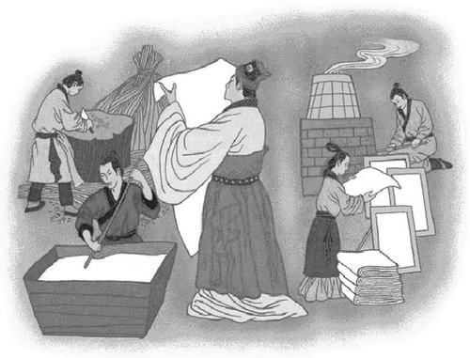
Thank you!

